Slide 1

Nested Loops
Using nested loops to draw shapes on the terminal
Nested Loops
СофтУни
трейнърски екип
Софтуерен университет
http://softuni.bg

Slide 2



Table of Contents
Drawing simple shapes with a for-loop
Nested Loops
Drawing problems: rectangles, squares, triangles, rhombuses, …
Drawing more complex shapes
Web Application for drawing with ASP.NET MVC

Slide 3

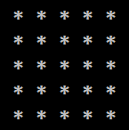
Drawing Simple Shapes
Using a for-loop for drawing

Slide 4
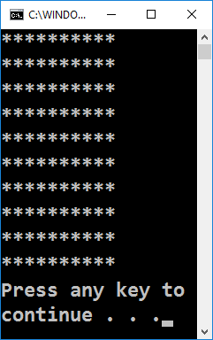
Rectangle of 10 x 10 asterisks
Draw a rectangle of 10 x 10 asterisks on the terminal:
How does the example work?
Draws a string 10 times, which consists of 10 asterisks
for (var i = 1; i <= 10; i++)
{
Console.WriteLine(new string('*', 10));
}
Testing the solution: https://judge.softuni.bg/Contests/Practice/Index/155#0

Slide 5
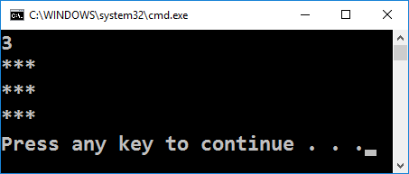
Rectangle of N x N asterisks
Draw a rectangle of N x N asterisks:
int n = int.Parse(Console.ReadLine());
for (var i = 1; i <= n; i++)
{
Console.WriteLine(
new string('*', n));
}
Testing the solution: https://judge.softuni.bg/Contests/Practice/Index/155#1

Slide 6
Nested Loops
Nested loops == a loop that contains another loop
The two loops iterate over different variables
Example: outer loop (by row) and inner loop (by col)
The body of the outer loop is repeated n times
for (var row = 1; row <= n; row++)
{
for (var col = 1; col <= n; col++)
Console.Write("*");
Console.WriteLine();
}
The body of the inner loop is repeated n * n times

Slide 7
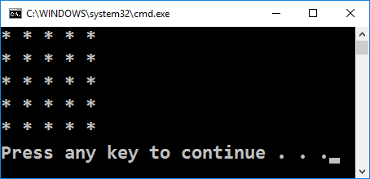
Square of Asterisks
Draw a square of N x N asterisks:
var n = int.Parse(Console.ReadLine());
for (var r = 1; r <= n; r++)
{
Console.Write("*");
for (var c = 1; c < n; c++)
Console.Write(" *");
Console.WriteLine();
}
Testing the solution: https://judge.softuni.bg/Contests/Practice/Index/155#2

Slide 8
Triangle of Dollars
Draw a triangle of dollars with height n
n = 5
var n = int.Parse(Console.ReadLine());
for (var row = 1; row <= n; row++)
{
Console.Write("$");
for (var col = 1; col < row; col++)
Console.Write(" $");
Console.WriteLine();
}
$
$ $
$ $ $
$ $ $ $
$ $ $ $ $
Testing the solution: https://judge.softuni.bg/Contests/Practice/Index/155#3

Slide 9
Square Frame
Draw a square frame with size n
n = 5
// Print the top row: + - - - +
Console.Write("+");
for (int i = 0; i < n-2; i++)
Console.Write(" -");
Console.WriteLine(" +");
for (int row = 0; row < n - 2; row++)
// TODO: print the mid rows: | - - - |
// TODO: print the bottom row: + - - - +
+ - - - +
| - - - |
| - - - |
| - - - |
+ - - - +
Testing the solution: https://judge.softuni.bg/Contests/Practice/Index/155#4

Slide 10
Rhombus of Asterisks
Draw a rhombus of asterisks with size n
n = 3
for (var row = 1; row <= n; row++)
{
for (var col = 1; col <= n-row; col++)
Console.Write(" ");
Console.Write("*");
for (var col = 1; col < row; col++)
Console.Write(" *");
Console.WriteLine();
}
// TODO: print the down side of the rhomb
*
* *
* * *
* *
*
Testing the solution: https://judge.softuni.bg/Contests/Practice/Index/155#5

Slide 11
Christmas Tree
Write a program, which reads an input number n (1 ≤ n ≤ 100) and draws a Christmas Tree with size n as in the examples:
N = 1
|
* | *
N = 2
|
* | *
** | **
N = 3
|
* | *
** | **
*** | ***
N = 4
|
* | *
** | **
*** | ***
**** | ****
N = 5
|
* | *
** | **
*** | ***
**** | ****
***** | *****
Testing the solution: https://judge.softuni.bg/Contests/Practice/Index/155#6

Slide 12
Christmas Tree – solution
int n = int.Parse(Console.ReadLine());
for (int i = 0; i <= n; i++)
{
var stars = new string('*', i);
var spaces = new string(' ', n - i);
Console.Write(spaces);
Console.Write(stars);
Console.Write(" | ");
Console.Write(stars);
Console.WriteLine(spaces);
}
|
* | *
** | **
*** | ***
**** | ****
***** | *****

Slide 13
Drawing More Comples Shapes
********** **********
*////////* *////////*
*////////*|||||*////////*
*////////* *////////*
********** **********
Working with nested loops and conditions

Slide 14
Sunglasses
Write a program, which reads an integer n (3 ≤ n ≤ 100) and draws sunglasses with size 5*n x n as in the examples:
N = 3
N = 4
****** ******
*////*|||*////*
****** ******
******** ********
*//////*||||*//////*
*//////* *//////*
******** ********
Testing the solution: https://judge.softuni.bg/Contests/Practice/Index/155#7

Slide 15
Sunglasses – solution
// Print the top part
Console.Write(new string('*', 2 * n));
Console.Write(new string(' ', n));
Console.WriteLine(new string('*', 2 * n));
for (int i = 0; i < n - 2; i++) {
// TODO: print the middle part
}
// Print the bottom part
Console.Write(new string('*', 2 * n));
Console.Write(new string(' ', n));
Console.WriteLine(new string('*', 2 * n));
****** ******
*////*|||*////*
****** ******

Slide 16
Sunglasses – solution (2)
// Print the middle part
for (int i = 0; i < n - 2; i++)
{
// TODO: print *///////*
if (i == (n-1) / 2 - 1)
Console.Write(new string('|', n));
else
Console.Write(new string(' ', n));
// TODO: print *///////*
Console.WriteLine();
}
****** ******
*////*|||*////*
****** ******

Slide 17
House
Write a program, which reads an integer n (2 ≤ n ≤ 100) and draws a house with size n x n:
N = 8
---**---
--****--
-******-
********
|******|
|******|
|******|
|******|
N = 3
N = 4
N = 5
-*-
***
|*|
-**-
****
|**|
|**|
--*--
-***-
*****
|***|
|***|
Testing the solution: https://judge.softuni.bg/Contests/Practice/Index/155#8

Slide 18
House – solution
var stars = 1;
if (n % 2 == 0) stars++;
for (int i = 0; i < (n+1) / 2; i++)
{ // Draw the roof
var padding = (n - stars) / 2);
Console.Write(new string('-', padding);
Console.Write(new string('*', stars));
Console.WriteLine(new string('-', padding);
stars = stars + 2;
}
for (int i = 0; i < n / 2; i++)
{ // Draw the house body: |*****| }
---*---
--***--
-*****-
*******
|*****|
|*****|
|*****|

Slide 19
Diamond
Write a program, which reads an integer n (1 ≤ n ≤ 100) and draws a diamond with size n:
N = 7
n = 1
n = 3
n = 4
n = 5
n = 6
---*---
--*-*--
-*---*-
*-----*
-*---*-
--*-*--
---*---
*
-*-
*-*
-*-
-**-
*--*
-**-
--*--
-*-*-
*---*
-*-*-
--*--
--**--
-*--*-
*----*
-*--*-
--**--
N = 2
**
Testing the solution: https://judge.softuni.bg/Contests/Practice/Index/155#9

Slide 20
Diamond – solution
var leftRight = (n - 1) / 2;
for (int i = 1; i <= (n-1) / 2; i++)
{ // Draw the top part
Console.Write(new string('-', leftRight));
Console.Write("*");
var mid = n - 2 * leftRight - 2;
if (mid >= 0)
{
Console.Write(new string('-', mid));
Console.Write("*");
}
Console.WriteLine(new string('-', leftRight));
leftRight--;
} // TODO: Draw the bottom part
---*---
--*-*--
-*---*-
*-----*
-*---*-
--*-*--
---*---

Slide 21
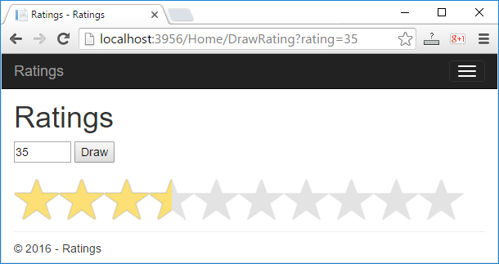
Drawing objects in Web
ASP.NET MVC Application for drawing

Slide 22

Visualizing rating in Web
Write a ASP.NET MVC web application for visualizing rating (a number from 0 to 100)
Draw 1 to 10 stars (with their halves)
The stars are generated with a for-loop

Slide 23
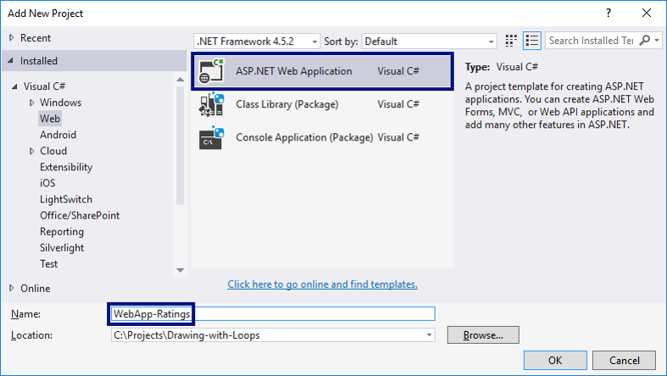
Creating the web application

Slide 24
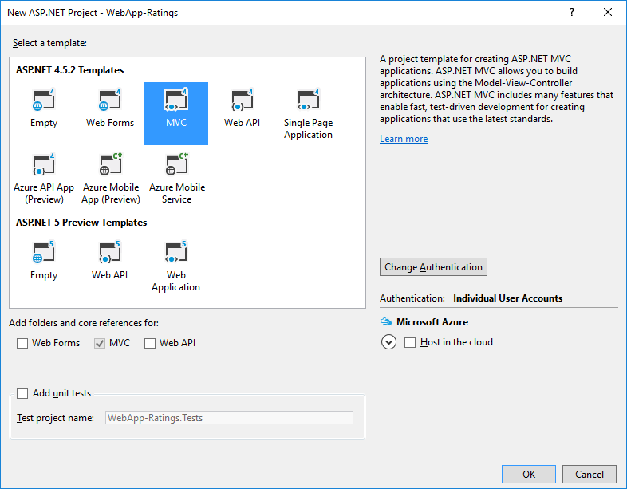
Choosing a web application type: MVC

Slide 25
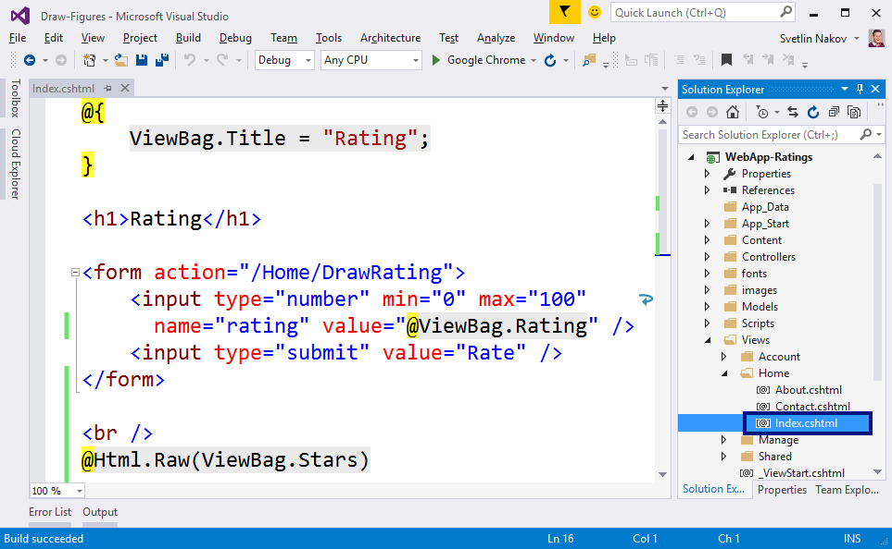
Creating a View

Slide 26
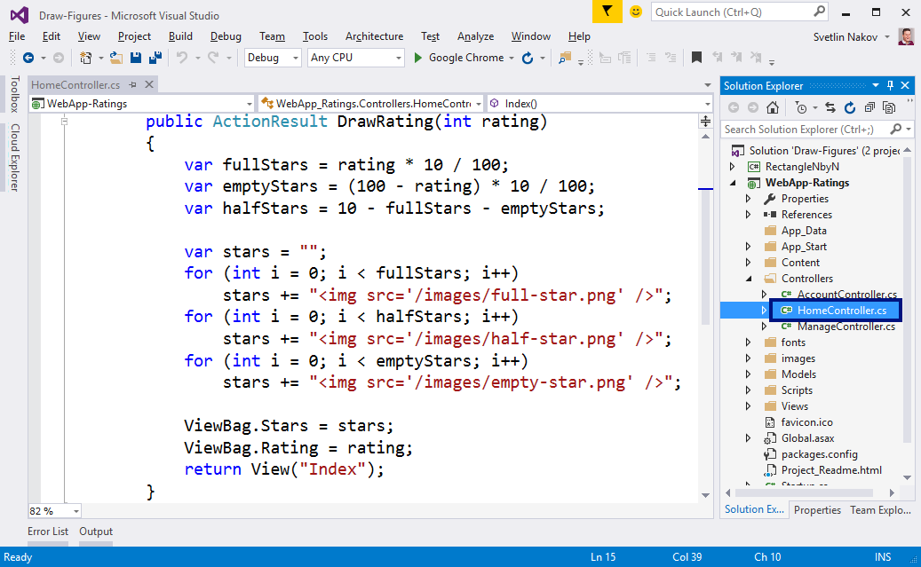
Creating an Action

Slide 27
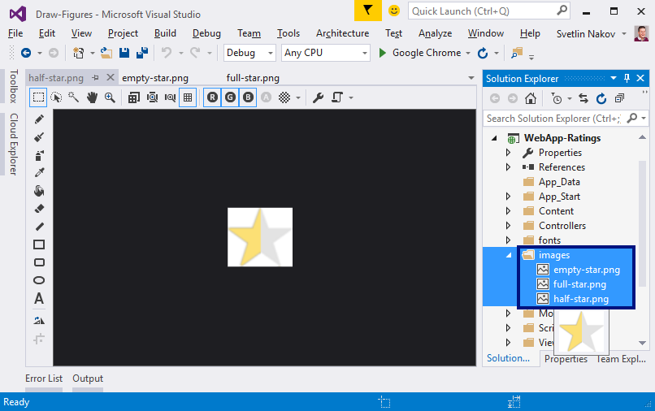
Adding Pictures
Create a folder "images" in the project
Copy the images with stars in it with copy / paste

Slide 28
Start & Test
Start the application with [Ctrl+F5] and test:

Slide 29

What did we learn today?
We can draw shapes with nested for-loop:
for (var r = 1; r <= 5; r++)
{
Console.Write("*");
for (var c = 1; c < 5; c++)
Console.Write(" *");
Console.WriteLine();
}

