Slide 1
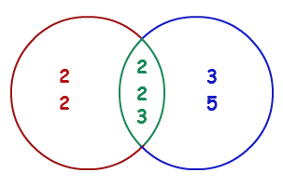
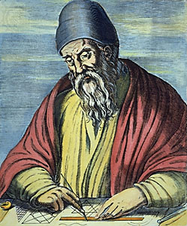
Greatest common denom. (GCD)
Euclid’s algorithm

Slide 2
Greatest Common Denominator (GCD)
Greatest Common Denominator of two natural numbers a and b is the greatest number, which divides both a and b without remainder
GCD(24, 16) = 8
GCD(67, 18) = 1
Euclid’s algorithm for finding the GCD:
Given integers a and b
Until b == 0
b = the remainder from division of a and b
a = the old b
GCD(12, 24) = 12
GCD(15, 9) = 3
GCD(10, 10) = 10
GCD(100, 88) = 4
while b ≠ 0
var oldB = b;
b = a % b;
a = oldB;
print а;

Slide 3
Euclid’s algorithm for finding GCD
Input two integers a and b and find GCD(a, b)
var a = int.Parse(Console.ReadLine());
var b = int.Parse(Console.ReadLine());
while (b != 0)
{
var oldB = b;
b = a % b;
a = oldB;
}
Console.WriteLine("GCD = {0}", a);
Testing the solution: https://judge.softuni.bg/Contests/Practice/Index/156#6

Slide 4

Greatest common denom. (GCD)
Try it yourself

