Slide 1




Prime Numbers

Slide 2
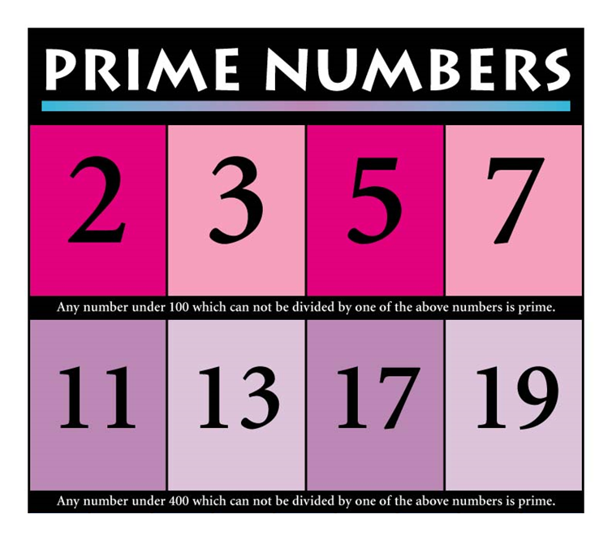
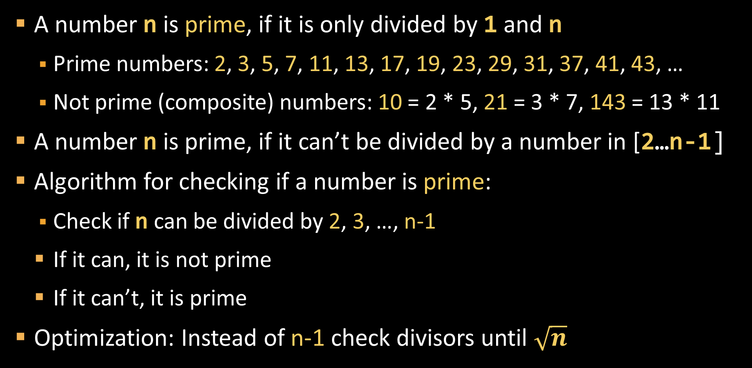
Prime Numbers
A number n is prime, if it is only divided by 1 and n
Prime numbers: 2, 3, 5, 7, 11, 13, 17, 19, 23, 29, 31, 37, 41, 43, …
Not prime (composite) numbers: 10 = 2 * 5, 21 = 3 * 7, 143 = 13 * 11
A number n is prime, if it can’t be divided by a number in [2…n-1]
Algorithm for checking if a number is prime:
Check if n can be divided by 2, 3, …, n-1
If it can, it is not prime
If it can’t, it is prime
Optimization: Instead of n-1 check divisors until $\sqrt{n}$

Slide 3

Is Number Prime. break operator
var n = int.Parse(Console.ReadLine());
var prime = true;
for (var i = 2; i <= Math.Sqrt(n); i++)
if (n % i == 0) {
prime = false;
break;
}
if (prime) Console.WriteLine("Prime");
else Console.WriteLine("Not prime");
break stops the loop
Testing the solution: https://judge.softuni.bg/Contests/Practice/Index/156#9

Slide 4

Prime Numbers
Try it yourself

