Slide 1




Fibonacci’s Numbers
loops

Slide 2
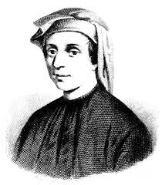
Fibonacci’s Numbers
Fibonacci’s numbers are: 1, 1, 2, 3, 5, 8, 13, 21, 34, …
F₀ = 1
F₁ = 1
F_{n} = F_{n-1} + F_{n-2}
var n = int.Parse(Console.ReadLine());
var f0 = 1;
var f1 = 1;
for (var i = 0; i < n-1; i++)
{
var fNext = f0 + f1;
f0 = f1;
f1 = fNext;
}
Console.WriteLine(f1);
Example: F(15) = 987
Input n and calculate the n-th Fibonacci number
Testing the solution: https://judge.softuni.bg/Contests/Practice/Index/156#11

Slide 3

Fibonacci’s Numbers
Try it yourself

