Slide 1

Exam Preparation
Preparation for practical programming exam
Programming Basics
Preslav Mihaylov
Head of Training & Software Engineer
Software University / SoftUni
https://softuni.org

Slide 2
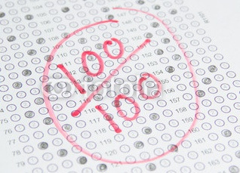

Table of Contents
What to expect on the exam?
Task with simple calculations
Task with a single check
Task with more complex checks
Task with loops
Task for drawing a shape on the console
Task with nested loops

Slide 3

Exam Preparation
Let’s Begin!

