Slide 1
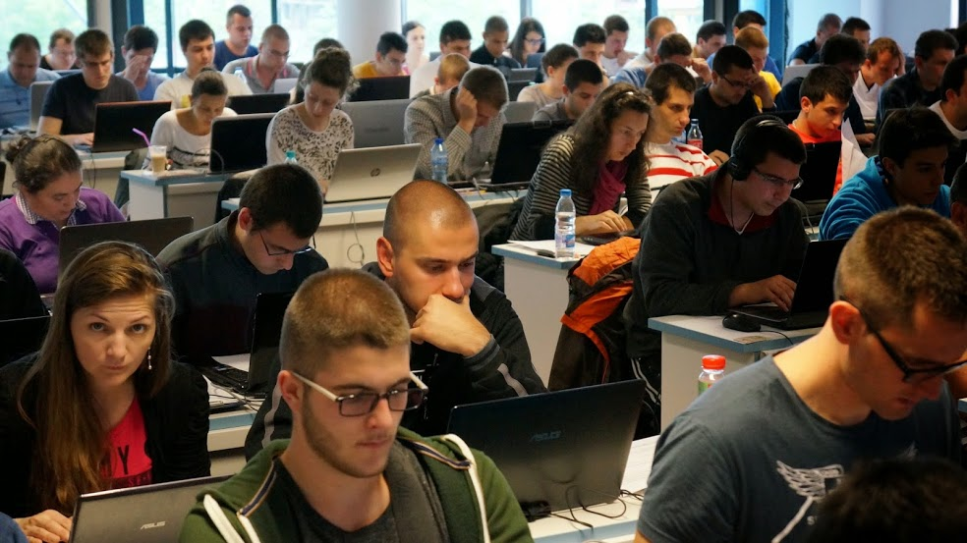

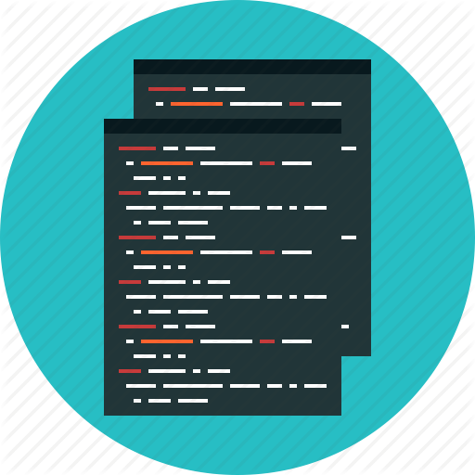
Practical Programming Exam

Slide 2
Practical Programming Exam
The course "Programming Basics" finishes with a practical exam
The exam includes 6 tasks for 4 hours with the judge system
Task with simple calculations
Task with simple conditional statements
Task with complex conditional statements
Task with loops
Task for drawing shapes in the console
Task with nested loops

Slide 3
Online Evaluation System
All exams and homeworks are tested automatically
Through the online judge system: judge.softuni.bg
All tasks have open and hidden test cases
You enter with your softuni.bg account
How does testing in the judge system work?
You submit the source code (C# program)
The program is tested by a set of tests
For every successful test, you receive points

Slide 4

Results From the Practical Exam
The practical exam evaluates the student’s skills
It includes all the material we have covered in the course
It prepares the students for the next programming course
Results from the practical exam
Result > 50% (at least 3 out of 6 tasks)
We recommend continuing in the next course
Result < 50% (at least 3 out of 6 tasks)
We recommend repeating the course

Slide 5

Practical Programming Exam
Let’s Begin!

