Slide 1



Tasks With Simple Calculations
Calculations without checks and loops

Slide 2
Area of Triangle in a Plane

Slide 3
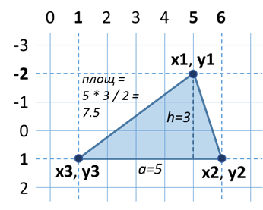
Area of Triangle in a Plane
A triangle is defined by the coordinates of its three vertices
Vertices (x2, y2) and (x3, y3) lie on a common horizontal straight line
Vertex (x1, y1) is either above or below
Calculate the area of the triangle
Hint: We can calculate side а and height h, and the area S = a * h / 2
5
-2
6
1
1
1
7.5
Testing the solution: https://judge.softuni.bg/Contests/Practice/Index/157#0

Slide 4

Area of Triangle in a Plane
Try it yourself

