Slide 1



Moving Bricks

Slide 2
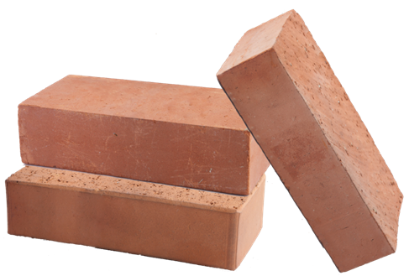
Moving Bricks
Builders have to move x bricks
The builders are w in total and work simultaneously
Bricks are moved in a cart, each one of them can carry m bricks
Calculate what’s the least amount of courses the workers have to make in order to move the bricks
Examples:
x = 120 bricks, w = 2 workers, m = 30 bricks → 2 courses
x = 310 bricks, w = 3 workers, m = 10 bricks → 11 courses
Testing the solution: https://judge.softuni.bg/Contests/Practice/Index/157#1

Slide 3

Moving Bricks
Try it yourself

