Slide 1



Point in a Figure

Slide 2
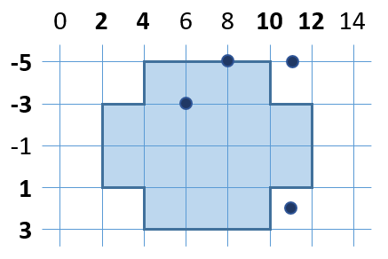
Point in a Figure
Write a program, which checks if a given point (x, y) is inside or outside the following figure:
8
-5
in
6
-3
in
11
-5
out
11
2
out
Testing the solution: https://judge.softuni.bg/Contests/Practice/Index/157#3

Slide 3

Point in Figure
Try it yourself

