Slide 1


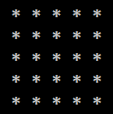
Tasks For Drawing Shapes In The console

Slide 2
Perfect Diamond

Slide 3

Perfect Diamond
Draw a diamond with size n:
n = 5
n = 2
n = 3
n = 4
*
*-*
*-*-*
*-*-*-*
*-*-*-*-*
*-*-*-*
*-*-*
*-*
*
*
*-*
*
*
*-*
*-*-*
*-*
*
*
*-*
*-*-*
*-*-*-*
*-*-*
*-*
*
Testing the solution: https://judge.softuni.bg/Contests/Practice/Index/157#8

Slide 4

Perfect Diamond
Try it yourself

