Slide 1


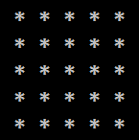
Rectangle With Asterisks in the Center

Slide 2
Rectangle With Asterisks in the Center
Draw a rectangle with asterisks in the center:
n = 2
n = 3
n = 4
n = 5
%%%%
%**%
%%%%
%%%%%%
% %
% ** %
% %
%%%%%%
%%%%%%%%
% %
% ** %
% %
%%%%%%%%
%%%%%%%%%%
% %
% %
% ** %
% %
% %
%%%%%%%%%%
Testing the solution: https://judge.softuni.bg/Contests/Practice/Index/157#9

Slide 3

Rectangle With Asterisks in the Center
Try it yourself

