Slide 1
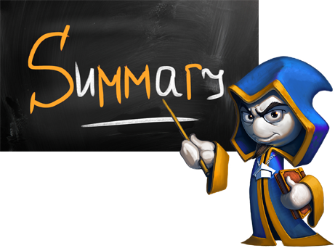
What did we learn today?

Slide 2
What did we learn today?
The exam will consist of 6 tasks:
Task with simple calculations
Task with simple conditional statements
Task with complex conditional statements
Task with simple loops
Task with drawing in the console
Task with nested loops
exam

Slide 3

What did we learn today?
Do the exercises!

