Slide 1

Exam Preparation
Preparation for practical programming exam
Programming Basics
Preslav Mihaylov
Head of Training & Software Engineer
Software University / SoftUni
https://softuni.org

Slide 2


Table of Contents
What to expect on the exam?
Task with simple calculations
Task with a single check
Task with more complex checks
Task with loops
Task for drawing a shape on the console
Task with nested loops

Slide 3
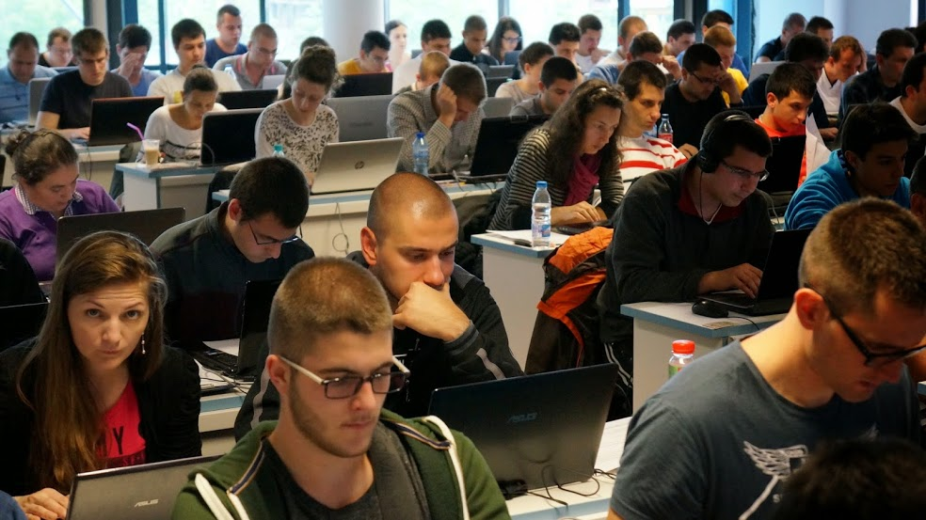


Practical Programming Exam

Slide 4
Practical Programming Exam
The course "Programming Basics" finishes with a practical exam
The exam includes 6 tasks for 4 hours with the judge system
Task with simple calculations
Task with simple conditional statements
Task with complex conditional statements
Task with loops
Task for drawing shapes in the console
Task with nested loops

Slide 5
Online Evaluation System
All exams and homeworks are tested automatically
Through the online judge system: judge.softuni.bg
All tasks have open and hidden test cases
You enter with your softuni.bg account
How does testing in the judge system work?
You submit the source code (C# program)
The program is tested by a set of tests
For every successful test, you receive points

Slide 6

Results From the Practical Exam
The practical exam evaluates the student’s skills
It includes all the material we have covered in the course
It prepares the students for the next programming course
Results from the practical exam
Result > 50% (at least 3 out of 6 tasks)
We recommend continuing in the next course
Result < 50% (at least 3 out of 6 tasks)
We recommend repeating the course

Slide 7



Tasks With Simple Calculations
Calculations without checks and loops

Slide 8
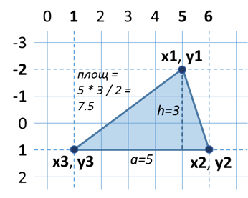
Area Of Triangle in a Plane
A triangle is defined by the coordinates of its three vertices
Vertices (x2, y2) and (x3, y3) lie on a common horizontal straight line
Vertex (x1, y1) is either above or below
Calculate the area of the triangle
Hint: We can calculate side а and height h, and the area S = a * h / 2
5
-2
6
1
1
1
7.5
Testing the solution: https://judge.softuni.bg/Contests/Practice/Index/157#0

Slide 9
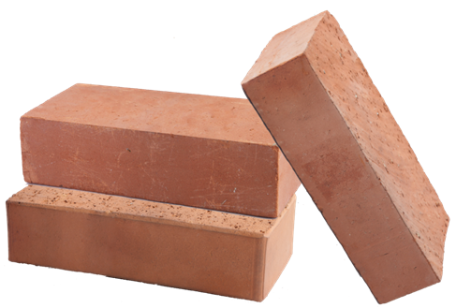
Moving Bricks
Builders have to move x bricks
The builders are w in total and work simultaneously
Bricks are moved in a cart, each one of them can carry m bricks
Calculate what’s the least amount of courses the workers have to make in order to move the bricks
Examples:
x = 120 bricks, w = 2 workers, m = 30 bricks → 2 courses
x = 310 bricks, w = 3 workers, m = 10 bricks → 11 courses
Testing the solution: https://judge.softuni.bg/Contests/Practice/Index/157#1

Slide 10

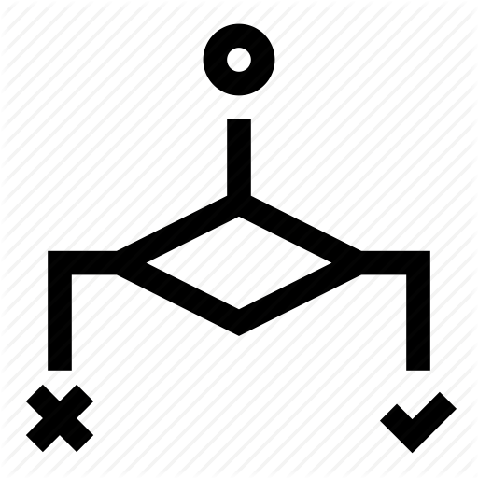

Tasks With Simple Conditional Statements

Slide 11


Point on a Line
A horizontal line is defined by its two ends
A point is defined by its position
Check if the point is on the line or not
Calculate the distance to the nearest end of the line
10
5
7
in
2
8
10
5
out
3
Testing the solution: https://judge.softuni.bg/Contests/Practice/Index/157#2

Slide 12
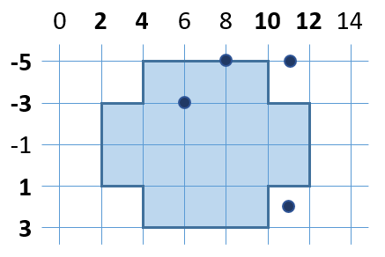
Point in Figure
Write a program, which checks if a given point (x, y) is inside or outside the following figure:
8
-5
in
6
-3
in
11
-5
out
11
2
out
Testing the solution: https://judge.softuni.bg/Contests/Practice/Index/157#3

Slide 13


Tasks With Complex Conditional Statements

Slide 14
Date After 5 Days
You are given numbers d (day) and m (month), which form a date
Write a program, which prints the date after 5 days
Months April, June, September and November will have 30 days; February has 28 days; The rest of the months have 31 days
Months are printed with a leading zero (E.g. 01, 08, 12)
28
03
2.04
27
12
1.01
25
1
30.01
Testing the solution: https://judge.softuni.bg/Contests/Practice/Index/157#4

Slide 15
Sums of 3 Numbers
You are given 3 numbers. Check if the sum of two of the numbers == the third one. Print A + B = C (A ≤ B) or "No"
3
5
2
2 + 3 = 5
2
2
4
2 + 2 = 4
1
1
5
No
5
3
2
2 + 3 = 5
4
2
2
2 + 2 = 4
3
5
6
No
Testing the solution: https://judge.softuni.bg/Contests/Practice/Index/157#5

Slide 16



Tasks with loops
for-loop
A single for-loop with simple logic

Slide 17



Sums of Third Numbers
Given n numbers a₁, a₂, …, a_{n}. Calculate the sums:
sum₁ = a₁ + a₄ + a₇ + …
sum₂ = a₂ + a₅ + a₈ + …
sum₃ = a₃ + a₆ + a₉ + …
5
3
5
2
7
8
sum1 = 10
sum2 = 13
sum3 = 2
2
3
5
sum1 = 3
sum2 = 5
sum3 = 0
4
7
-2
6
12
sum1 = 19
sum2 = -2
sum3 = 6
Testing the solution: https://judge.softuni.bg/Contests/Practice/Index/157#6

Slide 18
Growing Elements
You are given a sequence of n numbers a₁, a₂, …, a_{n}
Calculate the length of the longest increasing sequence of elements amongst these numbers
3
5
2
4
2
4
2
8
7
6
2
4
1
2
4
4
3
4
5
6
7
8
4
Testing the solution: https://judge.softuni.bg/Contests/Practice/Index/157#7

Slide 19

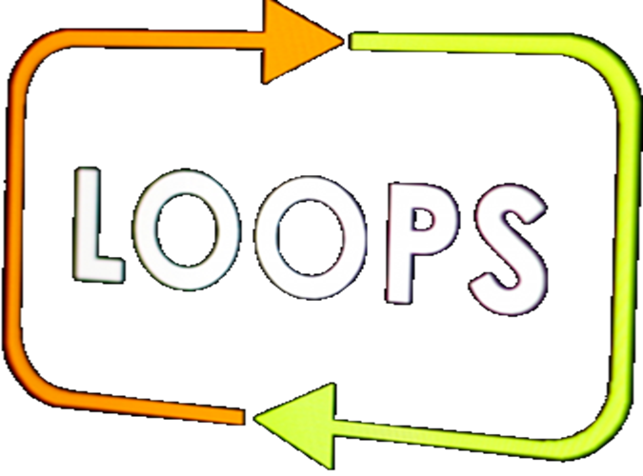
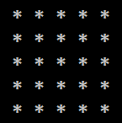
Tasks For Drawing Shapes In The console

Slide 20

Perfect Diamond
Draw a diamond with size n:
n = 5
n = 2
n = 3
n = 4
*
*-*
*-*-*
*-*-*-*
*-*-*-*-*
*-*-*-*
*-*-*
*-*
*
*
*-*
*
*
*-*
*-*-*
*-*
*
*
*-*
*-*-*
*-*-*-*
*-*-*
*-*
*
Testing the solution: https://judge.softuni.bg/Contests/Practice/Index/157#8

Slide 21
Rectangle With Asterisks In The Middle
Draw a rectangle with asterisks in the middle:
n = 2
n = 3
n = 4
n = 5
%%%%
%**%
%%%%
%%%%%%
% %
% ** %
% %
%%%%%%
%%%%%%%%
% %
% ** %
% %
%%%%%%%%
%%%%%%%%%%
% %
% %
% ** %
% %
% %
%%%%%%%%%%
Testing the solution: https://judge.softuni.bg/Contests/Practice/Index/157#9

Slide 22




Tasks With Nested Loops
loops
More complex loops, nested loops

Slide 23
Quadruplet Growing Numbers
Given two pairs of numbers a and b generate all quadruplets n₁, n₂, n₃, n₄, for which a ≤ n₁ < n₂ < n₃ < n₄ ≤ b
15 16 17 18
15 16 17 19
15 16 17 20
15 16 18 19
15 16 18 20
15 16 19 20
15 17 18 19
15 17 18 20
15 17 19 20
15 18 19 20
16 17 18 19
16 17 18 20
16 17 19 20
16 18 19 20
17 18 19 20
3 4 5 6
3 4 5 7
3 4 6 7
3 5 6 7
4 5 6 7
3
7
15
20
5
7
No
Testing the solution: https://judge.softuni.bg/Contests/Practice/Index/157#10

Slide 24
Generate Rectangles
Given numbers n and m generate all rectangles with integer coordinates in the interval [-n…n] with area at least m
Print them in the format:
Constraints: -n ≤ left < right ≤ n; -n ≤ top < bottom ≤ n
(left, top) (bottom, right) -> area
1
2
(-1, -1) (0, 1) -> 2
(-1, -1) (1, 0) -> 2
(-1, -1) (1, 1) -> 4
(-1, 0) (1, 1) -> 2
(0, -1) (1, 1) -> 2
2
17
No
3
36
(-3, -3) (3, 3) -> 36
Testing the solution: https://judge.softuni.bg/Contests/Practice/Index/157#11

Slide 25

What did we learn today?
The exam with comprise of 6 tasks:
Task with simple calculations
Task with simple conditional statement
Task with complex conditional statements
Task with loops
Task for drawing shapes on the console
Task with nested loops
exam

