Slide 1
Final Project QA Complete - test automation -

Slide 2
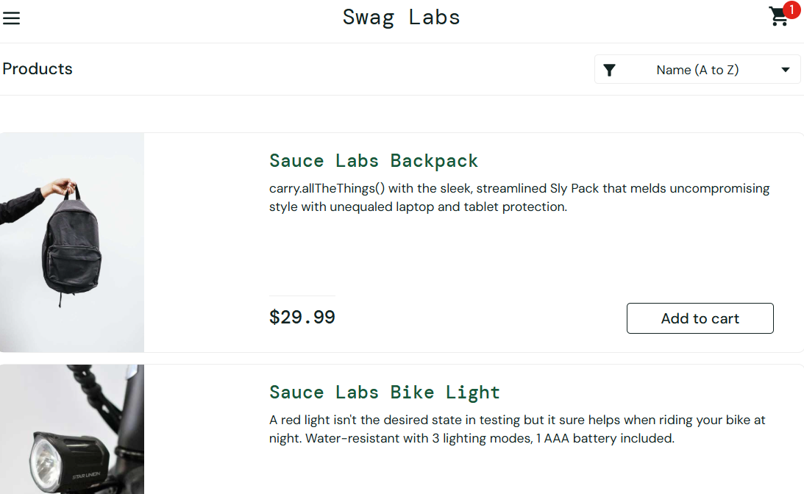
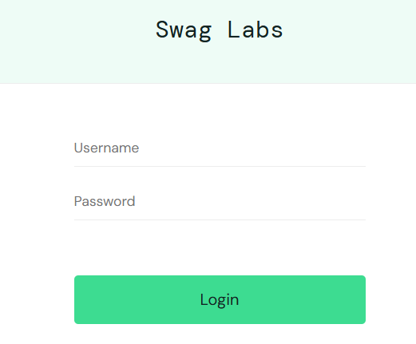
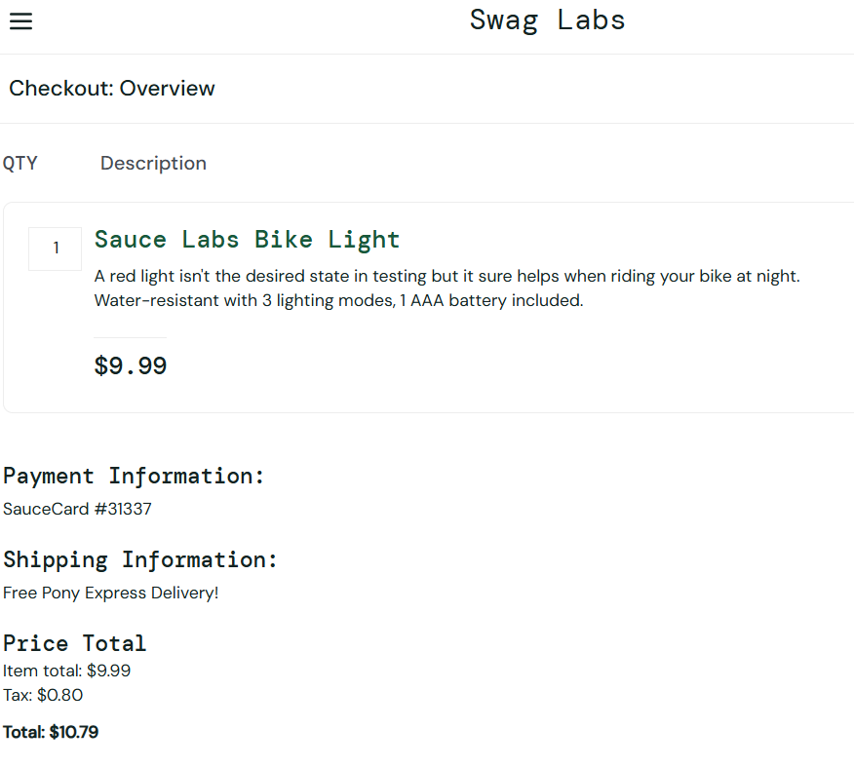
App Overview
Characteristics:
Web application
https://www.saucedemo.com
Functionality:
Authentication/Login
Products selection
Ordering/Payment

Slide 3




Tools

Slide 4
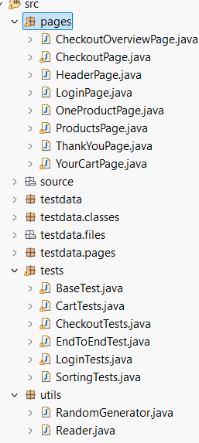
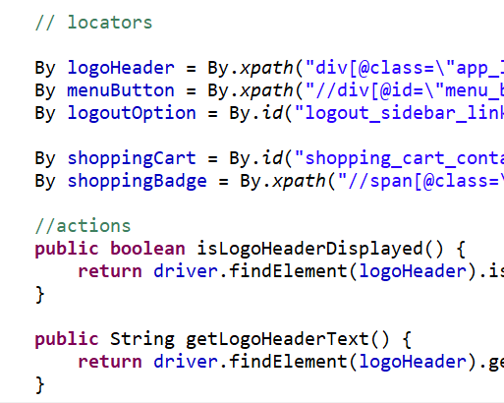
Test Automation - Design
POM concept and package structure
Pages
Test Data
Tests
Utils

Slide 5
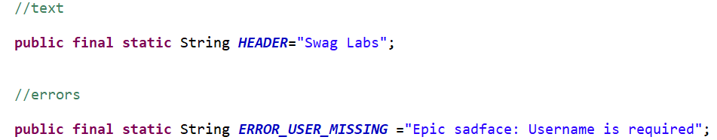
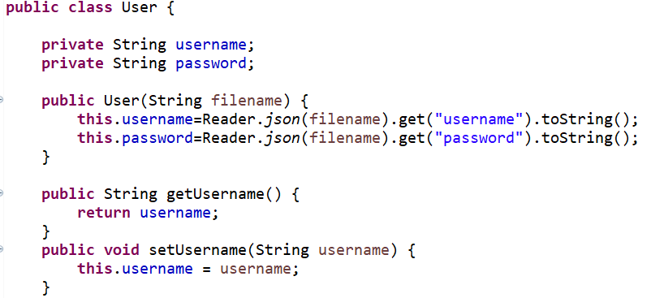

Test Data
Constants
URL
Texts, Titles
Error Messages
JSON files - coresponding classes
user
product
client

Slide 6
Tests
Base test - navigation to login page, extends all other tests
Test Suite | Positive tests | Negative tests
Authentication/Login | Valid Login/Logout | Missing username Missing password User not in data base Login with locked user
Cart/Product selection | Adding and removing a product from the cart
Checkout + Before | Valid random info Valid firstname - at 1, 29 and 30 char Valid lastname - at 1, 29 and 30 char Valid postalcode - at 1, 5 and 6 char | Invalid firstname at 0 and 31 char Invalid lastname at 0 and 31 char Invalid postalcode at 0 and 7 char
FullPurchase | EndToEnd - buying a product
Sorting Tests | Sorting products alphabetically, reverse alphabetical order, from the lowest price to the highest and the other way around

Slide 7
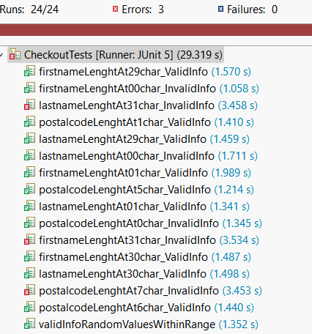
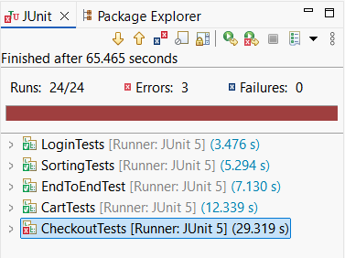
Tests Results
24 tests - 21 passed/3 failed - 87.5% WHY?

Slide 8
Challenges and conclusion
POM - balance between detail and usefulness
Selenium’s findElement throws a NoSuchElementException if the element isn’t found

Slide 9

Challenges and conclusion
POM - balance between detail and usefulness
create locators and add actions - only based on the need for testing
Selenium’s findElement throws a NoSuchElementException if the element isn’t found

Slide 10
Thank you
Please feel free to ask any additional questions.

