Slide 1
Capstone Project – Team 11
Pyladies Amsterdam
Python Bootcamp Data Analysis for Beginners
4-5/2020

Slide 2
Capstone Project – Team 11
Analysis of Mobile Apps Data from AppStore
Team members:
Agnieszka Kasztalska (Poland)
Daniela Nyblova (Slovakia)
Alexia Wpy (Hong Kong)
Melissa Charfuelan Aguirre (Columbia)
Capstone Project | Team 11 May 3 2020 | <number>

Slide 3

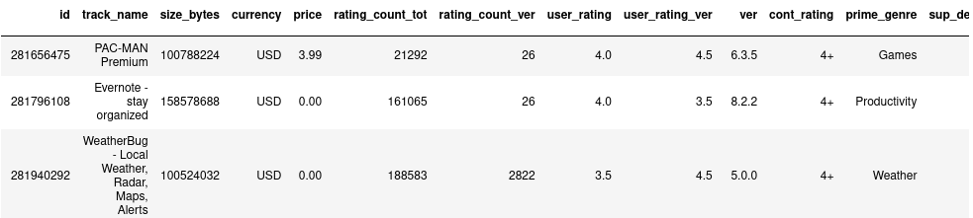
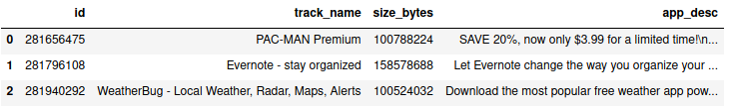
Analysis of Mobile Apps Data from AppStore
Dataset
AppleStore.csv (17 columns, 7147 rows)
appleStore_description.csv (4 columns, 7147 rows)
License: GPL 2
Source: Mobile App Store Dataset from Kaggle
Capstone Project | Team 11 May 3 2020 | <number>

Slide 4
Analysis of Mobile Apps Data from AppStore
Q1:
Some bullet points and graphs
Capstone Project | Team 11 May 3 2020 | <number>

Slide 5

Analysis of Mobile Apps Data from AppStore
Conclusion ?
Some bullet points
Some bullet points
Some bullet points
Project in public Github repository: https://github.com/DanielaNy/Pyladies_Amsterdam_Capstone_Project
Capstone Project | Team 11 May 3 2020 | <number>

Slide 6
Thank you for your attention :)
Capstone Project | Team 11 May 3 2020 | <number>

