Slide 1

Pyladies Amsterdam Python Bootcamp: Data Analysis for Beginners
Capstone Project – Team 11

Slide 2

Analysis of Mobile Apps Data from AppStore
Dataset
AppleStore.csv (17 columns, 7147 rows)
AppleStore_description.csv (4 columns, 7147 rows)
License: GPL 2
Source: Mobile App Store Dataset from Kaggle
Libraries used for analysis:
Pandas, Matplotlib, Seaborn, Plotly
Team members:
Agnieszka Kasztalska (Poland)
Daniela Nyblova (Slovakia)
Alexia Wpy (Hong Kong)
Melissa Charfuelán Aguirre (Colombia)
Capstone Project | Team 11
2

Slide 3
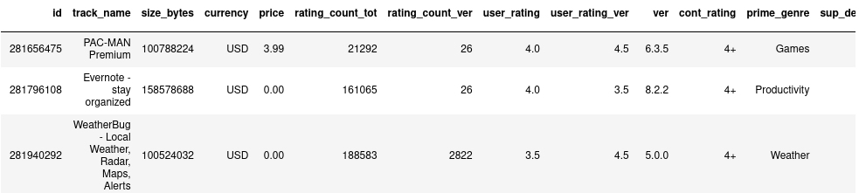
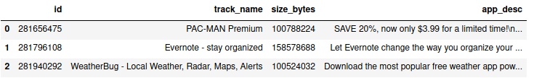
The datasets
Dataset 1
Dataset 2
Capstone Project | Team 11
3

Slide 4
EDA process
Data pre-processing
Questions
Data analysis
Capstone Project | Team 11
4

Slide 5
Pre-processing
1
Let’s start with the data
5

Slide 6
Data pre-processing
Reading
Merging
Cleaning
Capstone Project | Team 11
6

Slide 7
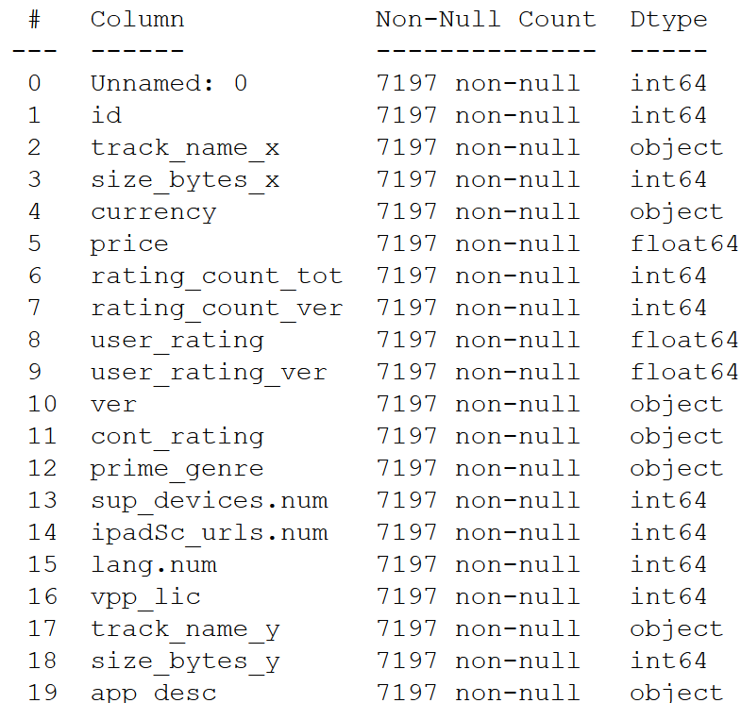
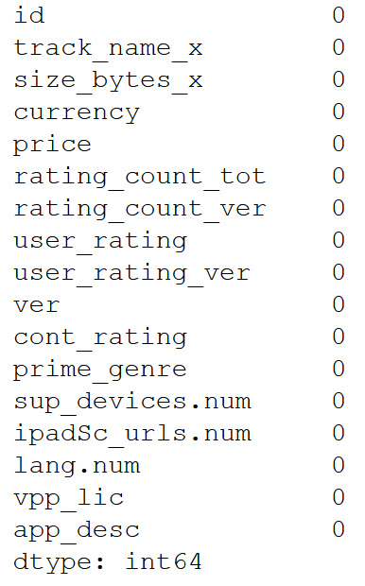
Pre – processing Findings
Total NaNs: 0
Total rows
Total columns: 19
Total rows: 7197
Datatypes:
Float 64 = 3
Int 64 = 10
Object = 7
Capstone Project | Team 11
7

Slide 8
Questions
2
Continuining with the exploration
8

Slide 9
Questions
How does the distribution of apps per price look like?
For how many applications rating of the current version is higher than for the previous ones?
How many languages applications support?
Which genres get the most user feedback, which the least?
How many apps are there per genre? what percentage do they represent?
What is the relationship between average user rating and average price per category
How does the average user rating value depend on user rating counts (all version)? Does the user rating value (all versions) correlate with any other variable?
What are the most commonly used words (with more than 5 letters) in the apps’ description?
Capstone Project | Team 11
9

Slide 10
Data Analysis
3
Analysing the data
10

Slide 11
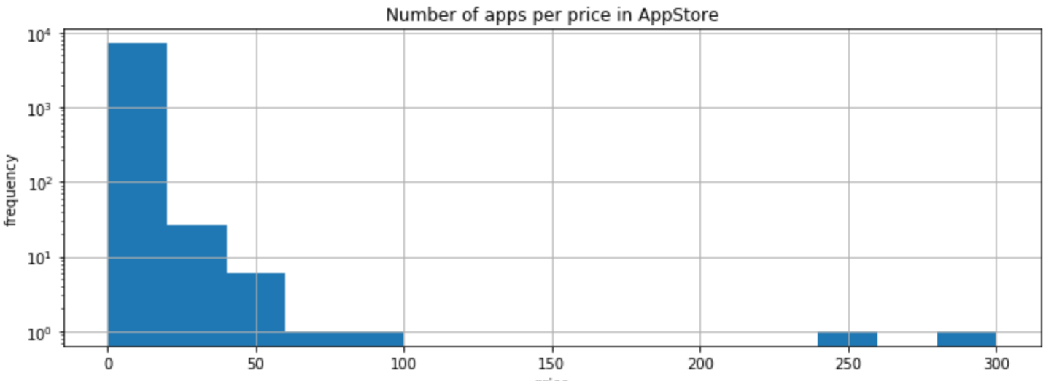
Data Analysis
1 How does the distribution of apps per price look like?
Conclusion:
Most of the apps available in AppStore is for free or for small amount of money
There are few very expensive apps
Capstone Project | Team 11
11

Slide 12
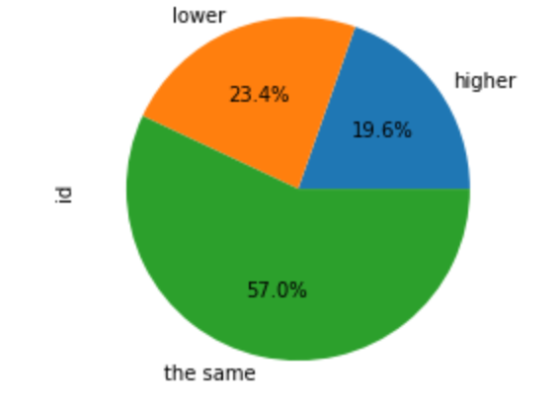
Data Analysis
2 Number of apps for which current version rating is higher, the same or lower than for the previous versions
Conclusion:
For majority of the apps, rating of the current version is the same as for the previous versions
A bit more apps get lower rating per current version than higher
Capstone Project | Team 11
12

Slide 13
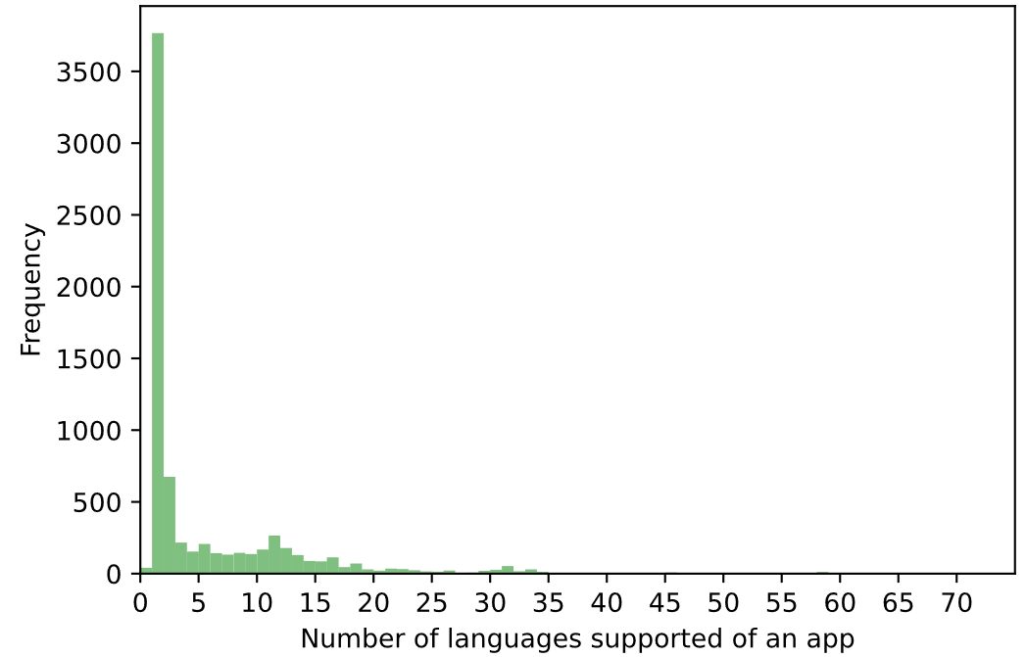
Data Analysis
3 Number of languages supported in each app. Presented on histogram.
Conclusion:
Most apps has less than 5 languages, with most apps support one language (counts=3767).
The maximum number of languages supported is 75 (in one application only)
Capstone Project | Team 11
13

Slide 14
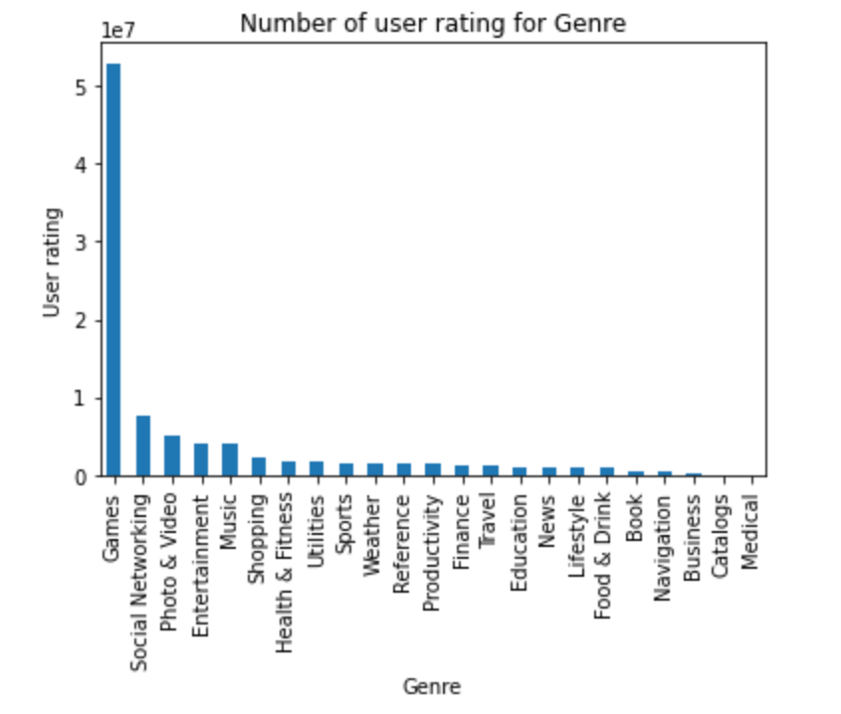
Data Analysis
4 Which genres get the most user feedback, which the least?
Conclusion:
Genre with the most user feedback is "Games“ = 52’8728.491
Genre with the least user feedback is "Medical“ = 13.634
It is important to point out that "Games" is by far the type of genre with the most user feedback.
Capstone Project | Team 11
14

Slide 15
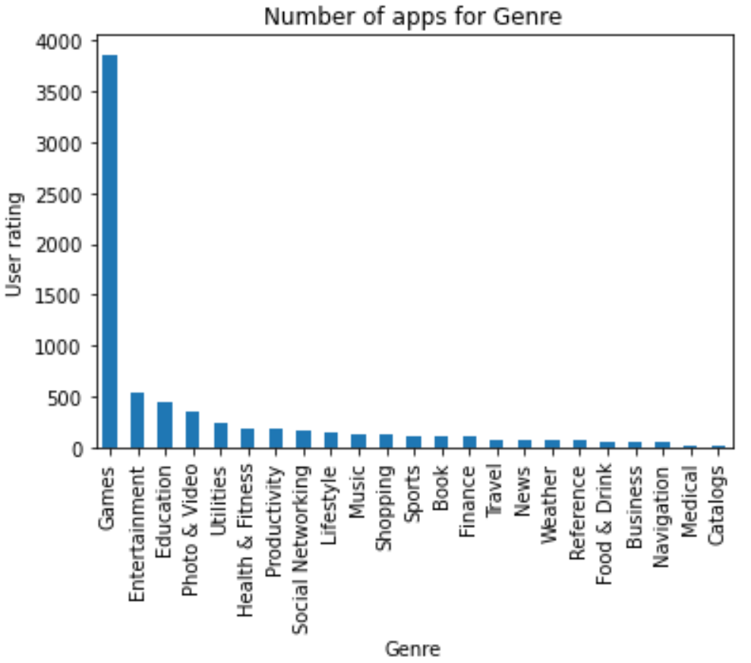
Data Analysis
5 How many apps are there per genre? What percentage do they represent?
Conclusion:
Top 5:
Games = 3.862
Entertainment = 535
Education = 453
Photo & video = 349
Utilities =248
Capstone Project | Team 11
15

Slide 16
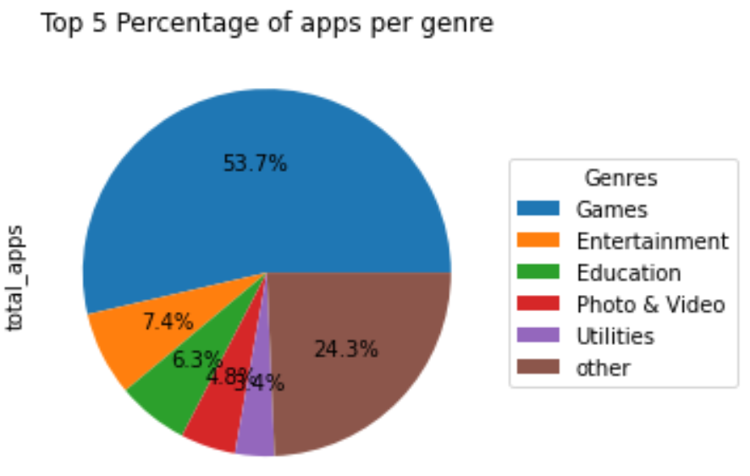
Data Analysis
5 How many apps are there per genre? What percentage do they represent?
Conclusion:
More than half of the apps in the dataset belong to the "Game" category = 3.862
The other top 5 categories represent much lower percentage.
Capstone Project | Team 11
16

Slide 17
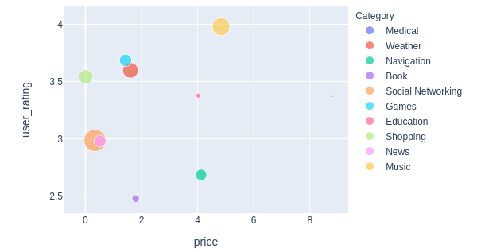
Data Analysis
6 What is the relationship between average user rating and average price per category?
- random 10 categories used
- bubble size = number of rating votes
- interactive graph
Conclusion
People pay most in average for medicinal apps, but they have only mid-range rating
Shopping apps are free or cheap
Music apps are quite expensive, but also highly rated
Capstone Project | Team 11
17

Slide 18
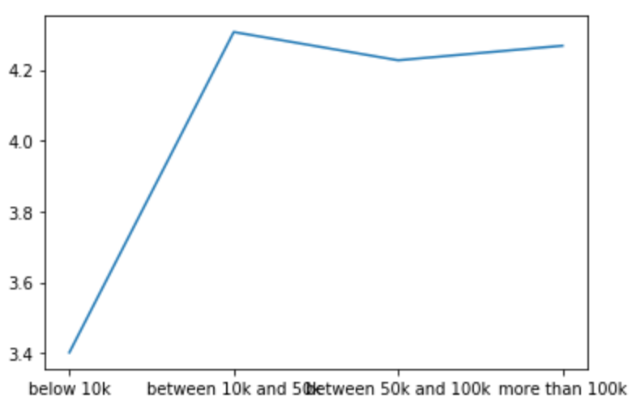
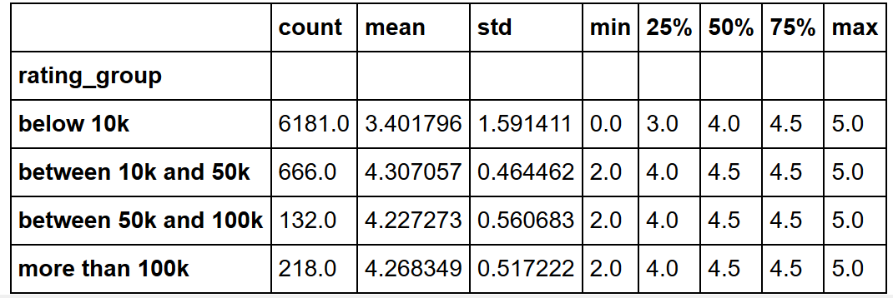
Data Analysis
7 How does the average user rating value depend on number of user rating counts (all versions)?
Conclusion:
Rating is the highest for the group between 10k and 50k reviews
The lowest for apps below 10k reviews.
Capstone Project | Team 11
18

Slide 19
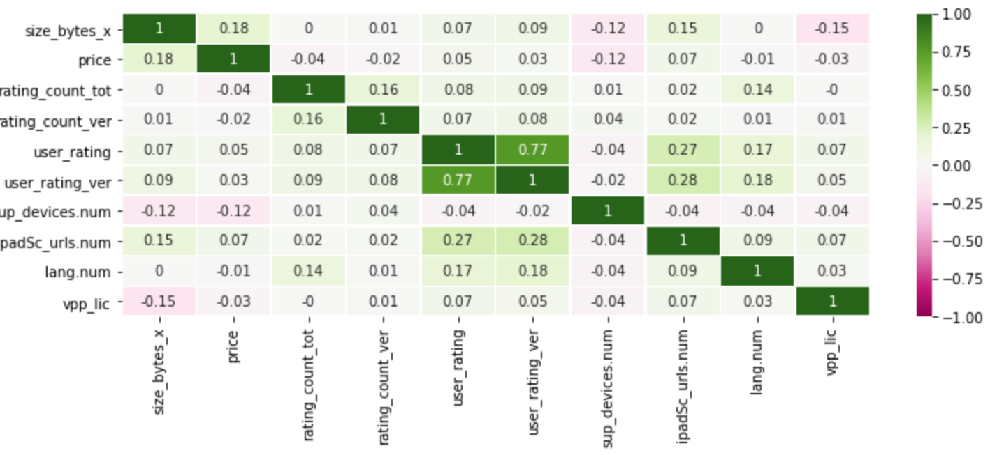
Data Analysis
7 Does the user rating value (all versions) correlate with any other variable?
Conclusion:
very strong correlation with user rating of actual version
mid-range correlation with number of screenshots showed for display (ipadSc_urls.num)
other correlations found
Capstone Project | Team 11
19

Slide 20
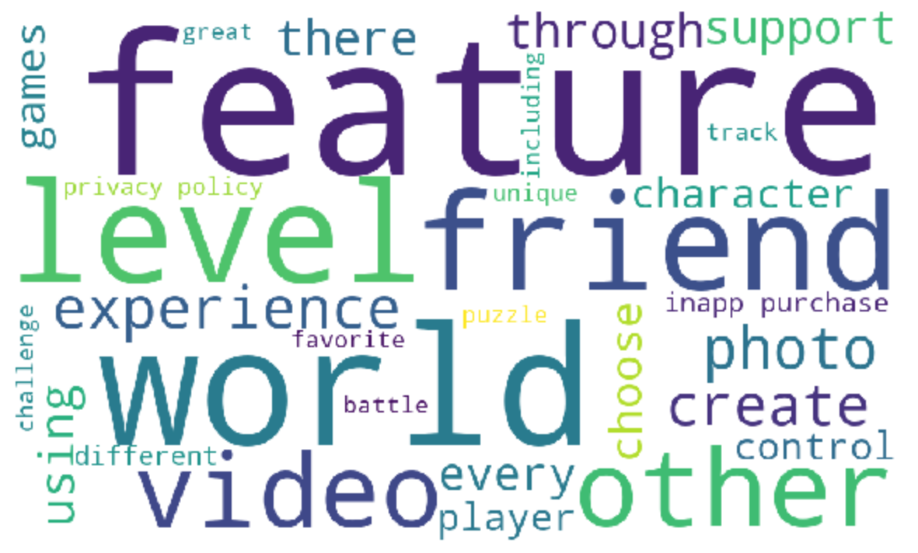
Data Analysis
8 What are the most commonly used words (with more than 5 letters) in the apps description?
Conclusion:
Just have a look :)
Capstone Project | Team 11
20

Slide 21

Thank you!
https://github.com/DanielaNy/Pyladies_Amsterdam_Capstone_Project
21

