Slide 1

Pyladies Amsterdam Python Bootcamp: Data Analysis for Beginners
Capstone Project – Team 11

Slide 2

Analysis of Mobile Apps Data from AppStore
Dataset
AppleStore.csv (17 columns, 7147 rows)
AppleStore_description.csv (4 columns, 7147 rows)
License: GPL 2
Source: Mobile App Store Dataset from Kaggle
Libraries used for analysis:
Pandas, Matplotlib and Seaborn
Team members:
Agnieszka Kasztalska (Poland)
Daniela Nyblova (Slovakia)
Alexia Wpy (Hong Kong)
Melissa Charfuelán Aguirre (Colombia)
Capstone Project | Team 11

Slide 3
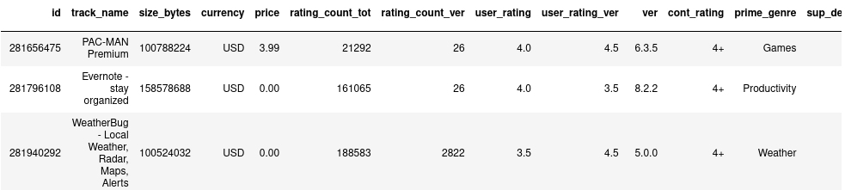
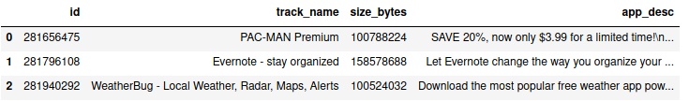
The datasets
Dataset 1
Dataset 2
Capstone Project | Team 11

Slide 4
EDA process
Data pre-processing
Data Analysis
A bit further
Capstone Project | Team 11

Slide 5
Pre-processing
1
Let’s start with the data

Slide 6
Data pre-processing
Reading
Merging
Cleaning
Capstone Project | Team 11

Slide 7
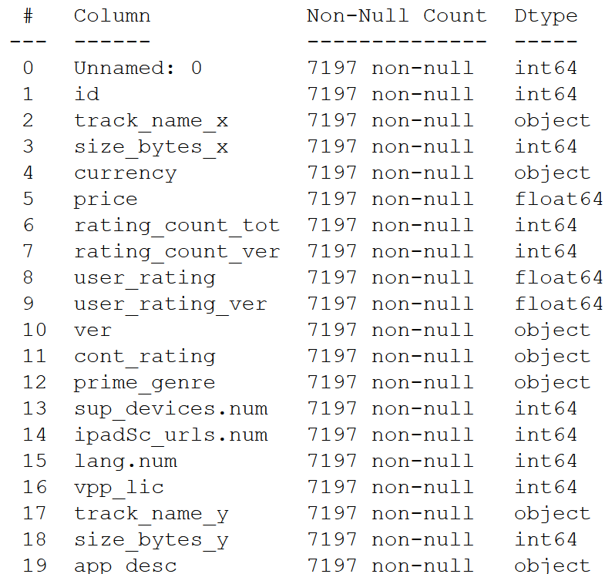
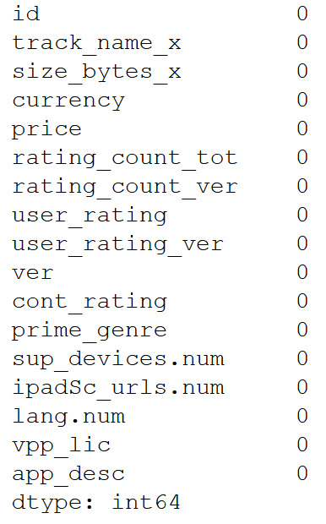
Pre – processing Findings
Total NaNs: 0
Total rows
Total columns: 19
Total rows: 7197
Datatypes:
Float 64 = 3
Int 64 = 10
Object = 7
Capstone Project | Team 11

Slide 8
Data Analysis
2
Continuining with the exploration

Slide 9
QUESTIONS
How does the distribution of apps per price look like?
For how many applications rating of the current version is higher than for the previous ones?
How many languages applications support?
Which genres get the most user feedback, which the least?
How many apps are there per genre? what percentage do they represent?
What is the relationship between average user_rating vs average price per category?
How does the average user rating value depend on any other variable, e.g. number of user rating counts (all version)? What are the correlations between columns?
What are the most commonly used words in the apps description?
Capstone Project | Team 11

Slide 10
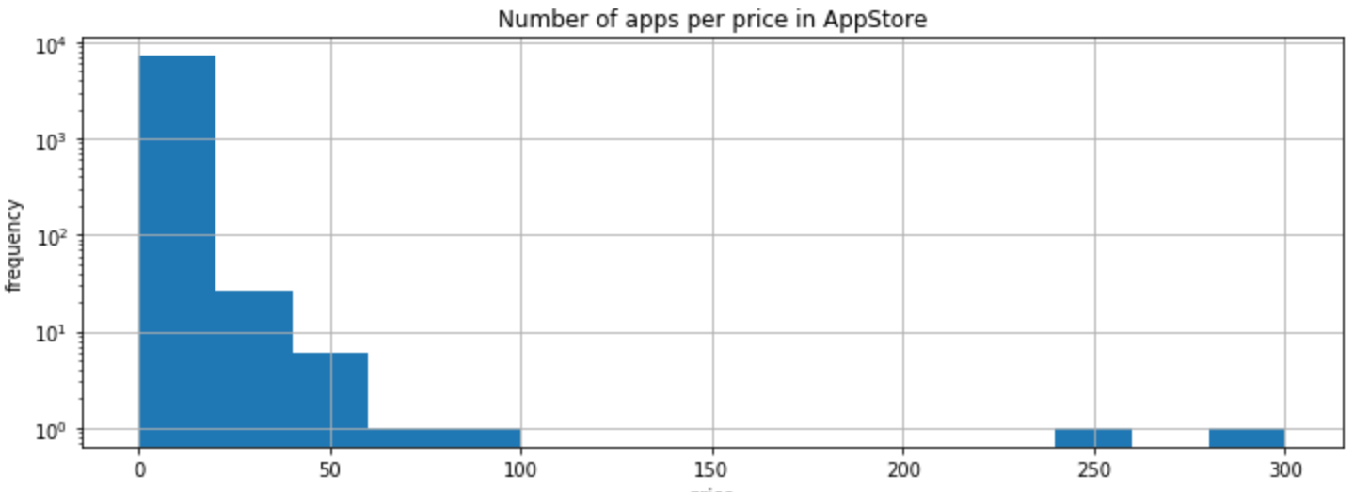
Data Analysis
1 Distribution of app prices (number of available apps per price plotted as histogram)
Conclusion:
Most of the apps available in AppStore is for free or for small amount of money.
Capstone Project | Team 11

Slide 11
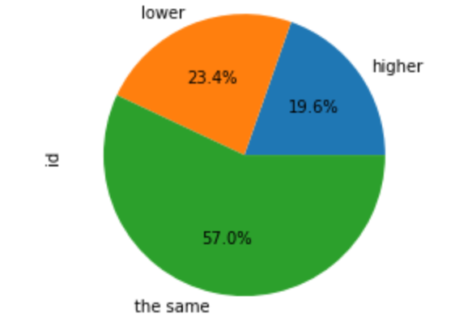
Data Analysis
2 Number of apps for which current version rating is higher, the same or lower than for the previous versions
Conclusion:
For majority of the apps, rating of the current version is the same as for the previous versions. A bit more apps get lower rating per current version than higher.
Capstone Project | Team 11

Slide 12
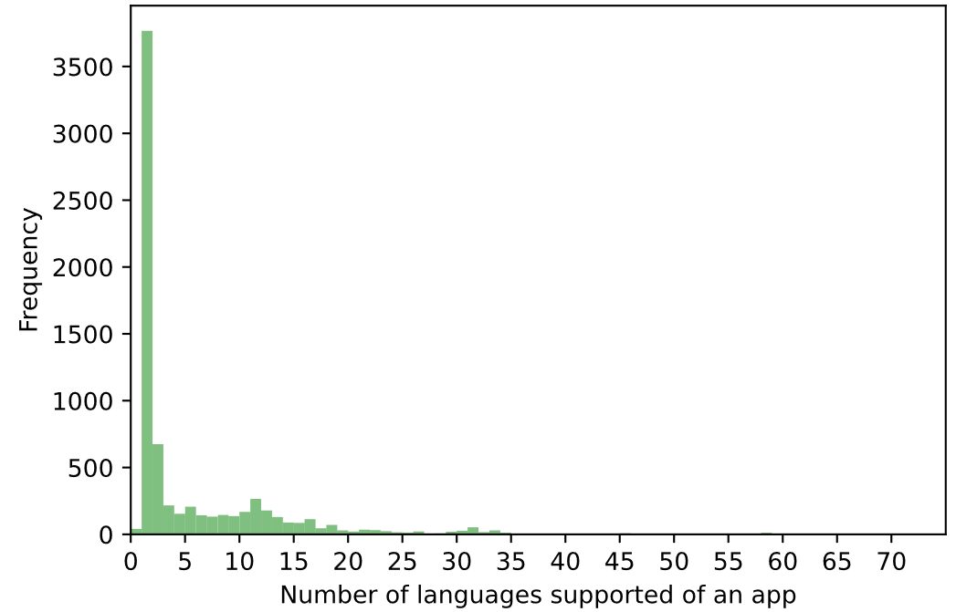
Data Analysis
3 Number of languages supported in each app. Presented on histogram.
Conclusion:
Most apps has less than 5 languages supported according to the histogram, with most apps support one language (counts=3767). And the maximum number of languages supported is 75 (in one application only).
Capstone Project | Team 11

Slide 13
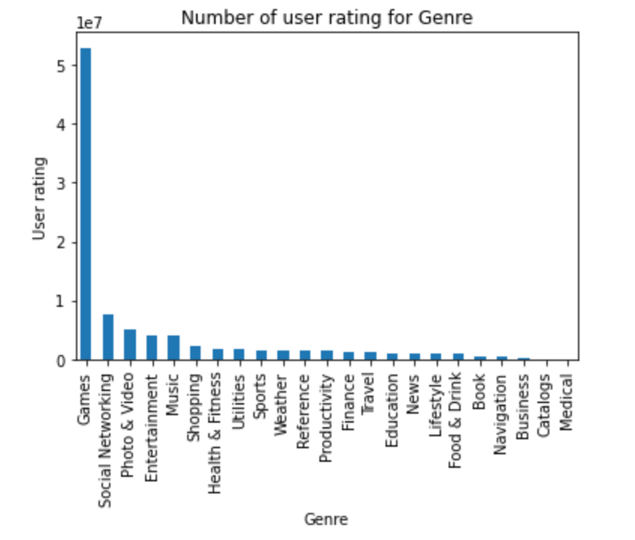
Data Analysis
4 Which genres get the most user feedback, which the least?
Conclusion:
As we can see the genre with the most user feedback is "Games" and the genre with the least user feedback is "Medical“
It is important to point out that "Games" is by far the type of genre with the most user feedback.
Capstone Project | Team 11

Slide 14
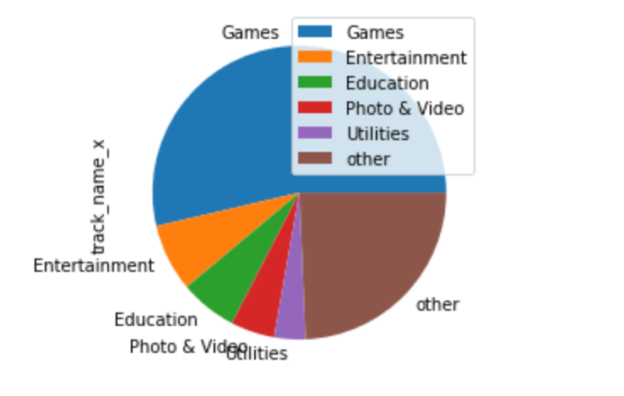
Data Analysis
5 How many apps are there per genre? what percentage do they represent?
Conclusion:
More than half of the apps in the dataset belong to the "Game" category. The other top 5 categories represent much lower percetage.
Capstone Project | Team 11

Slide 15
Data Analysing
6 Average user_rating vs average price per category
Capstone Project | Team 11

Slide 16
A bit further
3
Let’s start with the first set of slides

Slide 17
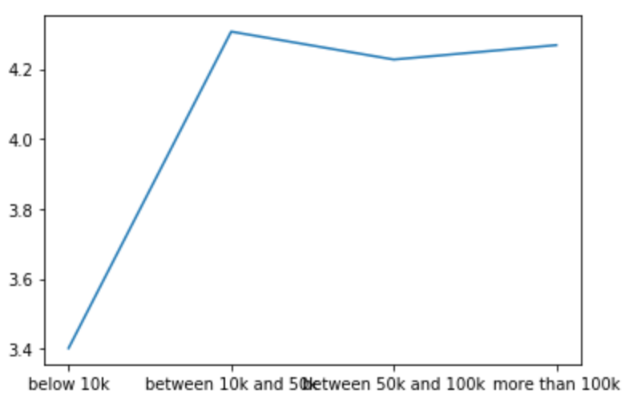
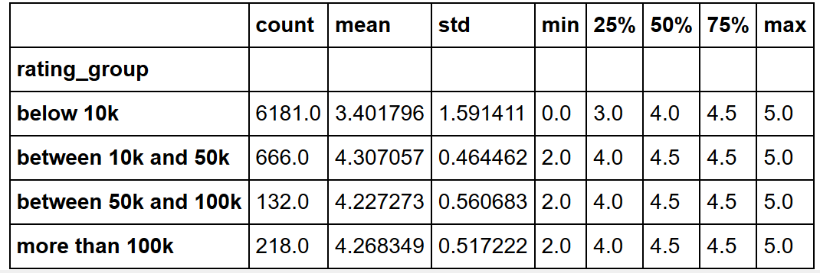
A bit furher
7 How does the average user rating value depend on other variable - number of user rating counts (all version)?
Conclusion:
Rating is the highest for the group between 10k and 50k reviews. The lowest for apps below 10k reviews.
Capstone Project | Team 11

Slide 18
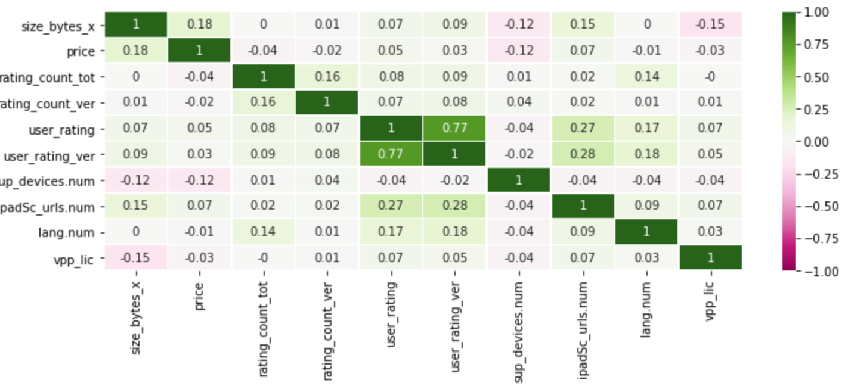
A bit further
7 How does the average user rating value depend on any other variable, e.g. number of user rating counts (all version)? We took a bit deeper look into correlations between columns using heatmap.
Capstone Project | Team 11

Slide 19
A bit further
7 How does the average user rating value depend on any other variable, e.g. number of user rating counts (all version)?
Conclusion:
From the heat map we can see very strong correlation between user_rating and user_rating_ver.
Mid-range correlation seems between user_rating and ipadSc_urls.num, between user_rating_ver and ipadSc_urls.num.
Slight correlation may be present between size_bytes_x and prize and between lang.num and user_rating_ver.
Capstone Project | Team 11

Slide 20
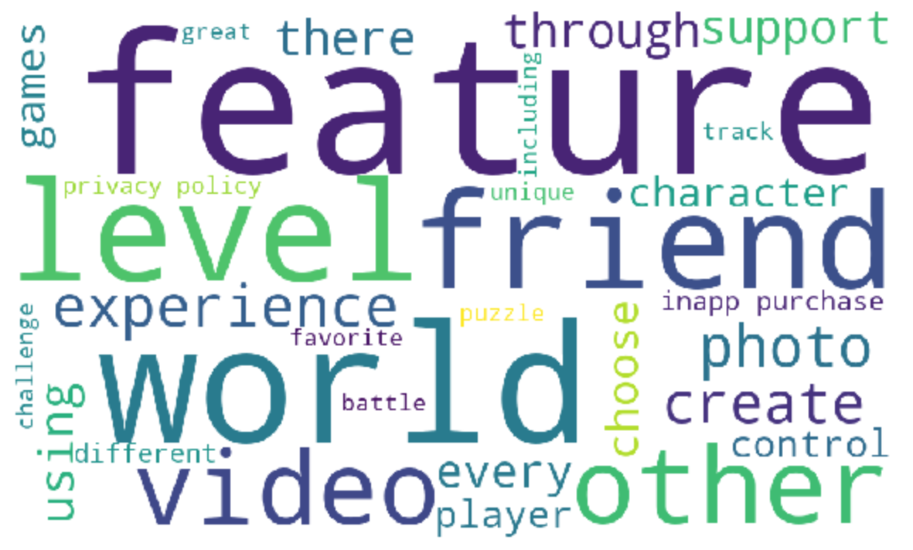
A bit further
8 What are the most commonly used words in the apps description?
Capstone Project | Team 11

Slide 21
Thank you!

Slide 22
SlidesCarnival icons are editable shapes.
This means that you can:
Resize them without losing quality.
Change line color, width and style.
Isn’t that nice? :)
Examples:

Slide 23
Diagrams and infographics

Slide 24
😉
Now you can use any emoji as an icon!
And of course it resizes without losing quality and you can change the color.
How? Follow Google instructions https://twitter.com/googledocs/status/730087240156643328
✋👆👉👍👤👦👧👨👩👪💃🏃💑❤😂😉😋😒😭👶😸🐟🍒🍔💣📌📖🔨🎃🎈🎨🏈🏰🌏🔌🔑 and many more...

