Slide 1


Slide 2
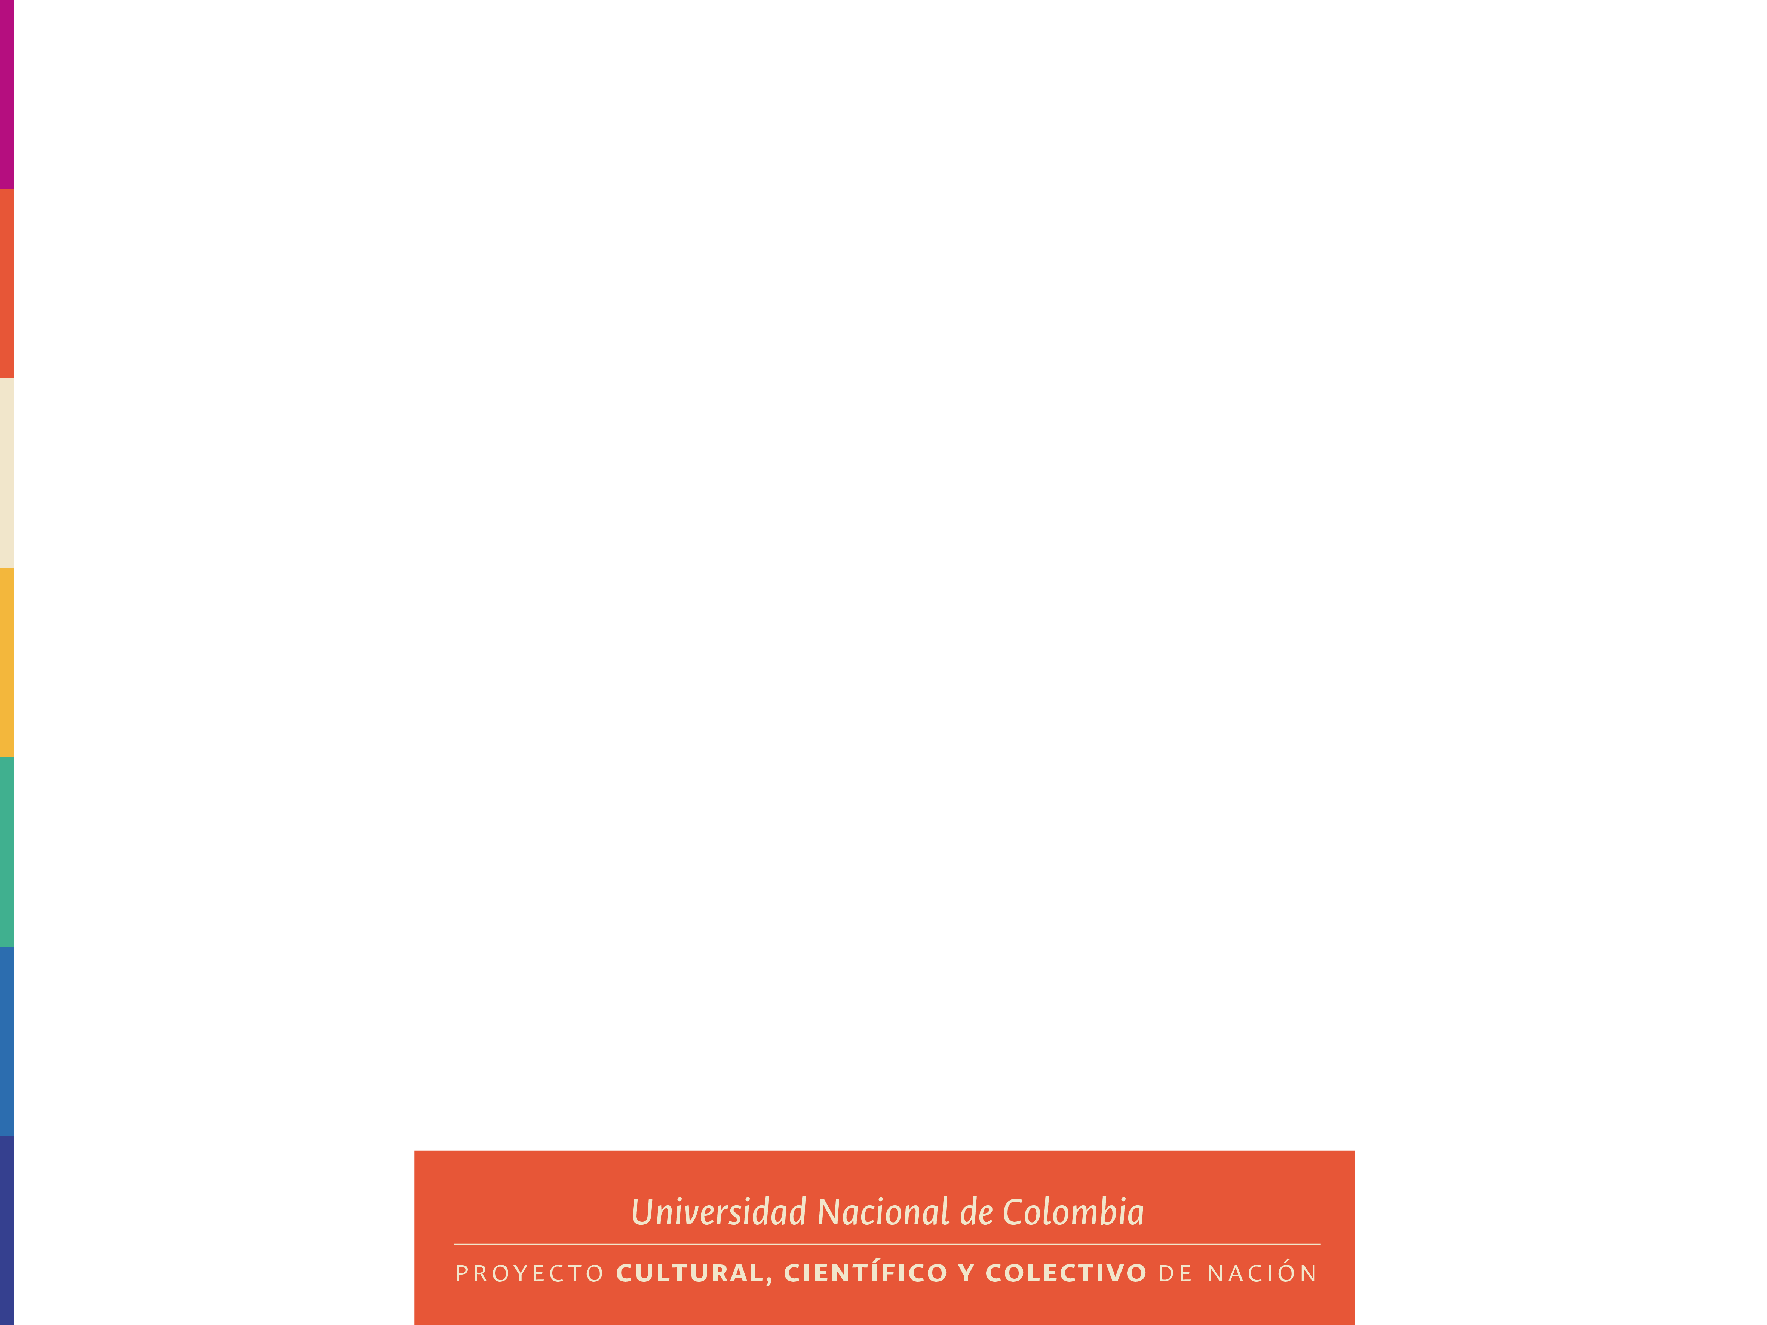
Detection of land cover change using remote sensing
Daniela Rayo Álvarez
Facultad de Ciencias Agrarias

Slide 3
Detection of land cover change using remote sensing
Land cover
Biophysical description of the land surface
Vegetation
Plants and natural ecosystems
Bodies of Water
Rivers, lakes, and oceans
Urban Areas
Cities and man-made structures
Agricultural Zones
Cropland and farms

Slide 4
Detection of land cover change using remote sensing
Importance
Unmonitored ecosystems
Mapping of land cover
Impact assessment
Identification of vulnerable areas
Resilient ecosystems
Untracked land cover transformations
Mapping of land cover and monitoring
Assessment of impact on global climate
Identification of vulnerable areas and prediction of impacts
Mitigation and adaptation strategies implemented

Slide 5
Detection of land cover change using remote sensing
Advances in change detection
Higher temporal resolution
Higher spatial resolution
Impact of cloud cover
Less impact of cloud cover
Landsat
MODIS

Slide 6
Detection of land cover change using remote sensing
Algorithms for change detection
Algorithm | Description | Advantages | Limitations | Sources
CCDC | Harmonic model that uses all available Landsat images to detect changes continuously | High temporal and spatial accuracy, does not require thresholds. | High computational cost. | Zhu & Woodcock, 2014
CCDC-SMA | Combines CCDC with spectral analysis (SMA) to detect gradual and subtle degradation. | Detects sub-pixel changes and progressive degradation. | Requires high-quality spectral mixture data. | Chen et al., 2021
LandTrendr | Segments annual Landsat time series with straight lines to identify disturbances and recovery. | Ideal for abrupt changes; validated with field data. | It may not adequately capture very short-term events or anomalies if there is insufficient temporal data density. | Kennedy et al., 2010
MDDI | Index based on NIR and SWIR bands with LandTrendr to detect tropical deforestation. | Accuracy >80% in humid forests. | Low accuracy in dry areas due to exposed soils. | Hurtado & Lizarazo, 2021

Slide 7
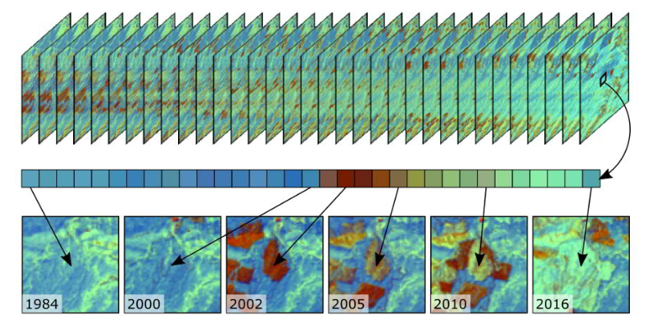
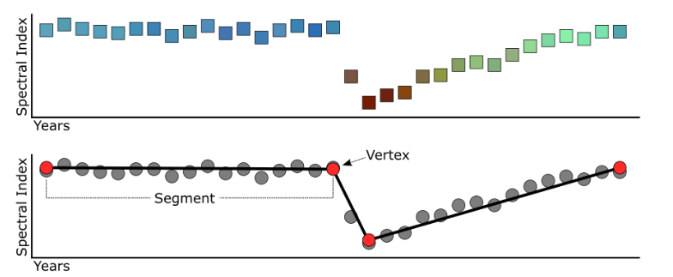
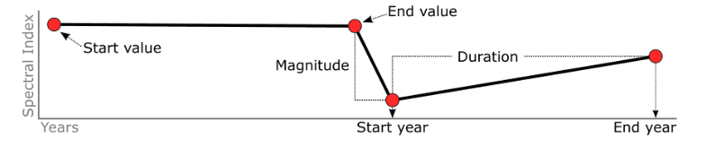
Detection of land cover change using remote sensing
LandTrendr
Input
Annual time series of an index.
Process
Detects change vertices and allows interpolation.
Output
Simplified trajectory + temporal metrics.
More information

Slide 8
Detection of land cover change using remote sensing
Methodology
Unsupervised classification
K-means
Classify pixels
Calculate residuals
Annual maximum NDVI
MODIS
Preprocessing
Exploratory analysis
Annual total precipitation
Simple linear regression per pixel
Temporal segmentation
Segmentation using fitted values
NDVI residual

Slide 9
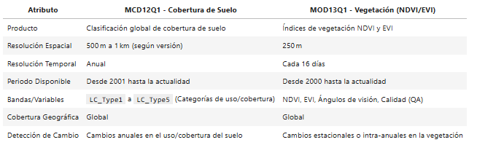
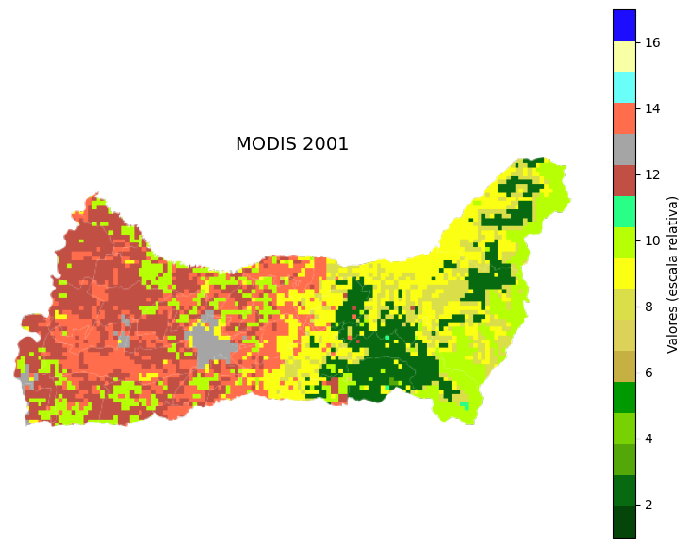
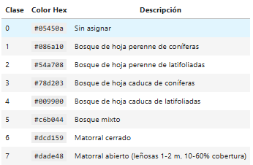
Detection of land cover change using remote sensing
Methodology: exploratory analysis
MODIS
Exploratory analysis

Slide 10
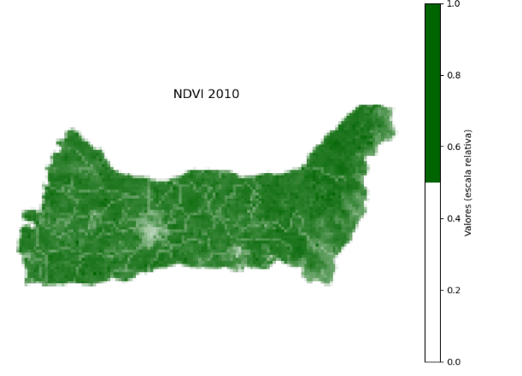
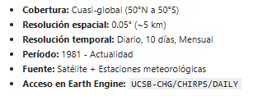
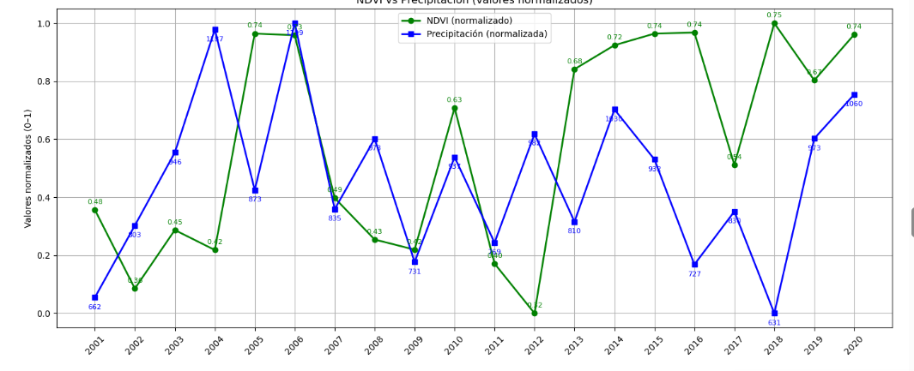
Detection of land cover change using remote sensing
Methodology: preprocessing
Calculate residuals
Annual maximum NDVI
Preprocessing
Annual total precipitation
Simple linear regression per pixel

Slide 11
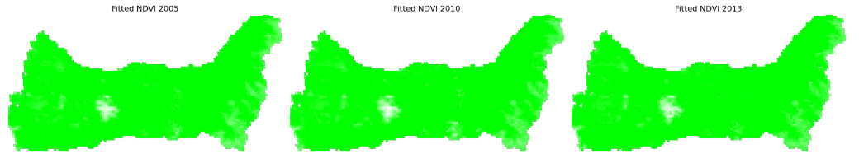
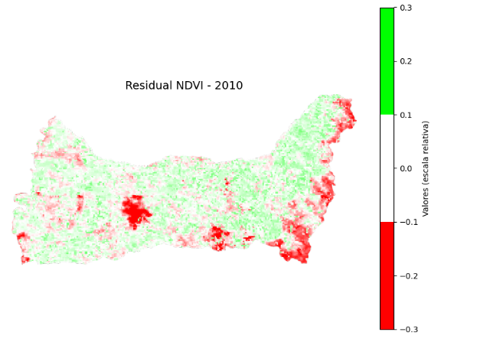
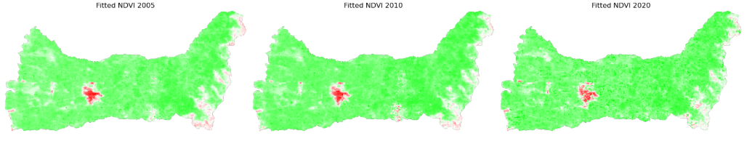
Detection of land cover change using remote sensing
Temporal segmentation
Segmentation using fitted values
NDVI residual
Methodology: temporal segmentation

Slide 12
Detection of land cover change using remote sensing
Temporal segmentation
Segmentation using fitted values
NDVI residual
Methodology: temporal segmentation

Slide 13
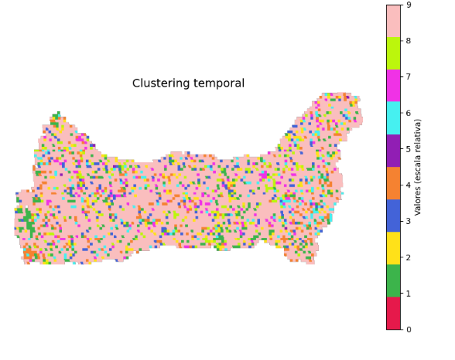
Detection of land cover change using remote sensing
Methodology: temporal segmentation
Unsupervised classification
K-means
Classify pixels
Extraer vértices (vertex_stack): Se generan 20 bandas (una por año) que indican si hubo un cambio (vértice) en cada píxel entre 2001 y 2020 (valor 0 o 1).
Muestrear datos de entrenamiento: Se extraen 5000 píxeles aleatorios con su historial de cambio (secuencia de 0s y 1s).
Entrenar K-means: Se agrupan los píxeles en 10 clusters según similitud en su historial de cambios temporales.

Slide 14
Detection of land cover change using remote sensing
Conclusion
Temporal analysis of residual NDVI, combined with segmentation and unsupervised clustering, enables the detection of vegetation change patterns that are not visible with traditional methods. This methodology enhances the monitoring of dynamic ecosystems such as grasslands, allowing for more accurate environmental management.

Slide 15
References
Cardille, J. A., Crowley, M. A., Saah, D., & Clinton, N. E. (Eds.). (2023). Cloud-based Remote Sensing with Google Earth Engine: Fundamentals and Applications. Springer Nature.
Chen, S., Woodcock, C. E., Bullock, E. L., Arévalo, P., Torchinava, P., Peng, S., & Olofsson, P. (2021). Monitoring temperate forest degradation on Google Earth Engine using Landsat time series analysis. Remote Sensing of Environment, 265, 112648. https://doi.org/10.1016/j.rse.2021.112648
Kennedy, R. E., Yang, Z., & Cohen, W. B. (2010). Detecting trends in forest disturbance and recovery using yearly Landsat time series: 1. LandTrendr—Temporal segmentation algorithms. Remote Sensing of Environment, 114(12), 2897-2910. https://doi.org/10.1016/j.rse.2010.07.008
Hurtado-Abril, J. L., y Lizarazo, I. (2022). Nuevo índice espectro-temporal para la detección de pérdida forestal en áreas de bosque tropical. Caso de estudio Amazonia colombiana. Revista Cartográfica, (104), 11-35. https://doi.org/10.35424/rcarto.i104.1096
Zhu, Z., & Woodcock, C. E. (2014). Continuous change detection and classification of land cover using all available Landsat data. Remote Sensing of Environment, 144, 152 171. http://dx.doi.org/10.1016/j.rse.2014.01.011

Slide 16

Thanks
GitHub

