Slide 1
UiPath AgentHack 2026
TRACK 2 · UIPATH MAESTRO BPMN
Deal Desk Agent
From laptop to production - governed.
An autonomous pricing-approval agent on UiPath Maestro BPMN.
Track 2: Maestro BPMN
Built with coding agents
Runs on Automation Cloud
Deal Desk Agent - from laptop to production, governed
01/12
Notes:
UiPath's 2026 challenge: bridge the gap between a prototype on a laptop and software running in production.

Slide 2
UiPath AgentHack 2026
TRACK 2 · UIPATH MAESTRO BPMN
Pricing approvals: 100% human-touched, mostly for nothing
Every discount / renewal change is routed to a human - even the trivial ones
Approval thresholds drift between managers
No SLA and no auditable decision trail
Slow
Inconsistent
Invisible
inbox ping-pong
tribal thresholds
no audit trail
Deal Desk Agent - from laptop to production, governed
02/12
Notes:
Manual AS-IS is inbox ping-pong: slow, inconsistent, unauditable.

Slide 3
UiPath AgentHack 2026
TRACK 2 · UIPATH MAESTRO BPMN
An agent for judgment. Maestro for the lifecycle.
AGENT (LangGraph)
MAESTRO BPMN
Decides what should happen
Runs how it happens
Disposition + risk score
Cards, human gate, SLA timer
Recommendation + rationale
Iterates agent chain
Sizes approver chain as data
Audit on every path
Deal Desk Agent - from laptop to production, governed
03/12
Notes:
Core design: agent owns judgment; Maestro owns lifecycle.

Slide 4
UiPath AgentHack 2026
TRACK 2 · UIPATH MAESTRO BPMN
The agent: Python LangGraph coded agent
Entry points
plan: score, set disposition, draft recommendation, size approver chain
render: generate contextual Outlook Adaptive Card per approver
process_response: interpret human reply and pick next action
Decision logic (from code)
risk = min(1.0, 0.5*(discount/25%) + 0.5*(value/$500k)) auto_clear if <=5% and <=$50k; >25% adds Director+VP; >$500k adds CFO; invalid payload -> exception
Deal Desk Agent - from laptop to production, governed
04/12
Notes:
Three LangGraph entry points. plan produces approver chain as data.

Slide 5
UiPath AgentHack 2026
TRACK 2 · UIPATH MAESTRO BPMN
One Maestro BPMN process - right actor per step
Start (opportunity change) -> agent plan
Disposition gateway: auto_clear / exception close out immediately
needs_approval -> multi-instance subprocess over approver chain
Boundary SLA timer -> reminder + escalation; Data Fabric audit
Deal Desk Agent - from laptop to production, governed
05/12
Notes:
One BPMN process with multi-instance + SLA timer + audit.

Slide 6
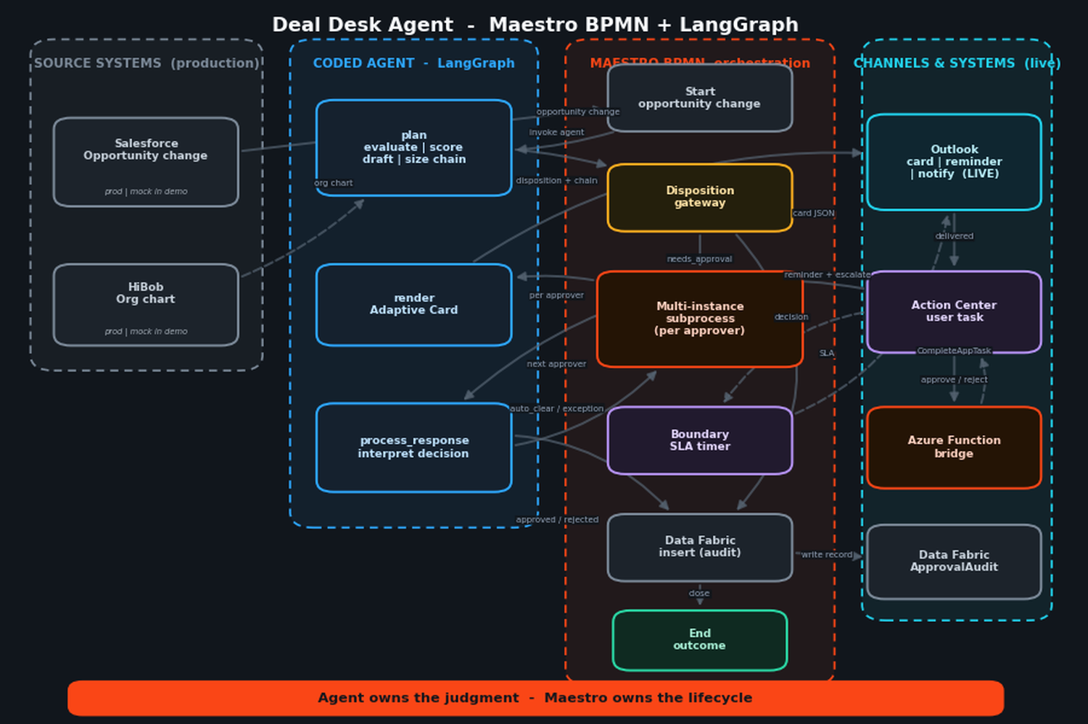
UiPath AgentHack 2026
TRACK 2 · UIPATH MAESTRO BPMN
The whole flow - explore it
Salesforce + HiBob -> LangGraph -> Maestro BPMN -> Outlook / Action Center / Azure bridge / Data Fabric
Deal Desk Agent - from laptop to production, governed
06/12
Notes:
Narrate trigger -> decide -> route -> human -> resume -> audit loop.

Slide 7
UiPath AgentHack 2026
TRACK 2 · UIPATH MAESTRO BPMN
Three paths, one process
1) Auto-clear
2) One manager
3) Multi-tier
<=5% / <=$50k
8% / $40k
30% / $1.2M
Zero cards
One card
Manager -> Director -> VP -> CFO
Logged + closed
Approve -> approved
Sequential cards
Deal Desk Agent - from laptop to production, governed
07/12
Notes:
One process, three behaviors: auto-clear, 1-tier, multi-tier.

Slide 8
UiPath AgentHack 2026
BONUS · UIPATH FOR CODING AGENTS
Built by coding agents
Natural language -> coding agents -> governed cloud process
Prompts
Cursor + Claude
Generated
Automation Cloud
Laptop intent
uip skills + CLI
Agent + BPMN + DF
Published + deployed
Coding agents generated/edited the LangGraph agent, BPMN, bindings, schema exports, Data Fabric entity
Low-code Maestro + pro-code agent combined
Embodies the laptop -> production bridge
Deal Desk Agent - from laptop to production, governed
08/12
Notes:
Built with coding agents (Cursor + Claude via UiPath for Coding Agents).

Slide 9
UiPath AgentHack 2026
TRACK 2 · UIPATH MAESTRO BPMN
Governance & human-in-the-loop
Human gate
Time governance
Audit
Guardrails
Action Center task
Boundary SLA timer
Data Fabric logs
Invalid payload -> exception
Azure bridge resumes instance
Reminder + escalation
agent rec vs human decision
Empty chain -> manager fallback
Deal Desk Agent - from laptop to production, governed
09/12
Notes:
Governance checklist: human gate, SLA, audit, guardrails.

Slide 10
UiPath AgentHack 2026
TRACK 2 · UIPATH MAESTRO BPMN
Runs on Automation Cloud
Coded agent published to tenant feed; 3 entry points deployed as runnable processes
BPMN validated; live Outlook connection bound
Full solution packaged as deployable .uipx (agent + BPMN + Data Fabric ApprovalAudit)
Unit tests passing across disposition, auto-clear, multi-tier, schema, guardrails, rendering
UiPath is the orchestration + governance layer that ties it together.
Deal Desk Agent - from laptop to production, governed
10/12
Notes:
Everything runs on Automation Cloud; packaged as .uipx.

Slide 11
UiPath AgentHack 2026
TRACK 2 · UIPATH MAESTRO BPMN
Business impact & reach
Deflection
Speed + consistency
Auditability
Portable
Low-risk deals clear
SLA + routing replace
Every decision logged
Invoice / expense / onboarding
with zero human touch
inbox ping-pong
for compliance + tuning
same pattern
Deal Desk Agent - from laptop to production, governed
11/12
Notes:
ROI: deflection, speed, consistency, auditability; portable pattern.

Slide 12
UiPath AgentHack 2026
TRACK 2 · UIPATH MAESTRO BPMN
Decide. Draft. Route. Audit.
Autonomously - and shipped to production.
Agent owns judgment · Maestro owns lifecycle · UiPath owns governance
DevPost
Demo video
Code
<link>
<link>
<link>
Deal Desk Agent - from laptop to production, governed
12/12
Notes:
Replace links and close with interactive page CTA.

