Slide 1
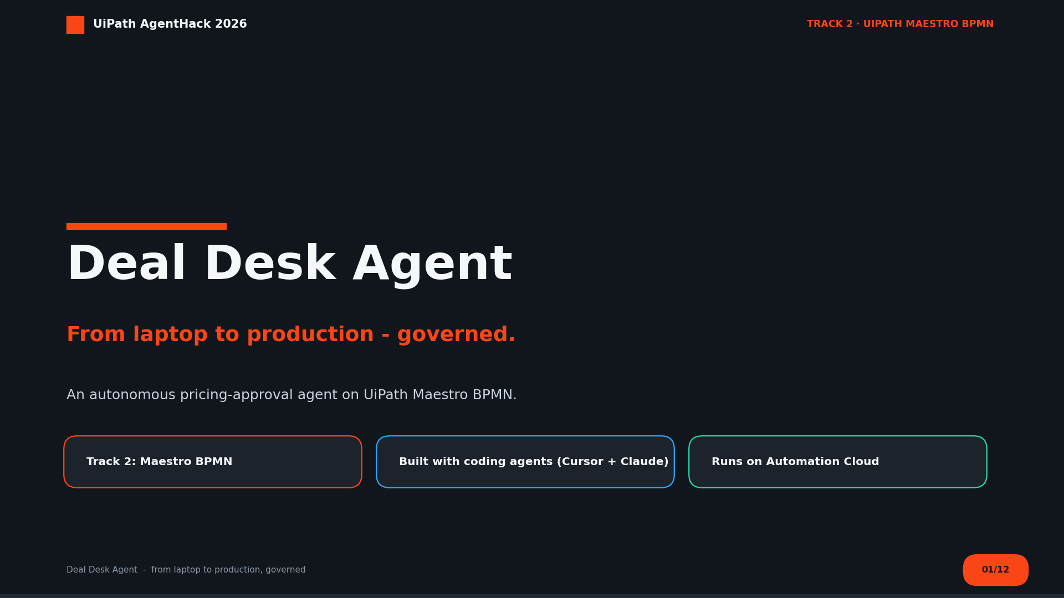
Notes:
UiPath's 2026 challenge: bridge the gap between a prototype on a laptop and software running in production. We did exactly that - an agent that runs pricing approvals for you.

Slide 2
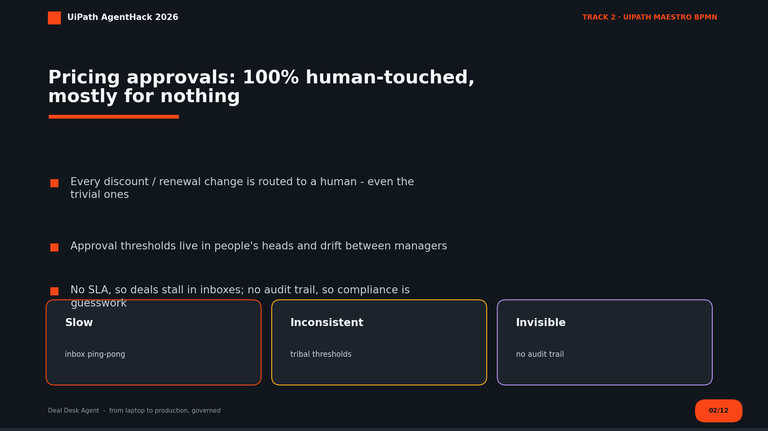
Notes:
The manual AS-IS: rep emails manager, manager forwards up if it's big, someone replies, rep updates the CRM by hand. Slow, inconsistent, unauditable.

Slide 3
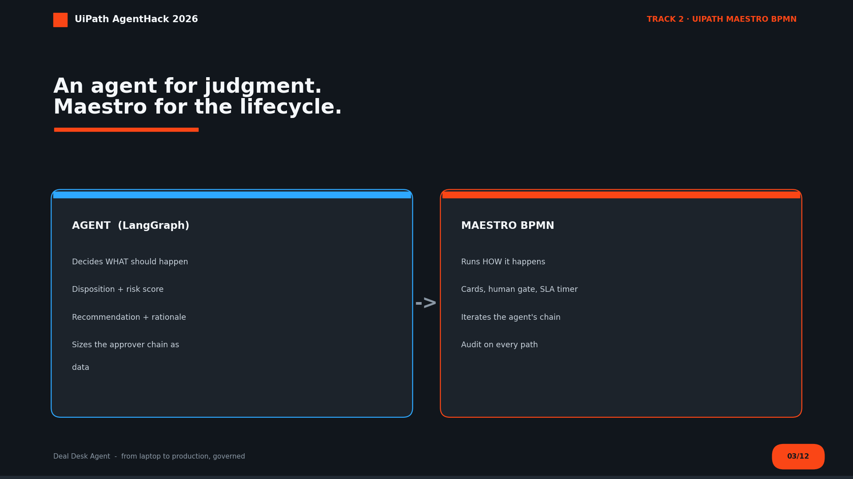
Notes:
The architectural bet: split intelligence (agent) from lifecycle (Maestro). Intelligence is versioned and testable on its own; the process is deterministic, observable, and governed.

Slide 4
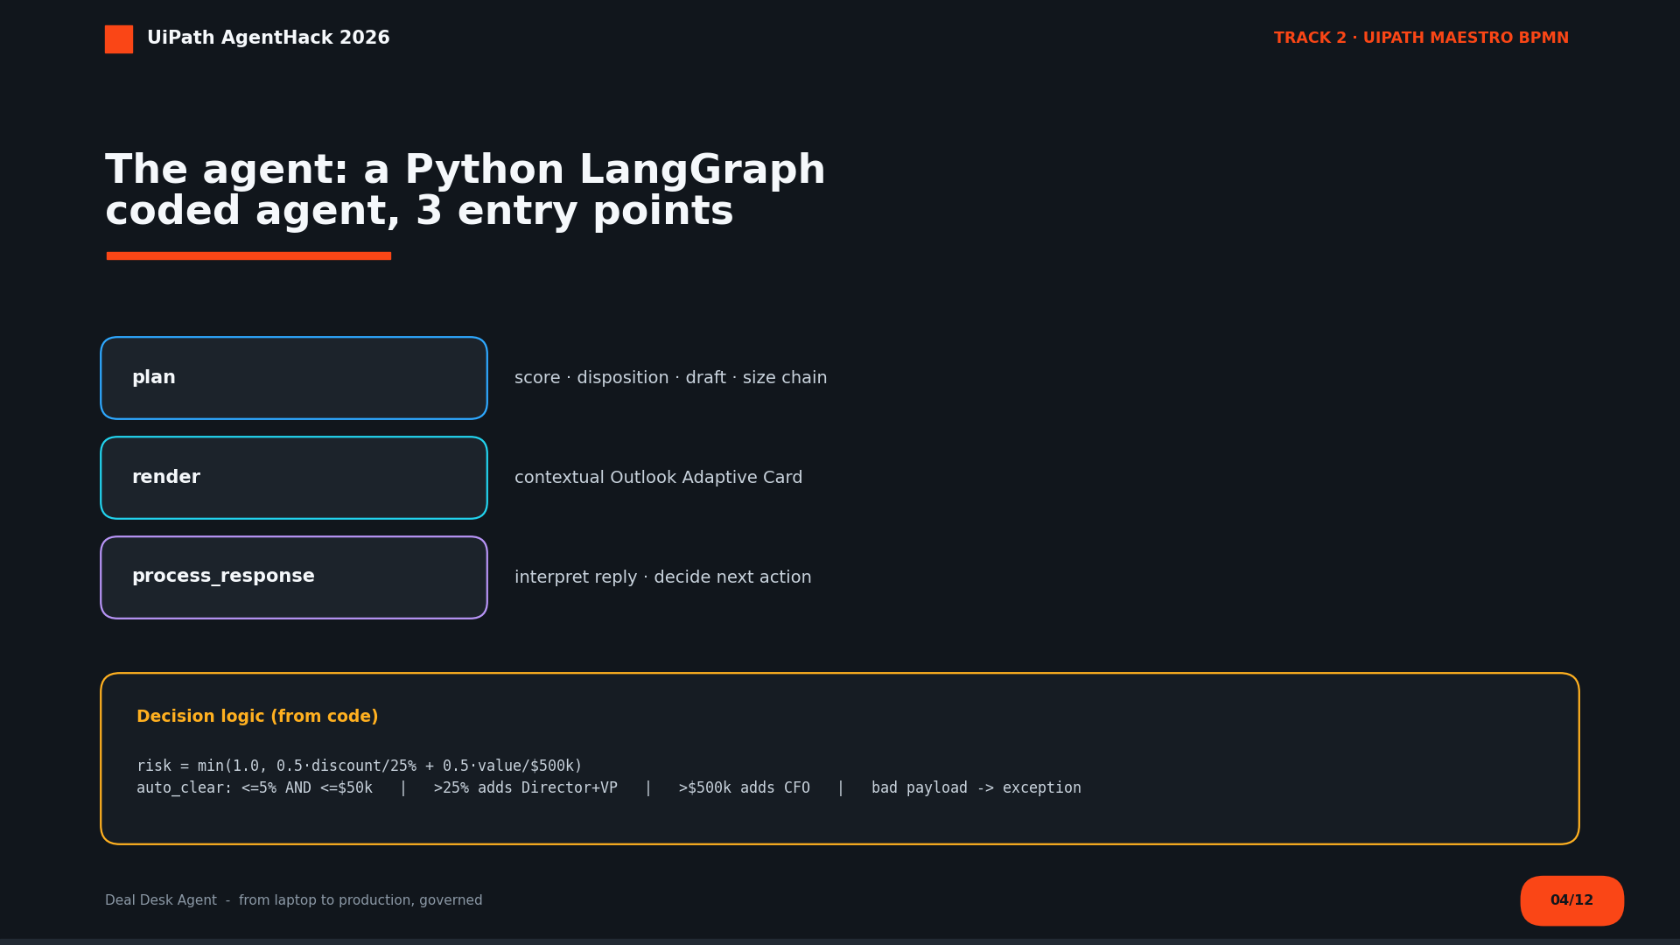
Notes:
Three LangGraph entry points. plan produces the approver chain as data - the agentic move.

Slide 5
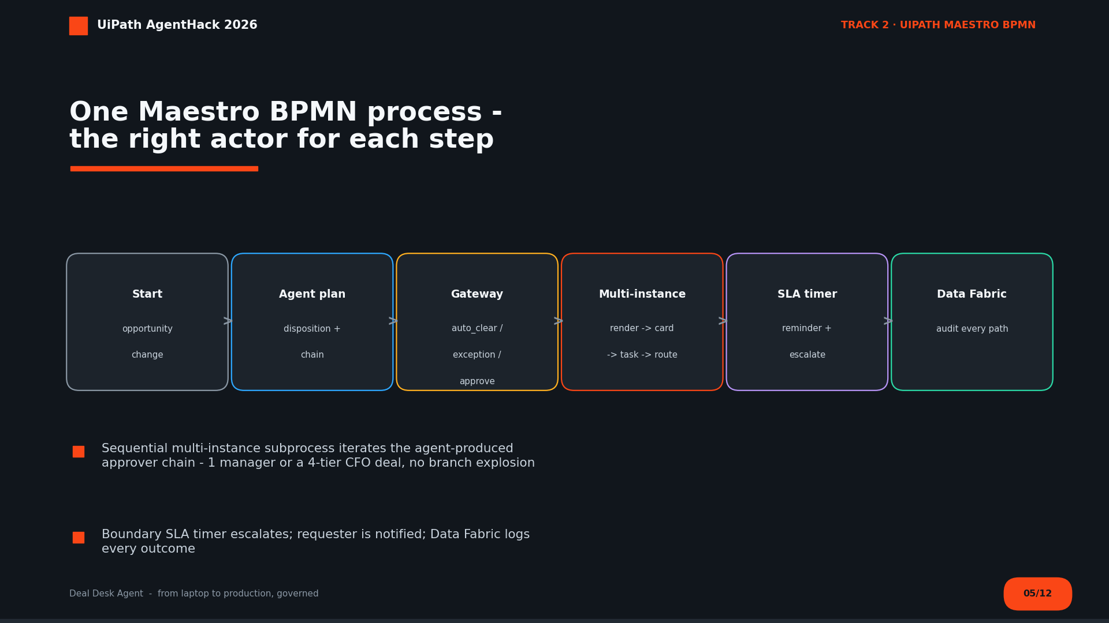
Notes:
One BPMN process. Multi-instance handles a 1-manager deal or a 4-tier CFO deal with no branch explosion. Boundary SLA timer escalates; Data Fabric audits every path.

Slide 6
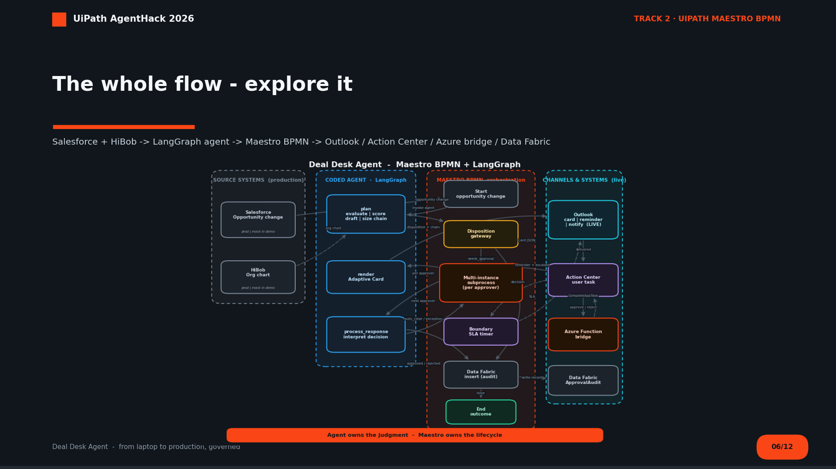
Notes:
Let the GIF play once; narrate the trigger -> decide -> route -> human -> resume -> audit loop. Salesforce + HiBob are production sources; Outlook is a live connection.

Slide 7
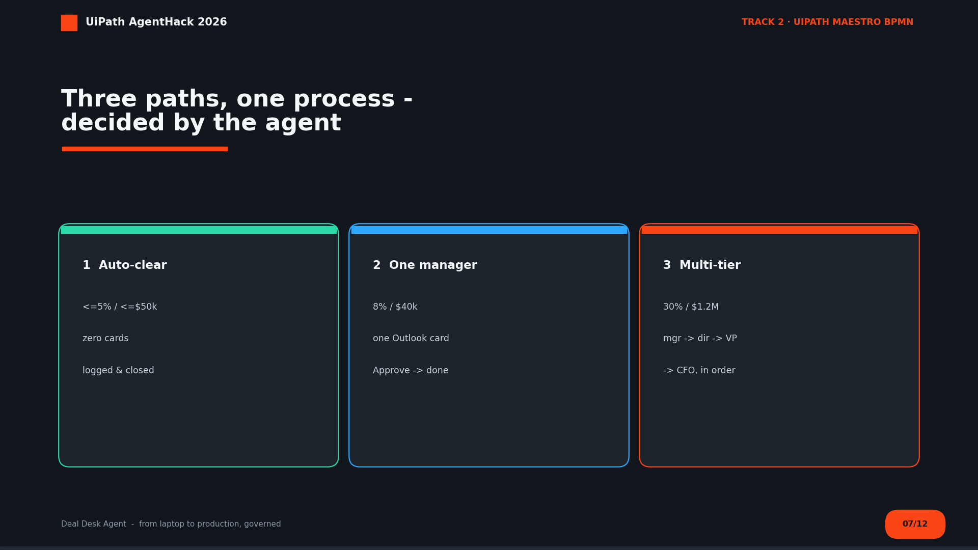
Notes:
Same process, three behaviors. Lead with auto-clear (the no-human wow), then multi-tier (right people, right order).

Slide 8
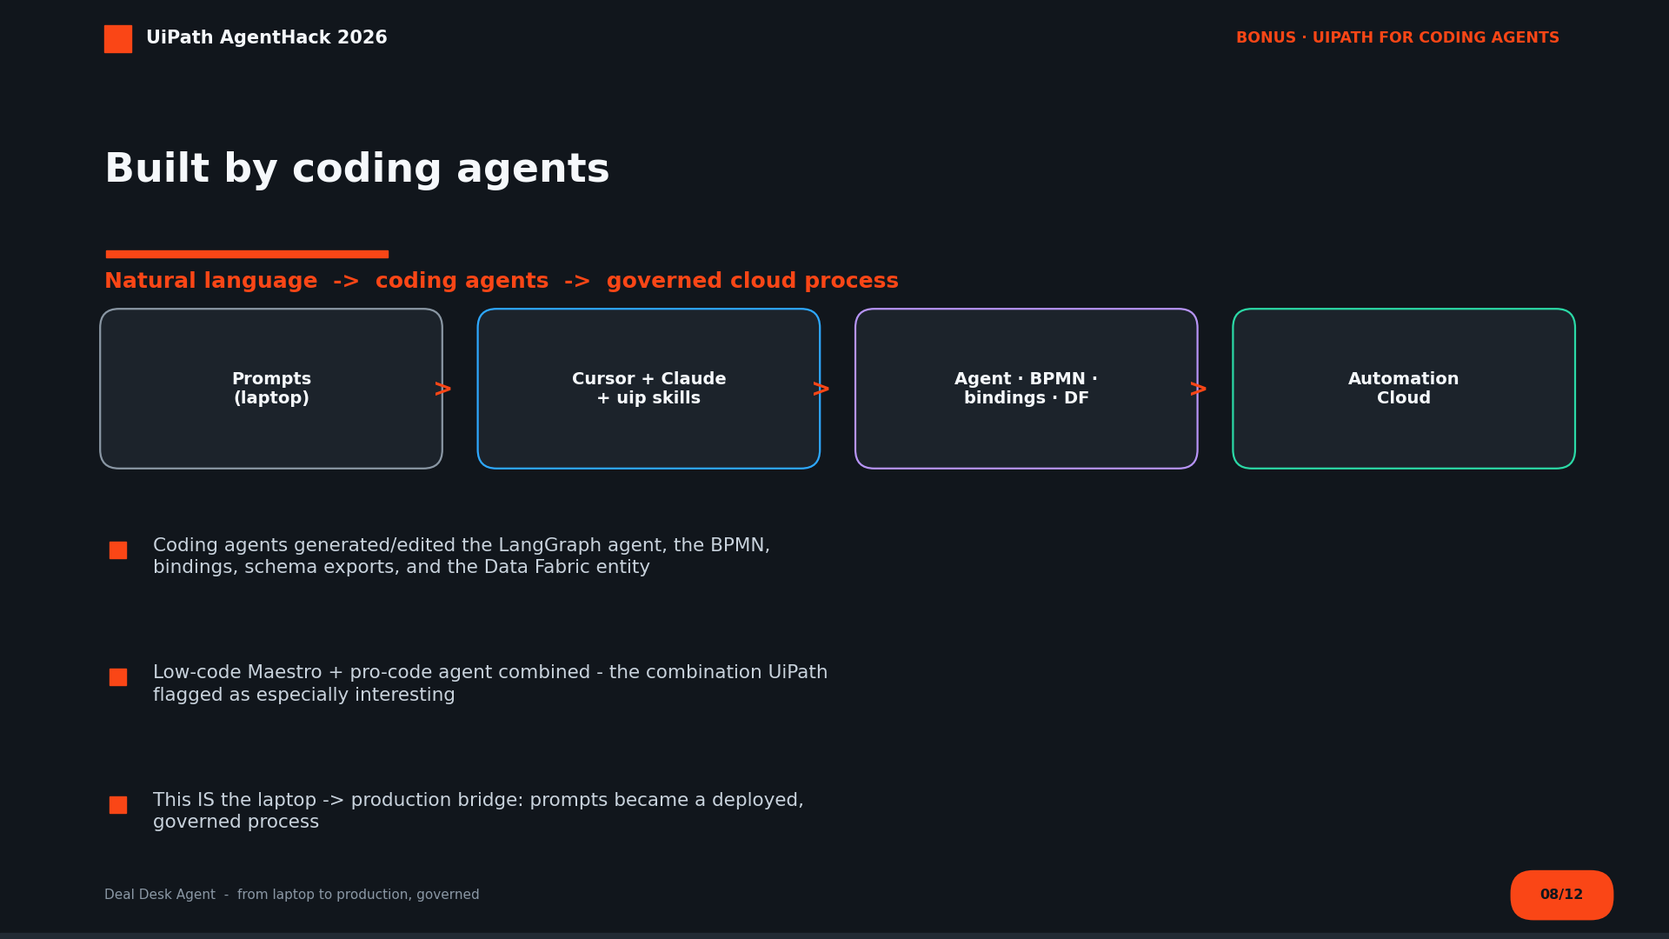
Notes:
The medium is the message: we used coding agents (Cursor + Claude via UiPath for Coding Agents) to build and ship it. Directly courts the coding-agent bonus + the event theme.

Slide 9
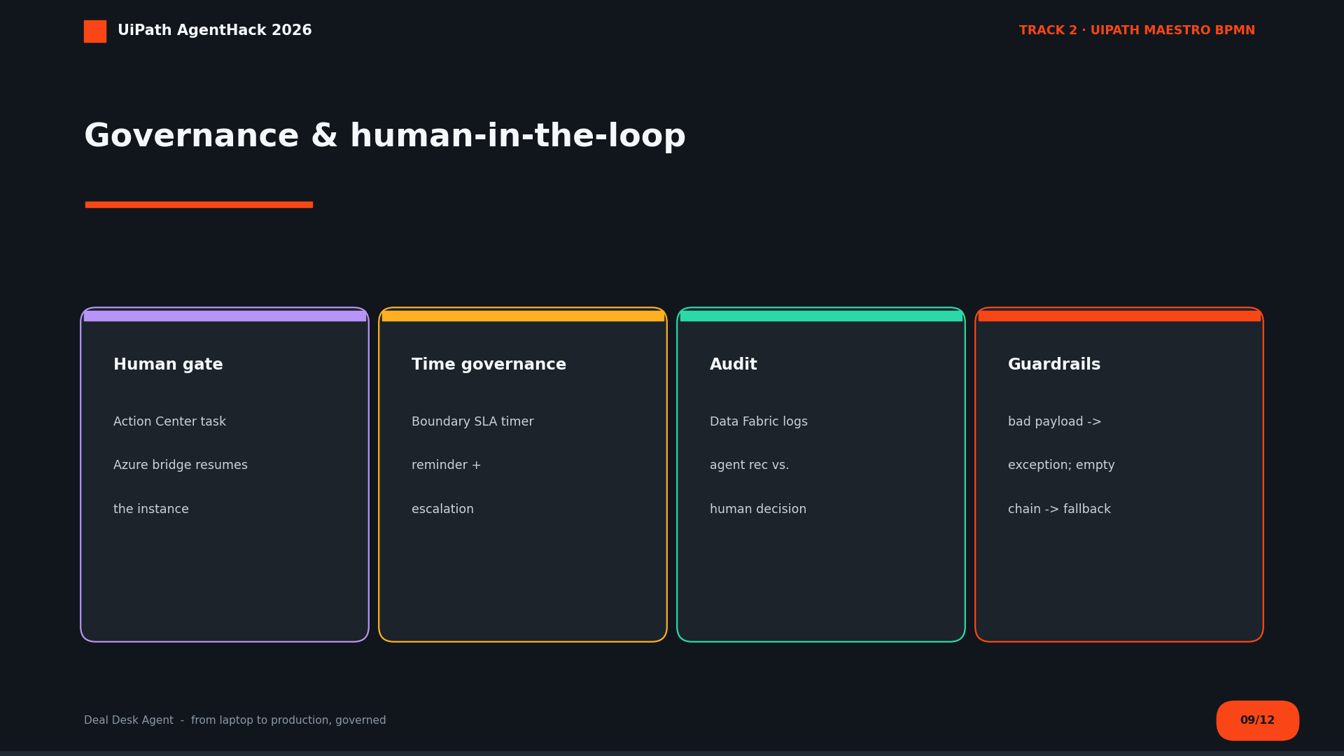
Notes:
UiPath asked for HITL control, governance, and measurable reliability - this slide is that checklist: human gate, SLA, audit, guardrails.

Slide 10
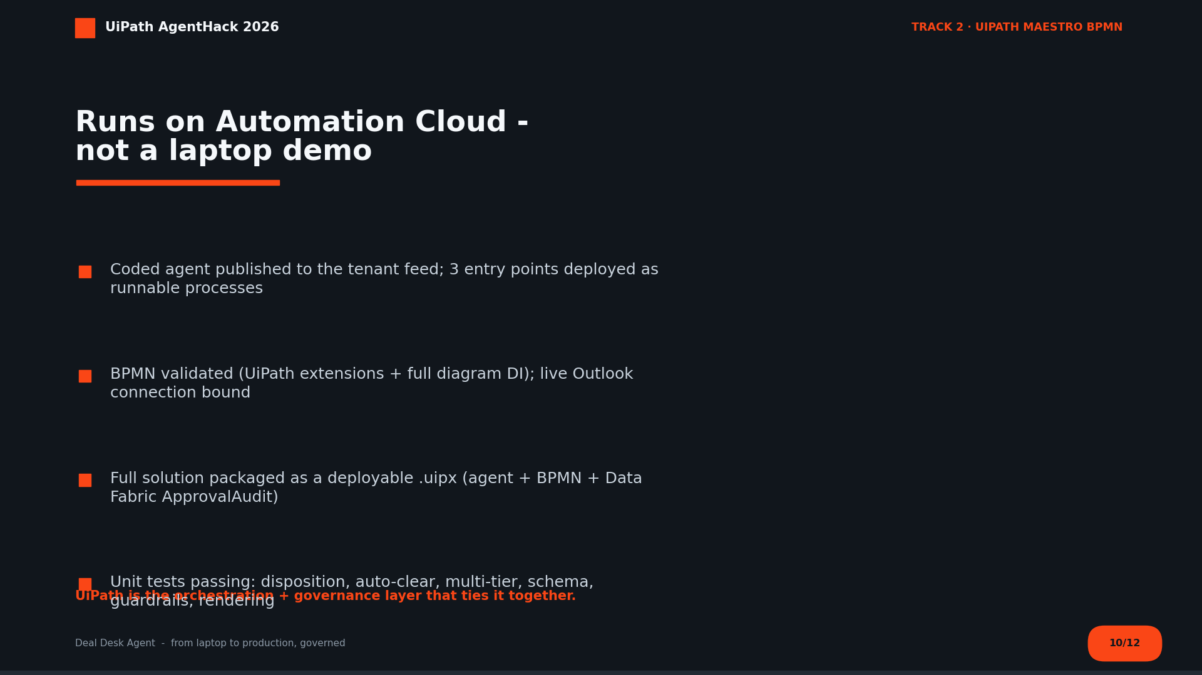
Notes:
Satisfies the hard requirement: everything runs on UiPath Automation Cloud, with UiPath as the orchestration + governance layer. Packaged as a deployable .uipx.

Slide 11
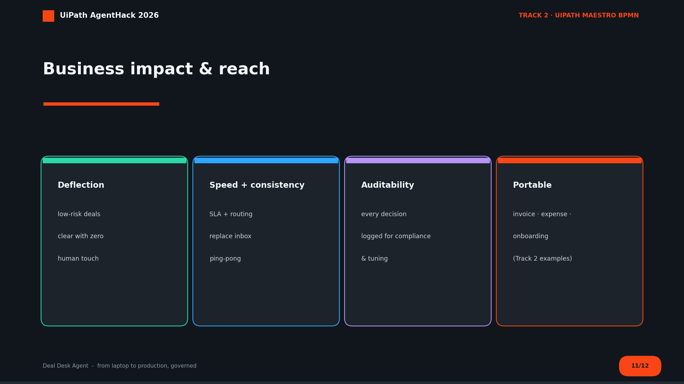
Notes:
Where the ROI comes from - deflection, speed, consistency, auditability - and how far it scales: invoice approval, expense reporting, onboarding (Track 2 examples).

Slide 12
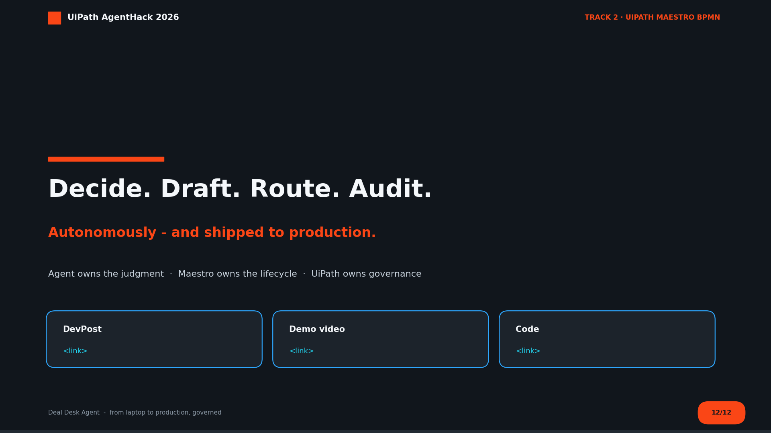
Notes:
Thank the jury; invite them to open the interactive page and play the disposition calculator. Replace the <link> placeholders with the DevPost / video / repo URLs.

