Slide 1
Deal Desk Agent
Your AI Deal Desk Analyst
UiPath AgentHack. Build the AI agents of tomorrow.

Slide 2

Track 2: UiPath Maestro BPMN
Coding-agent bonus: Cursor + Claude via UiPath for Coding Agents
Daniela Rosenstein
Coded Agents (LangGraph)
Maestro BPMN
WaitDecision Robot
Builder @ Cato Networks
plan / render / process_response
orchestration + sequential approval loop
RPA: 3 channels + Persistence wait

Slide 3
Problem statement and proposed solution
Problem
Solution
Every sales org has a Deal Desk: the team that reviews pricing exceptions,
emails managers up the chain, waits for replies, consolidates decisions,
and updates the CRM. It is manual, inbox-driven, and slow.
- No SLA: deals stall in inboxes for days.
- No consistency: routing thresholds drift between managers.
- No audit trail: decisions buried in email threads.
The Deal Desk Agent does that job, end to end on Automation Cloud:
1. Live Salesforce data via AgentHub MCP; approver chain from the org chart.
2. Risk scoring + LLM rationale -> recommendation and disposition.
3. Low-risk deals auto-approve with zero human touch.
4. WaitDecision Robot reaches each approver on 3 channels at once:
Outlook Adaptive Card + Slack DM + Action Center 'wait for task'.
5. AWS Lambda HITL bridge mints a token; any channel resolves the wait.
6. process_response interprets decisions; rejection short-circuits the chain.
7. Slack + Outlook summary to the AE; Data Fabric ApprovalAudit record.

Slide 4
Benefits and technologies used
Benefits, impact and outcomes
End users | Renewals analysts, AEs, deal-desk approvers
Department | Sales / Revenue Operations + Finance
Industries | Any B2B org with renewals & pricing exceptions
UiPath products | Maestro BPMN, Coded Agents, Action Center, Data Fabric, RPA, Integration Service, AgentHub MCP
Integrations / tech | Salesforce, Outlook Adaptive Cards, Slack, AWS Lambda + CloudFront, LangGraph
For the Opportunity Owner (AE):
- No chasing managers: agent routes, robot sends, BPMN tracks.
- Slack DM + Outlook summary with the full decision trail at the end.
- Low-risk deals (<=5% / <=$50k) clear with ZERO human touch.
For the business:
- Consistent policy applied identically via the risk-score formula.
- Rejection short-circuits the chain (no wasted approver time).
- Data Fabric logs the agent recommendation vs. each human decision.

Slide 5
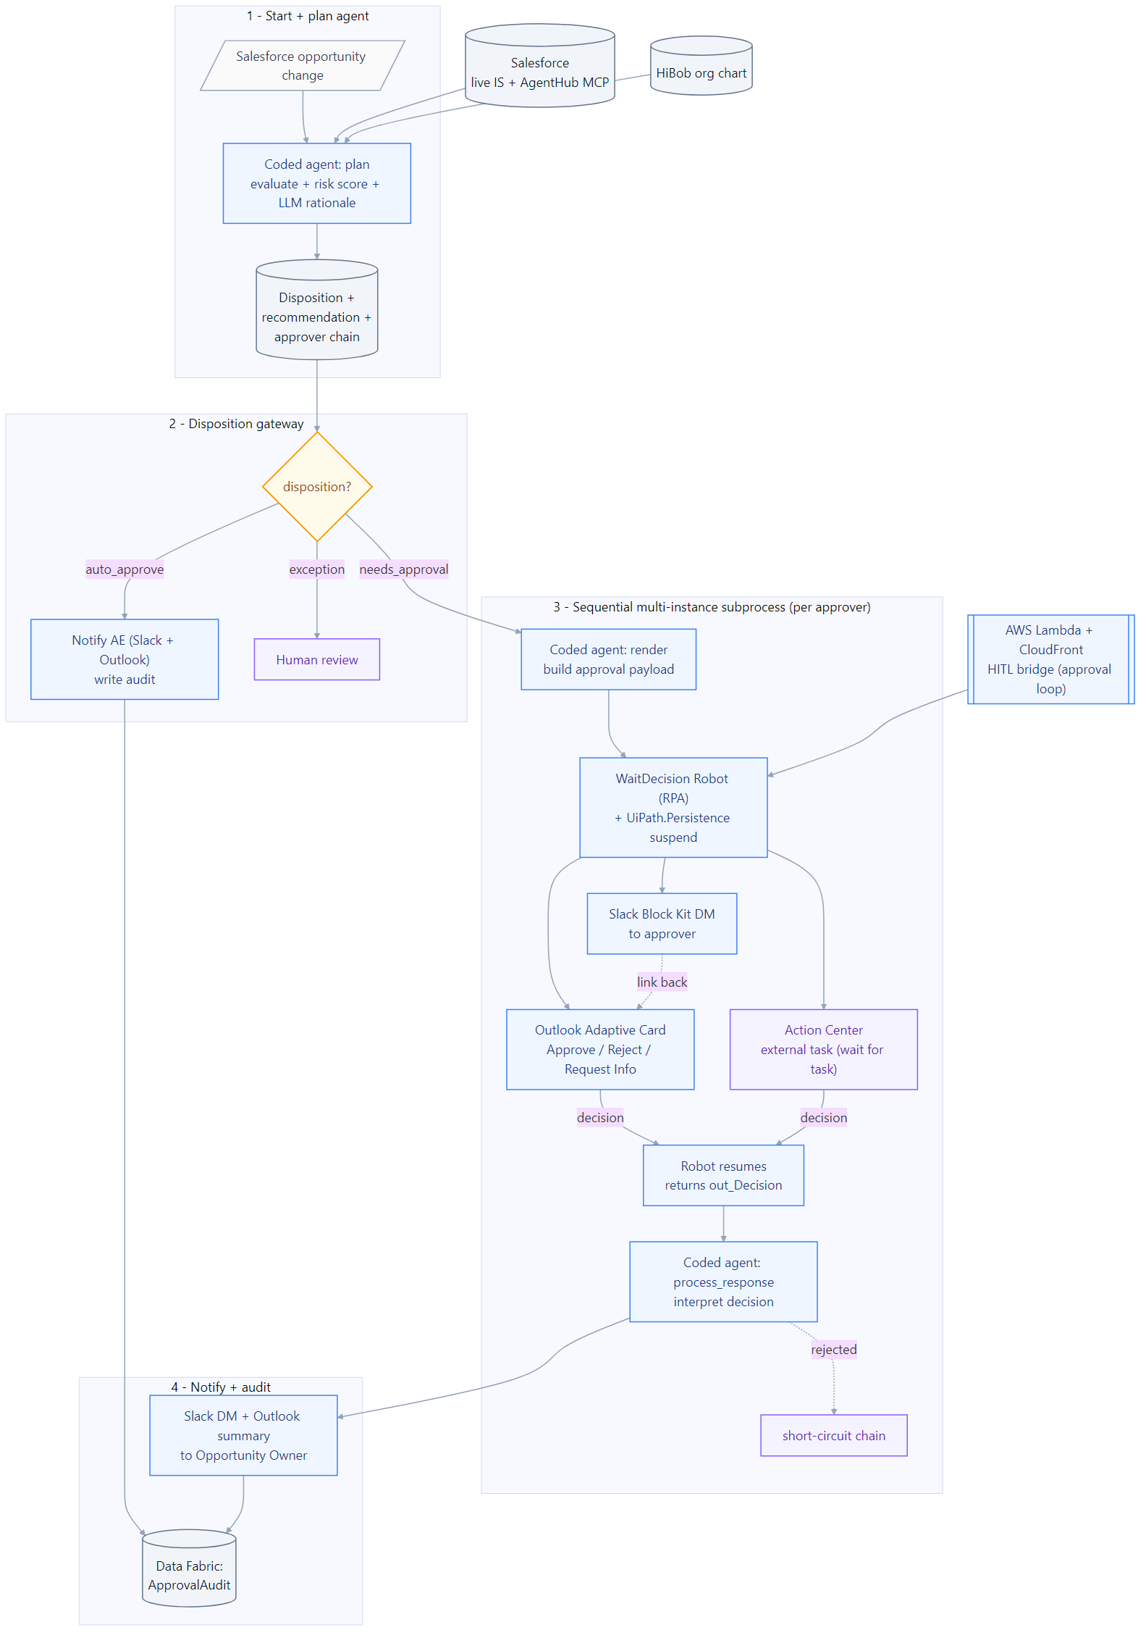
Solution architecture
Salesforce opportunity change starts the Maestro BPMN.
plan agent: live Salesforce (AgentHub MCP) + org chart
-> risk score + LLM rationale + approver chain
Disposition gateway:
auto_approve -> Slack + Outlook, audit (zero touch)
needs_approval -> sequential approver loop:
render -> WaitDecision Robot fires 3 channels
(Outlook Adaptive Card + Slack + Action Center)
AWS Lambda HITL bridge mints token; Persistence wait
any channel resolves; rejection short-circuits
process_response interprets the decisions
-> Slack + Outlook summary -> Data Fabric ApprovalAudit

Slide 6
Three demo scenarios
Live test results - Jun 22 2026 (all channels verified):
TEST-001: GlobalTech $120k/18% -> Approve (within policy)
TEST-002: MegaCorp $350k/32% -> Approve with conditions (escalation)
TEST-003: StartupXYZ $28k/45% -> Reject (margin impact too high)
TEST-004: Pharma $780k/22% -> Approve (enterprise, Finance pre-approved)
Outlook Adaptive Card | Slack DM | Action Center - all verified
Scenario 1 - Auto-approve (4% / $30k): zero human touches.
Scenario 2 - One approver (8% / $40k): Adaptive Card + Slack to Manager.
Scenario 3 - Full chain (30% / $1.2M): four sequential approvers; rejection
short-circuits; full Data Fabric audit trail.

Slide 7
Every Deal Desk should work like this.
Collect. Reason. Route. Sign-off. Audit. Automatically.
Track 2: Maestro BPMN | Coding-agent bonus | Runs on Automation Cloud

