Slide 1
Should We Loan?
Data Mining I 2023/2024
Daniela Tomás, up202004946
Diogo Nunes, up202007895
João Veloso, up202005801

Slide 2
Problem Definition
A bank is enhancing customer service quality by identifying good and bad clients using data mining techniques. The project aims to help bank managers understand clients and identify suitable credit card candidates. Two learning problems are addressed: descriptive, open-ended, and predictive, focusing on loan success.

Slide 3
Data Understanding
Data understanding is a vital step, especially so in a dataset with, as we’ll see, so much diversified data as this one.
Data is scattered on various files, linked in a relational manner.
This information was compiled circa 1997 and it pertains to the Czech Republic.
It contains information about a bank’s client base, their respective bank account, cards, transactions and loans that can either be completed successfully or with issues.
It also contains some demographic information such as age, gender and general district information.

Slide 4
Data Understanding
The dataset can be fairly vast in some aspects as it has almost 400 000 entries on the transactions table, related to over 5000 clients.
On the other hand, and this might be problematic for the future predictive modeling task, it contains information on only just over 300 loans with under 50(!) of these being of the “bad” class…

Slide 5
Data Preparation
Data preparation is another vital step, as it ensures data quality and suitability for machine learning algorithms.
To start off, the age and gender fields are fused as just one entry, so to make it more suitable, we separated them into their respective fields and one-hot encoded the gender field.
In the demographic data, there was missing data on one specific district regarding unemployment rate and committed crimes, both in the year 1995.
We addressed this by mean imputation.
Also, regarding demographic data, we performed some feature engineering that might be useful later and created the following columns:
- Unemployment Growth
- Committed Crimes Growth
- Crime Rate
- Entrepreneurs Percentage
- Urban Population Density
- District Rank

Slide 6
Data Preparation
In the transactions table there were several steps that were taken.
To start their entries for both “withdrawal” and “withdrawal in cash” and since it’s easy to see that they were the same we renamed one to be like the other. The same happened in column “operation” and we did the same.
There are some null values in column “operation”, and we found that these always belonged to k_symbol value “interest credited” so we added “credit in cash” to these null values. There was also a k_symbol value “ ” and after looking at records with this value and it always referred to cash withdrawals, so we renamed it to “regular expense”.
Furthermore, there were null values in some records on column “target bank” and these always belonged either to type “credit in cash” or “withdrawal in cash” contrary to non null ones which had “… another bank” so we can safely assume that these are all operations performed within “our” bank which we added to the target with the fake name “DJ”.
Finally, there were transactions with no target account, all of which belonged to the type “withdrawal” which makes sense since contrary to all other operations these only involve one account. We added the own account id to these.

Slide 7
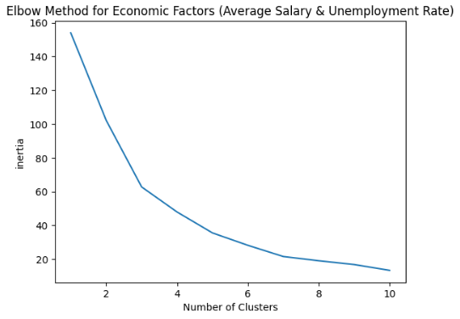
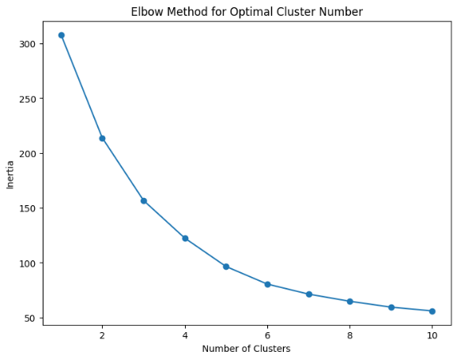
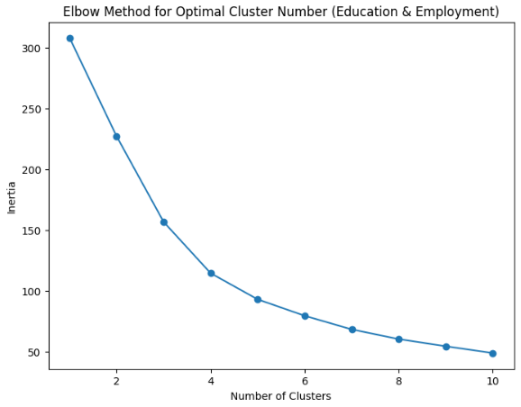
Descriptive Modelling
To find the best similiarities between regions, we decided to use the dataset “district” as our dataframe. We also created 3 diferent cases to find those similiarities. These cases are: Economic Factors, Crime Rate Factors and Demographic Factors.
K-means clustering was the algorithm we used because of its efficiency at finding similiarities and creating groups based on that efficiency.
To find the optimal number of clusters for each case, we used the elbow method. The optimal number in each case was 5.

Slide 8
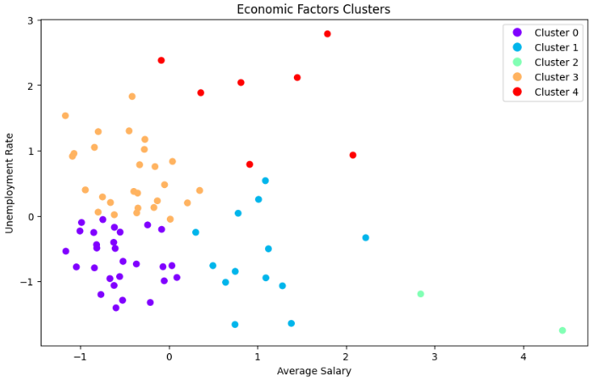
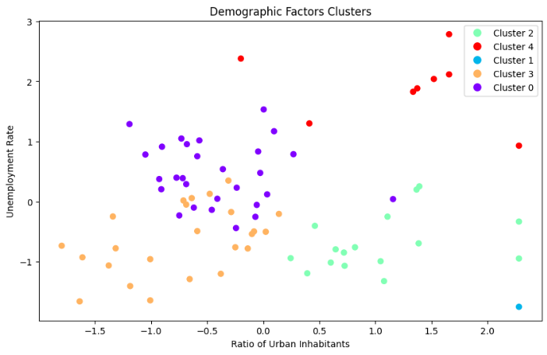
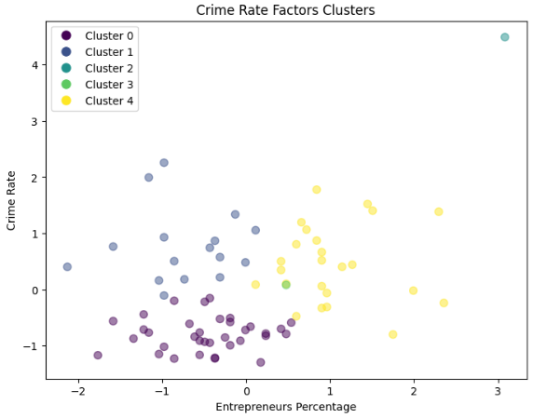
Descriptive Modelling

Slide 9
Predictive Modelling
Imbalanced Data: We used SMOTE (Synthetic Minority Over-sampling Technique) to address class imbalance in the target variable.
Feature Scaling: To ensure that all features contributed equally to the model we used feature scaling using StandardScaler.
Algorithms used: Decision Tree, Support Vector Machine, K-nearest Neighbors, Neural Networks, Random Forest (Randomized Search Cross-Validation was used to optimize the hyperparameters of each algorithm).
average_amount_of_transactions, payments, district_rank, age, amount, status

Slide 10
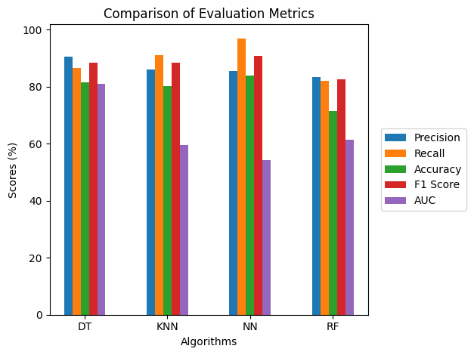
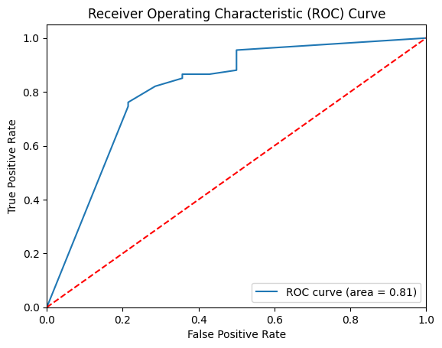
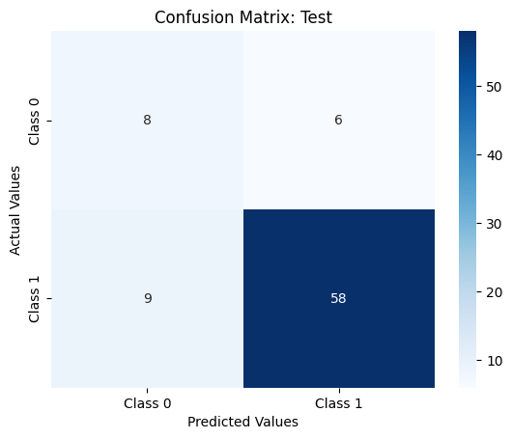
Predictive Modelling
DT has the highest precision (90.62%), and NN has the highest accuracy (83.95%), recall (97.01%) and f-1 (90.91%) score.
DT has the highest AUC (0.81).

Slide 11
Conclusion
In conclusion, even thought the loan dataset is very unbalanced we still managed to get better than random results, by the processes of data understanding and prepation.
We consider that our biggest limitation, by far, in the predictive modelling task was the small amount of bad loan candidates.
In the future with more bad loan candidate info, perhaps coupled with more in-depth data analysis, more accurate models could be built.

Slide 12
Annexes

