Slide 1
Should We Loan?
Data Mining I 2023/2024
Daniela Tomás, up202004946
Diogo Nunes, up202007895
João Veloso, up202005801

Slide 2
(?)
Imbalanced Data: We use SMOTE (Synthetic Minority Over-sampling Technique) to address class imbalance in the target variable.
Feature Scaling: To ensure that all features contributed equally to the model we use feature scaling using StandardScaler.
Dimensionality Reduction: We use PCA (Principal Component Analysis) to reduce the number of features while retaining essential information.

Slide 3
Problem Definition
A bank is enhancing customer service quality by identifying good and bad clients using data mining techniques. The project aims to help bank managers understand clients and identify suitable credit card candidates. Two learning problems are addressed: descriptive and predictive, focusing on loan success.

Slide 4
Data Understanding

Slide 5
Data Understanding

Slide 6
Data Preparation

Slide 7
Data Preparation

Slide 8
Descriptive Modelling

Slide 9
Predictive Modelling

Slide 10
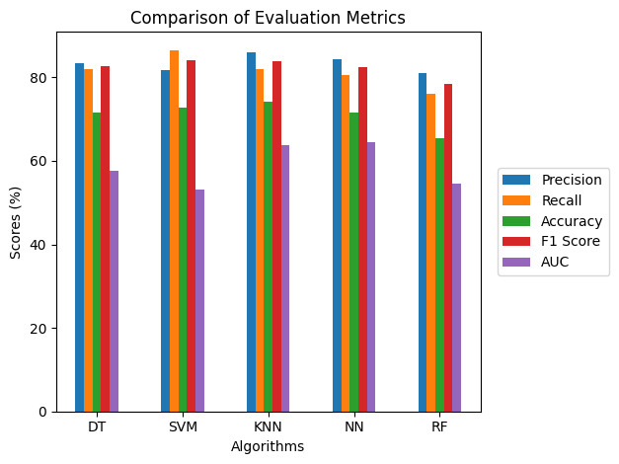
Predictive Modelling
KNN has the highest precision (85.94%) and accuracy (74.07%) score and SVM has the highest recall (86.57%) and f-1 (84.06%) score.
NN has the highest AUC (0.65).

Slide 11
Conclusion

Slide 12
Annexes

