Slide 1
Analysis of Posting Strategies for Higher Education Institutions
Daniela Tomás | Diogo Almeida | Diogo Nunes | João Veloso
up202004946@edu.fc.up.pt | up202006059@edu.fc.up.pt | up202007895@edu.fc.up.pt | up202005801@edu.fc.up.pt

Slide 2
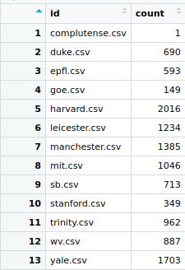
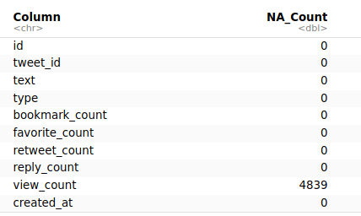
Data Pre-Processing

Slide 3
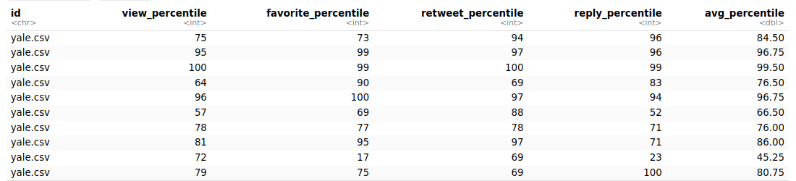
NA Removal
To remove NA values we calculated percentiles from several related metrics and calculated an average

Slide 4
Data Processing
Average posts per timeframe
High and low postage per day
Heatmaps
Hashtags
Urls
Text in posts

Slide 5
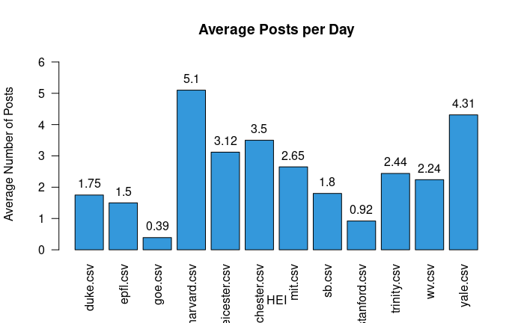
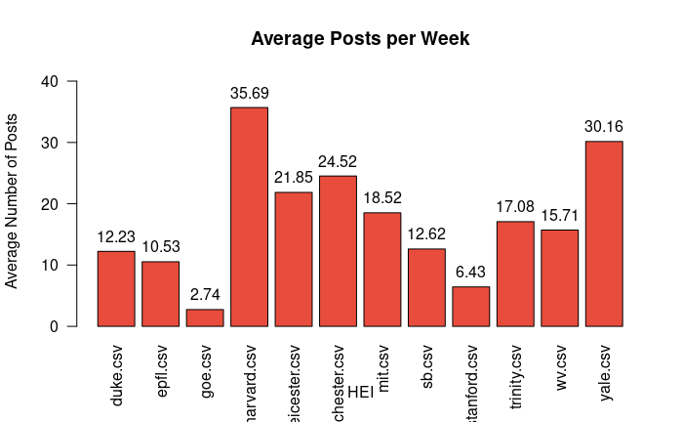
Average posts per day and week
In order to analyze the posting strategies of the various HEIs we decided to analyze the average amount of posts per week and per day.
Overall, it can be seen that most HEIs are active and post multiple times per day with the outstanding exemples of Harvard that is more active than others, while Goe doesn´t post every day, doing at most one post per day.

Slide 6
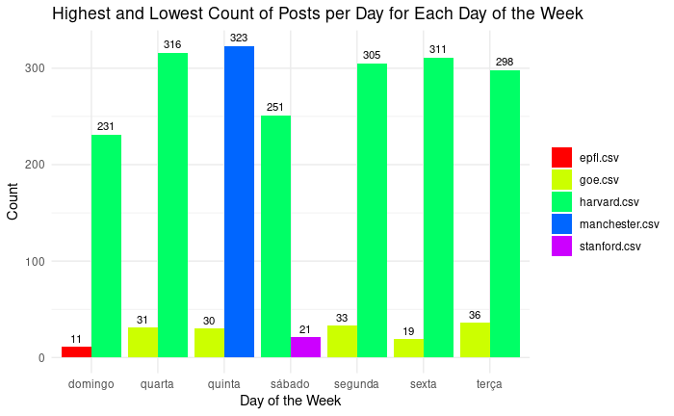
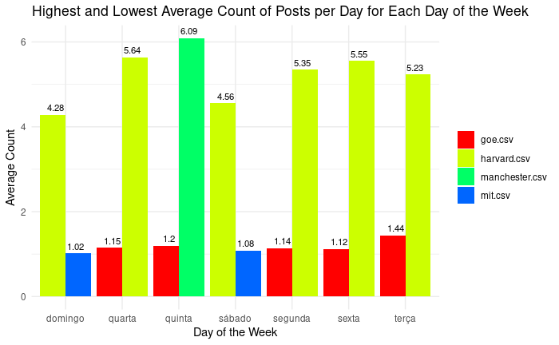
Highest and lowest postage for each day of the week
We went a bit deeper on this topic, searching for specific days of the week.
Harvard is the HEI that posts the most, almost everyday, just losing thursday to Manchester.
For the lowest posts, Goe has the majority of days as well, with Epfl and Stanford each having one day.

Slide 7
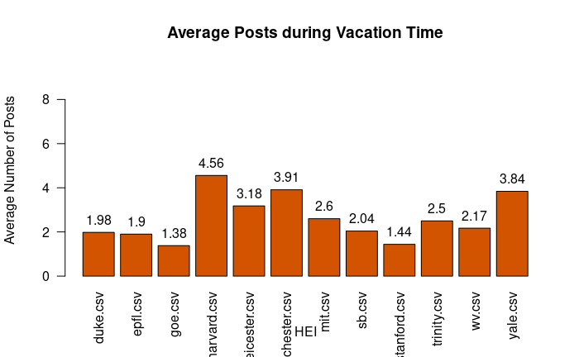
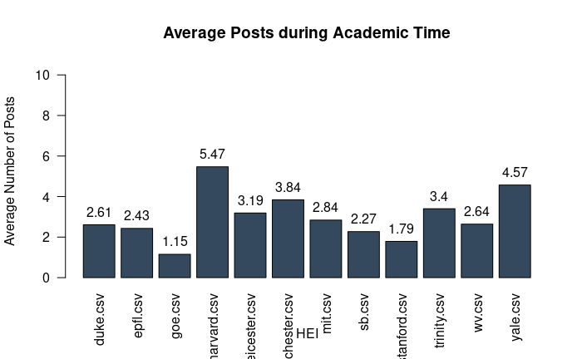
Average posts during vacation and academic time
We also investigated if the amount of posts varied between vacation and academic periods.
HEIs usually post more during the academic time, with Goe and Manchester having the opposite strategy.

Slide 8
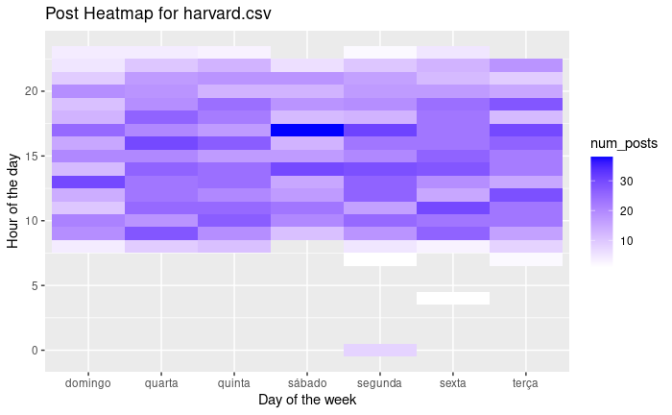
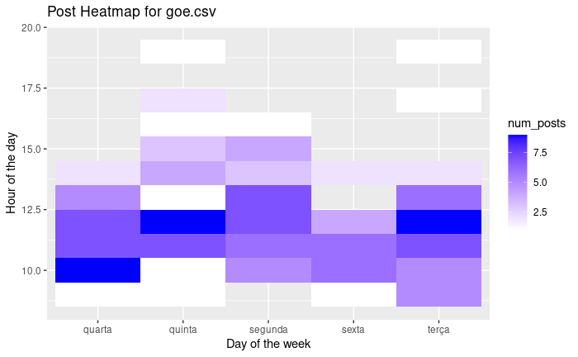
Heatmaps
We created heatmaps for every HEI, and noticed that Harvard was posting every day consistently. On the other hand Goe posted much in a precise timeframe and just during the week.

Slide 9
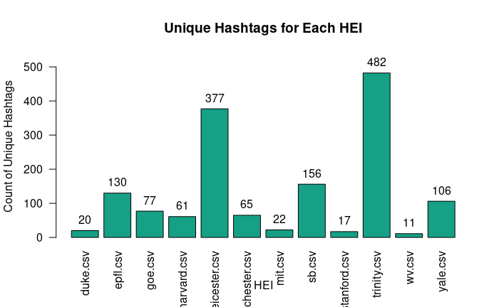
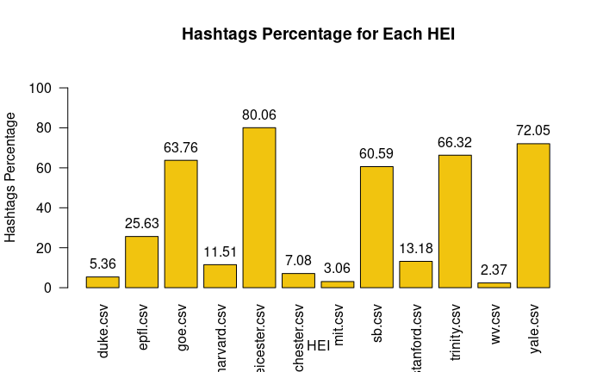
Hashtags
Within hashtags we noticed a pattern, where if a HEI had many unique hashtags then its usage percentage was also high, with noticeable outliers being Yale and Goe.
Notes:
Para as hashtags, transformámos primeiro todas as cadeias de caracteres vazias existentes num valor NA para que todos os posts sem hashtags fossem corretamente identificados.
Depois, criámos uma tabela denominada hashtags que, para cada HEI, inclui o número total de posts e número de posts sem hashtags, o número de hashtags únicas e, com as duas primeiras contagens, calculámos também a percentagem de posts com hashtags.
Com o gráfico das hashtags únicas, chegámos à conclusão de que a utilização de hashtags únicas é muito variada entre as HEI, com algumas a ultrapassar a marca dos cem, como a Epfl, Leicester, Sb, Yale e Trinity a serem os mais criativos.
No gráfico de percentagem, pensámos que como a Trinity tinha as hashtags mais exclusivas de todas, poderia ter a maior percentagem de utilização, mas foi Leicester. Por outro lado, Wv, Mit e Duke não utilizam muitos hashtags nas suas publicações, o que também explica o facto de não terem muitos hashtags únicos na tabela anterior.

Slide 10
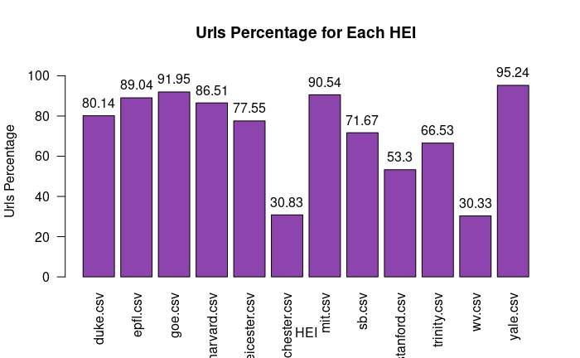
URLs
In urls, the usage within posts is very high, since the text has a limit on words, HEIs tend to add links to other pages that contain all the information.
Notes:
Para a utilização de urls, a nossa abordagem foi semelhante à da criação da tabela de hashtags.
Primeiro, passámos todos os valores vazios para NA e, depois, para cada HEI, contámos o número de posts com e sem url. De seguida, fizemos os cálculos e criámos um gráfico com base nos valores da tabela url_usage, que foi onde guardámos todos estes valores.
A partir desta tabela percebemos que as HEI que não usam muitas hashtags, usam muitas urls, com exceção da Wv. Manchester também não usa muitos urls, tendo valores muito semelhantes a Wv. Por outro lado, Yale, Mit e Goe têm percentagens muito elevadas, ultrapassando a marca dos noventa.

Slide 11
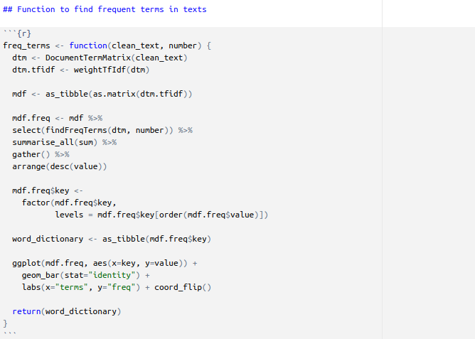
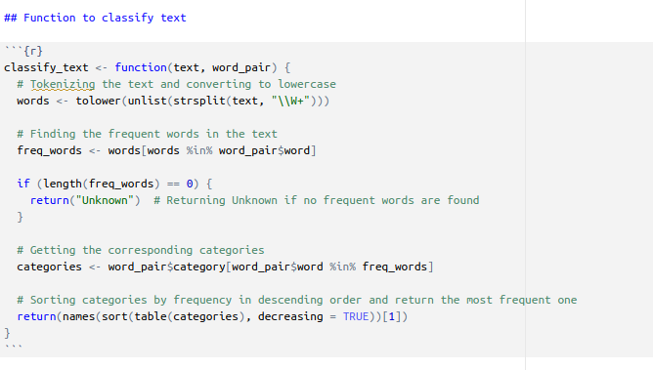
Classification of posts

Slide 12
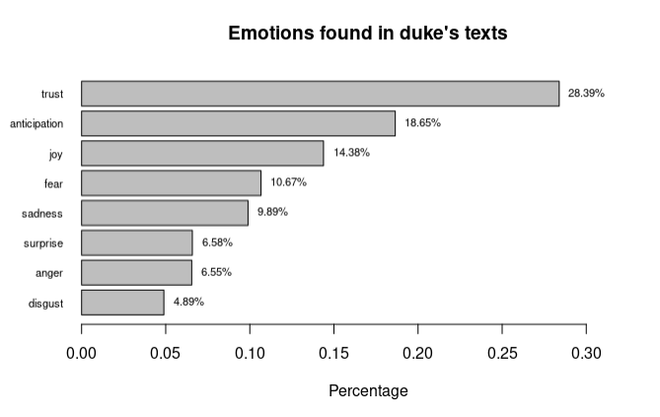
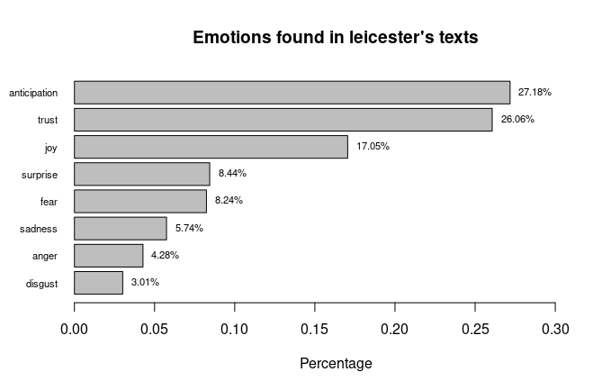
Sentiment Analysis
To do sentiment analysis we use several functions from the syuzhet library and noticed that anticipation and trust were for all HEIs the top 2 emotions with disgust being last for all.

Slide 13
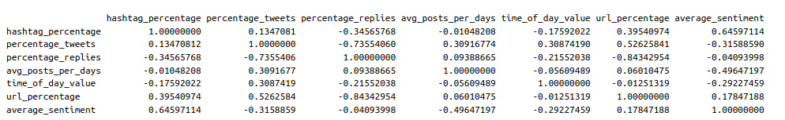
Clustering
After selecting various metrics and applying a cosine matrix to view similarities between them, we selected 7 attributes to cluster.

Slide 14
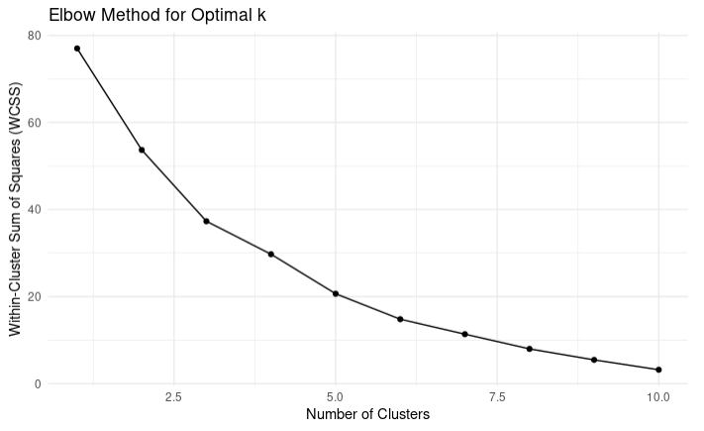
After applying the k-means method and using the elbow method, we selected 4 has the optimal number of clusters.
Cluster number 1 we got Epfl, Goe, Leicester, Sb, Trinity and Yale. Cluster 2 has Manchester.
Cluster 3 has Duke, Stanford and Wv.
Cluster 4 has Harvard and Mit

Slide 15
Conclusion

