Slide 1


Improved Monte Carlo Tree Search
for University Course Timetabling
Daniela Tomás · up202004946 · M:ERSI
Notes:
MCTS combinado com HC e Diving para o problema de alocação de horários universitários.

Slide 2
Index
Introduction
Background
2.1 Hard and Soft Constraints
2.2 International Timetabling Competitions (ITC)
2.3 Monte Carlo Tree Search
2.4 Upper Confidence Bounds for Trees (UCT)
Related Work
Methodology
4.1 Monte Carlo Tree Search
4.2 Hill Climbing
4.3 Diving
Tests
Results
Conclusion and Future Work

Slide 3
Introduction
Optimization
Combinatorial Optimization Problem
Scheduling
…
Educational Timetabling
…
…
University
School
Course Timetabling
Examination Timetabling
CB-CTT
PE-CTT
University Course Timetabling Problem (UCTTP):
Complex combinatorial optimization problem that consists of allocating events, rooms, lecturers, and students to weekly schedules while meeting certain constraints.
This dissertation focuses on the Curriculum-Based Course Timetabling (CB-CTT), a variant of UCTTP that focuses on course scheduling.
Fig. 1 – University Course Timetabling diagram.

Slide 4
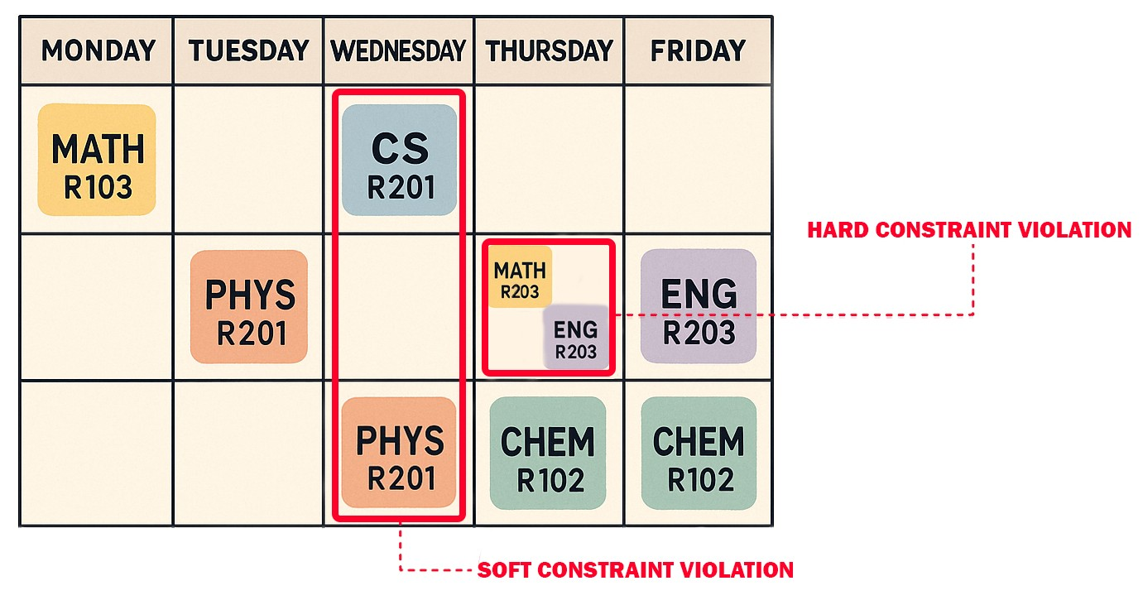
Background: Hard and Soft Constraints
Hard constraints:
Ensure the feasibility of the timetable and must be strictly satisfied.
Example: Avoid overlapping events for the same student or a lecturer.
Soft constraints:
Represent preferences to improve the quality of the solution without being mandatory.
Example: Minimizing gaps in students’ timetables to ensure a more compact timetable.
Fig. 2 – Hard and soft constraints example.

Slide 5
Background: International Timetabling Competitions (ITC)
The Second International Timetabling Competition (ITC-2007) was structured into three tracks: Examination Timetabling Problem, Post-enrollment Course Timetabling, and Curriculum-based Course Timetabling.
Benchmark datasets from ITC-2007 remain widely used in academic research and optimization studies.
Notes:
Since 2002
Five editions of the ITC have been held, three focusing on university timetabling.

Slide 6
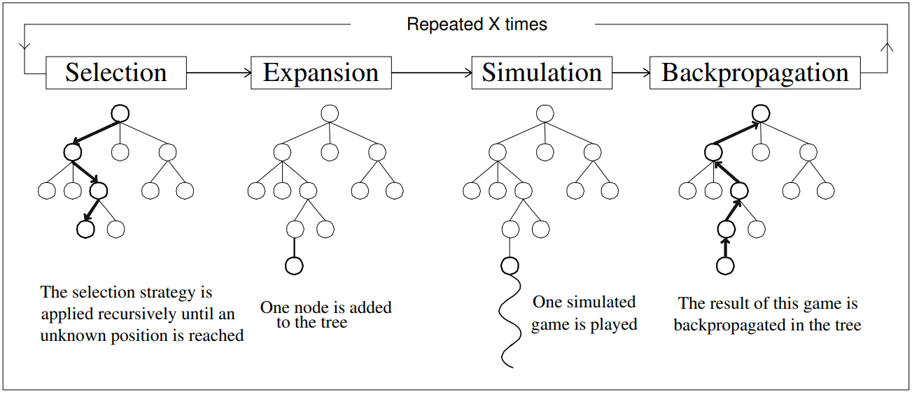
Background: Monte-Carlo Tree Search (MCTS)
Fig. 3 – Outline of Monte-Carlo Tree Search (Chaslot, 2006)
Notes:
Aheuristic, Anytime,
Asymmetric - A árvore construída depende da maneira como os nós são selecionados.

Slide 7
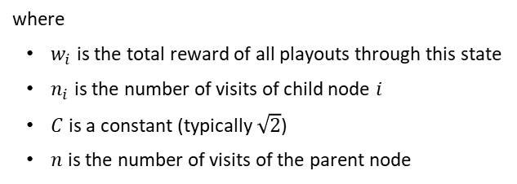
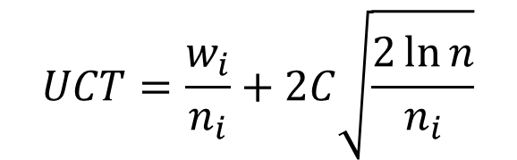
Background: Upper Confidence Bounds for Trees (UCT)
$$UCT=\frac{w_{i}}{n_{i}}+2C\sqrt{\frac{2\ln{n}}{n_{i}}}$$
where
$w_{i}$ is the total reward of all playouts through this state
$n_{i}$ is the number of visits of child node $i$
$C$ is a constant (typically $\sqrt{2}$)
$n$ is the number of visits of the parent node

Slide 8
Related Work
Analyzed various surveys and categorized UCTTP approaches based on their problem-solving strategies:
Metaheuristics emerged as one of the most promising, particularly single-solution-based algorithms like Simulated Annealing (SA) and Tabu Search (TS).
Hybrid approaches, like Müller’s ITC-2007 approach, were also shown to be effective.
Goh [6] study on the Post-Enrollment Course Timetabling Problem (PE-CTT) found that TS outperformed MCTS, despite improvements to the standard MCTS algorithm.
MCTS and its hybridization remain unexplored in the context of CB-CTT, making this the novel contribution of our work.

Slide 9
Problem Formulation
Periods, P = {P0, P1, ..., P|P|−1}
Rooms, R = {R0, R1, ..., R|R|−1}
Capacity
Lecturers, L = {L₀, L₁, ..., L_{|L|−1}}
Availability
Events, E = {E0, E1, ..., E|E|−1}
Capacity
Number of lectures
Minimum working days
Available periods
Priority
Lecturer
Blocks, B = {B0, B1, ..., B|B|−1}
Hard constraints:
Lectures
Room Occupancy
Conflicts
Unavailabilities
Soft constriants:
Room Capacity
Minimum Working Days
Curriculum Compactness
Room Stability
Notes:
Uma disciplina dada mais do que uma vez por semana tem de ser espalhada por um mínimo de dias

Slide 10
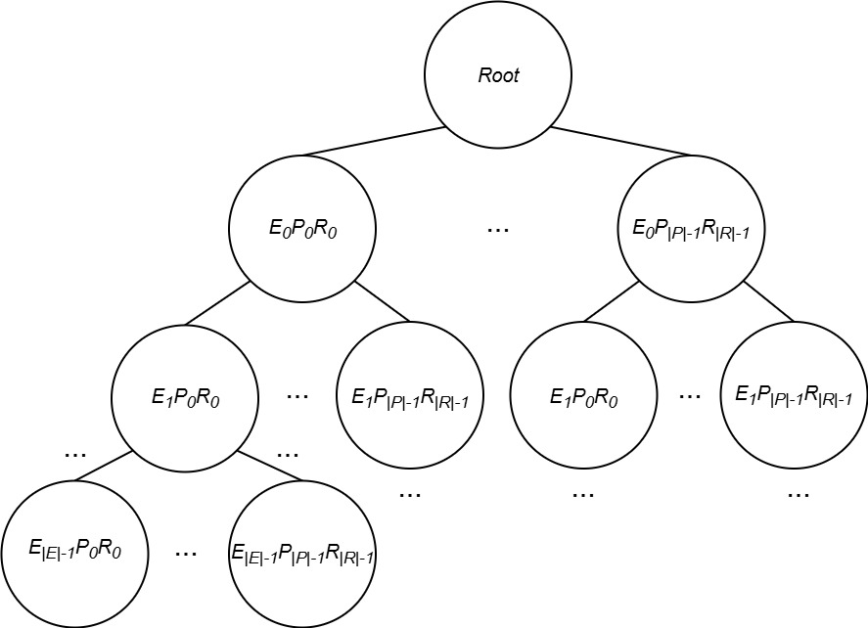
Methodology: Monte-Carlo Tree Search (MCTS)
Search space: S = (E x P x R)
where
E is the set of events
P is the set of periods (day,timeslot)
R is the set of rooms
A Node is composed of:
Parent
Children
Expansion limit
Visits
Hard and soft scores
Fig. 4 – MCTS tree

Slide 11
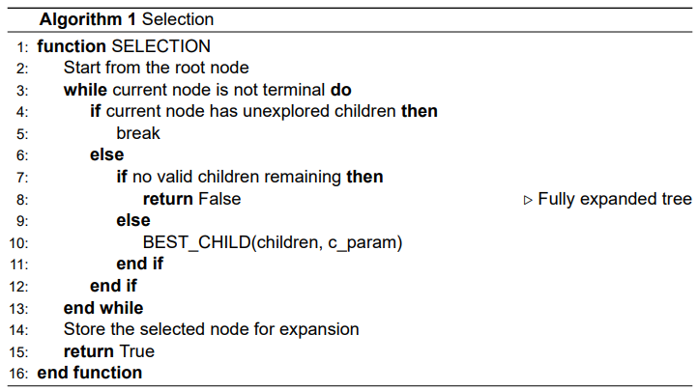
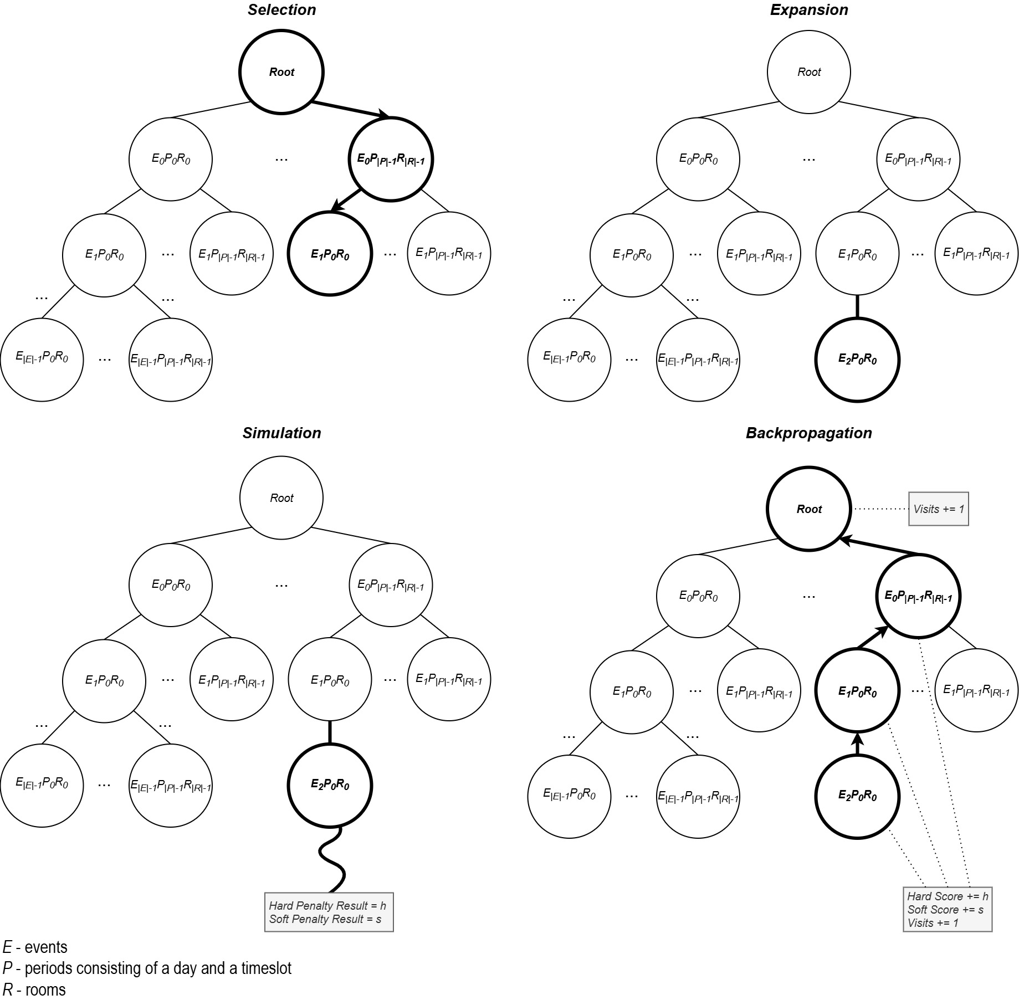
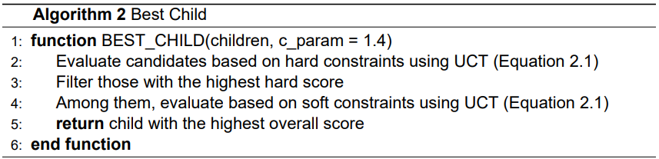
Methodology: Monte-Carlo Tree Search (MCTS)
Fig. 5 – MCTS selection phase

Slide 12
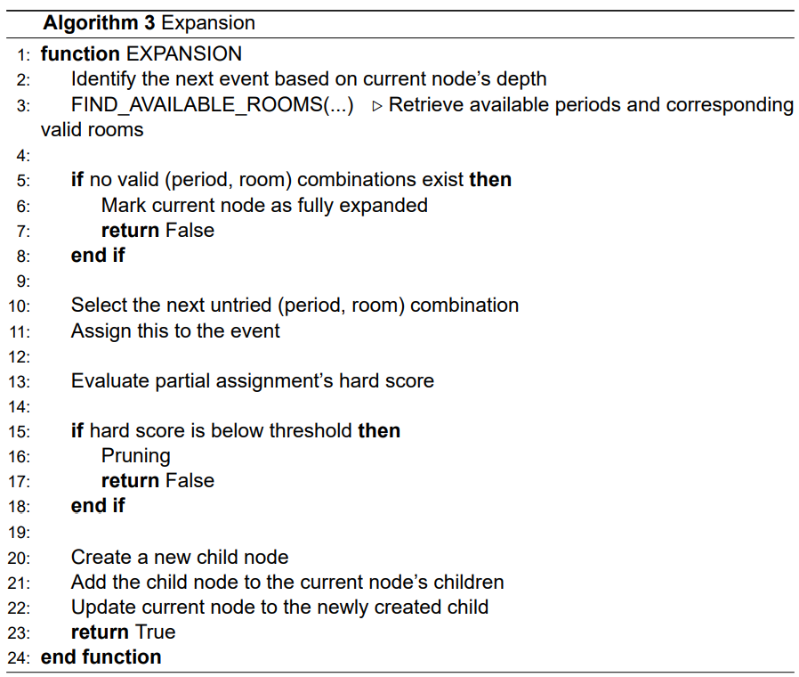
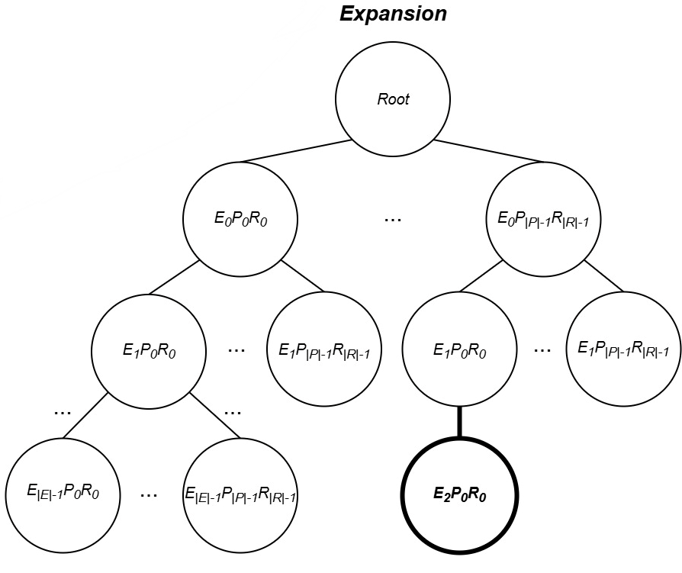
Methodology: Monte-Carlo Tree Search (MCTS)
Fig. 6 – MCTS expansion phase
Notes:
Aceitamos restrições hard se não tiver sido encontrada nenhuma solução válida até ao momento. Guardamos um valor global para ver qual a melhor solução hard encontrada.

Slide 13
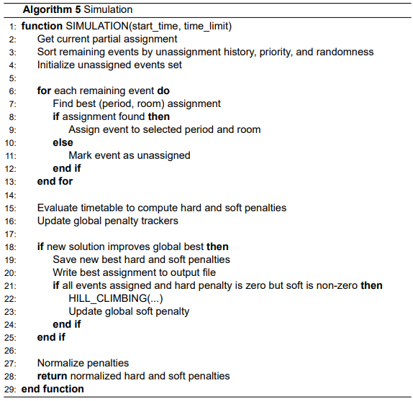
Methodology: Monte-Carlo Tree Search (MCTS)
Fig. 7 – MCTS simulation phase
Notes:
Temos então alocados já alguns eventos da raiz até à folha. Selecionamos um evento que não está alocado na árvore, alocamos todos os períodos e salas e avaliamos quanto a restrições hard e soft.

Slide 14
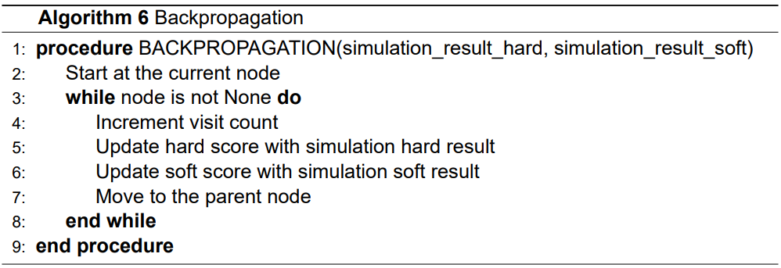
Methodology: Monte-Carlo Tree Search (MCTS)
Fig. 8 – MCTS backpropagation phase

Slide 15
Methodology: Hill Climbing (HC)
Neighborhoods: Period move, Room move, Event move, Room stability move, Compactness move, Minimum working days move
The HC approach follows the following steps:
Starts with an initial timetable without hard constraints violated;
Repeatedly selects a random neighborhood move, based on weights;
Applies the move and evaluates the new timetable;
If the new timetable is better, it keeps the changes; otherwise, it reverts them;
Stops when:
A timetable satisfying all hard and soft constraints is found;
No improvements identified after a predefined number of idle iterations;
The time limit is reached.

Slide 16
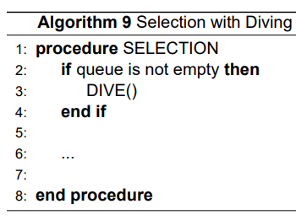
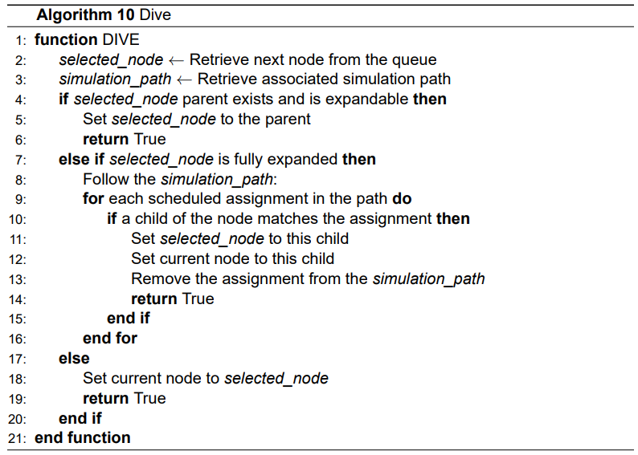
Methodology: Diving
Notes:
Quando encontramos uma solução de uma simulação que parece promissora, vamos mais em profundidade nesse caminho, expandindo cada vez mais para encontrar soluções vizinhas, em vez de começarmos sempre de novo.
Para isto é usada uma fila. Sempre que o MCTS faz uma simulação e encontra uma solução promissora, a informação do nó e dessa simulação é guardada na fila para ser explorada depois com mais profundidade.
Isto ajuda o algoritmo a concentrar-se em áreas de elevado potencial do espaço de pesquisa e a encontrar melhores soluções mais rapidamente.

Slide 17
Tests: Test Instances
The evaluation used all 21 instances from the ITC-2007 Track 3 dataset.
Each instance includes information about:
Curricula
Courses
Rooms
Unavailability constraints
Lectures
Periods
Teachers
 | Curricula | Courses | Rooms | Constraints | Lectures | Periods | Teachers
comp01 | 14 | 30 | 6 | 53 | 160 | 30 | 24
comp02 | 70 | 82 | 16 | 513 | 283 | 25 | 71
comp03 | 68 | 72 | 16 | 382 | 251 | 25 | 61
comp04 | 57 | 79 | 18 | 396 | 286 | 25 | 70
comp05 | 139 | 54 | 9 | 771 | 152 | 36 | 47
comp06 | 70 | 108 | 18 | 632 | 361 | 25 | 87
comp07 | 77 | 131 | 20 | 667 | 434 | 25 | 99
comp08 | 61 | 86 | 18 | 478 | 324 | 25 | 76
comp09 | 75 | 76 | 18 | 405 | 279 | 25 | 68
comp10 | 67 | 115 | 18 | 694 | 370 | 25 | 88
comp11 | 13 | 30 | 5 | 94 | 162 | 45 | 24
comp12 | 150 | 88 | 11 | 1368 | 218 | 36 | 74
comp13 | 66 | 82 | 19 | 468 | 308 | 25 | 77
comp14 | 60 | 85 | 17 | 486 | 275 | 25 | 68
comp15 | 68 | 72 | 16 | 382 | 251 | 25 | 61
comp16 | 71 | 108 | 20 | 518 | 366 | 25 | 89
comp17 | 70 | 99 | 17 | 548 | 339 | 25 | 80
comp18 | 52 | 47 | 9 | 594 | 138 | 36 | 47
comp19 | 66 | 74 | 16 | 475 | 277 | 25 | 66
comp20 | 78 | 121 | 19 | 691 | 390 | 25 | 95
comp21 | 78 | 94 | 18 | 463 | 327 | 25 | 76
Table 1 – Key features of the ITC-2007 track 3 instances

Slide 18
Tests: Test Setup/Procedure and Performance Metrics
Tested C values (0.1 to 1000) in the UCT formula and in a modified version incorporating accumulated rewards for exploitation.
Performance metrics:
Best soft and hard penalty
Worst soft and hard penalty
Iteration of best solution
Total number of iterations
Time to best solution
The algorithm was executed for:
1-hour and 24-hours to assess its ability to converge towards high-quality solutions given sufficient runtime
10 minutes using ten different seeds (1-10) to evaluate the consistency and variability of results across different initializations

Slide 19
Results
Python vs PyPy Performance Evaluation → PyPy called over 3x more functions
All tests have consistently produced feasible solutions in the challenging ITC-2007 set of benchmark instances.
C showed minimal impact on results, indicating a weaker-than-expected influence on node selection.
Purely random simulations failed to produce feasible solutions, emphasizing the necessity of guided search and domain knowledge to navigate the complex solution space effectively.

Slide 20
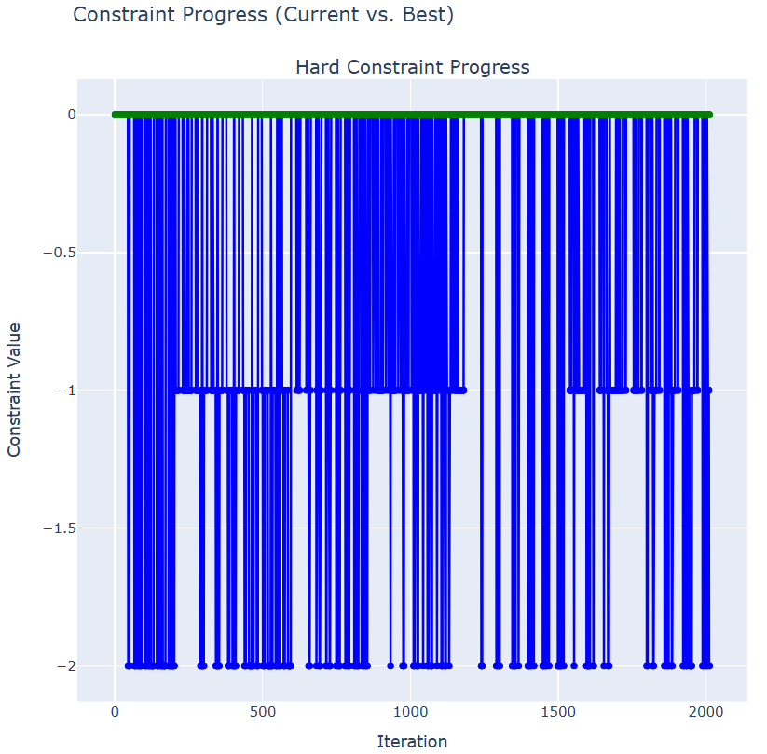
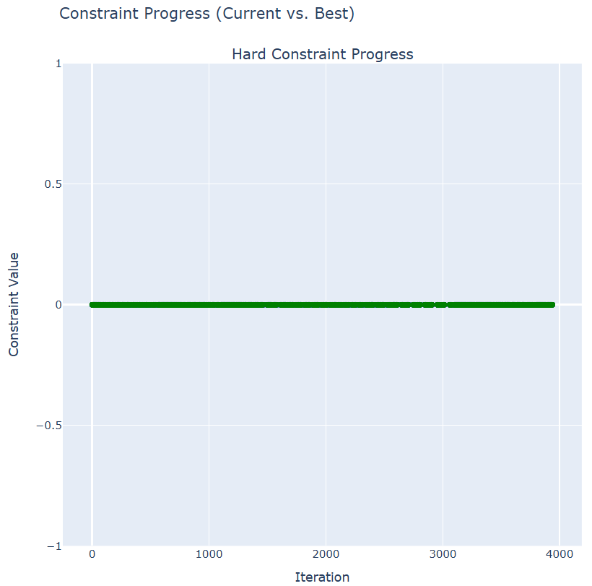

Results: Pruning
Without Pruning
With Pruning
Fig. 9 – Pruning Test
Notes:
A técnica de pruning eliminou ramos fixos da árvore com penalizações hard, o que acabou por evitar simulações desnecessárias. Contudo, hard constraints podem continuar a existir nas simulações apesar de não ter acontecido neste caso, porque o pruning elimina só nós que iam ser expandidos.

Slide 21
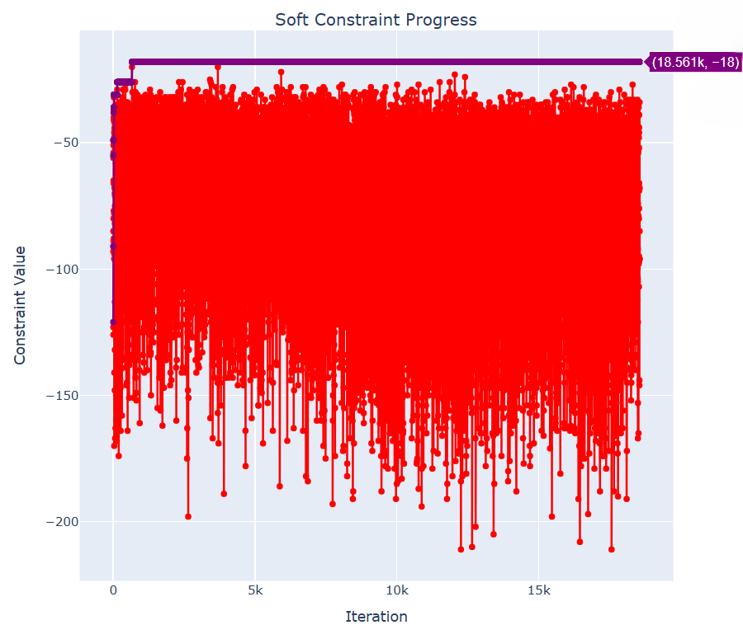
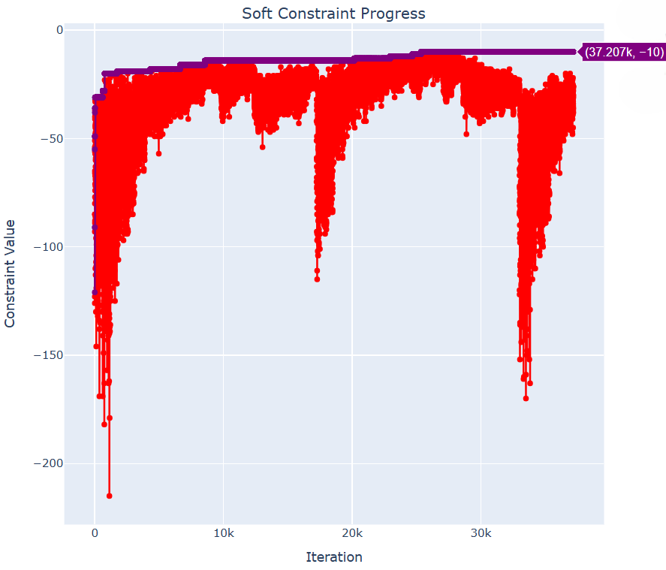

Results: Diving
Without Diving
With Diving
Fig. 10 – Diving Test
Notes:
Em ambos, o algoritmo eventualmente fica estagnado, mas com a estratégia de diving, as soft constraints em cada iteração tendem a ficar mais perto da melhor solução encontrada, mostrando uma trajetória mais focada.

Slide 22
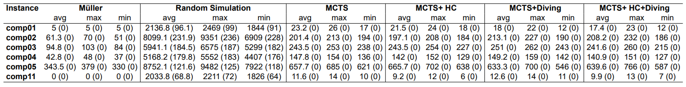
Results: Competition Results Comparison
Table 2 – Comparison of Müller and our method variants across six benchmark instances during 10 minutes.
Soft constraint penalties are shown with hard constraint violations in parentheses.

Slide 23
Conclusion and Future Work
Notes:
Esta dissertação apresenta uma nova forma de aplicar MCTS ao problema de horários universitários. Os resultados não foram os esperados mas mostram que, com mais ajustes – como melhorias de performance ou integração com outras heurísticas – esta abordagem pode evoluir.

Slide 24
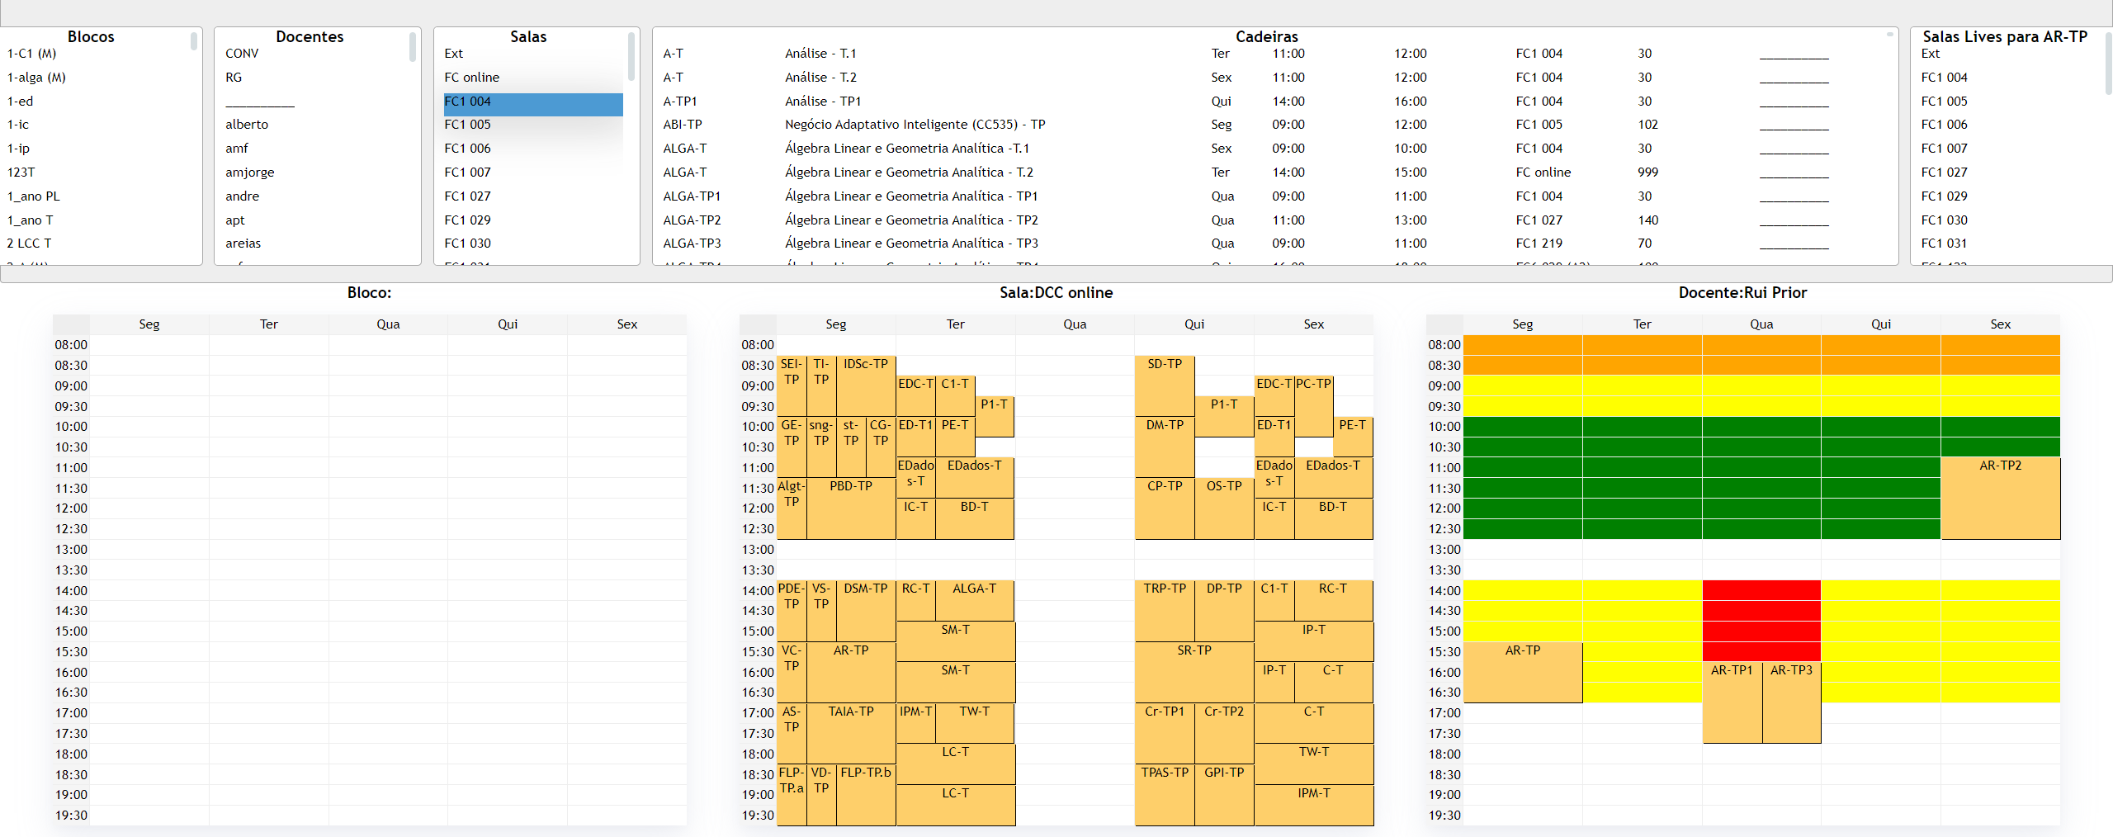
Previous project
Fig. 11 – Previous project frontend

Slide 25
Referencies
[1] U. D. Porto, “Fcup em números.” [Online]. Available: https://www.up.pt/fcup/pt/afcup/institucional/fcup-em-numeros/
[2] C. B. Browne, E. Powley, D. Whitehouse, S. M. Lucas, P. I. Cowling, P. Rohlfshagen, S. Tavener, D. Perez, S. Samothrakis, and S. Colton, “A survey of monte carlo tree search methods,” IEEE Transactions on Computational Intelligence and AI in Games, vol. 4, no. 1, pp. 1–43, Mar. 2012, conference Name: IEEE Transactions on Computational Intelligence and AI in Games. [Online]. Available: https://ieeexplore.ieee.org/document/6145622/?arnumber=6145622
[3] R. Lewis, “A survey of metaheuristic-based techniques for university timetabling problems,” OR Spectrum, vol. 30, no. 1, pp. 167–190, Jan. 2008. [Online]. Available: https://doi.org/10.1007/s00291-007-0097-0
[4] S. Abdipoor, R. Yaakob, S. L. Goh, and S. Abdullah, “Meta-heuristic approaches for the university course timetabling problem,” Intelligent Systems with Applications, vol. 19, p. 200253, Sep. 2023. [Online]. Available: https://linkinghub.elsevier.com/retrieve/pii/S2667305323000789
[5] H. Babaei, J. Karimpour, and A. Hadidi, “A survey of approaches for university course timetabling problem,” Computers & Industrial Engineering, vol. 86, pp. 43–59, Aug. 2015. [Online]. Available: https://linkinghub.elsevier.com/retrieve/pii/S0360835214003714
[6] M. C. Chen, S. N. Sze, S. L. Goh, N. R. Sabar, and G. Kendall, “A survey of university course timetabling problem: Perspectives, trends and opportunities,” IEEE Access, vol. 9, pp. 106 515–106 529, 2021, conference Name: IEEE Access. [Online]. Available: https://ieeexplore.ieee.org/document/9499056/?arnumber=9499056
[7] E. Talbi, “Metaheuristics: From design to implementation,” John Wiley & Sons google schola, vol. 2, pp. 268–308, 2009.
[8] K.-L. Du, M. Swamy et al., Search and optimization by metaheuristics. Springer, 2016, vol. 1.
[9] E. Burke, M. Gendreau, M. Hyde, G. Kendall, G. Ochoa, E. Özcan, and R. Qu, “Hyper-heuristics: A survey of the state of the art,” Journal
of the Operational Research Society, vol. 64, pp. 1695–1724, 07 2013. [Online]. Available: https://www.researchgate.net/publication/256442073_Hyperheuristics_A_survey_of_the_state_of_the_art
[10] T. Müller, “Itc2007 solver description: a hybrid approach,” Annals of Operations Research, vol. 172, no. 1, pp. 429–446, Nov. 2009. [Online]. Available: http://link.springer.com/10.1007/s10479-009-0644-y
[11] S. L. Goh, “An investigation of monte carlo tree search and local search for course timetabling problems,” University of Nottingham, Malaysia, pp. 76–105, Jul. 2017. [Online]. Available: https://eprints.nottingham.ac.uk/43558/
[12] J. P. Pedroso and R. Rei, “Tree search and simulation,” in Applied Simulation and Optimization: In Logistics, Industrial and Aeronautical Practice, M. Mujica Mota, I. F. De La Mota, and D. Guimarans Serrano, Eds. Cham: Springer International Publishing, 2015, pp. 109–131. [Online]. Available: https://doi.org/10.1007/978-3-319-15033-8_4

