Slide 1


An interactive tool for supporting university timetabling
Daniela Tomás · up202004946 · M:ERSI

Slide 2
Index
Introduction
Background
2.1 Hard and Soft Constraints
2.2 International Timetabling Competitions (ITC)
2.3 Monte Carlo Tree Search
2.4 Upper Confidence Bounds for Trees (UCT)
Related Work
Methodology
4.1 Monte Carlo Tree Search
4.2 Hill Climbing
4.3 Diving
Tests
Results
Conclusion and Future Work

Slide 3
Introduction
Optimization
Combinatorial Optimization Problem
Scheduling
…
Educational Timetabling
…
…
University
School
Course Timetabling
Examination Timetabling
CB-CTT
PE-CTT
University Course Timetabling Problem (UCTTP):
Complex combinatorial optimization problem that consists of allocating events, rooms, lecturers, and students to weekly schedules while meeting certain constraints.
This dissertation focuses on the Curriculum-Based Course Timetabling (CB-CTT), a variant of UCTTP that focuses on course scheduling.
FCUP’s timetabling building process is:
Time-consuming
Not automated
Suboptimal
Fig. 1 – University Course Timetabling diagram.

Slide 4
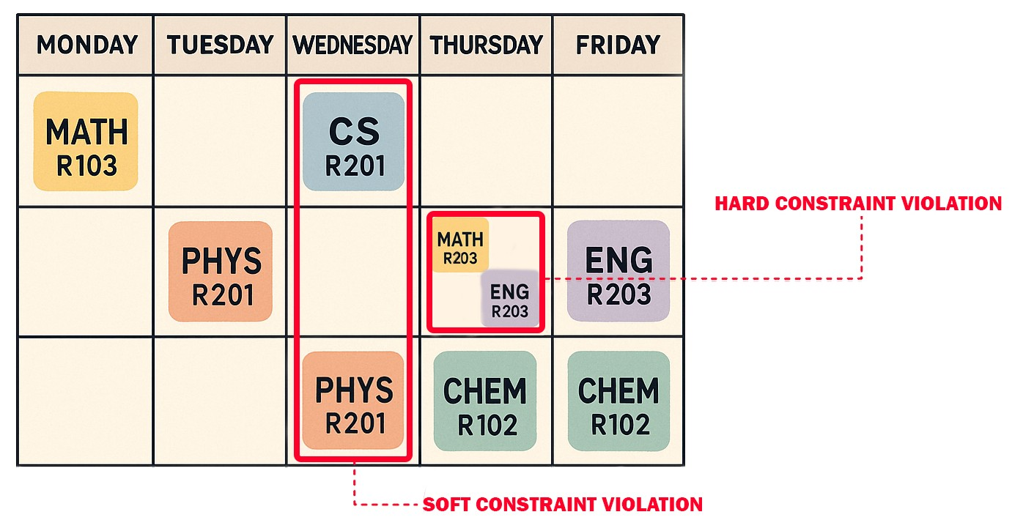
Background: Hard and Soft Constraints
Hard constraints:
Ensure the feasibility of the timetable and must be strictly satisfied.
Example: Avoid overlapping events for the same student or a lecturer.
Soft constraints:
Represent preferences to improve the quality of the solution without being mandatory.
Example: Minimizing gaps in students’ timetables to ensure a more compact timetable.
Fig. 2 – Hard and soft constraints example.

Slide 5
Background: International Timetabling Competitions (ITC)
Five editions of the ITC have been held, three focusing on university timetabling.
The Second International Timetabling Competition (ITC-2007) was structured into three tracks: Examination Timetabling Problem, Post-enrollment Course Timetabling, and Curriculum-based Course Timetabling.
Benchmark datasets from ITC-2007 remain widely used in academic research and optimization studies.
Notes:
Since 2002, PATAT has supported timetabling competitions to promote research.

Slide 6
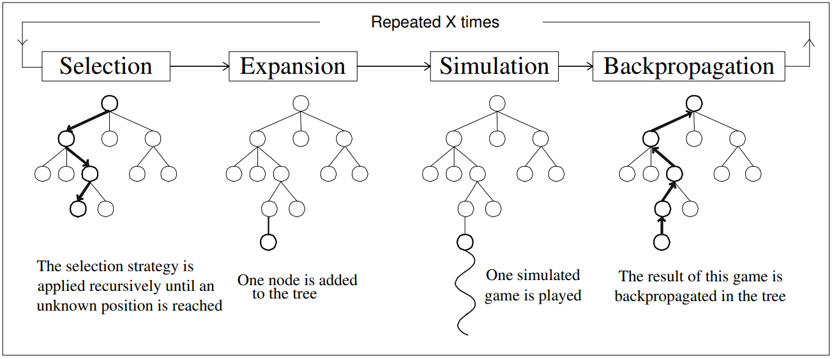
Background: Monte-Carlo Tree Search (MCTS)
Fig. 3 – Outline of Monte-Carlo Tree Search (Chaslot, 2006)

Slide 7
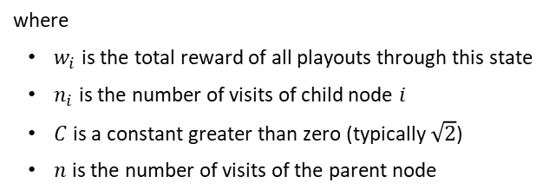
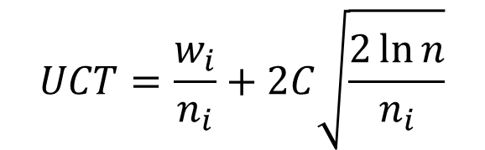
Background: Upper Confidence Bounds for Trees (UCT)
$$UCT=\frac{w_{i}}{n_{i}}+2C\sqrt{\frac{2\ln{n}}{n_{i}}}$$
where
$w_{i}$ is the total reward of all playouts through this state
$n_{i}$ is the number of visits of child node $i$
$C$ is a constant greater than zero (typically $\sqrt{2}$)
$n$ is the number of visits of the parent node

Slide 8
Related Work
Analyzed various surveys and categorized UCTTP approaches based on their problem-solving strategies:
Metaheuristics emerged as one of the most promising, particularly single-solution-based algorithms like Simulated Annealing (SA) and Tabu Search (TS).
Hybrid approaches, like Müller’s ITC-2007 approach, were also shown to be effective.
Goh [6] study on the Post-Enrollment Course Timetabling Problem (PE-CTT) found that TS outperformed MCTS, despite improvements to the standard MCTS algorithm.
MCTS and its hybridization remain unexplored in the context of CBCTT, making this the novel contribution of our work.

Slide 9
Problem Formulation
Periods, P = {P0, P1, ..., P|P|−1}
Rooms, R = {R0, R1, ..., R|R|−1}
Capacity
Lecturers, L = {L₀, L₁, ..., L_{|L|−1}}
Availability
Events, E = {E0, E1, ..., E|E|−1}
Capacity
Number of lectures
Minimum working days
Available periods
Priority
Lecturer
Blocks, B = {B0, B1, ..., B|B|−1}
Hard constraints:
Lectures
Room Occupancy
Conflicts
Unavailabilities
Soft constriants:
Room Capacity
Minimum Working Days
Curriculum Compactness
Room Stability

Slide 10
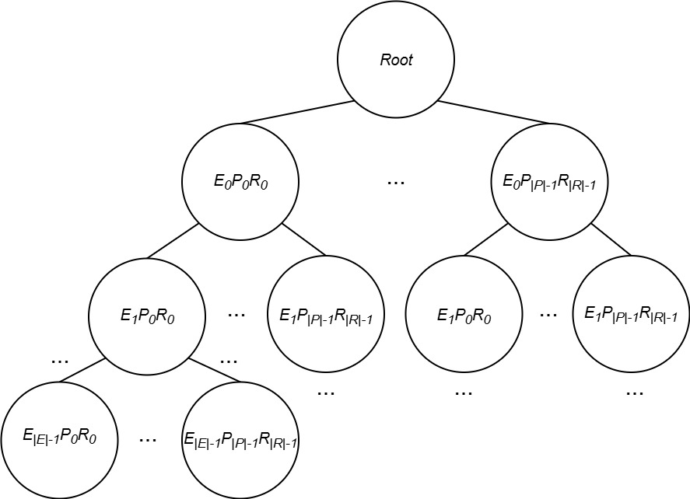
Methodology: Monte-Carlo Tree Search (MCTS)
Search space: S = (E x P x R)
where
E is the set of events
P is the set of periods (day,timeslot)
R is the set of rooms
A Node is composed of:
Path
Parent
Children
Expansion limit
Visits
Hard and soft scores
Fig. 4 – MCTS tree

Slide 11
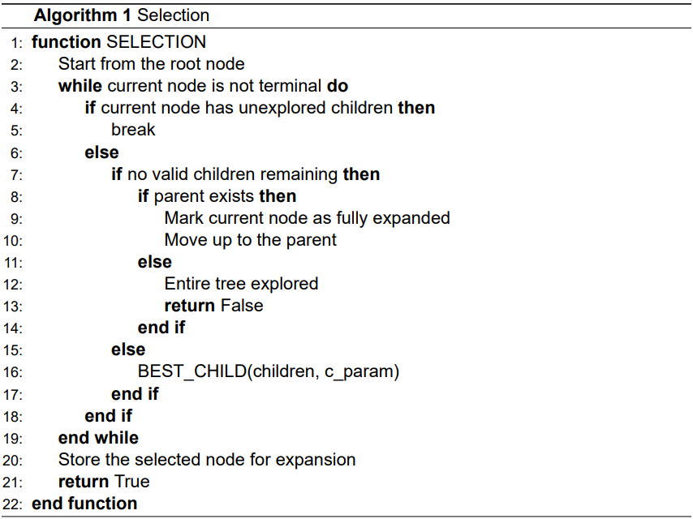
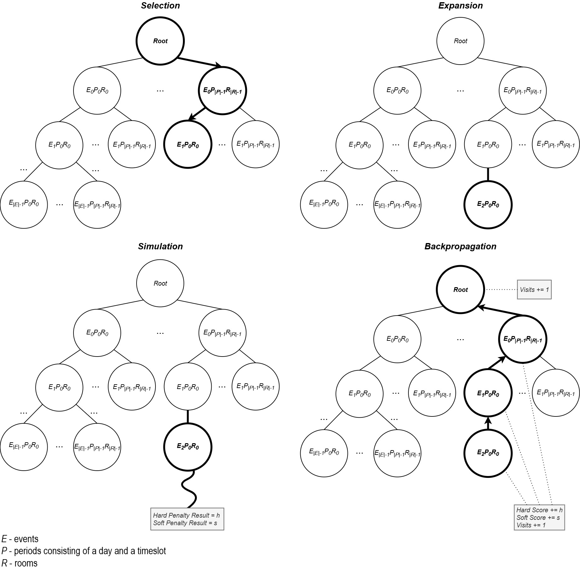
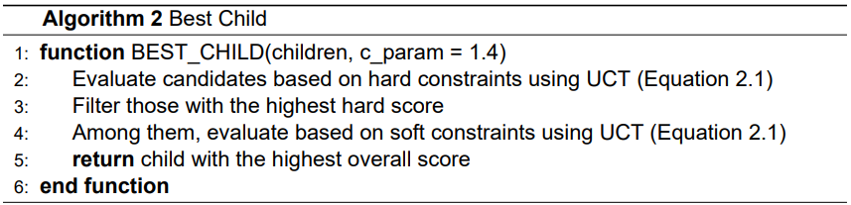
Methodology: Monte-Carlo Tree Search (MCTS)
Fig. 5 – MCTS selection phase

Slide 12
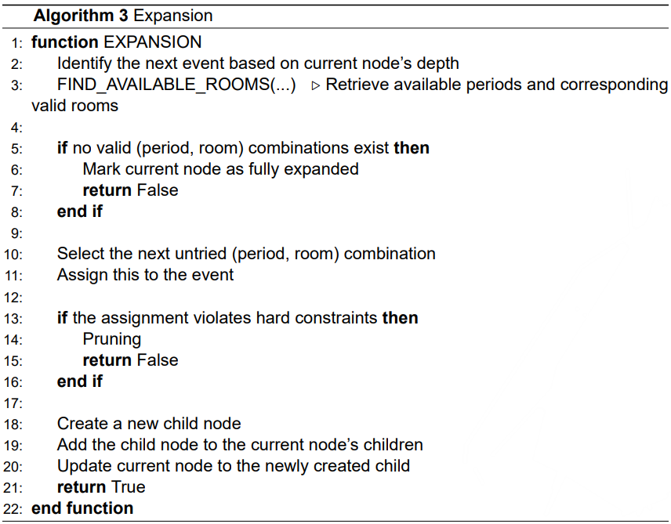
Methodology: Monte-Carlo Tree Search (MCTS)

Slide 13
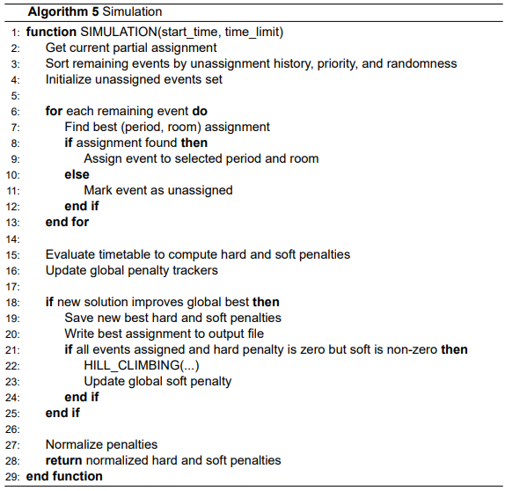
Methodology: Monte-Carlo Tree Search (MCTS)

Slide 14
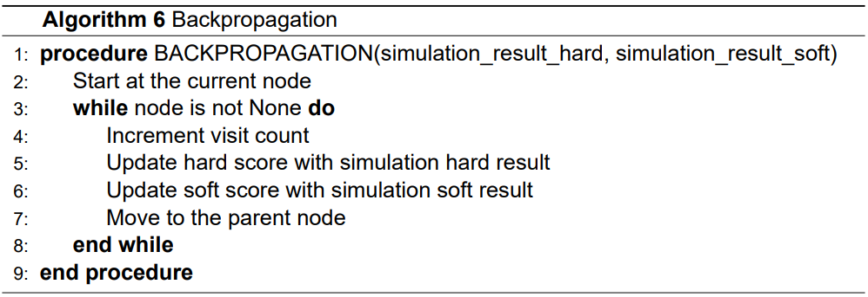
Methodology: Monte-Carlo Tree Search (MCTS)

Slide 15
Methodology: Hill Climbing (HC)
Neighborhoods: Period move, Room move, Event move, Room stability move, Compactness move, Minimum working days move
The HC approach follows the following steps:
Starts with an initial timetable without hard constraints violated;
Repeatedly selects a random neighborhood move, based on weights;
Applies the move and evaluates the new timetable;
If the new timetable is better, it keeps the changes; otherwise, it reverts them;
Stops when:
A timetable satisfying all hard and soft constraints is found;
No improvements identified after a predefined number of idle iterations;
The time limit is reached.

Slide 16
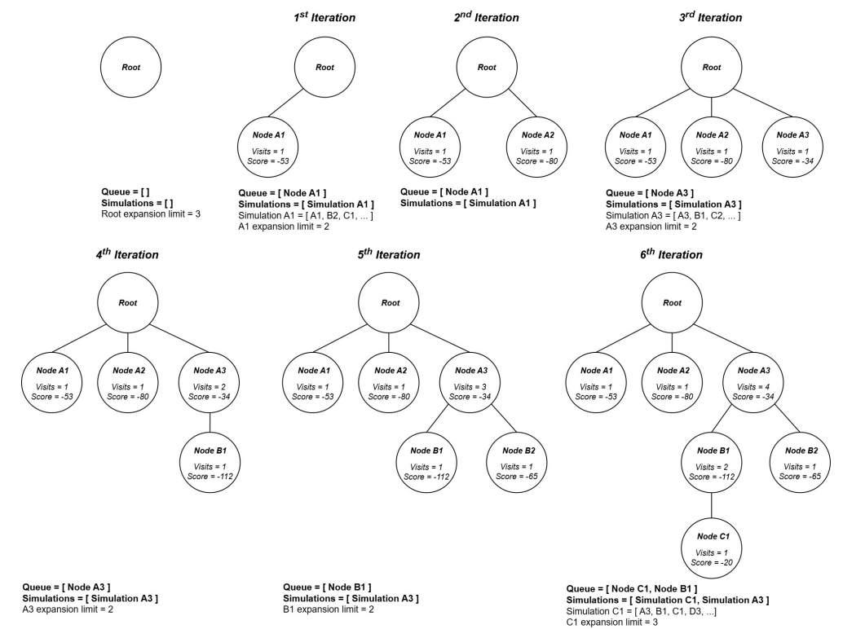
Methodology: Diving
Fig. – Diving strategy example

Slide 17
Tests: Test Instances
The evaluation used all 21 instances from the ITC-2007 Track 3 dataset.
Each instance includes information about:
Curricula
Courses
Rooms
Unavailability constraints
Lectures
Periods
Teachers
 | Curricula | Courses | Rooms | Constraints | Lectures | Periods | Teachers
comp01 | 14 | 30 | 6 | 53 | 160 | 30 | 24
comp02 | 70 | 82 | 16 | 513 | 283 | 25 | 71
comp03 | 68 | 72 | 16 | 382 | 251 | 25 | 61
comp04 | 57 | 79 | 18 | 396 | 286 | 25 | 70
comp05 | 139 | 54 | 9 | 771 | 152 | 36 | 47
comp06 | 70 | 108 | 18 | 632 | 361 | 25 | 87
comp07 | 77 | 131 | 20 | 667 | 434 | 25 | 99
comp08 | 61 | 86 | 18 | 478 | 324 | 25 | 76
comp09 | 75 | 76 | 18 | 405 | 279 | 25 | 68
comp10 | 67 | 115 | 18 | 694 | 370 | 25 | 88
comp11 | 13 | 30 | 5 | 94 | 162 | 45 | 24
comp12 | 150 | 88 | 11 | 1368 | 218 | 36 | 74
comp13 | 66 | 82 | 19 | 468 | 308 | 25 | 77
comp14 | 60 | 85 | 17 | 486 | 275 | 25 | 68
comp15 | 68 | 72 | 16 | 382 | 251 | 25 | 61
comp16 | 71 | 108 | 20 | 518 | 366 | 25 | 89
comp17 | 70 | 99 | 17 | 548 | 339 | 25 | 80
comp18 | 52 | 47 | 9 | 594 | 138 | 36 | 47
comp19 | 66 | 74 | 16 | 475 | 277 | 25 | 66
comp20 | 78 | 121 | 19 | 691 | 390 | 25 | 95
comp21 | 78 | 94 | 18 | 463 | 327 | 25 | 76
Table 1 – Key features of the ITC-2007 track 3 instances

Slide 18
Tests: Test Setup/Procedure and Performance Metrics
Tested C values (0.1 to 1000) in the UCT formula and in a modified version incorporating accumulated rewards for exploitation.
Performance metrics:
Best hard penalty
Worst hard penalty
Best soft penalty
Worst soft penalty
Iteration of best solution
The algorithm was executed for:
1 hour and 24-hours to assess its ability to converge towards high-quality solutions given sufficient runtime
10 minutes using ten different seeds (1-10) to evaluate the consistency and variability of results across different initializations

Slide 19
Results
Python vs PyPy Performance Evaluation → PyPy called over 3x more functions
All tests have consistently produced feasible solutions in the challenging ITC-2007 set of benchmark instances.
C showed minimal impact on results, indicating a weaker-than-expected influence on node selection.

Slide 20
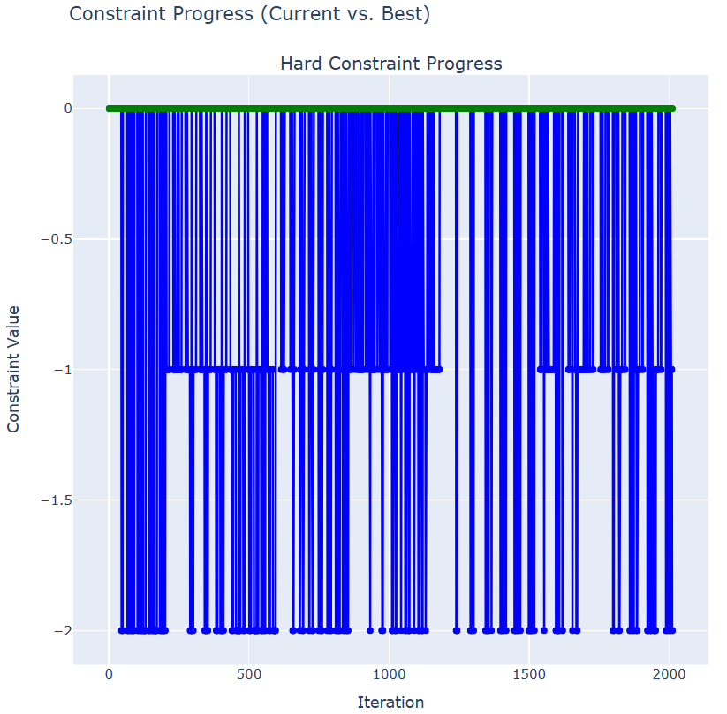
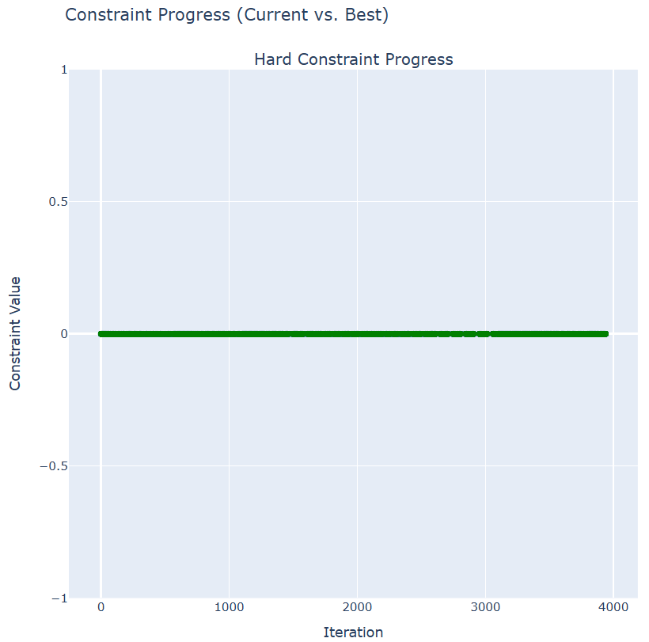

Results: Pruning
Fig. –

Slide 21
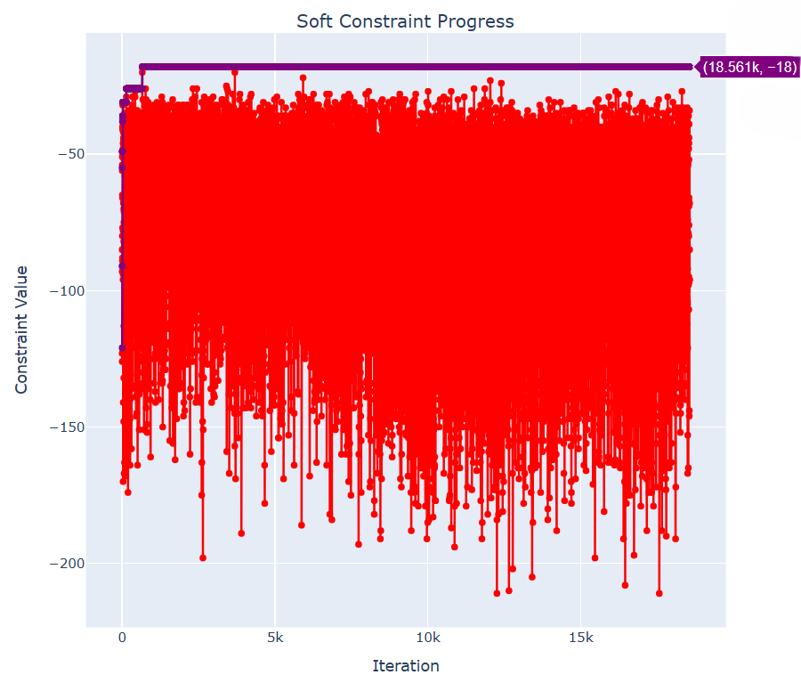
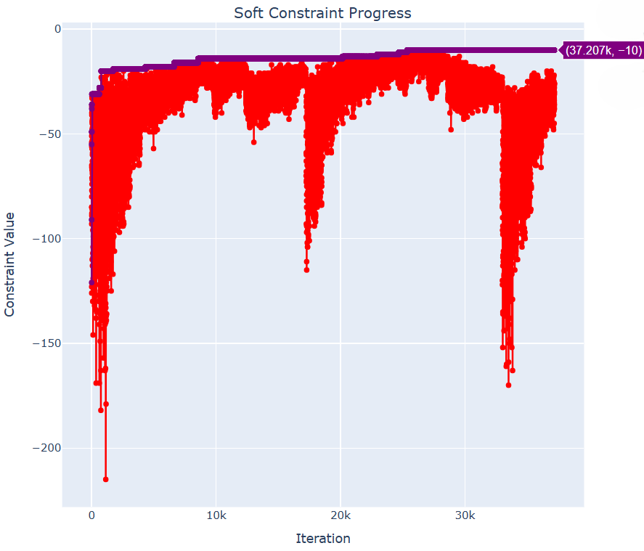

Results: Diving

Slide 22
Results: Competition Results Comparison
A

Slide 23
Conclusion and Future Work

Slide 24
Referencies
[1] U. D. Porto, “Fcup em números.” [Online]. Available: https://www.up.pt/fcup/pt/afcup/institucional/fcup-em-numeros/
[2] C. B. Browne, E. Powley, D. Whitehouse, S. M. Lucas, P. I. Cowling, P. Rohlfshagen, S. Tavener, D. Perez, S. Samothrakis, and S. Colton, “A survey of monte carlo tree search methods,” IEEE Transactions on Computational Intelligence and AI in Games, vol. 4, no. 1, pp. 1–43, Mar. 2012, conference Name: IEEE Transactions on Computational Intelligence and AI in Games. [Online]. Available: https://ieeexplore.ieee.org/document/6145622/?arnumber=6145622
[3] R. Lewis, “A survey of metaheuristic-based techniques for university timetabling problems,” OR Spectrum, vol. 30, no. 1, pp. 167–190, Jan. 2008. [Online]. Available: https://doi.org/10.1007/s00291-007-0097-0
[4] S. Abdipoor, R. Yaakob, S. L. Goh, and S. Abdullah, “Meta-heuristic approaches for the university course timetabling problem,” Intelligent Systems with Applications, vol. 19, p. 200253, Sep. 2023. [Online]. Available: https://linkinghub.elsevier.com/retrieve/pii/S2667305323000789
[5] H. Babaei, J. Karimpour, and A. Hadidi, “A survey of approaches for university course timetabling problem,” Computers & Industrial Engineering, vol. 86, pp. 43–59, Aug. 2015. [Online]. Available: https://linkinghub.elsevier.com/retrieve/pii/S0360835214003714
[6] M. C. Chen, S. N. Sze, S. L. Goh, N. R. Sabar, and G. Kendall, “A survey of university course timetabling problem: Perspectives, trends and opportunities,” IEEE Access, vol. 9, pp. 106 515–106 529, 2021, conference Name: IEEE Access. [Online]. Available: https://ieeexplore.ieee.org/document/9499056/?arnumber=9499056
[7] E. Talbi, “Metaheuristics: From design to implementation,” John Wiley & Sons google schola, vol. 2, pp. 268–308, 2009.
[8] K.-L. Du, M. Swamy et al., Search and optimization by metaheuristics. Springer, 2016, vol. 1.
[9] E. Burke, M. Gendreau, M. Hyde, G. Kendall, G. Ochoa, E. Özcan, and R. Qu, “Hyper-heuristics: A survey of the state of the art,” Journal
of the Operational Research Society, vol. 64, pp. 1695–1724, 07 2013. [Online]. Available: https://www.researchgate.net/publication/256442073_Hyperheuristics_A_survey_of_the_state_of_the_art
[10] T. Müller, “Itc2007 solver description: a hybrid approach,” Annals of Operations Research, vol. 172, no. 1, pp. 429–446, Nov. 2009. [Online]. Available: http://link.springer.com/10.1007/s10479-009-0644-y
[11] S. L. Goh, “An investigation of monte carlo tree search and local search for course timetabling problems,” University of Nottingham, Malaysia, pp. 76–105, Jul. 2017. [Online]. Available: https://eprints.nottingham.ac.uk/43558/
[12] J. P. Pedroso and R. Rei, “Tree search and simulation,” in Applied Simulation and Optimization: In Logistics, Industrial and Aeronautical Practice, M. Mujica Mota, I. F. De La Mota, and D. Guimarans Serrano, Eds. Cham: Springer International Publishing, 2015, pp. 109–131. [Online]. Available: https://doi.org/10.1007/978-3-319-15033-8_4

Slide 25
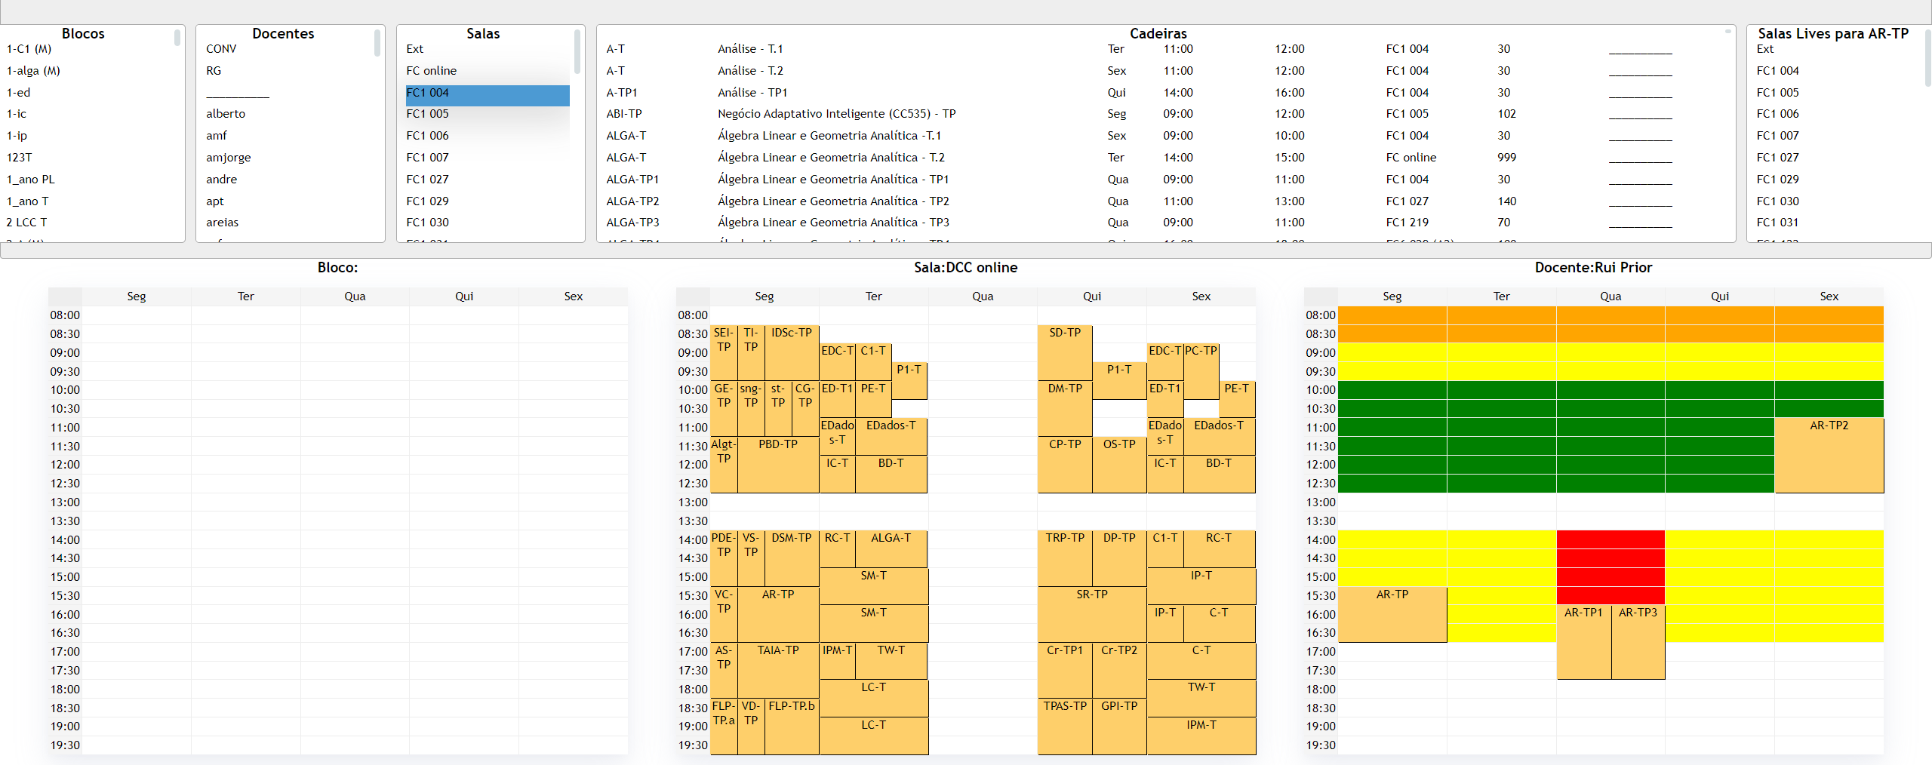
Previous project
Fig. 3 – Previous project frontend

