Slide 1


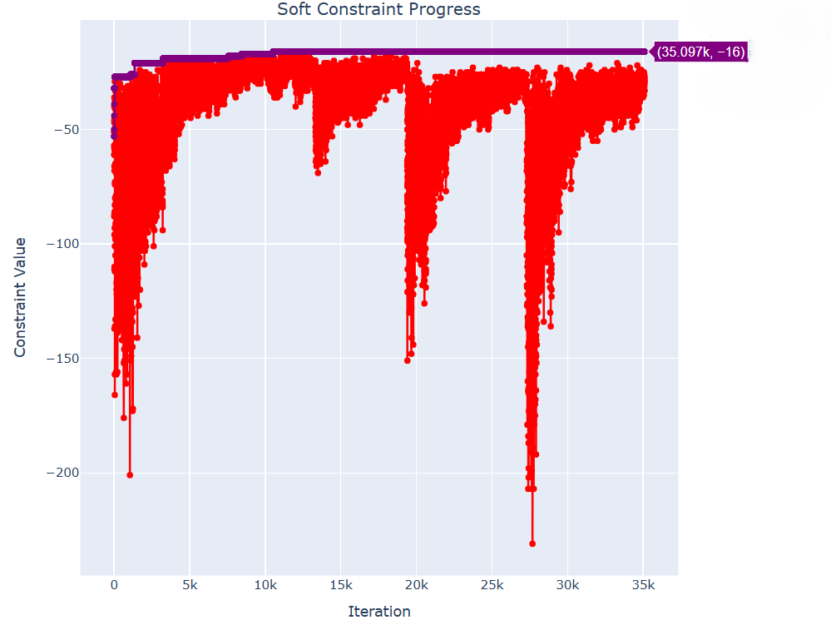
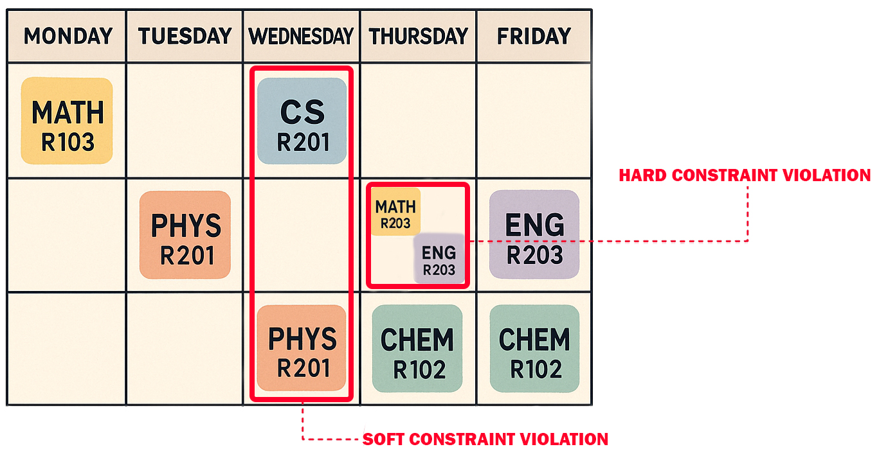

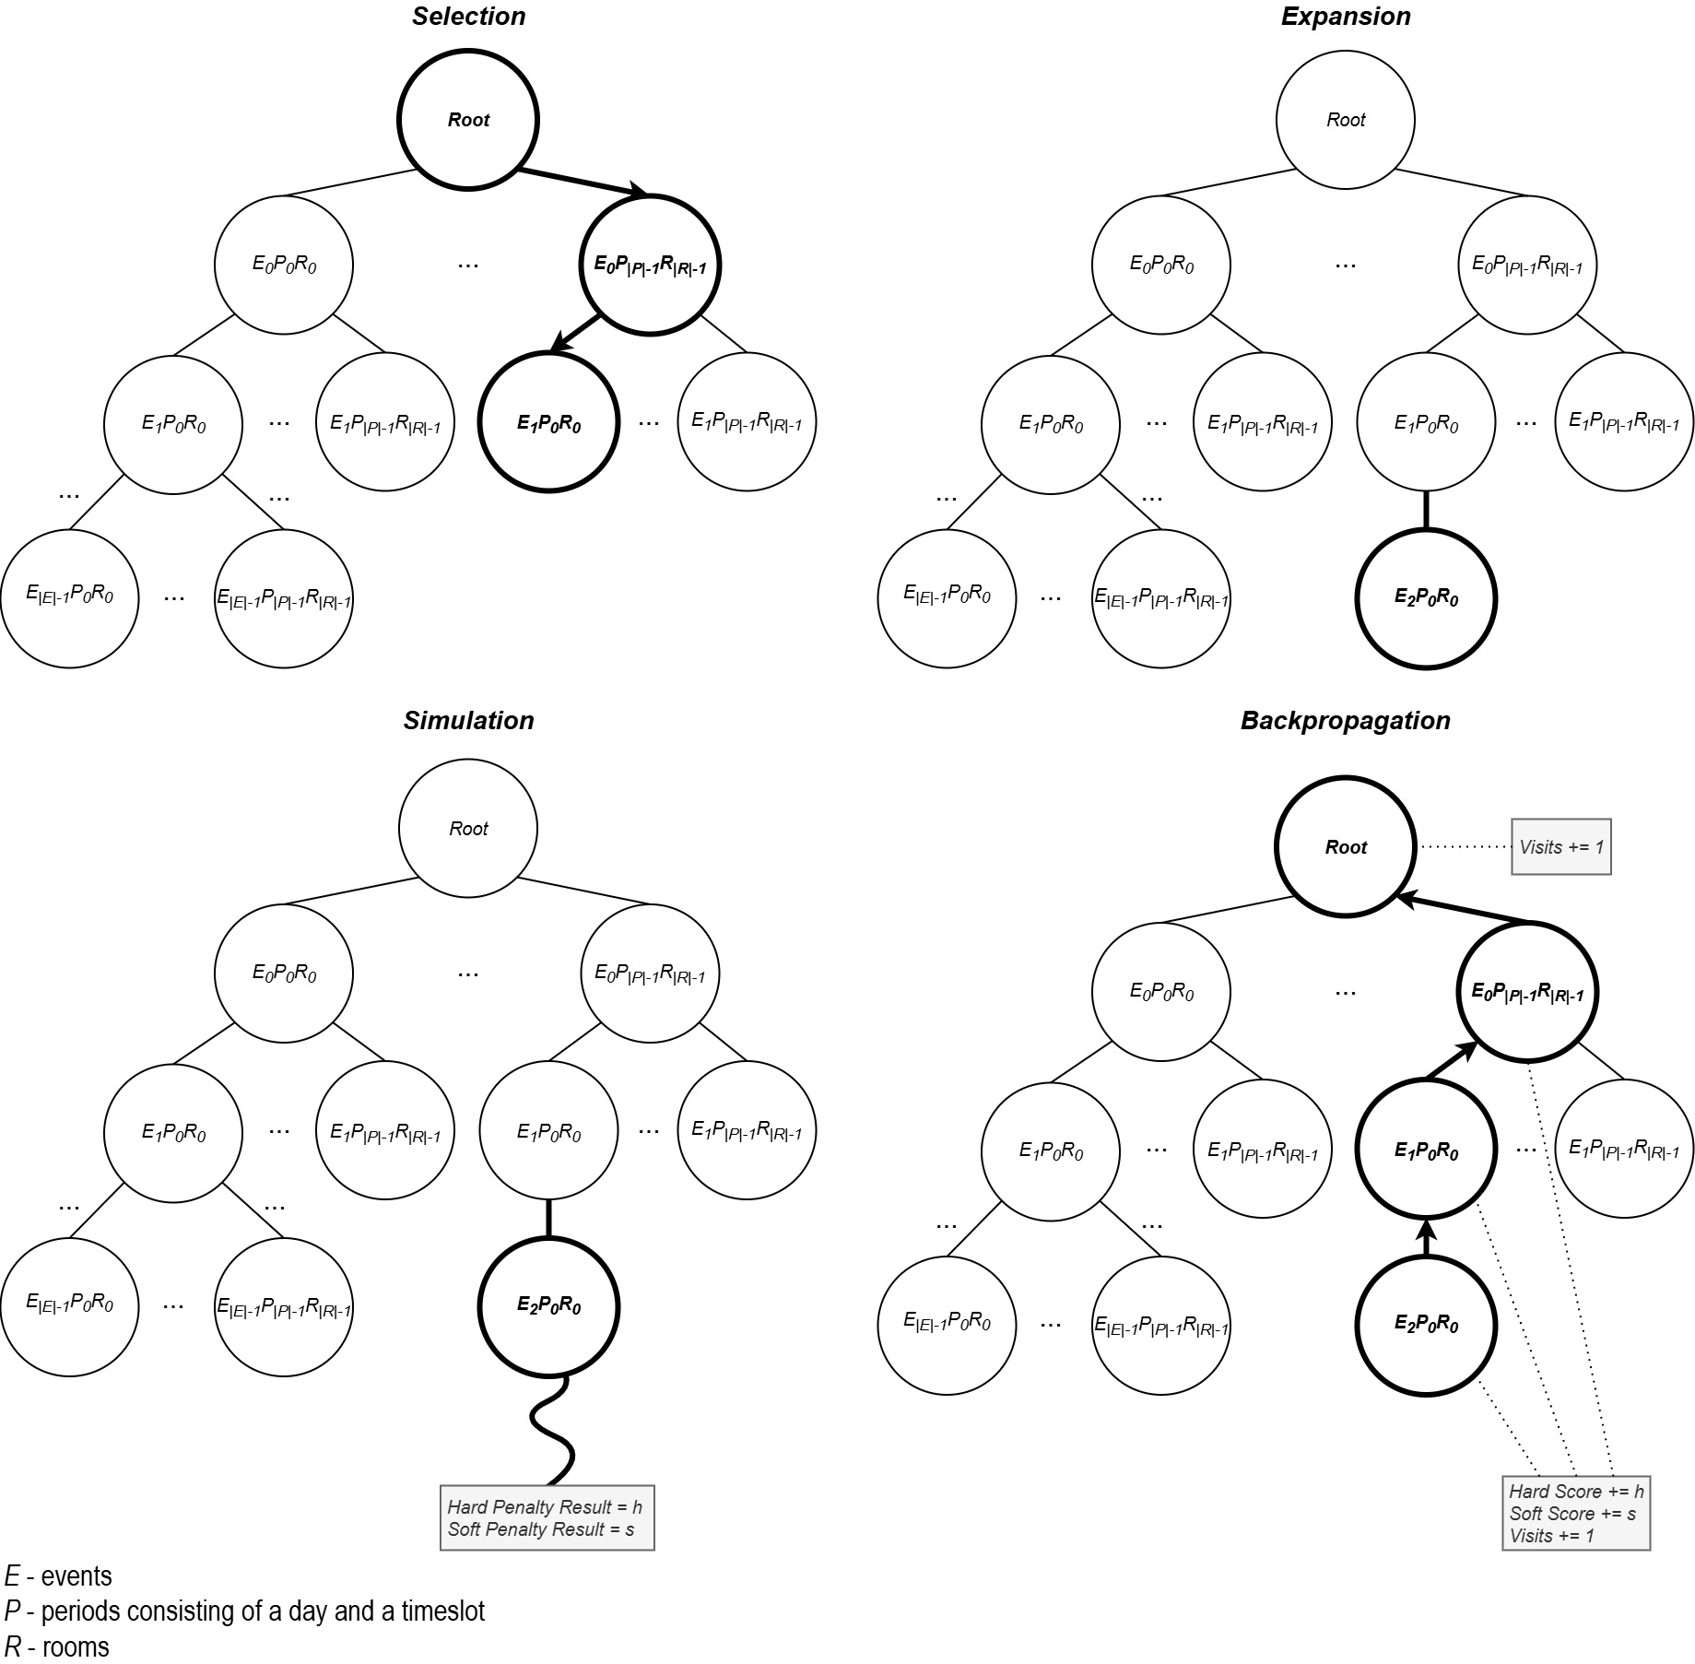



An interactive tool for supporting university timetabling
Daniela Tomás (up202004946@edu.fc.up.pt), Department of Computer Science, Faculty of Sciences of the University of Porto, Portugal
João Pedro Pedroso (jpp@fc.up.pt), Department of Computer Science, Faculty of Sciences of the University of Porto, Portugal
Introduction
Preliminary Results
University Course Timetabling Problem (UCTTP) is a combinatorial optimization problem that consists of allocating events, rooms, lecturers, and students to weekly schedules while meeting certain constraints (Figure 1). This research focuses on Curriculum-Based Course Timetabling (CB-CTT), a variant of UCTTP that focuses on course scheduling.
Due to the size and complexity of the problem, obtaining an optimal solution in usable time is typically infeasible. However, using heuristic algorithms, it is possible to get approximate and good-quality solutions effectively.
FCUP’s timetabling building process is time-consuming, not automated, and suboptimal. In general, the currently available tools focus primarily on visualizing timetables or on basic conflict detection without offering optimized solutions.
Tested C values (0.1 to 1000) in the UCT formula and in a modified version incorporating accumulated rewards for exploitation.
All tests so far have consistently produced feasible solutions, in the challenging ITC-2007 set of benchmark instances.
In 10-minute runs with different fixed seeds, C showed minimal impact on results, indicating a weaker-than-expected influence on node selection.
Diving strategy is still under development, but early results (Figure 3) are encouraging, though not yet competitive with state-of-the-art solutions.
Aim
Figure 1 – Hard and Soft constraints.
Enhance the efficiency and quality of FCUP's timetabling.
Provide step-by-step interactive recommendations.
Detect potential conflicts.
Integrate these functionalities into a timetable visualization interface that was previously developed using reactive programming.
Figure 3 – Soft constraint progress using the diving approach on the comp01 instance from ITC-2007.
Conclusion
The proposed system presents a novel application of MCTS to UCTTP, combined with HC for local improvements. By leveraging interactive recommendations and conflict detection, the tool provides a more effective and adaptive scheduling process for FCUP and can be extended to other institutions and help in other studies.
Future work will focus on the diving strategy, refining the heuristic functions and improving computational performance.
Methodology
Monte Carlo Tree Search (MCTS) chosen due to its effectiveness in games and optimization problems, as well as its ability to navigate large search spaces effectively (Figure 2). Although it has shown positive results in various areas, in the context of CB-CTT there are no studies that use MCTS.
Hill Climbing (HC) used in simulation phase for local optimization but only if a feasible and improved solution is found.
Additionally, a diving strategy is under investigation to enhance MCTS. Instead of restarting from the root each iteration, the algorithm follow and deepen promising paths, aiming to improve the convergence speed and solution quality.
Performance is evaluated using the benchmark datasets from ITC-2007 track 3 [1].
References
[1] International Timetabling Competition --- eeecs.qub.ac.uk. https://www.eeecs.qub.ac.uk/itc2007/Login/SecretPage.php
[2] R. Lewis, “A survey of metaheuristic-based techniques for university timetabling problems,” OR Spectrum, vol. 30, no. 1, pp. 167–190, Jan. 2008. Available: https://doi.org/10.1007/s00291-007-0097-0
[2] S. Abdipoor, R. Yaakob, S. L. Goh, and S. Abdullah, “Meta-heuristic approaches for the university course timetabling problem,” Intelligent Systems with Applications, vol. 19, p. 200253, Sep. 2023. Available: https://linkinghub.elsevier.com/retrieve/pii/S2667305323000789
[3] H. Babaei, J. Karimpour, and A. Hadidi, “A survey of approaches for university course timetabling problem,” Computers & Industrial Engineering, vol. 86, pp.43–59, Aug. 2015. Available: https://linkinghub.elsevier.com/retrieve/pii/S0360835214003714
[4] M. C. Chen, S. N. Sze, S. L. Goh, N. R. Sabar, and G. Kendall, “A survey of university course timetabling problem: Perspectives, trends and opportunities,” IEEE Access, vol. 9, pp. 106 515–106 529, 2021, conference Name: IEEE Access. Available: https://ieeexplore.ieee.org/document/9499056/?arnumber=9499056
[5] T. Müller, “Itc2007 solver description: a hybrid approach,” Annals of Operations Research, vol. 172, no. 1, pp. 429–446, Nov. 2009. Available: http://link.springer.com/10.1007/s10479-009-0644-y
[6] S. L. Goh, “An investigation of monte carlo tree search and local search for course timetabling problems,”, pp. 76–105, Jul. 2017. Available: https://eprints.nottingham.ac.uk/43558/
Figure 2 – Monte Carlo Tree Search steps.

Slide 2
“Title”
Author (e-mail), Institution, Country
Author (e-mail), Institution, Country
Author (e-mail), Institution, Country
Introduction
text
Aim
text
text
text
Methodology
text
Conclusion
text
Results
text
References
text

