Slide 1
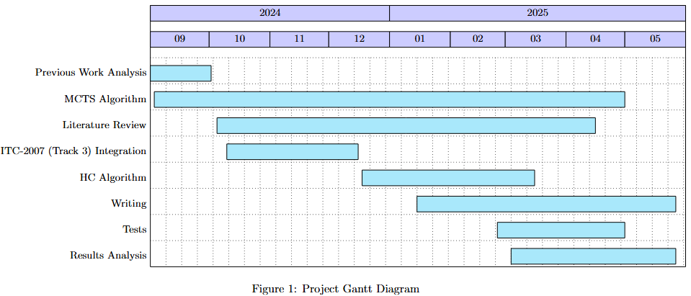
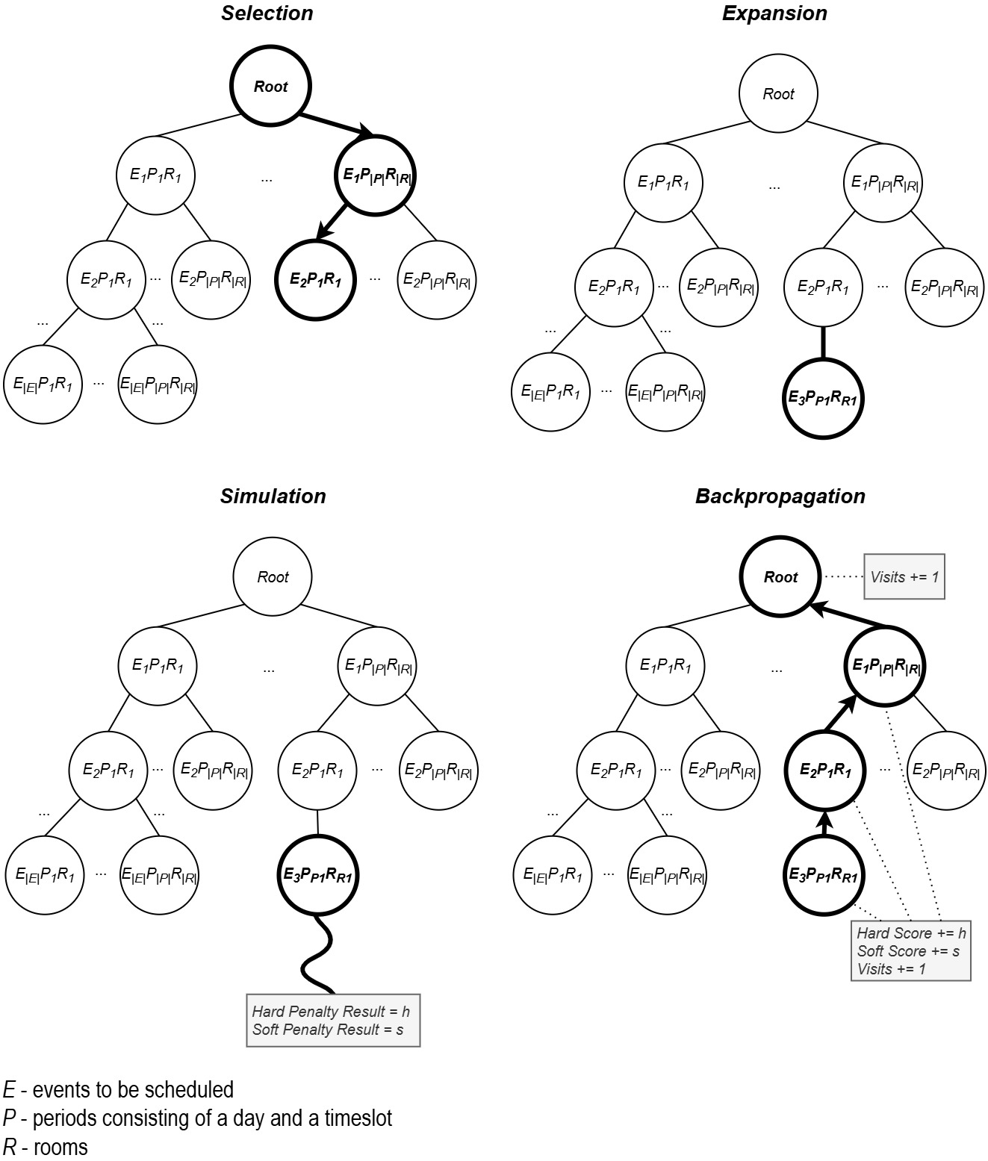
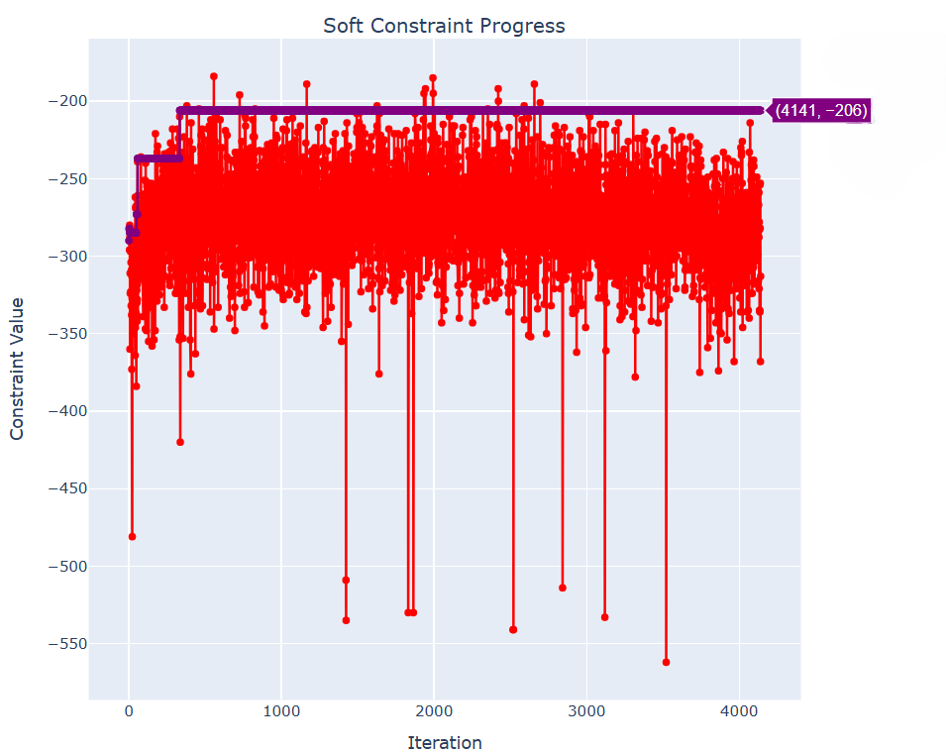



An interactive tool for supporting university timetabling Daniela Tomás¹ | João Pedroso¹ | Pedro Vasconcelos¹
¹Faculdade de Ciências da Universidade do Porto
Introduction
Workplan
University Course Timetabling Problem (UCTTP) is a complex combinatorial optimization problem that consists of allocating events, rooms, lecturers, and students to weekly schedules while meeting certain constraints.
This research focuses on Curriculum-Based Course Timetabling (CB-CTT), a variant of UCTTP that focuses on course scheduling.
FCUP’s timetabling building process is time-consuming, not automated, and the results are not the most satisfactory.
Monte Carlo Tree Search (MCTS) chosen due to its effectiveness in games and optimization problems (Figure 1).
Hill Climbing (HC) used in simulation phase for local optimization.
Key tasks involve thorough literature review, algorithms implementation, system integration with ITC-2007 (track 3) standards, and extensive testing (Figure 2).
Figure 2 – Gantt chart with the project tasks and estimated duration
Preliminary results
Tested C values (0.1 to 1000) in the UCT formula and in a modified version incorporating accumulated rewards for exploitation.
So far, all the executed tests have found feasible solutions.
C = 100 in the alternative UCT formula yielded the best results in most instances (Figure 3) but remains less competitive than top solutions.
Figure 1 – Monte Carlo Tree Search steps.
Objective(s)
Enhance the efficiency and quality of FCUP's weekly timetable development.
Provide step-by-step interactive recommendations.
Detect potential conflicts.
Integrate these functionalities into a timetable visualization interface that was previously developed using reactive programming.
Figure 3 – Soft constraint progress for comp02 instance from ITC-2007.
References
[1] R. Lewis, “A survey of metaheuristic-based techniques for university timetabling
problems,” OR Spectrum, vol. 30, no. 1, pp. 167–190, Jan. 2008. Available: https://doi.org/10.1007/s00291-007-0097-0
[2] S. Abdipoor, R. Yaakob, S. L. Goh, and S. Abdullah, “Meta-heuristic approaches
for the university course timetabling problem,” Intelligent Systems with Applications, vol. 19, p. 200253, Sep. 2023. Available: https://linkinghub.elsevier.com/retrieve/pii/S2667305323000789
[3] H. Babaei, J. Karimpour, and A. Hadidi, “A survey of approaches for university course timetabling problem,” Computers & Industrial Engineering, vol. 86, pp. 43– 59, Aug. 2015. Available: https://linkinghub.elsevier.com/retrieve/pii/S0360835214003714
[4] M. C. Chen, S. N. Sze, S. L. Goh, N. R. Sabar, and G. Kendall, “A survey of university course timetabling problem: Perspectives, trends and opportunities,” IEEE Access, vol. 9, pp. 106 515–106 529, 2021, conference Name: IEEE Access. Available: https://ieeexplore.ieee.org/document/9499056/?arnumber=9499056
[5] T. Müller, “Itc2007 solver description: a hybrid approach,” Annals of Operations Research, vol. 172, no. 1, pp. 429–446, Nov. 2009. Available: http://link.springer.com/10.1007/s10479-009-0644-y
[6] S. L. Goh, “An investigation of monte carlo tree search and local search for course timetabling problems,”, pp. 76–105, Jul. 2017. Available: https://eprints.nottingham.ac.uk/43558/
State-of-the-Art
Analyzed various surveys [1,2,3,4] and categorized UCTTP solutions based on their problem-solving strategies.
Among the approaches, metaheuristics emerged as one of the most promising, particularly single-solution-based algorithms like Simulated Annealing (SA) and Tabu Search (TS).
Hybrid approaches, such as the one used by Tomáš Müller [5] in the ITC-2007, were also shown to be effective.
Goh [6] study on the Post-Enrollment Course Timetabling Problem (PE-CTT) found that TS outperformed MCTS, despite improvements to the standard MCTS algorithm.
MCTS and its hybridization remain unexplored in the context of CB-CTT, making this the novel contribution of our work. This decision is driven by the potential of MCTS to effectively navigate large search spaces and its underutilization in this domain.
M:DS
M:ERSI
Notes:
1

Slide 2

Title Candidate’s name (First and Last)¹ | Supervisor’s name¹
¹Faculdade de Ciências da Universidade do Porto
Introduction
Preliminary results
Provide some context
What is the problem you are trying to solve?
What is your main idea for solving it?
Show some results
Focus on what is more promising
Show plots, visualizations, diagrams
What are your expectations for the next developments?
Objective(s)
What is the explicit objective or objectives of your proposed work?
Try to use topics or research questions
Obs:
You can make your poster standout by using clear diagrams and figures. Try to keep the text to the minimum necessary while using several figures.
Try do develop a graphical introduction.
Your introduction and, possibly the preliminary results, should take about 50-70% of all the poster space.
State-of-the-Art
What was the methodology you used to review the state-of-the-art of your work?
What did you find most promising?
What decisions for your work did you make, based on this knowledge?
Note:
All above text boxes have 23.5 cm width, and the font is Arial Narrow, size 24.
Please respect these formatting rules.
Figure 1 – Description of Figure 1. Use figures, illustrations, diagrams, or whatever you think will be useful so people can easily understand your work..
Workplan
References
What tasks do you need to accomplish to achieve your proposed goal?
What will you do in each task?
Include a small Gantt chart to make this clear.
Key scientific references for your thesis, eventually cited in previous sections of this poster
Pick a citation format and be coherent (Chicago, Vancouver, etc).
Use Arial Narrow, size 20 for the references
Try to use between the best 5 and 10 references
M:DS
M:ERSI
Notes:
2

