Slide 1

Airlines Delay
Supervised Learning
Artificial Intelligence 2022/2023 3LEIC10 Group 27
Daniela Tomás up202004946
Diogo Nunes up202007895
João Veloso up202005801

Slide 2
Work Specification
The task at hand is a binary classification problem, to predict whether a given flight will be delayed, given the information of the scheduled departure.
Dataset attributes:
Flight - Flight ID
Time - Time of departure
Length - Length of Flight
Airline - Airline ID
AirportFrom - Which airport the flight flew from
AirportTo - Which airport the flight flew to
DayOfWeek - Day of the week of the flight
Class - Delayed (1) or not (0)

Slide 3
Tools and Algorithms
Programming language: Python
Python libraries: Pandas, Seaborn, Scikit-Learn, …
Development environment: Jupyter Notebook / VSCode
Machine learning algorithms: Decision Trees, K-Nearest Neighbours, Support Vector Machine, ...

Slide 4
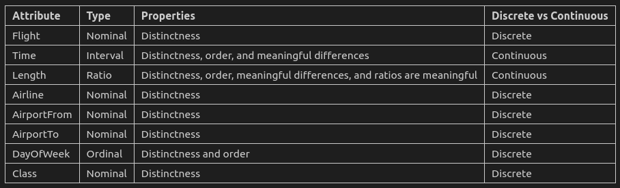
Work Already Done
The dataset has been analysed and pre-processed. The following conclusions were drawn:
There are 539382 rows and 8 cols in the dataset
There are 216618 duplicates
There are no null values
Length has some outliers

Slide 5
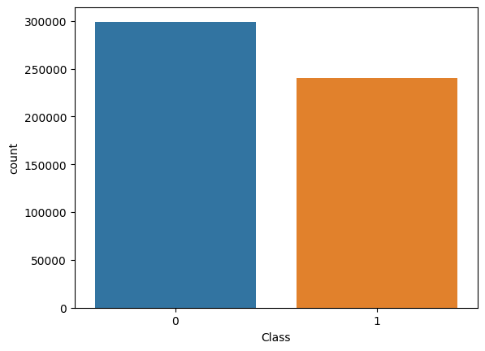
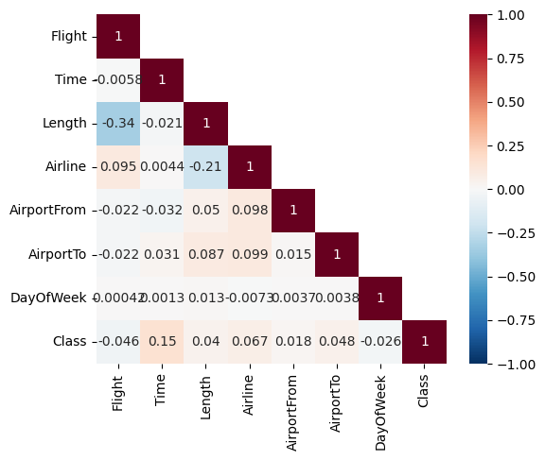
Data Pre-processing
Our dataset presented to be ready to use as:
There are no null values
Although there are duplicate values, we decided not to remove them because they could represent regularly scheduled flights that are usually on time/delayed.
There are few (<5%) outliers in ‘Length’, but they don’t necessarily represent errors, just very long flights, and so we choose not to remove them.

Slide 6
Developed Algorithms
Decision Tree
K-Nearest Neightbours
This model was based on the implementation of the DecisionTreeClassifier from the sklearn.tree module.
max_depth = 5
This model was based on the implementation of the KNeighborsClassifier from the sklearn.neighbors module.
n_neighbors = 5
Support Vector Machine
Neural Networks
This model was based on the implementation of the SVC from the sklearn.svm module.
We use a smaller subset of the data to train the model faster. If we didn't, the model would not execute in doable time.
kernel = 'rbf'
This model was based on the implementation of the MLPClassifier from the sklearn.neural_network module.
hidden_layer_sizes=(100,)
max_iter: 1000

Slide 7
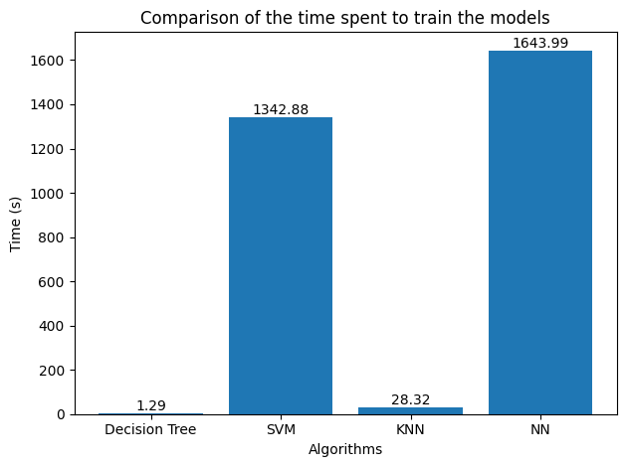
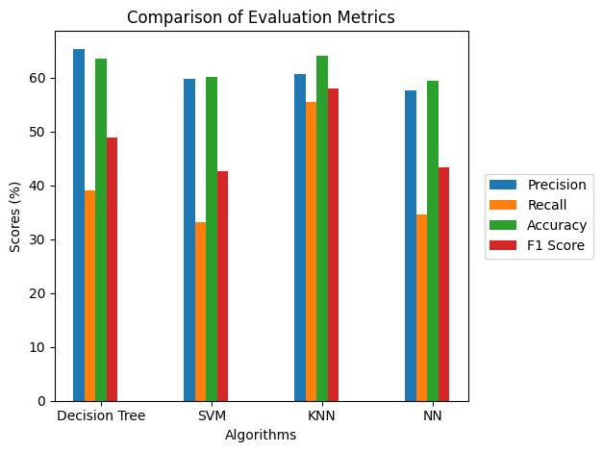
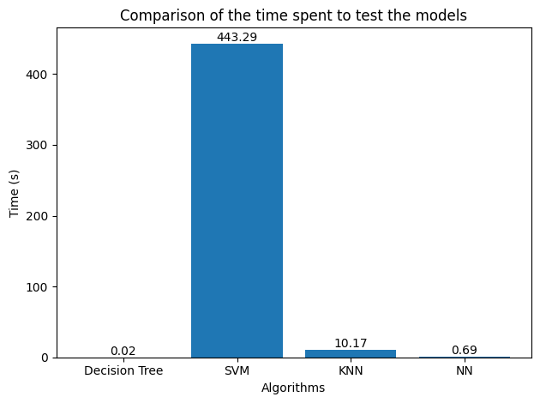
Developed Algorithms
DT has a slightly higher precision score (65.4%) than the other algorithms.
KNN has the highest recall (55.51%) and accuracy (64.06%) scores.
DT and KNN models also have the higher F-1 scores (48.97% and 58.0%, respectively).
In terms of training time, DT was the fastest (1.29s) and NN the slowest (1643.99s ≈ 27 min).
In terms of testing time, DT was once again the fastest (0.02s) and SVM was by far the slowest (443.29s ≈ 7 min).
But we must consider that the train size of SVM (10%) was smaller than the others (30%).

Slide 8
Conclusion
With this project, we have learned to work with various Machine Learning models directed at Supervised Learning.
Overall, Decision Tree and K-Nearest Neighbors models performed relatively better than Support Vector Machine and Neural Network in predicting flight delays. They achieved higher evaluation metrics scores and by far the fastest train/test times.

Slide 9
References
IART classes slides and exercises
https://www.kaggle.com/datasets/ulrikthygepedersen/airlines-delay?datasetId=2859795&sortBy=dateRun&tab=bookmarked

