Slide 1

Cohesion
Artificial Intelligence 2022/2023 3LEIC10 Group 27
Daniela Tomás up202004946
Diogo Nunes up202007895
João Veloso up202005801

Slide 2
Problem Specification
Cohesion is a puzzle game where the player slides squares of different colors, and when two squares of the same color are placed next to each other, they bond together and become permanently attached. The puzzle is solved when all the squares of each color are connected.

Slide 3
Formulation of the problem
State Representation: Matrix MxN composed of squares with different colors
Initial State: Generated board and squares
Objective Test: Check wether all the squares are connected to all other squares of the same color
Operators:
Names | Preconditions | Effects | Costs
moveUp | There is an empty space above the square and all attached pieces of the same color will remain connected after the move | The square and all attached pieces move up by one position | 1
moveDown | There is an empty space below the square and all attached pieces of the same color will remain connected after the move | The square and all attached pieces move down by one position | 1
moveLeft | There is an empty space left to the square and all attached pieces of the same color will remain connected after the move | The square and all attached pieces move left by one position | 1
moveRight | There is an empty space right to the square and all attached pieces of the same color will remain connected after the move | The square and all attached pieces move right by one position | 1

Slide 4
Formulation of the problem (cont.)
Heuristics:
Heuristic 1 – Distance:
Heuristic 1.1 – Calculate the distance between all elements of the same color
Heuristic 1.2 – Calculate the Manhattan distance between each square and its closest neighbor of the same color
Heuristic 2 – Number of squares:
Heuristic 2.1 – Calculate the number of groups of squares for each color that are not yet connected to each other
Heuristic 2.2 – Calculate the number of squares that are not yet connected and adds up their Manhattan distance

Slide 5
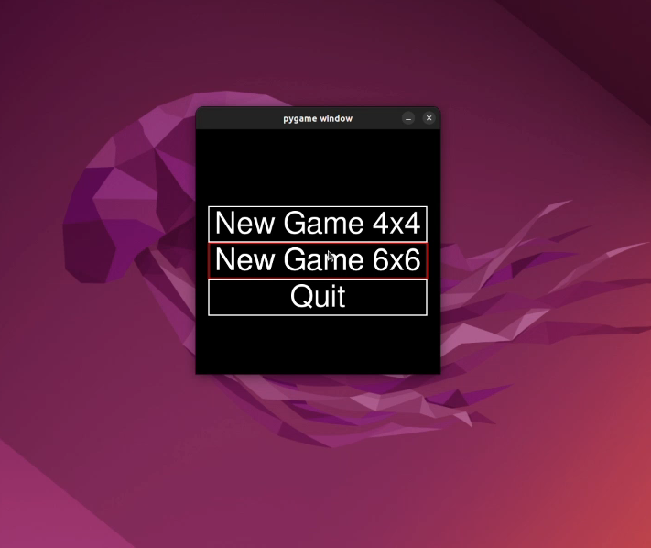
Work already done
Programming language: Python, using Pygame for the graphic interface
Development environment: VSCode
Data structures: Custom classes for different entities + more to come
The game development is already in progress
Demo link:
https://drive.google.com/file/d/1vmbYidO_sJHE37yMsZ9yVJeQC7nVtCPJ/view?usp=sharing

Slide 6
References
Google Play - Cohesion Free
https://play.google.com/store/apps/details?id=com.NeatWits.CohesionFree&hl=en&gl=US
Solver implementation for the 15 puzzle
https://github.com/MichaelKim/15puzzle
Evaluating Search Algorithms for Solving n-Puzzle
http://sumitg.com/assets/n-puzzle.pdf
Stack Overflow
https://stackoverflow.com/questions

