Slide 1

Cohesion
Artificial Intelligence 2022/2023 3LEIC10 Group 27
Daniela Tomás up202004946
Diogo Nunes up202007895
João Veloso up202005801

Slide 2
Problem Specification
Cohesion is a puzzle game where the player slides squares of different colors, and when two squares of the same color are placed next to each other, they bond together and become permanently attached. The puzzle is solved when all the squares of each color are connected.

Slide 3
Formulation of the problem
State Representation: Matrix MxN composed of squares with different colors
Initial State: Generated board and squares
Objective Test: Check wether all the squares are connected to all other squares of the same color
Operators:
Names | Preconditions | Effects | Costs
moveUp | There is an empty space above the square and all attached pieces of the same color will remain connected after the move | The square and all attached pieces move up by one position | 1
moveDown | There is an empty space below the square and all attached pieces of the same color will remain connected after the move | The square and all attached pieces move down by one position | 1
moveLeft | There is an empty space left to the square and all attached pieces of the same color will remain connected after the move | The square and all attached pieces move left by one position | 1
moveRight | There is an empty space right to the square and all attached pieces of the same color will remain connected after the move | The square and all attached pieces move right by one position | 1

Slide 4
Formulation of the problem (cont.)
Heuristics:
Heuristic 1 – Distance:
Heuristic 1.1 – Calculate the distance between all elements of the same color
Heuristic 1.2 – Calculate the Manhattan distance between each square and its closest neighbor of the same color
Heuristic 2 – Number of squares:
Heuristic 2.1 – Calculate the number of groups of squares for each color that are not yet connected to each other
Heuristic 2.2 – Calculate the number of squares that are not yet connected and adds up their Manhattan distance

Slide 5
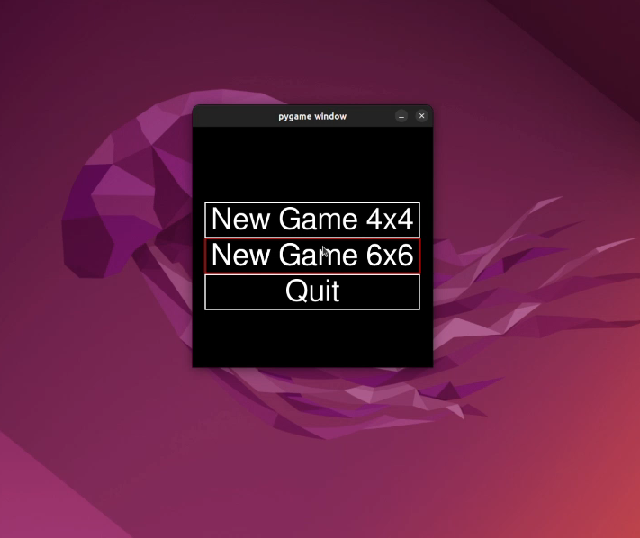
Work already done
Programming language: Python, using Pygame for the graphic interface
Development environment: VSCode
Data structures: Custom classes for different entities + more to come
The game development is already in progress
Demo link:
https://drive.google.com/file/d/1vmbYidO_sJHE37yMsZ9yVJeQC7nVtCPJ/view?usp=sharing

Slide 6
Algorithms
We implemented the following algorithms:
Uninformed:
Breadth-First Search
Depth-First Search
Uniform cost
Iterative deepening
Informed:
Greedy
A*
Approach:
For heuristics, we choose to implement 2 different ones, namely:
Manhattan distance: For this heuristic, we sum the Manhattan distances of all blocks of the same color.
Color clusters: For this heuristic we calculate the minimum distance between any 2 pieces of differing colors.

Slide 7
Results
 |  | Algorithm
 |  | BFS | DFS | Uniform Cost | Iterative Deepening | A* Manhattan | Greedy Manhattan | A* Color Cluster | Greedy Color Cluster
Level 1 (4x4) | Time (s) | 0,546 | 0,568 | 1,043 | 0,3 | 0,018 | 0,017 | 1,213 | 0,182
 | Moves | 5 | 5 | 5 | 5 | 5 | 5 | 5 | 16
 | Nodes | 310 | 321 | 715 | 622 | 6 | 6 | 872 | 104
Level 2 (4x4) | Time (s) | 0,897 | 0,772 | 1,139 | 0,629 | 0,091 | 0,048 | 2,312 | -
 | Moves | 5 | 5 | 5 | 5 | 8 | 8 | 5 | -
 | Nodes | 187 | 181 | 278 | 443 | 18 | 9 | 702 | -
Level 3 (6x6) | Time (s) | 108,15 | 60,117 | - | 426,257 | 0,058 | 0,051 | - | -
 | Moves | 10 | 10 | - | 10 | 10 | 10 | - | -
 | Nodes | 60969 | 48250 | - | 1048269 | 16 | 12 | - | -
Level 4 (6x6) | Time (s) | - | - | - | - | 0,625 | - | - | -
 | Moves | - | - | - | - | 26 | - | - | -
 | Nodes | - | - | - | - | 63 | - | - | -

Slide 8
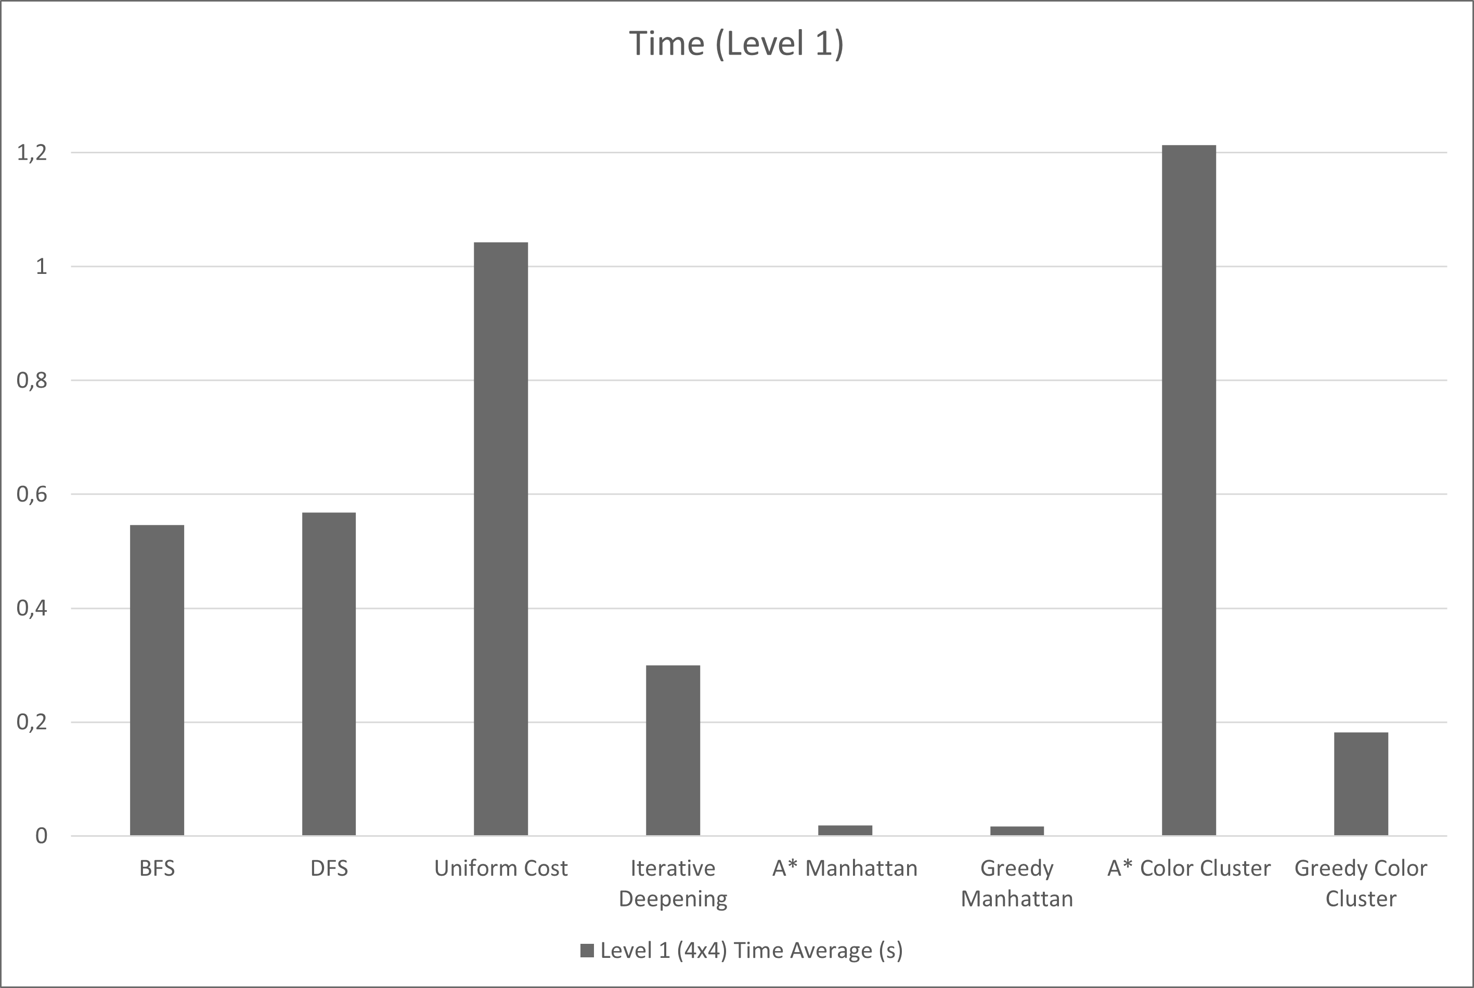
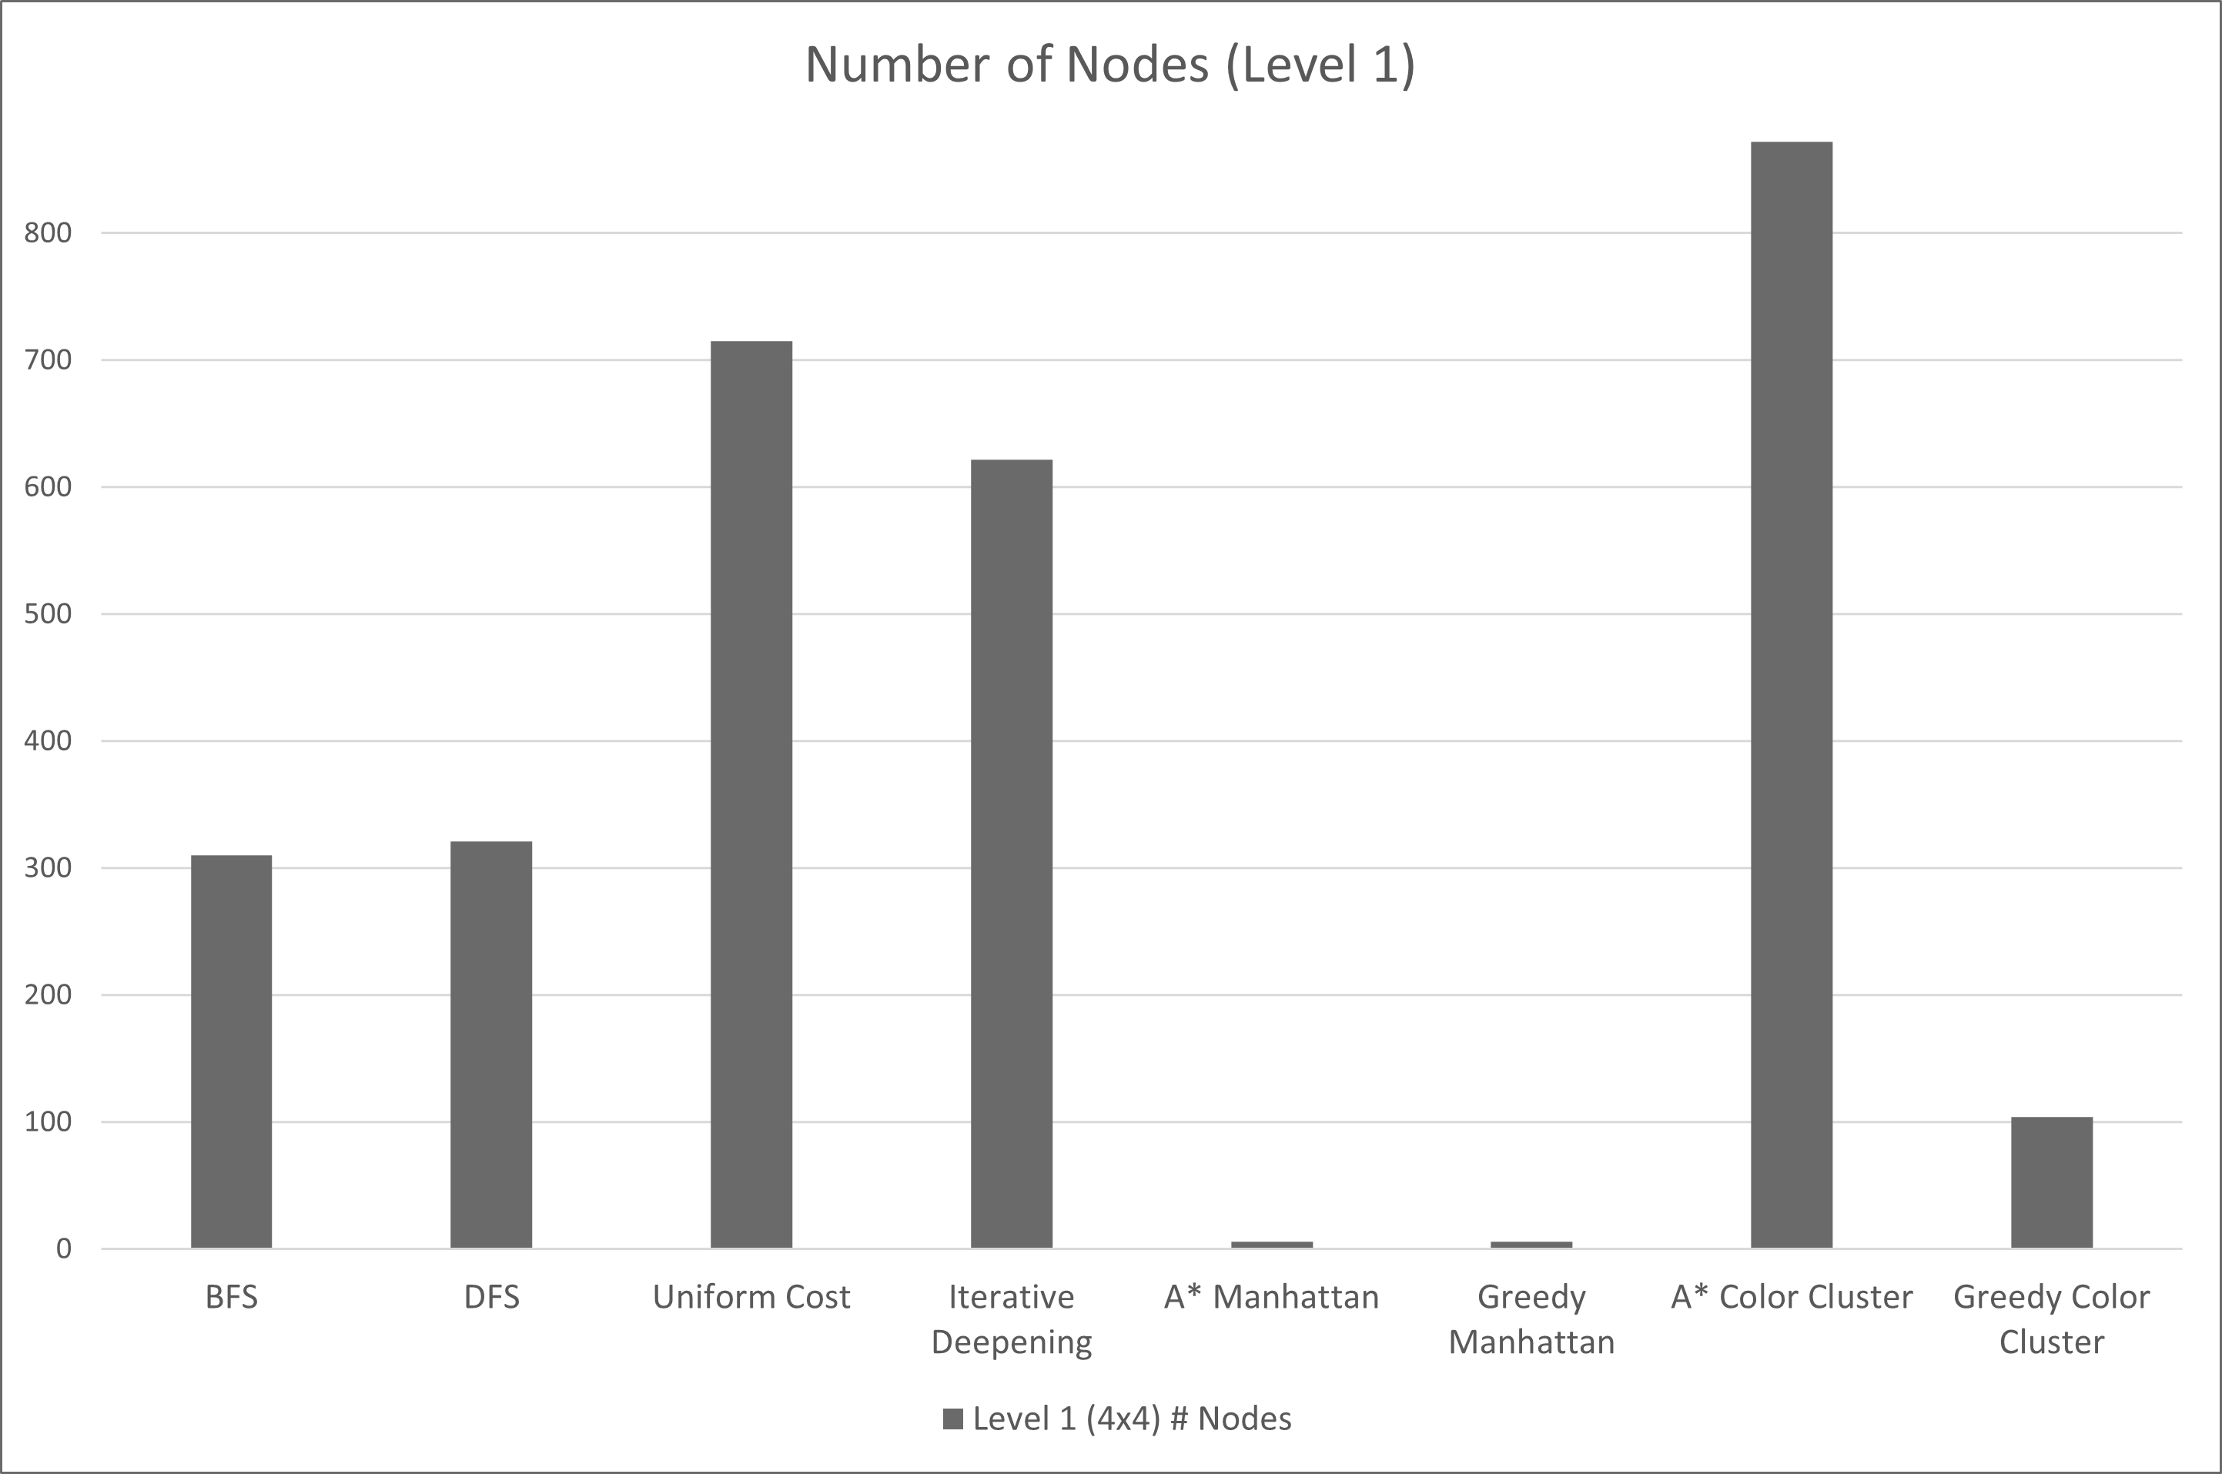
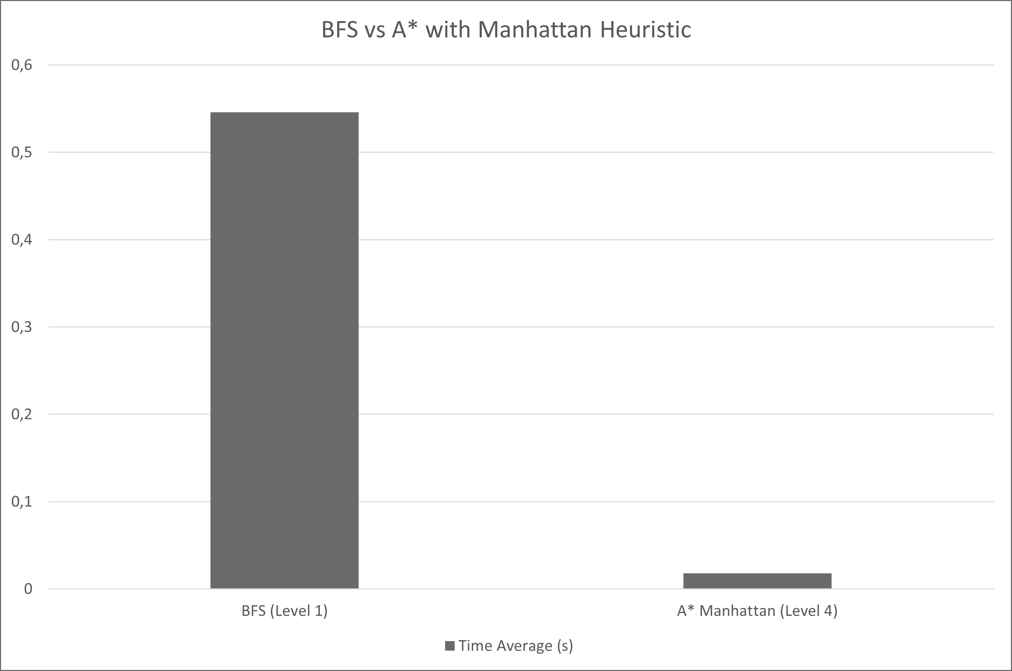
Results
Even in level 1, the simplest of all, we can already see some differences between uninformed and informed search algorithms, as when they are guided by a good heuristic for this instance, in this case, the Manhattan distance, as there are only blocks of 1 color with no obstacles only 6(!) nodes are explored to find the optimal solution, whereas uninformed searches take between 300 to 700 (Figure 2).
In level 2, which has more pieces and of different colors, we can see that informed search algorithms guided by Manhattan distance can´t find the same optimal solution that uninformed ones do, but they do find this solution in a much lower number of nodes explored, which will have more clear advantages on the next levels.
By level 3, which is on a significantly bigger board, uninformed searches are starting to take quite a bit more time, the most noticeable of which is iterative deepening which goes from an average of 0,629 seconds to just over 7 minutes (exploring over 1 000 000 nodes). Meanwhile A* and greedy both find a solution extremely quickly, exploring less than 20 nodes each.
By level 4, only A* guided by Manhattan distance manages to find a solution, and although it is fast finding it, it is not an optimal one, which is estimated at around 16 moves.
Figure 1: Time (Level 1)
Figure 2: Number of Nodes (Level 1)
Figure 3: Time - BFS (Level1) vs A* Manhattan (Level 4)

Slide 9
Conclusions
Informed searches are superior in bigger boards as they find a solution in useful times, whereas uninformed ones would simply take too long. They also show potential to being superior in smaller boards, if guided by an admissible (never overestimates the actual cost) and consistent heuristic function, which we didn't manage to find for this game.

Slide 10
References
Google Play - Cohesion Free
https://play.google.com/store/apps/details?id=com.NeatWits.CohesionFree&hl=en&gl=US
Solver implementation for the 15 puzzle
https://github.com/MichaelKim/15puzzle
Evaluating Search Algorithms for Solving n-Puzzle
http://sumitg.com/assets/n-puzzle.pdf
Stack Overflow
https://stackoverflow.com/questions
Pygame Documentation
https://www.pygame.org/docs/

