Slide 1

Airlines Delay
Supervised Learning
Artificial Intelligence 2022/2023 3LEIC10 Group 27
Daniela Tomás up202004946
Diogo Nunes up202007895
João Veloso up202005801

Slide 2
Work Specification
The task at hand is a binary classification problem, to predict whether a given flight will be delayed, given the information of the scheduled departure.
Dataset attributes:
Flight - Flight ID
Time - Time of departure
Length - Length of Flight
Airline - Airline ID
AirportFrom - Which airport the flight flew from
AirportTo - Which airport the flight flew to
DayOfWeek - Day of the week of the flight
Class - Delayed (1) or not (0)

Slide 3
Tools and Algorithms
Programming language: Python
Python libraries: Pandas, Seaborn, Scikit-Learn, …
Development environment: Jupyter Notebook / VSCode
Machine learning algorithms: Decision Trees, K-Nearest Neighbours, Support Vector Machine, ...

Slide 4
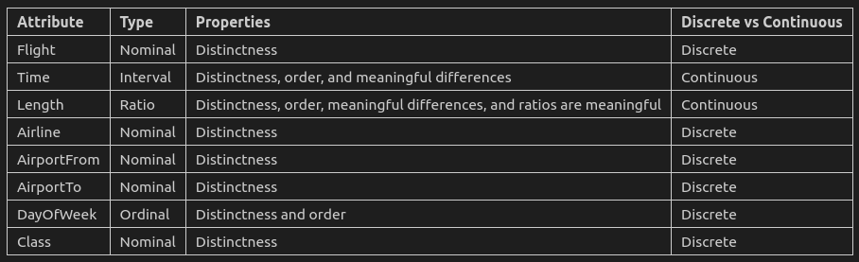
Work Already Done
The dataset has been analysed and pre-processed. The following conclusions were drawn:
There are 539382 rows and 8 cols in the dataset
There are 216618 duplicates
There are no null values
Length has some outliers

Slide 5
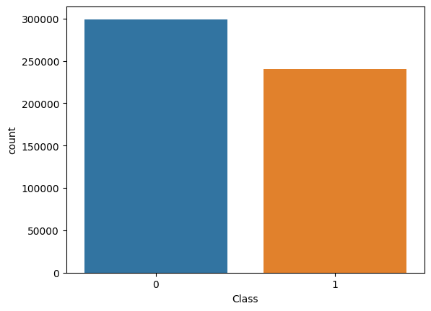
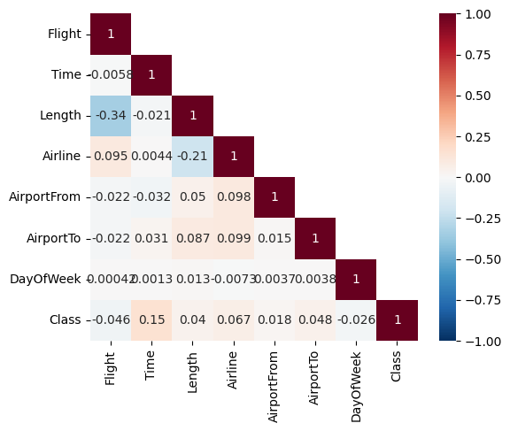
Data Pre-processing
Our dataset presented to be ready to use as:
There are no null values
Although there are duplicate values, we decided not to remove them because… (they could represent flights with the same delay time or flights with multiple delays).
There are some outliers in ‘Length’ but they don’t represent errors since most likely we will be removing the exact object of our analysis

Slide 6
Developed Algorithms
Decision Tree
Support Vector Machine
To classify this model, DecisionTreeClassifier relative to the sklearn.tree module was used.
max_depth = 5
The sklearn module svm was used.
We use a smaller subset of the data to train the model faster. If we didn't, the model would not execute in doable time.
kernel = 'rbf'
K-Nearest Neightbours
Neural Networks
To classify this model, KNeighborsClassifier relative to the sklearn.neighbors module was used.
n_neighbors = 5
This model was based on the implementation of the MLPClassifier relative to the sklearn.neural_network module.
hidden_layer_sizes=(100,)
max_iter: 1000

Slide 7
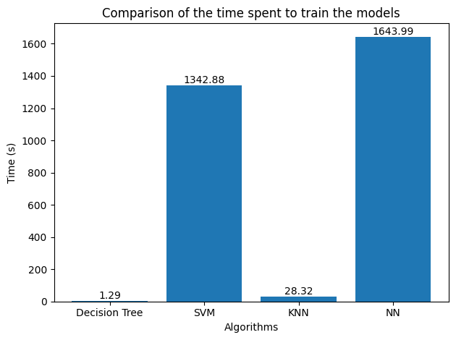
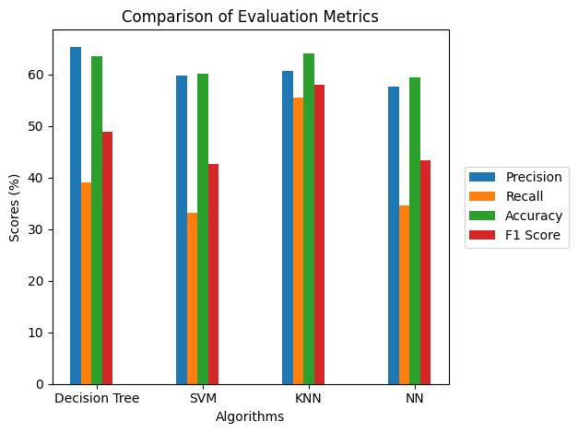
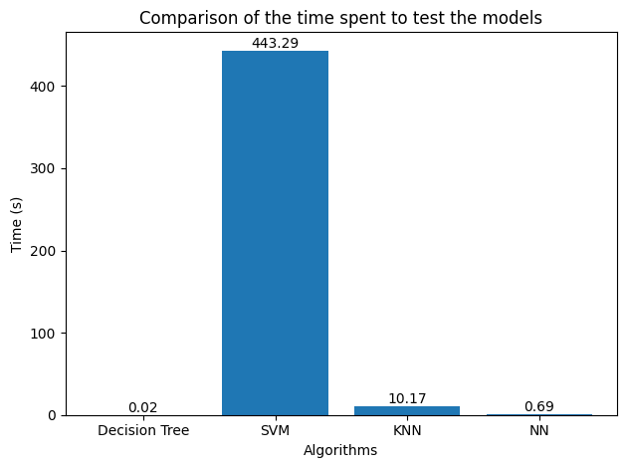
Developed Algorithms
DT has a slightly higher precision score (65.4%) than the other algorithms.
KNN has the highest recall (55.51%) and accuracy (64.06%) scores.
DT and KNN models also have the higher F-1 scores (48.97% and 58.0%, respectively).
In terms of training time, DT was the fastest (1.29s) and NN the slowest (1643.99s ≈ 27 min).
In terms of testing time, DT was once again the fastest (0.02s) and SVM was by far the slowest (443.29s ≈ 7 min).
But we must consider that the train size of SVM (10%) was smaller than the others (30%).

Slide 8
Conclusion
With this project, we have learned to work with various Machine Learning models directed at Supervised Learning.
Overall, Decision Tree and K-Nearest Neighbors models performed relatively better than Support Vector Machine and Neural Network in predicting flight delays. They achieved higher evaluation metrics scores and by far the fastest train/test times.

Slide 9
References
IART classes slides and exercises
https://www.kaggle.com/datasets/ulrikthygepedersen/airlines-delay?datasetId=2859795&sortBy=dateRun&tab=bookmarked

