Slide 1
Chapter 4: Recurrences
Sun-Yuan Hsieh
謝孫源 教授
成功大學資訊工程學系

Slide 2

Overview
A recurrence is a function is defined in terms of
one or more base cases, and
itself, with smaller arguments

Slide 3
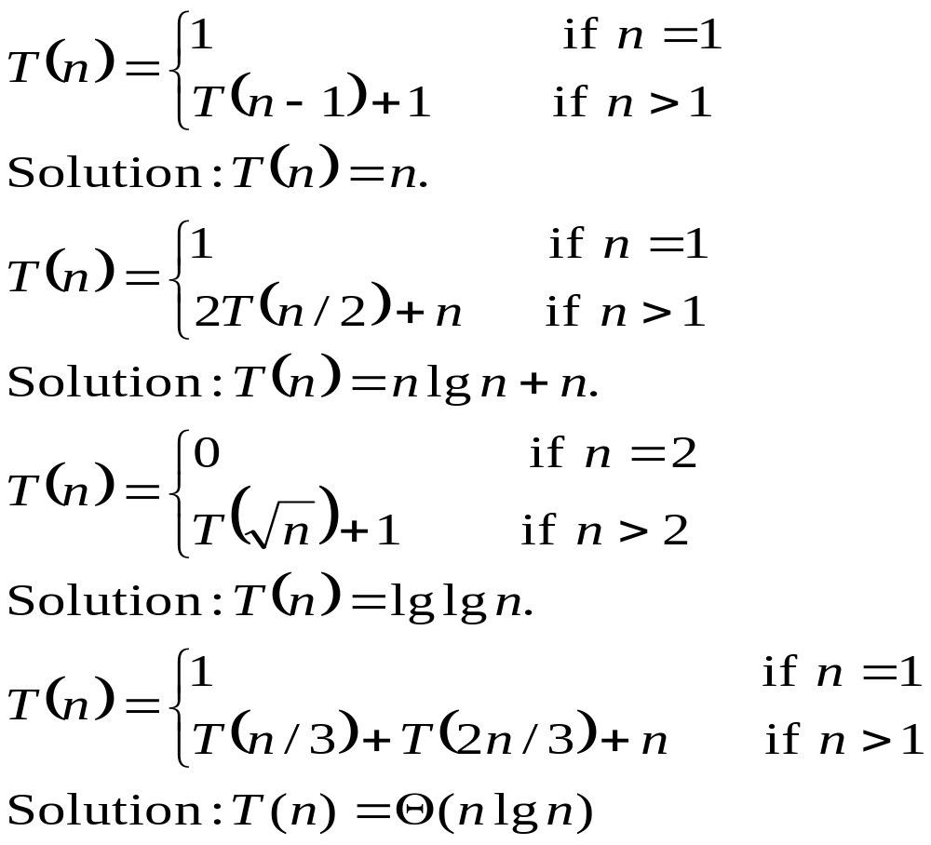
Examples:

Slide 4

Many technical issues:
Floors and ceilings
[Floors and ceilings can easily be removed and don’t affect the solution to the recurrence.]
Exact vs. asymptotic functions
Boundary condition

Slide 5

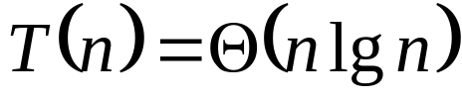
In algorithm analysis, we usually express both the recurrence and its solution using asymptotic notation.
E.g. , with solution
The boundary conditions are usually expressed as “T(n) = O(1) for sufficiently small n.”
When we desire an exact, rather than an asymptotic, solution, we need to deal with boundary conditions.
In practice, we just use asymptotic most of the time, and we ignore boundary conditions.

Slide 6
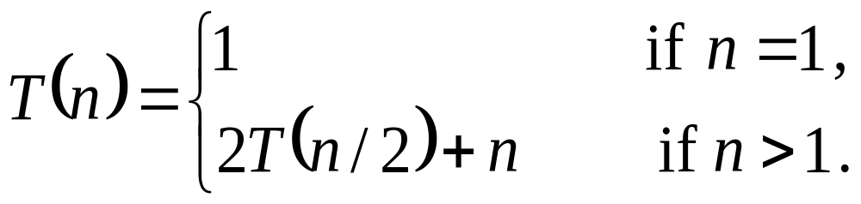
Substitution method
Guess the solution.
Use induction to find the constants and show that the solution works.
E.g.
Guess: T(n) = nlgn + n. [Here, we have a recurrence with an exact function, rather than asymptotic notation, and the solution is also exact rather than asymptotic. We’ll have to check boundary conditions and the base case.]

Slide 7
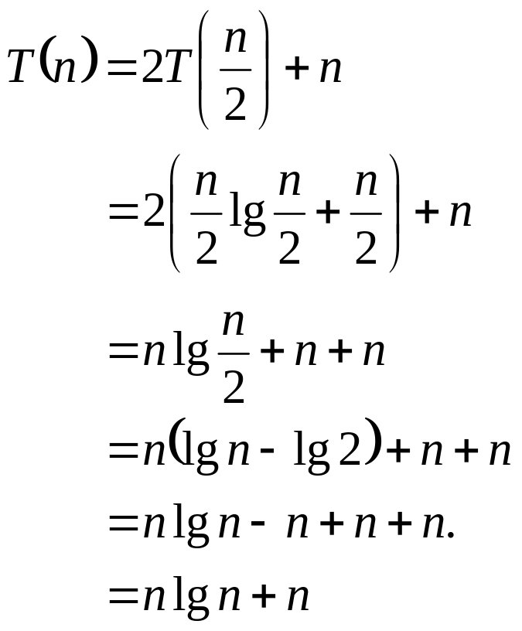
Substitution method (cont’d)
Induction:
Bass: n = 1 ➔ nlgn + n = 1 = T(n)
Inductive step: Inductive hypothesis is that T(k) = klgk + k for all k < n.
We’ll use this inductive hypothesis for T(n/2).

Slide 8
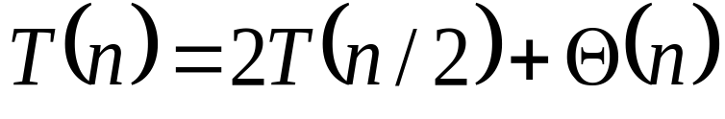
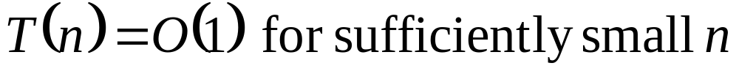
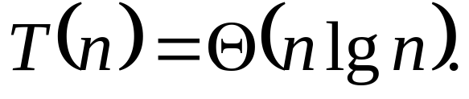
Substitution method (cont’d)
Generally, we use asymptotic notation:
Assume
Express the solution by asymptotic notation:
Don’t worry about boundary cases, nor do we show base cases in the substitution proof.

Slide 9

Substitution method (cont’d)
    T(n) is always constant for any constant n.
    Since we are ultimately interested in asymptotic solution to a recurrence, it will always be possible to choose base cases that work
    When we want an asymptotic solution to a recurrence, we don’t worry about the base cases in our proofs.
    When we want an exact solution, then we have to deal with base cases.

Slide 10


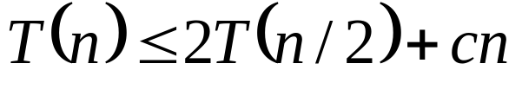
Substitution method (cont’d)
For the substitution method:
Name the constant in the additive term
Show the upper (O) and lower (Ω) bounds separately. Might need to use different constants for each notation
E.g.: . If we want to show an upper bound of , we write for some positive constant c.

Slide 11

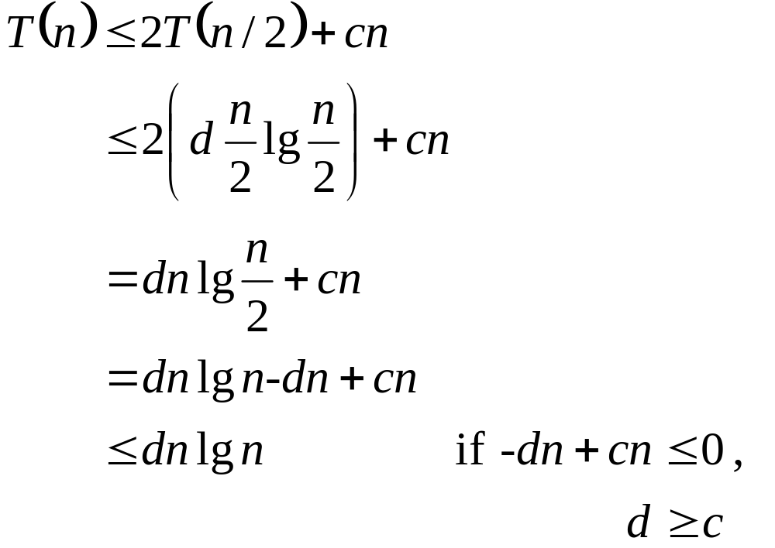
Upper bound:
Guess: for some positive constant d. We are given c in the recurrence, and we get to choose d as any positive constant. It’s OK for d to depend on c.
Substitution:
Therefore, T(n) = O(n lg n)

Slide 12


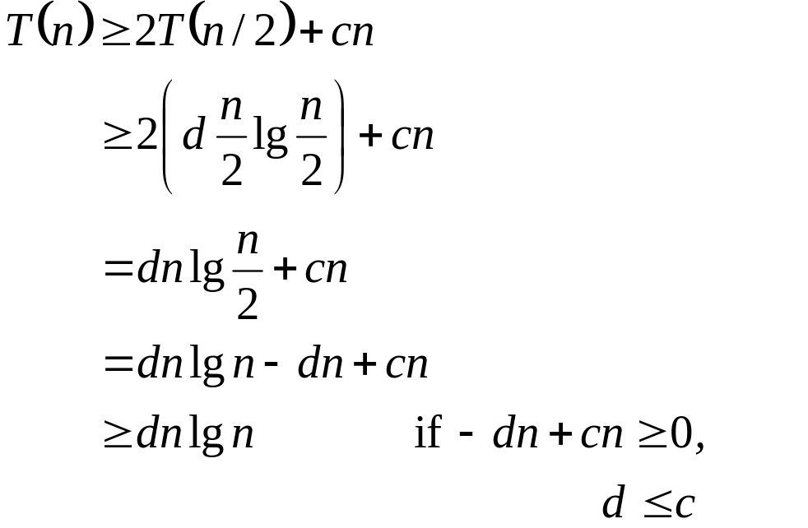
Lower bound:
Write for some positive constant c.
Guess: for some positive constant d.
Substitution:
Therefore, T(n) = Ω(n lg n).
Therefore, T(n) = Θ( n lg n ) [For this particular recurrence, we can use d = c for both the upper-bound and lower-bound proofs. That won’t always be the case.]

Slide 13
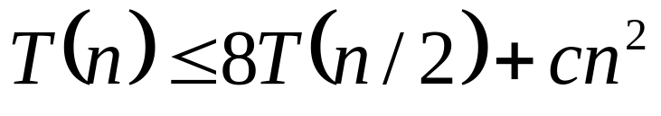
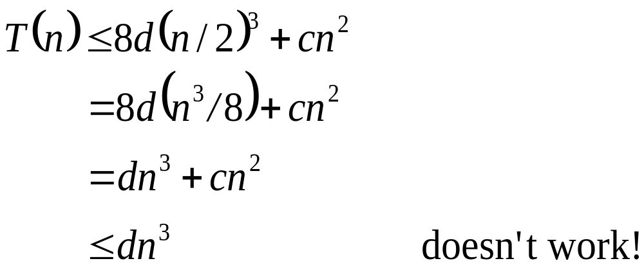
Substitution method (cont’d)
Make sure you show the same exact form when doing a substitution proof.
Consider the recurrence
T(n) = 8T(n/2) + Θ(n²) .
For an upper bound:
Guess: T(n) ≤ dn³

Slide 14
Substitution method (cont’d)
Remedy: Subtract off a lower-order term.
Guess: T(n) ≤ d n³ – d’ n²
T(n) ≤ 8(d (n/2)³ – d’(n/2)²) + cn²
= 8d (n³/8) – 8d’ (n²/4) + cn²
= d n³ – 2 d’ n² + cn²
≤ d n³ – d’ n² if – 2d’n² + cn² ≤ – d’ n² ,
d’ ≥c

Slide 15
Substitution method (cont’d)
Be careful when using asymptotic notation.
The false proof for the recurrence T(n) = 4T(n/4) + n, that T(n) = O(n):
T(n) ≤ 4( c(n/4)) + n
≤ cn + n
= O(n) wrong!
Because we haven’t proven the exact from of our inductive hypothesis (which is that T(n) ≤ cn), this proof is false.

Slide 16

Recurrence trees
Goal of the recursion-tree method
  a good guess for the substitution method
  a direct proof of a solution to a recurrence (provided by carefully drawing a recursion tree)

Slide 17
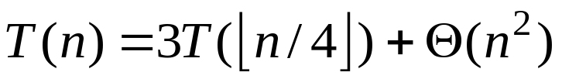
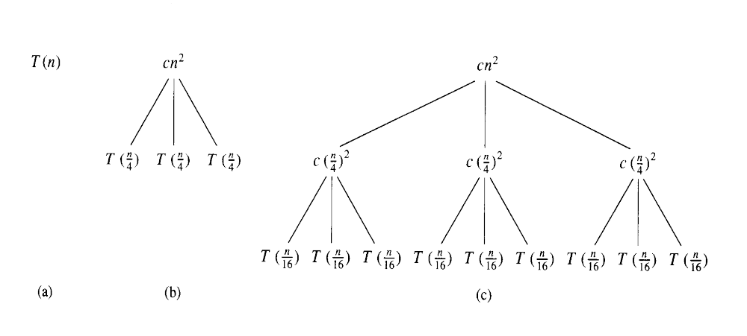
Recurrence trees

Slide 18
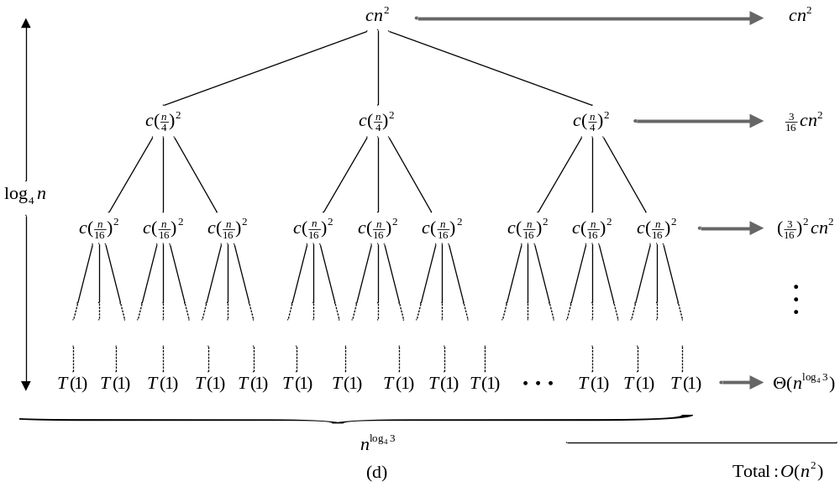
Recurrence trees

Slide 19
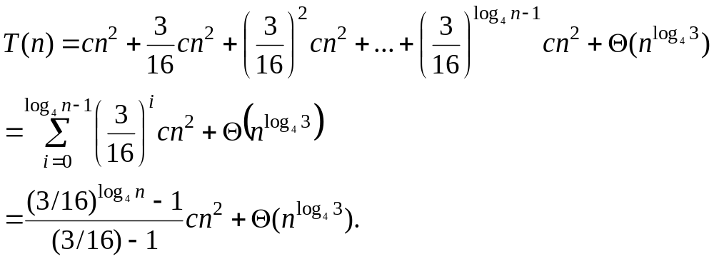
Recurrence trees
The cost of the entire tree

Slide 20
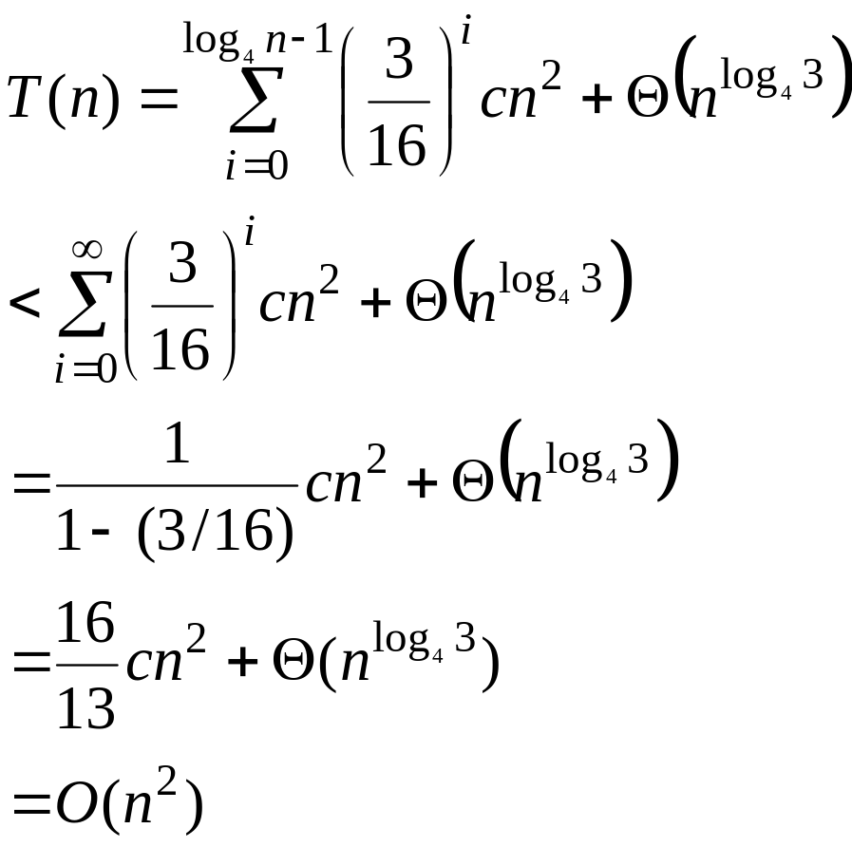
Recurrence trees

Slide 21


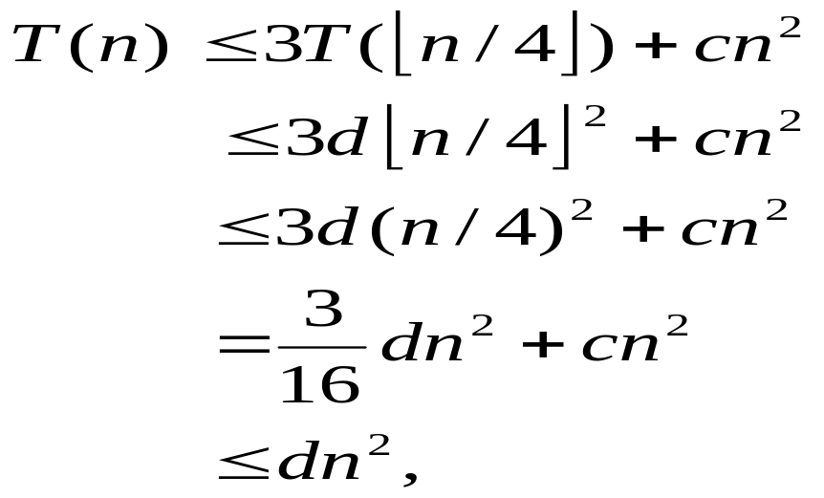

Recurrence trees
Verify by the substitution method
  Show that for some constant
  where the last step holds as long as

Slide 22
Recurrence trees
Use to generate a guess. Then verify by substitution method.
E.g.: T(n) = T(n/3) + T(2n/3) + Θ(n). For upper bound, rewrite as T(n) ≤
T(n/3) + T(2n/3) + cn; for lower bound, as T(n) ≥ T(n/3) + T(2n/3) + cn. By
summing across each level, the recursion tree shows the cost at each level of
recursion (minus the costs of recursive calls, which appear in subtrees):
cn cn
c(n/3) c(2n/3) cn
T(n/9) T(2n/9) T(2n/9) T(4n/9) cn
leftmost branch peters rightmost branch peters
out after log₃ n levels out after log_{3/2} n levels
…

Slide 23
Recurrence trees (cont’d)
There are log₃n full levels, and after log_{3/2}n levels, the problem size is down to 1.
Each level contributes ≤ cn.
Lower bound guess: ≥ d n log₃ n = Ω(n log n) for some positive constant d.
Upper bound guess: ≤ d n log_{3/2} n = O(n log n) for some positive constant d.
Then prove by substitution.

Slide 24
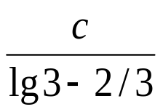
Recurrence trees (cont’d)
Upper bound:
Guess: T(n) ≤ dnlgn.
Substitution:
T(n) ≤ T(n/3) + T(2n/3) +cn
≤ d (n/3) lg (n/3) + d(2n/3) lg (2n/3) + cn
= (d (n/3) lg n – d (n/3)lg3) + (d (2n/3) lgn – d (2n/3) lg (3/2) ) + cn
= d n lg n – d ((n/3) lg3 + (2n/3) lg (3/2)) + cn
= d n lg n – d ((n/3) lg3 + (2n/3) lg3 – (2n/3) lg2) +cn
= d n lg n – d n (lg3 – 2/3) + cn
≤ d n lg n if – d n (lg3 – 2/3) + cn ≤ 0,
d ≥ Therefore, T(n) = O(n lg n).
Note: Make sure that symbolic constants used in the recurrence (e.g.,c) and the guess (e.g.,d) are different.

Slide 25
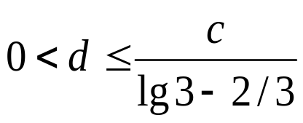
Recurrence trees (cont’d)
Lower bound:
Guess: T(n) ≥dn lg n.
Substitution: Same as for the upper bound, but replacing ≤ by ≥. End up needing
Therefore, T(n) = Ω(n lg n).
Since T(n) = O(n lg n) and T(n) = Ω(n lg n), we conclude that T(n) = Θ(n lg n)

Slide 26
Master method (cond’t)
Used for many divide-and-conquer recurrences of the form
T(n) = aT(n/b) + f (n),
Where a ≥ 1, b > 1, and f (n) > 0.
Based on the master theorem (Theorem 4.1).
Compare n^{logba} vs. f (n):
Case 1: f (n) = O ( n^{logba-ε} ) for some constant ε > 0.
(f (n) is polynomially smaller than n^{logba})
Solution: T(n) = Θ( n^{logba} )

Slide 27
Master method (cond’t)
Case 2: f (n) = Θ(n^{logba}lg^{k}n), where k ≥ 0
(f (n) is within a polylog factor of n^{logba} , but not smaller)
Solution: T(n) = Θ( n^{logba} lg^{k+1} n)
Simple case:
k =0 ➔ f (n) = Θ( n^{logba} ) ➔T(n) = Θ( n^{logba} lg n)

Slide 28
Master method (cond’t)
Case 3: f (n) = Ω (n^{logba+ε} ) for some constant ε > 0 and f (n) satisfies the regularity condition a f ( n/b ) ≤ c f (n) for some constant c < 1 and all sufficiently large n.
( f (n) is polynomially greater than n^{logba} )
Solution: T(n) = Θ( f (n) )

Slide 29
Master method (cond’t)
What’s with the Case 3 regularity condition?
Generally not a problem.
It always holds whenever f (n) = n^{k} and f (n) = Ω(n^{logba+ε} ) for constant ε > 0. So you don’t need to check it when f (n) is a polynomial.

Slide 30
Master method (cond’t)
Examples:
T(n) = 5T(n/2) + Θ(n²)
n^{log25} vs. n²
Since log₂5 – ε = 2 for some constant ε > 0, use Case 1 ➔T(n) = Θ(n^{lg5})
T(n) = 27T(n/3) + Θ(n³lgn)
n^{log327} =n³ vs. n³lgn
Use Case 2 with k = 1 ➔ T(n) = Θ(n³lg²n)

Slide 31
Master method (cond’t)
T(n) = 5T(n/2) + Θ(n³)
n^{log25} vs. n³
Now lg5 + ε = 3 for some constant ε > 0
Check regularity condition (don’t really need to since f (n) is a polynomial):
a f (n/b) = 5(n/2)³ = 5n³/8 ≤ cn³ for c =5/8 <1
Use Case 3 ➔T(n) = Θ(n³)
T(n) = 27T(n/3) + Θ(n³/lgn)
n^{log327} = n³ vs. n³/lgn = n³lg⁻¹n ≠ Θ(n³lg^{k}n) for any k ≥ 0
Cannot use the master method.

