Slide 1
Lecture Notes for Chapter 15:
Dynamic Programming
Sun-Yuan Hsieh
謝孫源 教授
成功大學資訊工程學系

Slide 2


Dynamic Programming
Not a specific algorithm, but a technique (like divide-and-conquer).
Developed back in the day when “programming” meant “tabular method” (like linear programming). Doesn’t really refer to computer programming.
Used for optimization problems:
  Find a solution with the optimal value.
  Minimization or maximization. (We’ll see both.)

Slide 3
Four-step method
Characterize the structure of an optimal solution.
Recursively define the value of an optimal solution.
Compute the value of an optimal solution in a bottom-up fashion.
Construct an optimal solution from computed information.

Slide 4
Rod cutting
How to cut steel rods into pieces in order to maximize the revenue you can get?
Each cut is free . Rod lengths are always an integral number of inches.
Input: A length n and table of prices p_{i} , for i=1, 2,…, n .
Output: the maximum revenue obtainable for rods whose lengths sum to n , computed as the sum of the prices for the individual rods .
If p_{n} is large enough , an optimal solution might require no cuts, i.e., just leave the rod as n inches long.

Slide 5
Example:[Using the first 8values from the example in the book. ]
Can cut up a rod in 2^{n-1} different ways, because can choose to cut or not cut after each of the first n-1 inches.
Here are all 8 ways to cut a rod of length 4, with the costs from the example:
Length i | 1 | 2 | 3 | 4 | 5 | 6 | 7 | 8
Price pi | 1 | 5 | 8 | 9 | 10 | 17 | 17 | 20

Slide 6
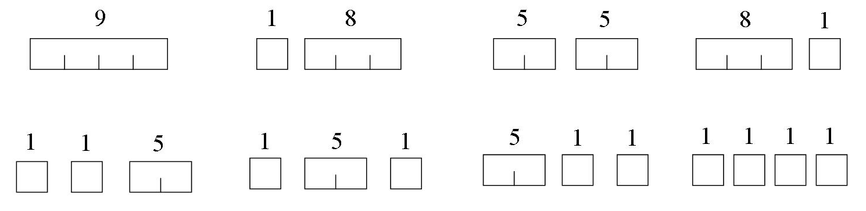
The best way is to cut it into two 2-inch pieces, getting a revenue of p₂ + p₂ =5 + 5 = 10.
Let r_{i} be the maximum revenue for a rod of length i. Can express a solution as a sum of individual rod lengths.

Slide 7
Can determine optimal revenues r_{i} for the example, by inspection:
i | r_{i} | optimal solution
1 | 1 | 1(no cuts)
2 | 5 | 2 (no cuts)
3 | 8 | 3 (no cuts)
4 | 10 | 2 + 2
5 | 13 | 2 + 3
6 | 17 | 6 (no cuts)
7 | 18 | 1 + 6 or 2 + 2 + 3
8 | 22 | 2 + 6

Slide 8
Can determine optimal revenue r_{n} by taking the maximum of
  p_{n}: the price we get by not making a cut,
  r₁ + r_{n-1}: the maximum revenue from a rod of 1 inch and a rod n-1 inches,
  r₂ + r_{n-2}: the maximum revenue from a rod of 2 inches and a rod of n-2 inches, …
  r_{n-1} + r₁.
That is,
r_{n} = max(p_{n ,} r₁ + r_{n-1} , r₂ + r_{n-2}, …, r_{n-1} + r₁)

Slide 9
Optimal substructure
Optimal substructure: To solve the original problem of size n, solve subproblems on smaller sizes. After making a cut, we have two subproblems. The optimal solution to the original problem incorporates optimal solutions to the subproblems.We may solve the subproblems independently.
Example: For n = 7 , one of the optimal solutions makes a cut at 3 inches, giving two subproblems, of lengths 3 and 4. We need to solve both of them optimally. The optimal solution for the problem of length 4, cutting into 2 pieces, each of length 2, is used in the optimal solution to the original problem with length 7.

Slide 10
A simpler way to decompose the problem
A simpler way to decompose the problem: Every optimal solution has a leftmost cut. In other words, there’s some cut that gives a first piece of length i cut off the left end, and a remaining piece of length n - i on the right.
  Need to divide only the remainder, not the first piece.
  Leaves only one subproblem to solve, rather than two subproblems.

Slide 11
  Say that the solution with no cuts has first piece size i = n with revenue p_{n} , and remainder size 0 with revenue r₀ = 0.
  Gives a simpler version of the equation for r_{n:}
r_{n} ₌ max (p_{i} + r_{n-i}) .
1 ≦i ≦n

Slide 12
Recursive top-down
Recursive top-down
  Direct implementation of the simpler equation for r_{n}.
  The call CUT-ROD(p,n) returns the optimal revenue r_{n} :
CUT-ROD(p,n)
If n = = 0
return 0
q = -∞
for i = 1 to n
q = max( q, p[i] + CUT-ROD(p,n – i) )
return q

Slide 13
This procedure works, but it is terribly inefficient. If you code it up and run it , it could take more than an hour for n = 40. Running time almost doubles each time n increases by 1.
Why so inefficient?: CUT-ROD calls itself repeatedly, even on subproblems it has already solved. Here’s a tree of recursive calls for n = 4. Inside each node is the value of n for the call represented by the node:

Slide 14
4
3
2
0
1
2
1
0
1
0
0
1
0
0
0
0
Lots of repeated sub problems. Solve the subproblem for size 2 twice, for size 1 four times, and for size 0 eight times.

Slide 15
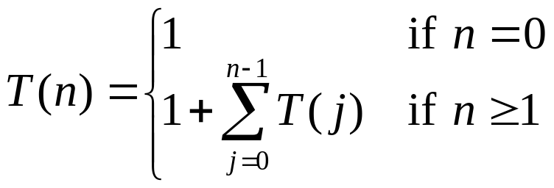
Exponential growth: Let T(n) equal the number of calls to CUT-ROD with second parameter equal to n. Then
Summation counts calls where second parameter is j = n-i.
Solution to recurrence if T(n) = 2^{n}.

Slide 16
Dynamic-programming solution
Instead of solving the same subproblems repeatedly, arrange to solve each subproblem just once.
Save the solution to a subproblem in a table , and refer back to the table whenever we revisit the subproblem.
“Store, don’t recompute” => time-memory trade-off.
Can turn an exponential-time solution into a polynomial-time solution.
Two basic approaches: top-down with memoization, and bottom-up.

Slide 17
Top-down with memoization
Solve recursively, but store each result in a table.
To find the solution to a sub problem, first look in the table. If the answer is there, use it. Otherwise, compute the solution to the sub problem and then store the solution in the table for future use.

Slide 18
Memorizing is remembering what we have computed previously.
Memorized version of the recursive solution, storing the solution to the subproblem of length i in array entry r [i]:
MEMOIZED-CUT-ROD(p,n)
let r [0..n] be a new array
for i = 0 to n
r[i] = - ∞
return MEMOIZED-CUT-ROD-AUX(p,n,r)

Slide 19
MEMOIZED-CUT-ROD-AUX(p,n,r)
if r[n] ≧ 0
return r[n]
if n = = 0
q = 0
else q = - ∞
for i = 1 to n
q = max (q, p[i] +MEMOIZED-CUT-ROD-AUX(p,n-i,r))
r[n] = q
return q

Slide 20
Bottom-up
Sort the subproblems by size and solve the smaller ones first. That way, when solving a subproblem, have already solved the smaller subproblems we need.

Slide 21
BOTTOM-UP-CUT-ROD(p,n)
let r[0..n] be a new array
r[0] = 0
for j = 1 to n
q = - ∞
for i = 1 to j
q = max(q, p [i] + r [j - i])
r [j ] = q
return r [n]

Slide 22
Running time
Both the top-down and bottom-up versions run in Θ(n²) time.
  Bottom-up: Doubly nested loops. Number of iterations of inner for loop forms an arithmetic series.
  Top-down: MEMOIZED-CUT-ROD solves each subproblem just once, and it solves subproblems for sizes 0,1,…,n. To solve a subproblem of size n, the for loop iterates n times => over all recursive calls, total number of iterations forms an arithmetic series. [Actually using aggregate analysis, which Chapter 17 covers.]

Slide 23
Subproblem graphs
How to understand the subproblems involved and how they depend on each other.
Directed graph:
  One vertex for each distinct subproblem.
  Has a direct edge (x,y) if computing an optimal solution to subproblem x directly requires knowing an optimal solution to subproblem y.

Slide 24
Example: For rod-cutting problem with n = 4:
4
3
2
1
0

Slide 25
Can think of the subproblem graph as a collapsed version of the tree of recursive calls, where all nodes for the same subproblem are collapsed into a single vertex, and all edges go from parent to child.
Subproblem graph can help determine running time. Because we solve each subproblem just once, running time is sum of times needed to solve each subproblem.

Slide 26
  Time to compute solution to a subproblem is typically linear in the out-degree(number of outgoing edges) of its vertex.
  Number of subproblems equals number of vertices.
When these conditions hold, running time is linear in number of vertices and edges.

Slide 27
Reconstructing a solution
So far, have focused on computing the value of an optimal solution, rather than the choices that produced an optimal solution.
Extend the bottom-up approach to record not just optimal values, but optimal choices. Save the optimal choices in a separate table. Then use a separate procedure to print the optimal choices.

Slide 28
EXTENDED-BOTTOM-UP-CUT-ROD(p,n)
let r[0..n] and s[0..n] be new arrays
r[0] = 0
for j = 1 to n
q= - ∞
for i = 1 to j
if q < p[i] + r[j – i]
q = p[i] + r[j – i]
s[j ] = i
r[j] = q
return r and s

Slide 29
Saves the first cut made in an optimal solution for a problem of size i in s[i].
To print out the cuts made in an optimal solution:
PRINT-CUT-ROD-SOLUTION(p,n)
(r, s) = EXTENDED-BOTTOM-UP-CUT-ROD(p,n)
while n > 0
print s[n]
n = n – s[n]

Slide 30
Examples: For the example, EXTENDED-BOTTOM-UP-CUT-ROD returns
A call to PRINT-CUT-ROD-SOLUTION(p,8) calls EXTENDED-BOTTOM-UP-CUT-ROD to compute the above r and s tables. Then it prints 2, sets n to 6, prints 6, and finishes (because n becomes 0).
i | 0 | 1 | 2 | 3 | 4 | 5 | 6 | 7 | 8
r[i] | 0 | 1 | 5 | 8 | 10 | 13 | 17 | 18 | 22
s[i] | 0 | 1 | 2 | 3 | 2 | 2 | 6 | 1 | 2

Slide 31
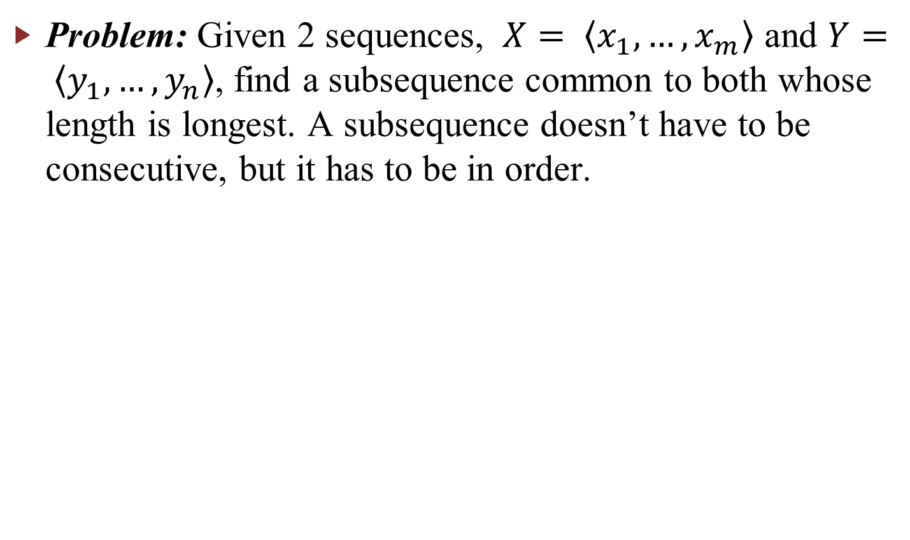
Longest common subsequence

Slide 32
Examples: [The examples are of different types of trees.]
s p r i n g t i m e
h o r s e b a c k
p i o n e e r
s n o w f l a k e
m a e l s t r o m
h e r o i c a l l y
b e c a l m
s c h o l a r l y

Slide 33
Brute-force algorithm:
For every subsequence of X, check whether it’s a subsequence of Y.
Time Θ(n2^{m}):
2^{m} subsequences of X to check.
Each subsequence takes Θ(n) time to check: scan Y for first letter, from there scan for second, and so on.

Slide 34



Optimal substructure
Notation:
X_{i} = prefix
Y_{i} = prefix
Theorem
Let Z = be any LCS of X and Y.
If x_{m} = y_{n}, then z_{k} = x_{m} = y_{n} and Z_{k-1} is an LCS of X_{m-1} and Y_{n-1}.
If x_{m} ≠ y_{n}, then z_{k} ≠ x_{m} => Z is an LCS of X_{m-1} and Y
If x_{m} ≠ y_{n}, then z_{k} ≠ y_{n} => Z is an LCS of X and Y_{n-1}

Slide 35
If x_{m} = y_{n}, then z_{k} = x_{m} = y_{n}
If x_{m} ≠ y_{n}, then z_{k} ≠ x_{m}
X
X_{m–1} | x_{m}
X
X_{m–1}
X_{m–2} | x_{m–1} | x_{m}
Y
Y_{n–1} | y_{n}
Y
Y_{n–1} | y_{n}
Z
Z_{k–1} | z_{k}
Z
Z_{k–1} | z_{k}
If x_{m} ≠ y_{n}, then z_{k} ≠ y_{n}
X
X_{m–1} | x_{m}
Y
Y_{n–2} | y_{n–1} | y_{n}
Y_{n–1}
Z
Z_{k–1} | z_{k}

Slide 36


Proof
1. First show that z_{k} = x_{m} = y_{n}. Suppose not. Then make a subsequence Z’ =
. It’s a common subsequence of X and Y and has length k + 1
Z’ is a longer common subsequence that Z contradicts Z being an LCS. Now show Z_{k-1} is an LCS of X_{m-1} and Y_{n-1}. Clearly, it’s a common subsequence. Now suppose there exists a common subsequence W of X_{m-1} and Y_{n-1} that’s longer than Z_{k-1} length of W ≧ k. Make subsequence W’ by appending x_{m} to W. W’ is common subsequence of X and Y, has length ≧ k + 1 contradicts Z being an LCS.
2. If z_{k} ≠ x_{m},then Z is a common subsequence of X_{m-1} and Y. Suppose there exists a subsequence W of X_{m-1} and Y with length ＞ k. Then W is a common subsequence of X and Y contradicts Z being an LCS.
3. Symmetric to 2.
Therefore, an LCS of two sequences contains as a prefix an LCS of prefixes of
the sequences.

Slide 37
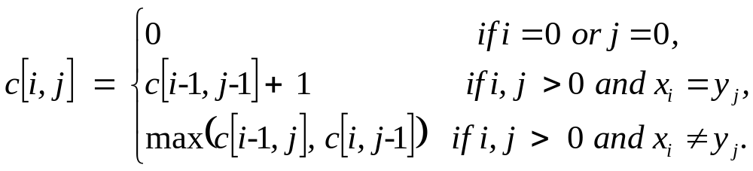
Recursive formulation
Define c[i, j] = length of LCS of X_{i} and Y_{j}. We want c[m, n].
Again, we could write a recursive algorithm based on this formulation.
Try with bozo,bat.

Slide 38
4,3
3,3
4,2
2,3
3,2
3,2
4,1
1,3
2,2
2,2
3,1
2,2
3,1
3,1
4,0
0,3
1,2
1,2
2,1
1,2
2,1
2,1
3,0
Lots of repeated subproblems
Instead of recomputing, store in a table.

Slide 39
Compute length of optimal solution
LCS-Length( X, Y, m, n)
for i ← 1 to m
do c[i, 0] ← 0
for j ← 0 to n
do c[0, j] ← 0
for i ← 1 to m
do for j ← 1 to n
do if x_{i} = y_{j}
then c[i, j] ← c[i－1, j－1] +1
b[i, j] ← “↖”
else if c[i－1, j] ≧c[i, j－1]
then c[i, j] ← c[i－1, j]
b[i, j] ← “↑”
else c[i, j] ← c[i, j－1]
b[i, j] ← “←”
return c and b

Slide 40
PRINT-LCS( b, X, i, j)
if i = 0 or j = 0
then return
if b[i, j] = “↖”
then PRINT-LCS( b, X , i－1, j －1)
print x_{i}
else if b[i, j] = “↑”
then PRINT-LCS( b, X, i －1, j)
else PRINT-LCS( b, X, i, j－1)
Initial call is PRINT-LCS( b, X, m, n).
b[i, j] points to table entry whose subproblem we used in solving LCS of X_{i} and Y_{j}.
When b[i, j] = ↖, we have extended LCS by one character. So longest common subsequence = entries with ↖ in them.

Slide 41
Demonstration: show only c[i, j] :
 |  | a | m | p | u | t | a | t | i | o | n
 | 0 | 0 | 0 | 0 | 0 | 0 | 0 | 0 | 0 | 0 | 0
s | 0 | 0 | 0 | 0 | 0 | 0 | 0 | 0 | 0 | 0 | 0
p | 0 | 0 | 0 |  | 1 | 1 | 1 | 1 | 1 | 1 | 1
a | 0 | 1 | 1 | 1 | 1 | 1 |  | 2 | 2 | 2 | 2
n | 0 | 1 | 1 | 1 | 1 | 1 | 2 | 2 | 2 | 2 | 3
k | 0 | 1 | 1 | 1 | 1 | 1 | 2 | 2 | 2 | 2 | 3
i | 0 | 1 | 1 | 1 | 1 | 1 | 2 | 2 |  | 3 | 3
n | 0 | 1 | 1 | 1 | 1 | 1 | 2 | 2 | 3 | 3
g | 0 | 1 | 1 | 1 | 1 | 1 | 2 | 2 | 3 | 3 | 4
 |  |  |  | p |  |  | a |  | i |  | n
1
2
3
4
Time: Θ(mn)

Slide 42
Optimal binary search trees
[Also new in the second edition.]
Given sequence K = (k_{1,} k₂, …, k_{n} ) of n distinct keys, sorted (k₁ < k₂ < …< k_{n} ).
Want to build a binary search tree from the keys.
For k_{i}, have probability p_{i} that a search is for k_{i}.
Want BST with minimum expected search cost.
Actual cost = # of items examined.
For key k_{i}, cost = depth_{T}(k_{i}) + 1, where depth_{T}(k_{i}) = depth of k_{i} in BST T.

Slide 43
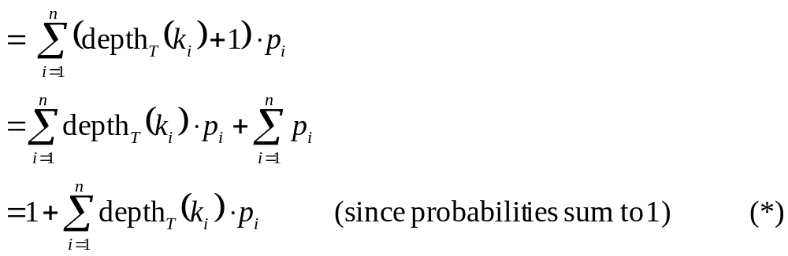
E [search cost in T]
[Similar to optimal BST problem in the book, but simplified here: we
assume that all searches are successful. Book has probabilities of
searches between keys in tree.]

Slide 44
Example:
i | 1 | 2 | 3 | 4 | 5
p_{i} | .25 | .2 | .05 | .2 | .3
i | depth_{T}(k_{i}) | depth_{T}(k_{i}) ．p_{i}
1 2 3 4 5 | 1 0 2 1 2 | .25 0 .1 .2 .6
 |  | 1.15
k₂
k₁
k₄
k₃
k₅
Therefore, E[search cost] = 2.15.

Slide 45
k₂
k₁
k₅
k₄
k₃
i | depth_{T}(k_{i}) | depth_{T}(k_{i}) ．p_{i}
1 2 3 4 5 | 1 0 3 2 1 | .25 0 .15 .4 .3
 |  | 1.10
Therefore, E[search cost] = 2.10, which turns out to be optimal.

Slide 46
Observations:
Optimal BST might not have smallest height.
Optimal BST might not have highest-probability key at root.
Build by exhaustive checking?
Construct each n-node BST.
For each, put in keys.
Then compute expected search cost.
But there are Ω(4^{n}/n^{3/2}) different BSTs with n nodes.

Slide 47
Optimal substructure
Consider any subtree of a BST. It contains keys in a contiguous range k_{i}, …, k_{j}
for some 1 ≦ i ≦ j ≦ n.
If T is an optimal BST and T contains subtree T’ with keys k_{i}, …, k_{j}, then T’
must be an optimal BST for keys k_{i}, …, k_{j}.
Proof Cut and paste. ■
T
T’

Slide 48
Use optimal substructure to construct an optimal solution to the problem from
optimal solutions to subproblems:
Given keys k_{i}, …, k_{j} (the problem).
One of them, k_{r}, where i ≦ r ≦ j, must be the root.
Left subtree of k_{r} contains k_{i}, …, k_{r-1}.
Right subtree of k_{r} contains k_{r+1}, …, k_{j}.
If
  examine all candidate roots k_{r}, for i ≦ r ≦ j, and
  we determine all optimal BSTs containing k_{i}, …, k_{r-1} and containing
  k_{r+1}, …, k_{j} ,
  then we’re guaranteed to find an optimal BST for k_{i}, …, k_{j}.
k_{r}
k_{i} k_{r-1}
k_{r+1} k_{j}

Slide 49
Recursive solution
Subproblem domain:
Find optimal BST for k_{i}, …, k_{j}, where i ≧ 1, j ≦ n, j ≧ i －1.
When j = i －1, the tree is empty.
Define e[i, j] = expected search cost of optimal BST for k_{i}, …, k_{j}.
If j = i －1, then e[i, j] = 0.
If j ≧ i,
Select a root k_{r}, for some i ≦ r ≦ j.
Make an optimal BST with k_{i}, …, k_{r-1} as the left subtree.
Make an optimal BST with k_{r+1}, …, k_{j} as the right subtree.
Note: when r = i, left subtree is k_{i}, …, k_{i-1} ; when r = j, right subtree is
k_{j+1}, …, k_{j}.

Slide 50
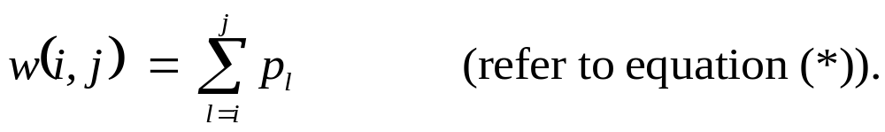
When a subtree becomes a subtree of a node:
Depth of every node in subtree goes up by 1.
Expected search cost increases by
If k_{r} is the root of an optimal BST for k_{i}, …, k_{j}:
e[i, j] = p_{r} + (e[i, r－1] + w(i, r－1)) + (e[r + 1, j] + w(r + 1, j)).
But w(i, j) = w(i, r－1) + p_{r} + w(r + 1, j).
Therefore, e[i, j] = e[i, r－1] + e[r + 1, j] + w(i, j).

Slide 51
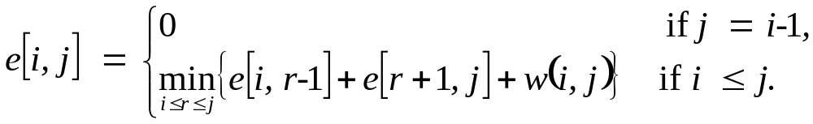
This equation assumes that we already know which key is k_{r}.
We don’t.
Try all candidates, and pick the best one:
Could write a recursive algorithm…

Slide 52
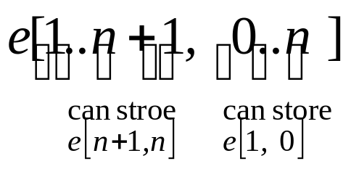
Computing an optimal solution
As “usual,” we’ll store the values in a table:
Will use only entries e[i, j], where j ≧ i －1.
Will also compute
root[i, j] = root of subtree with keys k_{i}, …, k_{j}, for 1 ≦ i ≦ j ≦ n.

Slide 53
One other table…don’t recompute w(i, j) form scratch every time we need it.
(Would take Θ(j －i) additions.)
Instead:
Table w[1..n + 1, 0..n]
w[i, i－1] = 0 for 1 ≦ i ≦ n
w[i, j] = w[i, j－1] + p_{j} for 1 ≦ i ≦ j ≦ n
Can compute all Θ(n²) values in Ο(1) time each.

Slide 54
OPTIMAL-BST(p, q, n)
for i ← 1 to n + 1
do e[i, i－1] ← 0
w[i, i－1] ← 0
for l ← 1 to n
do for i ← 1 to n － l + 1
do j ← i + l －1
e[i, j] ← ∞
w[i, j] ← w[i, j－1] + p_{j}
for r ← i to j
do t ← e[i, r－1] + e[r + 1, j] + w[i, j]
if t < e[i, j]
then e[i, j] ← t
root[i, j] ← r
return e and root

Slide 55
First for loop initializes e, w entries for subtrees with 0 keys.
Main for loop:
Iteration for l works on subtrees with l keys.
Idea: compute in order of subtree sizes, smaller (1 key) to larger (n keys).

Slide 56
For example at beginning:
i | 1 | 2 | 3 | 4 | 5
p_{i} | .25 | .2 | .05 | .2 | .3
i | j
 | e | 0 | 1 | 2 | 3 | 4 | 5
 | 1 2 3 4 5 6 | 0 | .25 0 | .65 .2 0 | .8 .3 .05 0 | 1.25 .75 .3 .2 0 | 2.10 1.35 .85 .7 .3 0
p_{i}

Slide 57
i | j
 | w | 0 | 1 | 2 | 3 | 4 | 5
 | 1 2 3 4 5 6 | 0 | .25 0 | .45 .2 0 | .5 .25 .05 0 | .7 .45 .25 .2 0 | 1.0 .75 .55 .5 .3 0
i | j
 | root | 1 | 2 | 3 | 4 | 5
 | 1 2 3 4 5 | 1 | 1 2 | 1 2 3 | 2 2 4 4 | 2 4 5 5 5
Time: Ο(n³): for loops nested 3deep, each loop index takes on ≦ n values.
Can also show Ω(n³). Therefore, Θ(n³).

Slide 58
Construct an optimal solution
CONSTRUCT-OPTIMAL-BST(root)
r ← root[1, n]
print “k”_{r} “ is the root”
CONSTRUCT-OPT-SUBTREE(1, r－1, r, “left”, root)
CONSTRUCT-OPT-SUBTREE(r + 1, n, r, “right”, root)
CONSTRUCT-OPT-SUBTREE(i, j, r, dir, root)
if i ≦ j
then t ← root[i, j]
print “k”_{t} “is” dir “child of k”r
CONSTRUCT-OPT-SUBTREE(i, t－1, t, “left”, root)
CONSTRUCT-OPT-SUBTREE(t + 1, j, t, “right”, root)

Slide 59

Elements of dynamic programming
Mentioned already:
optimal substructure
overlapping subproblems

Slide 60
Optimal substructure
Show that a solution to a problem consists of making a choice, which leaves one or subproblems to solve.
Suppose that you are given this last choice that leads to an optimal solution. [We find that students often have trouble understanding the relationship between optimal substructure and determining which choice is made in an optimal solution. One way that helps them understand optimal substructure is to imagine that “God” tells you what was the last choice made in an optimal solution.]
Given this choice, determine which subproblems arise and how to characterize the resulting space of subproblems.
Show that the solutions to the subproblems used within the optimal solution must themselves be optimal. Usually use cut-and-paste:
  Suppose that one of the subproblem solutions is not optimal.
  Cut it out
  Paste in an optimal solution.
  Get a better solution to the original problem. Contradicts optimality of problem solution.

Slide 61
That was optimal substructure.
Need to ensure that you consider a wide enough range of
choices and subproblems that you get them all. [“God” is
too busy to tell you what that last choice rally was.] Try all
the choices, solve all the subproblems resulting from each
choice, and pick the choice whose solution, along with
subproblem solutions, is best.
How to characterize the space of subproblems?
Keep the space as simple as possible.
Expand it as necessary.

Slide 62
Examples:
Rod cutting
Space of subproblems was rods of length n-i , for 1 ≦ i ≦ n.
No need to try a more general space of subproblems.
Optimal binary search trees
Suppose we had tried to constrain space of subproblems to subtrees with keys k₁, k₂, …, k_{j} .
An optimal BST would have root k_{r},for some 1 ≦ r ≦ j .
Get subproblems k₁, …, k_{r-1} and k_{r+1}, …, k_{j} .
Unless we could guarantee that r = j, so that subproblem with k_{r+1}, …, k_{j} is empty, then this subproblem is not of the form k₁, k₂, …, k_{j} .
Thus, needed to allow the subproblems to vary at “both ends,” i.e., allow both i and j to vary.

Slide 63

Optimal substructure varies across problem domains:
How many subproblems are used in an optimal solution.
How many choices in determining which subproblem(s) to use.
Rod cutting:
  1 subproblem ( of size n – i )
  n choices
Longest common subsequence:
  1 subproblem
  Either
    1 choice (if x_{i} = y_{j},LCS of X_{i-1} and Y_{j-1}), or
    2 choices (if x_{i} ≠ y_{j},LCS of X_{i-1} and Y_{j}, and LCS of X_{i} and Y_{j-1})
Optimal binary search tree:
  2 subproblems (k₁, …, k_{r-1} and k_{r+1}, …, k_{j})
  j －i + 1choices for k_{r} in k_{i}, …, k_{j}. Once we determine optimal solutions to subproblems, we choose from among the j －i + 1 candidates for k_{r} .

Slide 64
Informally, running time depends on (# of subproblems overall)×(# of choices).
Rod cutting : Θ(n) subproblems, ≦ n choices for each
O(n²) running time.
Longest common subsequence: Θ(mn) subproblems, ≦ 2 choices for each
Θ(mn) running time.
Optimal binary search tree: Θ(n²) subproblems, O(n) choices for each
Ο(n³) running time.

Slide 65

Can use the subproblem graph to get the same analysis:
count the number of edges.
Each vertex corresponds to a subproblem.
Choices for a subproblem are vertices that the subproblem has edges going to.
For rod cutting, subproblem graph has n vertices and ≦ n edges per vertex O(n²) running time.
In fact, can get an exact count of the edges: for i = 0,1,…,n, vertex
for subproblem size i has out-degree i # of edges =
Subprolem graph for matrix-chain multiplication would have Θ(n²) vertices, each with degree ≦ n – 1
O(n³) running time.

Slide 66
Dynamic programming uses optimal substructure bottom
up.
First find optimal solutions to subproblems.
Then choose which to use in optimal solution to the problem.

Slide 67
When we look at greedy algorithms, we’ll see that they work top down: first
make a choice that looks best, then solve the resulting subproblem.
Don’t be fooled into thinking optimal substructure applies to all optimization
problems. It doesn’t.
Here are two problems that look similar. In both, we’re given an unweighted,
directed graph G = (V, E).
V is a set of vertices.
E is a set of edges.
And we ask about finding a path (sequence of connected edges) from vertex u
to vertex v.
Shortest path: find path u v with fewest edges. Must be simple ( no cycles), since removing a cycle from a path gives a path with fewer edges.
Longest simple path: find simple path u v with most edges. If didn’t require simple, could repeatedly traverse a cycle to make an arbitrarily long path.

Slide 68


Shortest path has optimal substructure.
Suppose p is shortest path u v.
Let w be any vertex on p.
Let p₁ be the portion of p, u w.
Then p₁ is a shortest path u w.
Proof Suppose there exists a shorter path , u w. Cut out p₁, replace it
with , get path u w v with fewer edges than p. ■
p₁
p₂
u
w
v
p

Slide 69
Therefore, can find shortest path u v by considering all intermediate vertices
w, then finding shortest paths u w and w v.
Same argument applies to p₂.
Does longest path have optimal substructure?
It seems like it should.
It does not.
Consider q → r → t = longest path q t. Are its subpaths longest paths?
No!
q
r
s
t

Slide 70
Subpath q r is q → r.
Longest simple path q r is q → s → t → r.
Subpath r t is r → t.
Longest simple path r t is r → q → s → t.
Not only isn’t there optimal substructure, but we can’t even
assemble a legal solution from solutions to subproblems.
Combine longest simple paths:
q → s → t → r → q → s → t
Not simple!
In fact, this problem is NP-complete (so it probably has no optimal
substructure to find.)

Slide 71

What’s the big difference between shortest path and longest path?
Shortest path has independent subproblems.
Solution to one subproblem does not affect solution to another subproblem of the same problem.
Longest simple path: subproblems are not independent.
Consider subproblems of longest simple paths q r and r t .
Longest simple path q r uses s and t.
Cannot use s and t to solve longest simple path r t, since if we do the path isn’t simple.
But we have to use t to find longest simple path r t!
Using resources (vertices) to solve one subproblem renders them unavailable to solve the other subproblem.
[For shortest paths, if we look at a shortest path u w v, no vertex other than w can appear in p₁ and p₂.Otherwise, we have a cycle.]

Slide 72
Independent subproblems in our examples:
Rod cutting and longest common subsequence
  1 subproblem automatically independent.
Optimal binary search tree
  k_{i}, …, k_{r-1} and k_{r+1}, …, k_{j} independent.

Slide 73
Overlapping subproblems
These occur when a recursive algorithm revisits the same problem over and
over. Good divide-and-conquer algorithms usually generate a brand new
problem at each stage of recursion.
Example: merge sort
1..8
1..4
5..8
1..2
3..4
5..6
7..8
3..3
4..4
5..5
6..6
7..7
8..8
1..1
2..2

Slide 74
Won’t go through exercise of showing repeated subproblems.
Book has a good example for matrix-chain multiplication.
Alternative approach: memoization
“Store, don’t recompute.”
Make a table indexed by subproblem.
When solving a subproblem:
  Lookup in table.
  If answer is there, use it.
  Else, compute answer, then store it.
In dynamic programming, we go one step further. We determine in what order we’d want to access the table, and fill it in that way.

