Slide 1
Dan’s Portfolio
By Dan

Slide 2
Contents
Sitemap
Wireframes
Components
Challenges

Slide 3
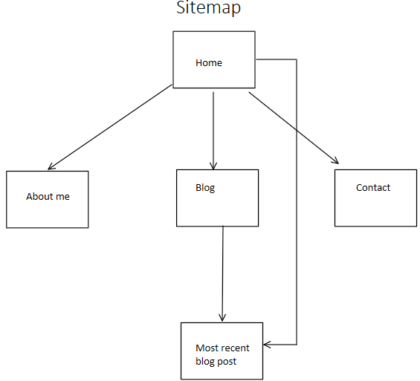
Sitemap
Original design

Slide 4
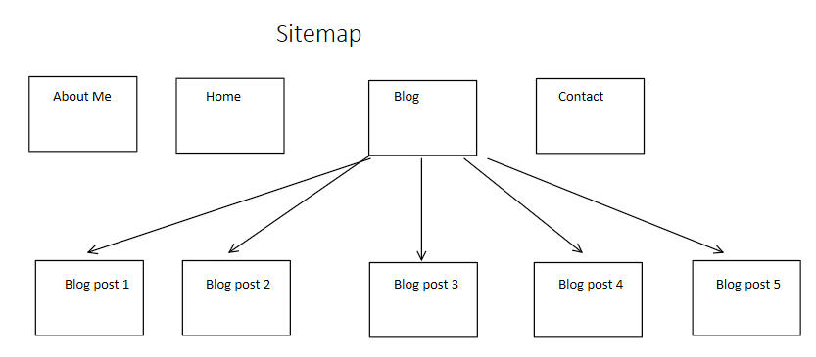
Sitemap
Redesigned Site

Slide 5
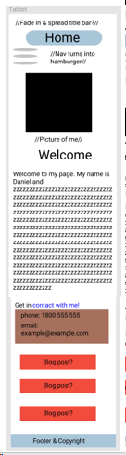
Wireframes
Home page (mobile 1st iteration)

Slide 6
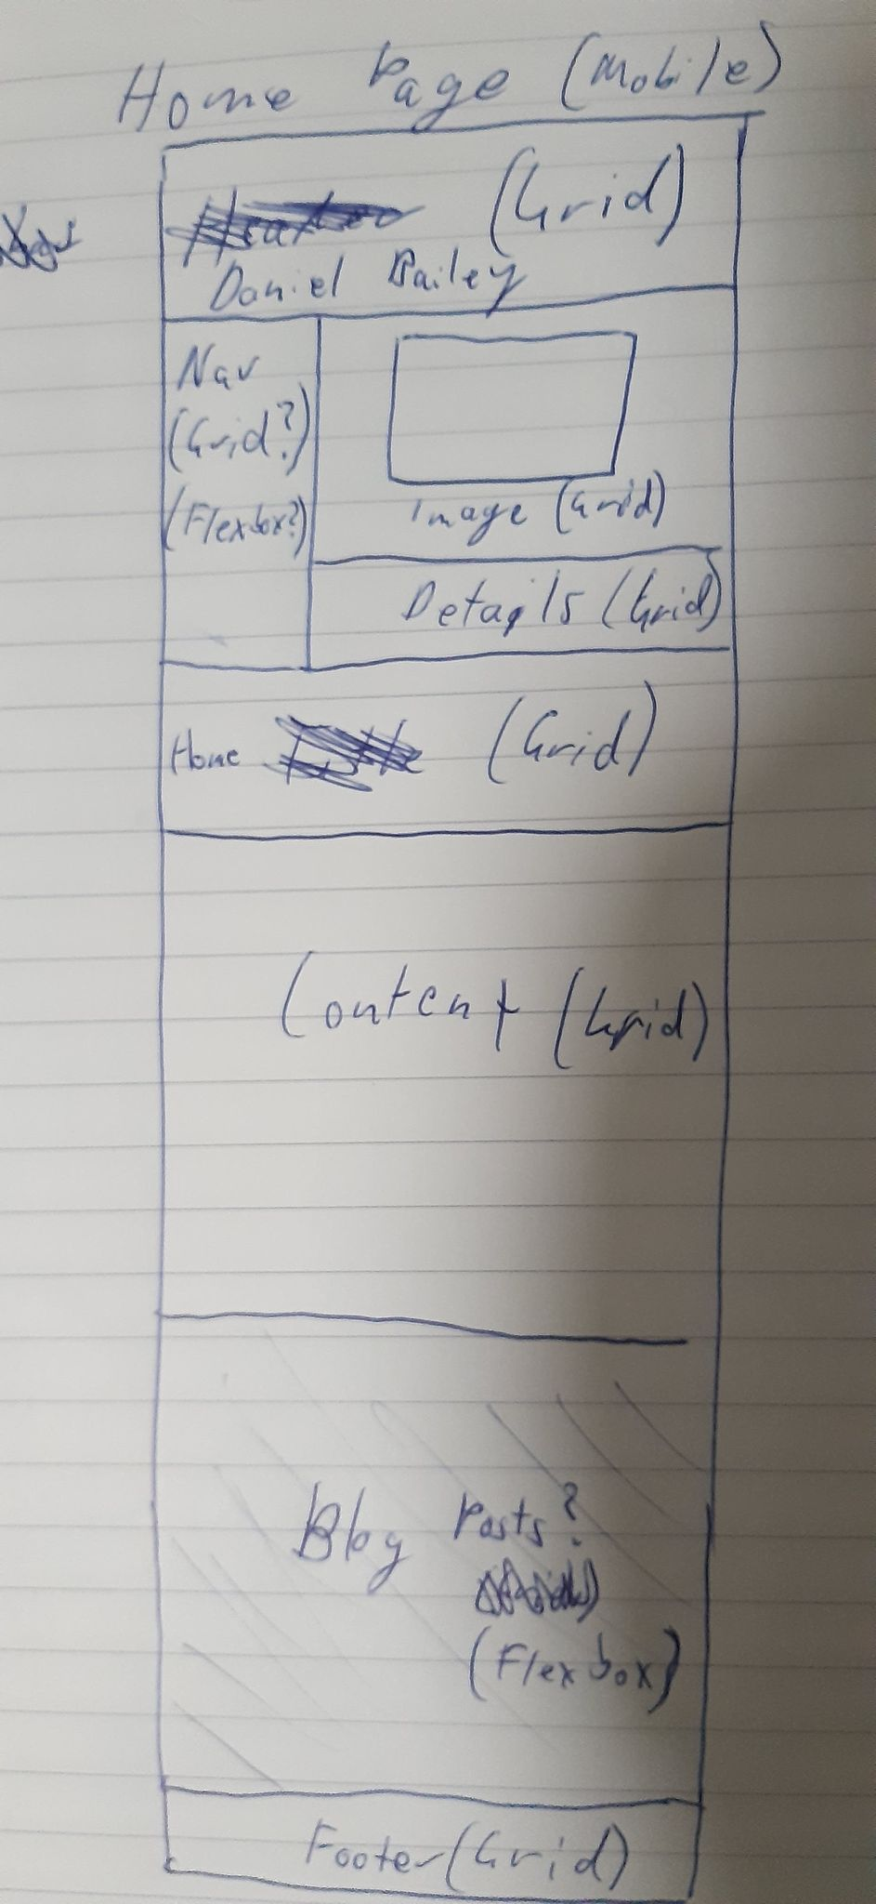
Wireframes
Home page (mobile 2nd iteration)

Slide 7
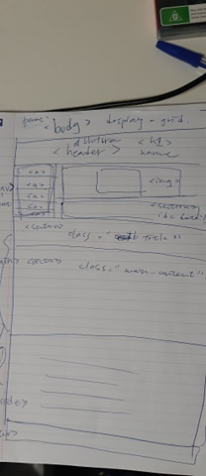
Wireframes
Home page (mobile 3rd iteration)

Slide 8
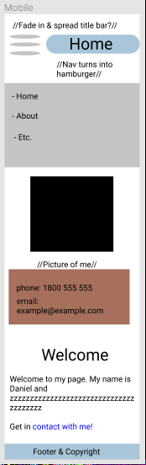
Wireframes
Home page (mobile current iteration)

Slide 9
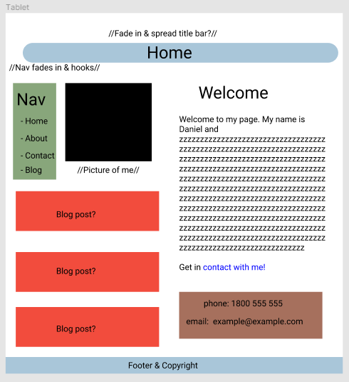
Wireframes
Home page (Tablet 1st iteration)

Slide 10
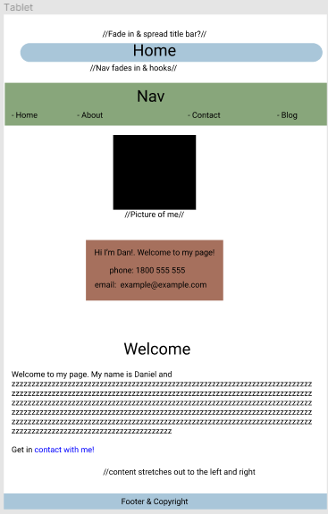
Wireframes
Home page (Tablet current iteration)

Slide 11
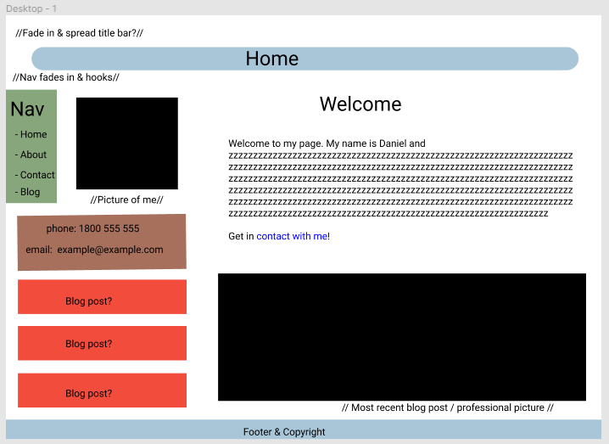
Wireframes
Home page (desktop 1st iteration

Slide 12
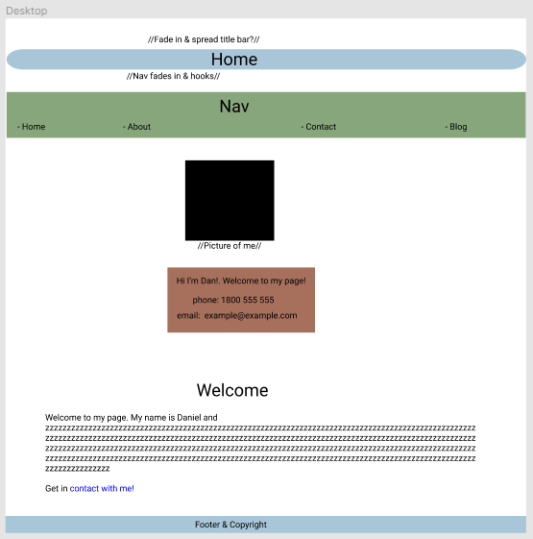
Wireframes
Home page (desktop current iteration)

Slide 13
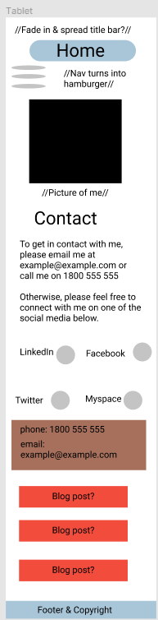
Wireframes
Contact (mobile)

Slide 14
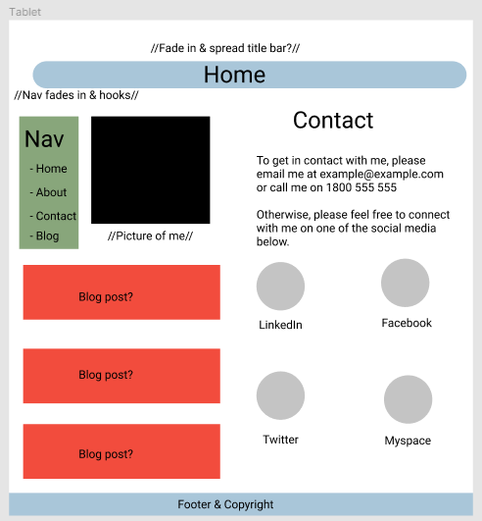
Wireframes
Contact (Tablet)

Slide 15
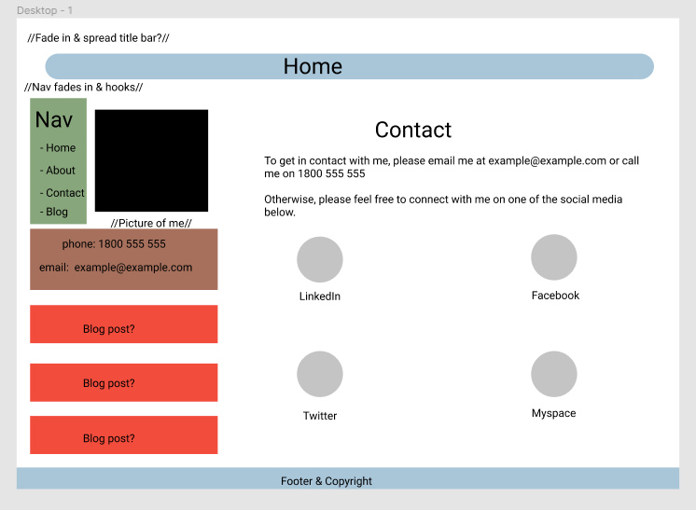
Wireframes
Contact (desktop)

Slide 16
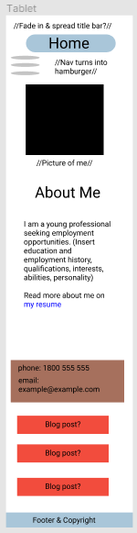
Wireframes
About (mobile)

Slide 17
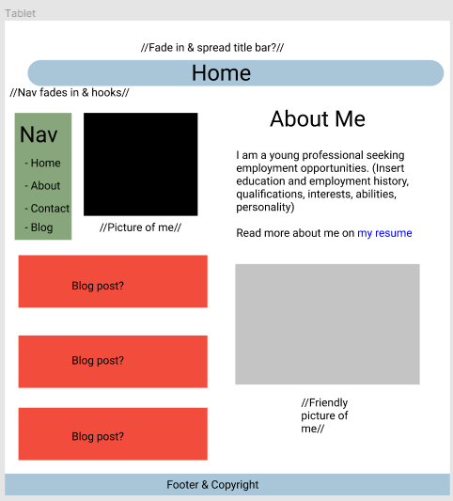
Wireframes
About (tablet)

Slide 18
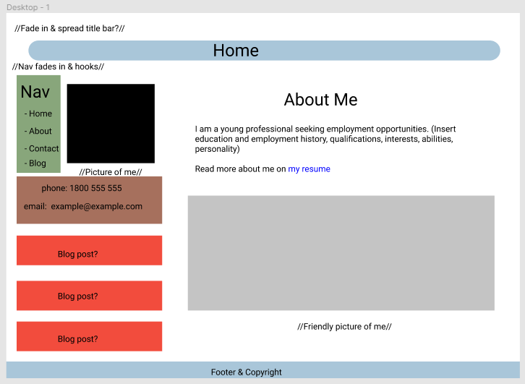
Wireframes
About (desktop)

Slide 19
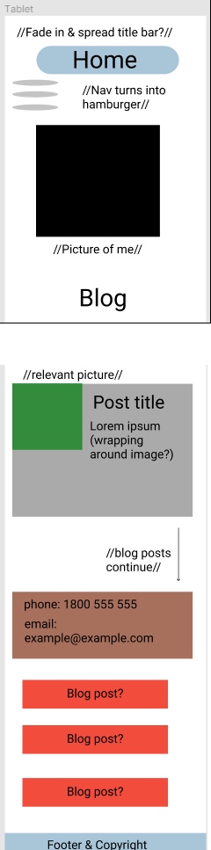
Wireframes
Blog (mobile)

Slide 20
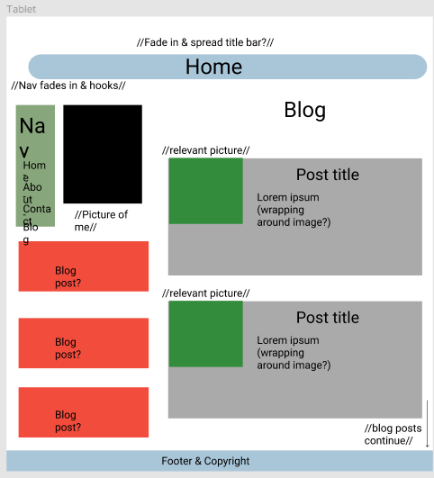
Wireframes
Blog (tablet)

Slide 21
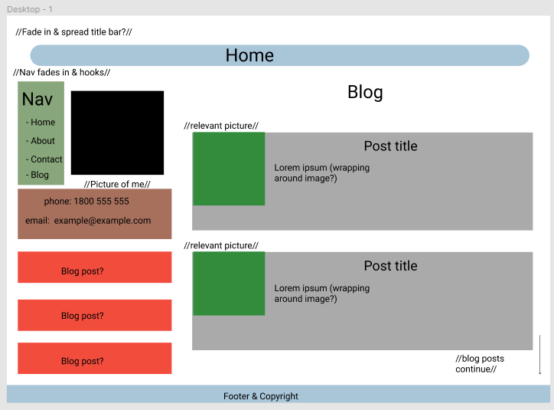
Wireframes
Blog (desktop)

Slide 22
Components
Flexbox (most pages)
Grid (social media)
Hamburger menu (navigation on mobile)
Zoom-in (pictures of social media icons and me)
Fade-in (header on each page)
Anchoring (navigation bar)
Complimentary colour palette (as variables in scss)
Fonts that complement aesthetic (from Google Fonts)

Slide 23
Challenges
Grid and flexbox
Overestimating my abilities
Design influence
Creating wireframes

Slide 24
Thanks for listening!

