Slide 1

Ambulo
Your Personalized Hiking Companion
Shai Odeni Daniel Betzalel

Slide 2

The Pain Points of Traditional Hiking
Time-Consuming Planning
Unexpected Trail Issues
Equipment Hassles
Navigation and Weather
Trip planning is difficult, requiring multiple unreliable sources and word-of-mouth recommendations.
Hikers face obstacles like hazardous terrain, overgrown vegetation, or dangerous water crossings and rockslides.
Organizing gear is tricky, leading to forgotten essentials or overpacking.
Navigating trails and dealing with sudden weather changes make hikes stressful and less enjoyable.

Slide 3

Literature Review Matching Algorithms:
1
Collaborative Filtering
2
Content-Based Filtering
User-Based: Finds other users with similar hiking preferences and suggests routes they liked.
Routes-Based: Analyzes route attributes like difficulty, length, terrain, and points of interest.
Item-Based: Compares routes the user has enjoyed and recommends similar ones.
Users-Based: Builds a user profile based on preferences and past hikes.

Slide 4
How the Matching Algorithm Works
User Data Collection: Gather data from the user's profile (preferences, hiking history) and real-time conditions (weather, trail status).
Collaborative Filtering: Compare the user’s preferences with similar users (User-Based) or past routes (Item-Based) to suggest routes.
Content-Based Filtering: Match routes based on user preferences (difficulty, terrain, length) and past activity.
Hybrid Approach: Combine both filtering methods to improve recommendations.
Recommendation Delivery: Suggest the best routes to the user, considering their profile and real-time conditions.
User Feedback: Collect feedback to refine future route suggestions and improve accuracy.

Slide 5
Competitors
Parameter
Ambulo
Off Road
Komoot
AllTrails
Live alerts for complex points
yes
no
no
no
Customized equipment lists
yes
no
no
no
Official routes (not by the community)
yes
no
no
yes
Variety of map types
yes
yes
yes
yes
User levels
yes
no
no
no
Multiple parameters for route ratings
yes
Yes (only based on stars)
Yes (only based on stars)
Yes (Starts + filters)

Slide 6





Functional Requirements
Personalized Route Planning
Comprehensive Route Descriptions
Weather Forecast Integration
Community Features
Real-Time Alerts

Slide 7
Non-Functional Requirements
Performance
Handle 1000 concurrent users with optimized resource utilization for high traffic.
Scalability
Design for horizontal scaling by adding microservice instances to support growing user loads.
Maintainability
Write clean, modular code, maintain documentation, and use Git for version control.
Compatibility
Ensure compatibility across major browsers, web and mobile platforms, and various devices.
Testing and Quality Assurance
Use automated testing to ensure reliability and functionality.

Slide 8
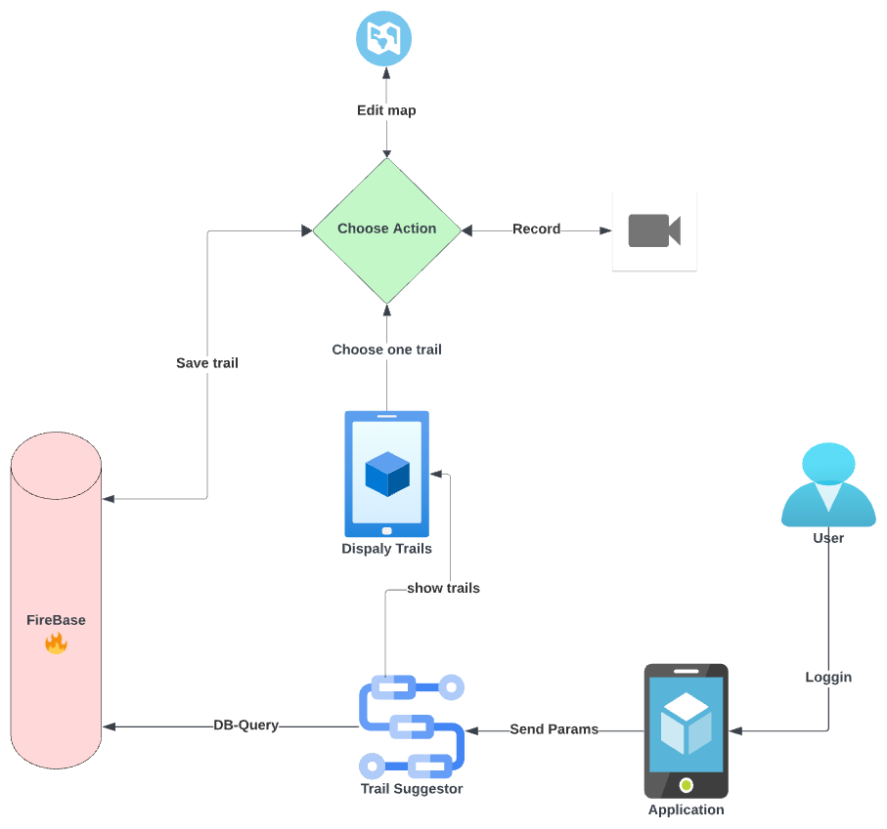
High-Level Architecture

Slide 9
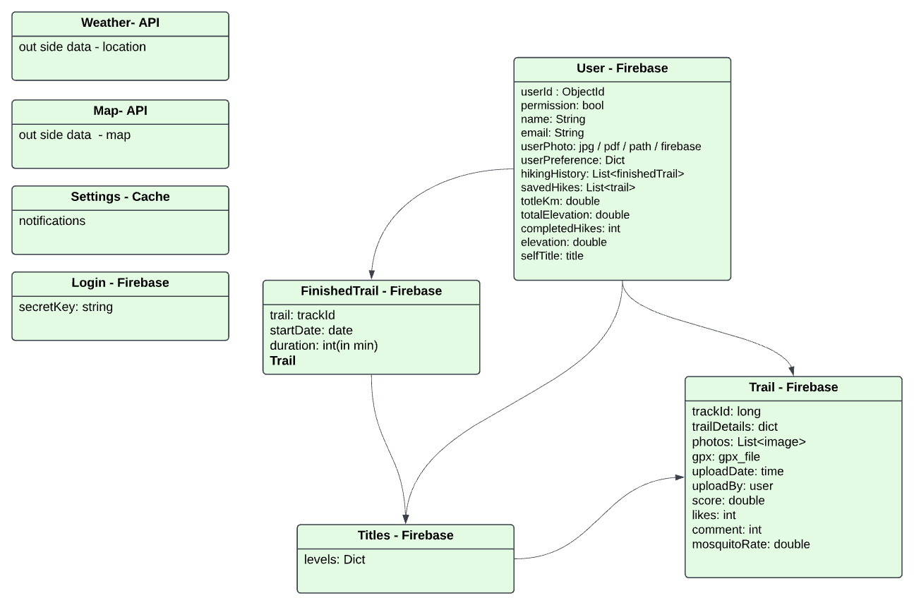
Database Diagram

Slide 10
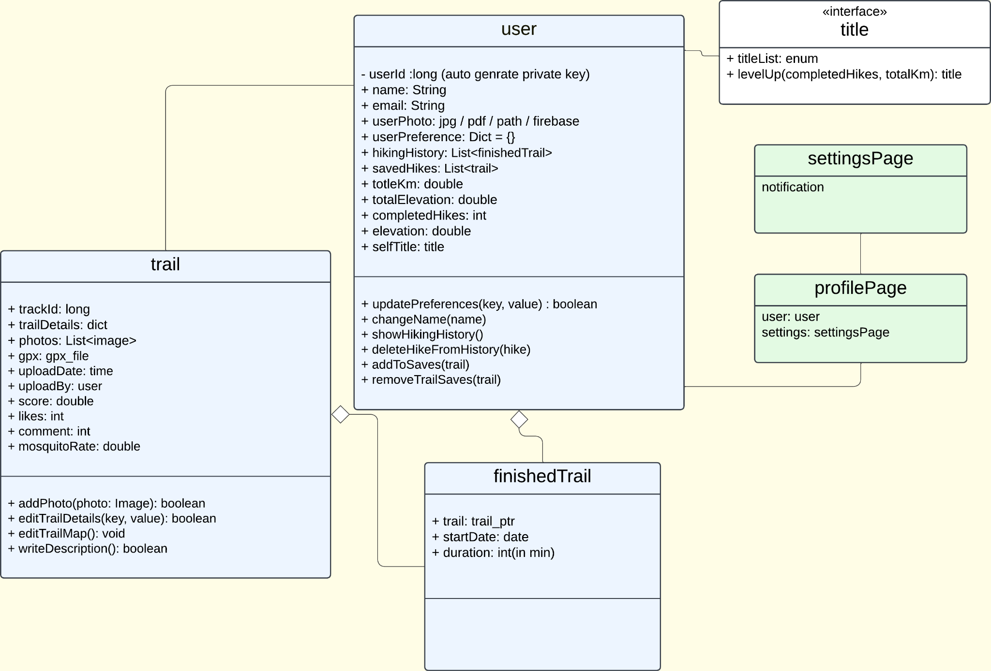
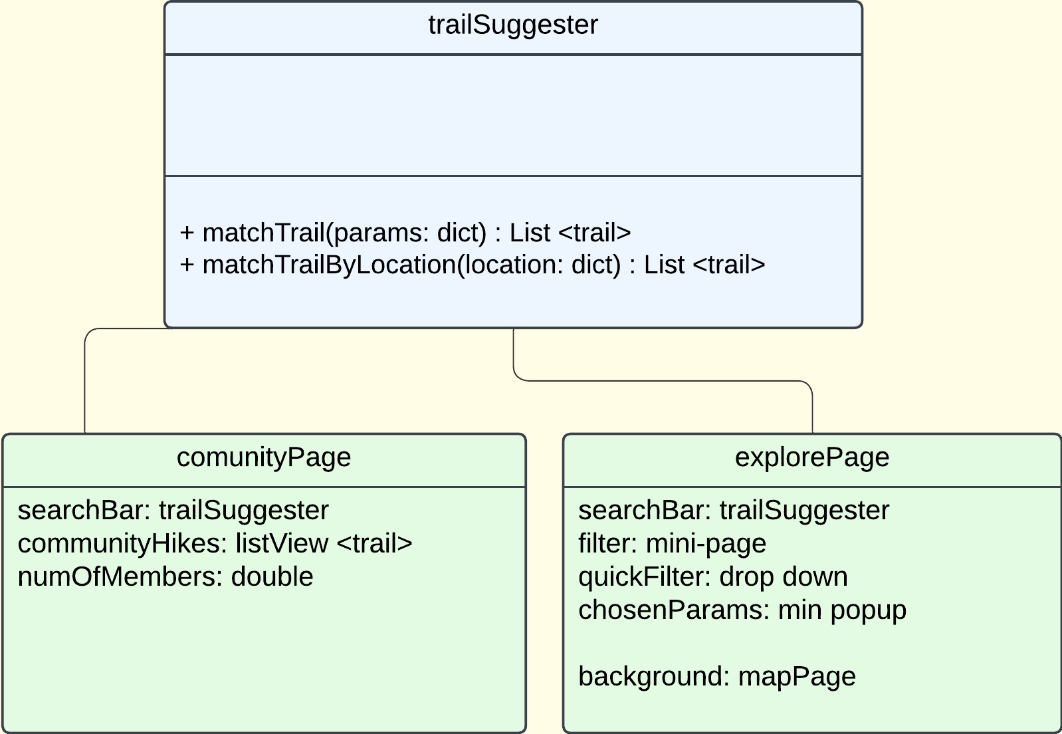
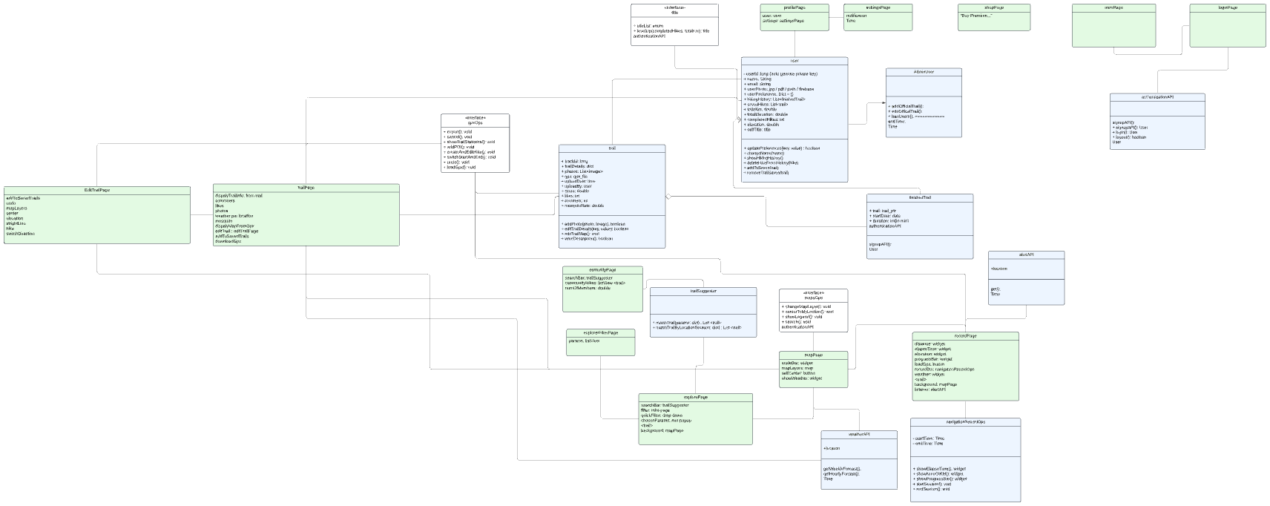
UML Class Diagram

Slide 11






Development stages
Presentation
Test the app
Deployment
Coding

