Slide 1
California Home Price Prediction
IDX Exchange
Team DS51
Summer 2026

Slide 2
Agenda
01
Introduction
02
Data Quality Choices
03
Baseline Model
04
Feature Engineering
05
Final Model/Model Comparison
06
Streamlit/Future Steps
Confidential

Slide 3






Meet the team
Daniel Kim
Daniel Cai
Yuuna Wang
Jennifer Hu
Leon Huang
Emma Gurevich

Slide 4
Build a machine learning model to predict the final ClosePrice of a California single-family home based on its property characteristics.
PROJECT OBJECTIVE

Slide 5
Why it matters
Step 1
Understand which property features influence House Close Price.
Step 2
Evaluate how models perform across pricing band. Identify the the most fitted model for our dataset.
Step 3
Provide data-driven home price estimate support pricing decisions for buyers, sellers, and real estate business.

Slide 6
Dataset Overview
Property Filter:
PropertyType = Residential
PropertySubType = SingleFamilyResidence
Target Variable:
Close Price
Key Features:
Living Area
Bedrooms & Bathrooms
Lot Size
Garage Spaces
Year Built
Days on Market
Latitude & Longitude
Property Amenities
Geographic / School District Features
Mention as many objectives as you want. Consider what is feasible and relevant to your business. Duplicate this slide if you need more space.

Slide 7
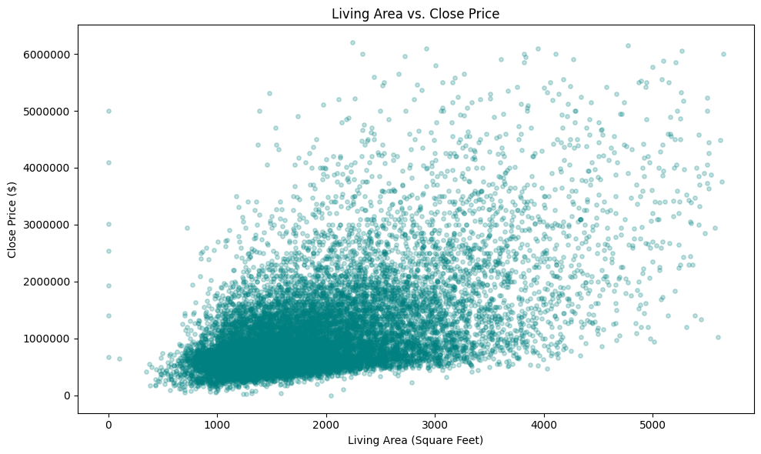
Dataset Exploration:

Slide 8
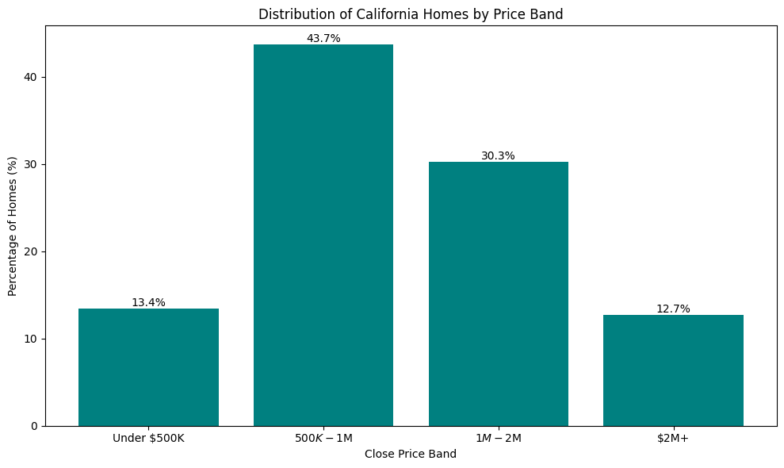

Slide 9
Data scope & Quality Check
Step 1
Step 2
Step 3
Step 4
Step 5
Retrieve data from CRMLS/Trestle MLS sold-listing data. 636,443 raw listings
320,506 residential single-family listings
Removed unsuitable features:
Ex.
- Agent and brokerage identifiers
- Business/commercial fields
Apply row and column sanity checks:
- Removed column with more than 60% missing value
- Removed duplicate rows & missing close prices
Handled Outliers:
- Removed the bottom and top 0.5 percentile
(Learned from training window only, then applied to test/validation sets)

Slide 10
More Preprocessing
Location Correction and Validation:
Flagged missing or suspicious coordinate records
Corrected them using a geocoding checkpoint
Missing Value Handling:
Median imputation for most numerical variables (ex. LivingArea)
Categorical variables set to most frequently occurring option in training set
Leakage Prevention:
ListPrice
OriginalListPrice

Slide 11
Train/test split
Training Set
Validation Set
Test Set
24 months of data from April 2024 to March 2026
263,552 rows
April 2026
11,872 rows
May 2026
11,876 rows

Slide 12
Baseline Modeling
A simple but strong starting point for evaluating later models

Slide 13
Linear Regression
Approach
Feature Types
Linear Regression baseline
Leakage-safe preprocessing with Pipeline + ColumnTransformer
Median imputation for numeric features
Standard scaling for numeric features
One-hot encoding for categorical features
Property size: living area, lot size
Room counts: bedrooms, bathrooms, garage spaces
Location: latitude, longitude, city, county, MLS area, high school district
Property attributes: pool, view, fireplace, year built, stories, flooring
Notes:
For the baseline, we used Linear Regression as a simple, interpretable benchmark. The model was trained using the preprocessed train, validation, and test splits, so this notebook focuses only on modeling rather than repeating the cleaning logic. We used a leakage-safe pipeline with median imputation and scaling for numeric features, plus one-hot encoding for categorical features.

Slide 14
Results
Split
R²
MAE
MDAPE
Train
0.827
$232.6K
15.90%
Validation
0.822
$247.4K
16.19%
Test
0.822
$248.9K
16.10%
Notes:
The baseline performed fairly strongly, with a test R² of about 0.822, test MAPE of about 22.7%, and test MdAPE of about 16.1%. One thing I noticed is that the train, validation, and test scores are very close, which suggests the model is not heavily overfitting. At the same time, the gap between MAPE and MdAPE tells us that some harder or more unusual cases are pulling up the average error. So this baseline gave us a strong benchmark, but it also motivated later models that could capture nonlinear relationships and interactions better than a linear model.

Slide 15
Feature Engineering
Coordinate quality
Detected and corrected missing / placeholder GPS coordinates via the Census geocoder
Hub distance
Haversine distance to LA, SD, and SF
Zip-level price comps
Median $/sqft within a listing's own ZIP
High-cardinality encoding
City, MLSAreaMajor, and school district joined in as categorical signal
Time-of-sale features
Month-of-sale seasonality and time-since-start trend

Slide 16
Coordinate Quality: Finding What Needs Fixing
Two failure modes hid in the raw MLS coordinates: missing values, and placeholder clusters, many rows silently sharing one fake point (e.g. 107 rows all sitting on the same Hemet coordinate).
Detection rule
2,653
Flag a row if: Latitude/Longitude is missing or its coordinate is shared by 5+ other rows
of 320,506 rows flagged
A single hardcoded placeholder check only catches known bad points, this generalizes to any new cluster, not just Hemet.
0.8% of the dataset

Slide 17
The Fix: Census Batch Geocoding
Why the Census Bulk Geocoder over a service like Nominatim: no API key, no per-row rate limit, and up to 10,000 addresses per request instead of one row at a time with a mandatory delay, traded for a lower match rate on messy addresses.
1
2
3
4
2,653 flagged rows
Batched to the Census API
Matched → corrected
Unmatched → kept as-is
Street / City / State / ZIP kept as separate fields: geocoding runs before those columns are dropped later in the pipeline
Up to 10,000 addresses per request; checkpointed per batch, not per row
820 rows get their Latitude/Longitude overwritten with the geocoded value
1,835 rows keep their original, still-suspect coordinate

Slide 18
Isolating the Effect of Geocoding
Model | m1 R² (uncorrected) | m3 R² (geocoded) | Change
Linear Regression | 0.8217 | 0.8218 | +0.0001
Decision Tree | 0.7824 | 0.7741 | −0.0083
Random Forest | 0.8768 | 0.8773 | +0.0005
Why so small
Only 0.8% of rows were even flagged, and just 0.26% were actually correctable

Slide 19
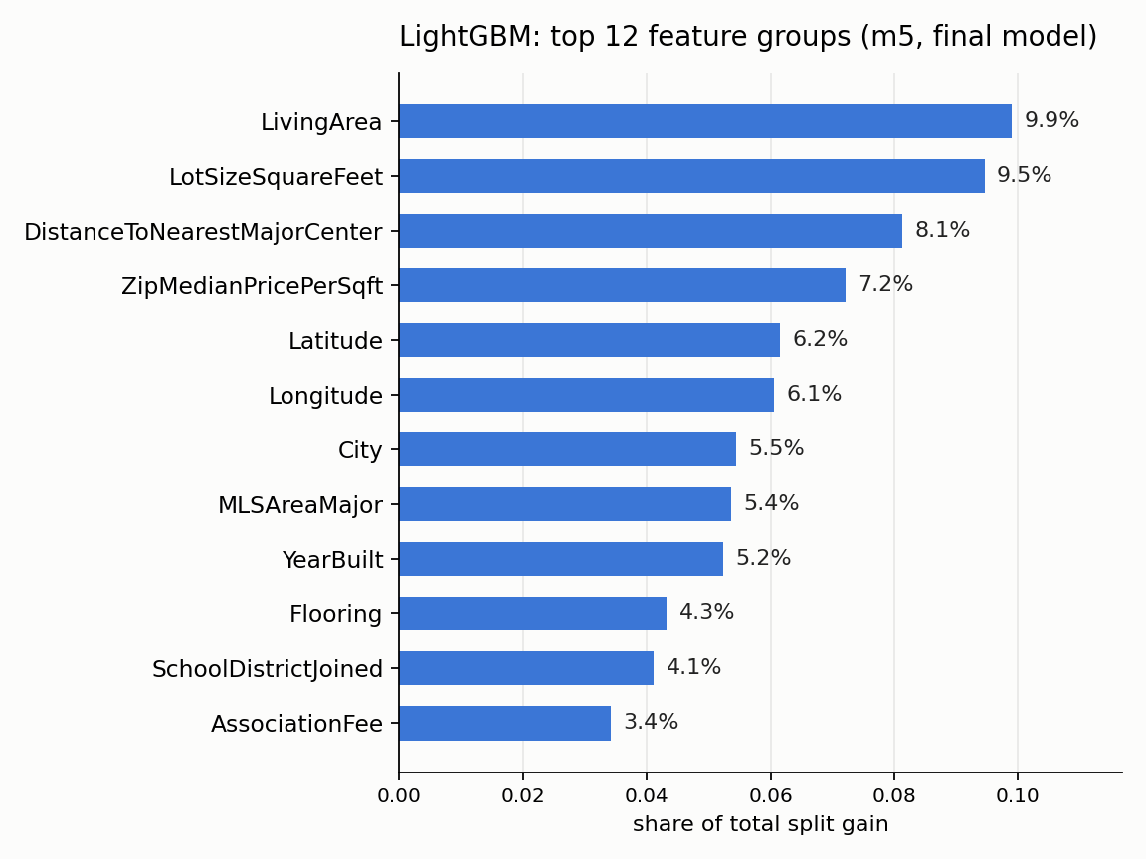
What Actually Drives Price: Feature Importance
Location + size dominate. LivingArea and LotSizeSquareFeet remain the top two. Immediately after them were hub distance and ZIP price comps.
Hub distance (8.1%) and ZIP-level price comps (7.2%) each outrank Latitude (6.2%) and Longitude (6.1%) individually
City, MLSAreaMajor, and YearBuilt trail the geographic features. Accuracy itself still varies by county: roughly 10% MAPE in some, over 20% in Lake, Santa Cruz, etc
20

Slide 20
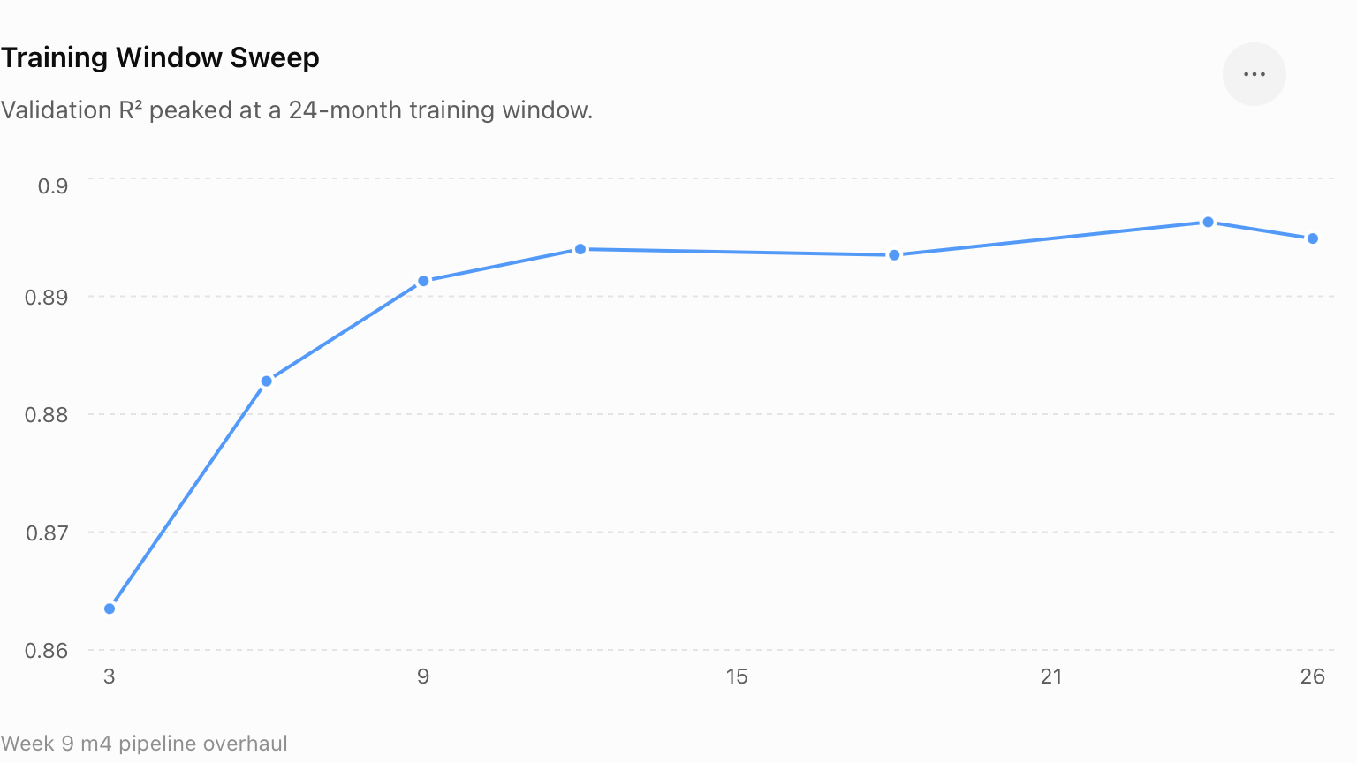
HyperParameter Tuning - Training Window
Why 24 months?
Validation performance improved as more historical data was added, but gains became more gradual after about a year. The 24-month window produced the highest validation R² (0.8963), while performance dipped slightly at 26 months. This suggests that more data was not always better, and 24 months provided the best balance between recency and sample size.
Notes:
24 months selected: highest validation R² of 0.8963, compared with the previously assumed 12-month window at 0.8940. Daniel says the 12-month value had simply been reused since Week 3 without being tested. In Week 9, he swept 3, 6, 9, 12, 18, 24, and 26 months using a fixed LightGBM proxy and selected 24 based on validation R².

Slide 21
HyperParameter Tuning & Final Configuration
Model | Configurations Tested | Selected Configuration
XGBoost | 300 trees / depth 4 / LR .10 • 500 / depth 5 / LR .05 • 800 / depth 6 / LR .03 | 800 trees, max depth = 6, learning rate = 0.03
LightGBM | 300 trees / 31 leaves / LR .10 • 500 / 63 leaves / LR .05 • 800 / 127 leaves / LR .03 | 800 trees, 127 leaves, learning rate = 0.03, unlimited max depth
Both boosted models performed best with more trees and a lower learning rate. XGBoost selected 800 trees, depth 6, LR 0.03, while LightGBM selected 800 trees, 127 leaves, LR 0.03. LightGBM achieved the stronger validation performance and was ultimately carried forward as the final model.

Slide 22
Final Model Evaluation - LightGBM
Model | Test R² | Test MAE | Test MAPE | Test MdAPE
Linear Regression | 0.8162 | $252,475 | 23.90% | 16.64%
Decision Tree | 0.7871 | $224,990 | 16.43% | 10.79%
Random Forest | 0.8967 | $156,842 | 11.53% | 7.57%
XGBoost | 0.9023 | $159,349 | 11.96% | 8.34%
LightGBM | 0.9094 | $152,550 | 11.55% | 7.97%
Final model: LightGBM + m5 feature set, used in the Streamlit application
Notes:
LightGBM achieved the highest overall test R² and lowest MAE, making it the final deployed model.
LightGBM achieved the strongest overall performance. It explained about 91% of the variation in sale prices and had the lowest mean absolute error at roughly $153,000. Random Forest had a slightly lower MAPE, but LightGBM provided the strongest combination of R-squared and absolute error, so it was selected for deployment.

Slide 23
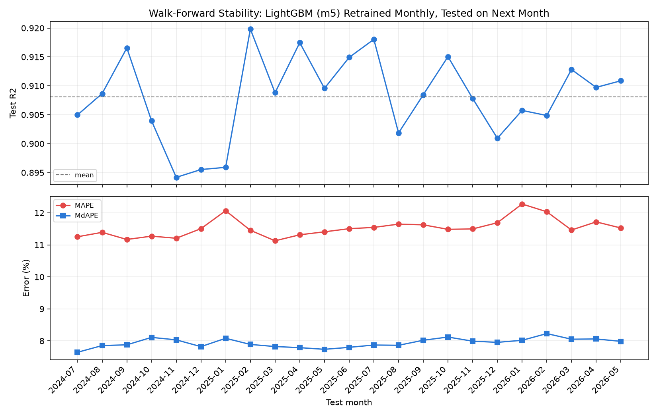
Final Model Evaluation - Performance Over Time
Across 23 monthly retrains, LightGBM maintained stable out of sample performance, with R² between 0.894–0.920 and error rates staying relatively consistent. This suggests the final model generalized well over time rather than relying on a single favorable test split.
Notes:
We also wanted to make sure the final test month was not simply a lucky split. Daniel ran a 23-fold walk-forward validation, where the model was repeatedly trained on all available past months and evaluated on the following month. R-squared stayed between 0.894 and 0.920, and the average MAPE was 11.53%, almost identical to our final 11.55% result. That gives us much stronger evidence that the model generalizes across time.

Slide 24
How the app works
lgbm_m5.pkl
app.py
Live prediction
The fitted pipeline saved as one object: imputers, scalers, encoders, and the trained model.
Rebuilds every engineered feature from the raw form inputs, using the training notebook's logic.
Form in, predicted ClosePrice out, shown with the model's real held-out accuracy.

Slide 25
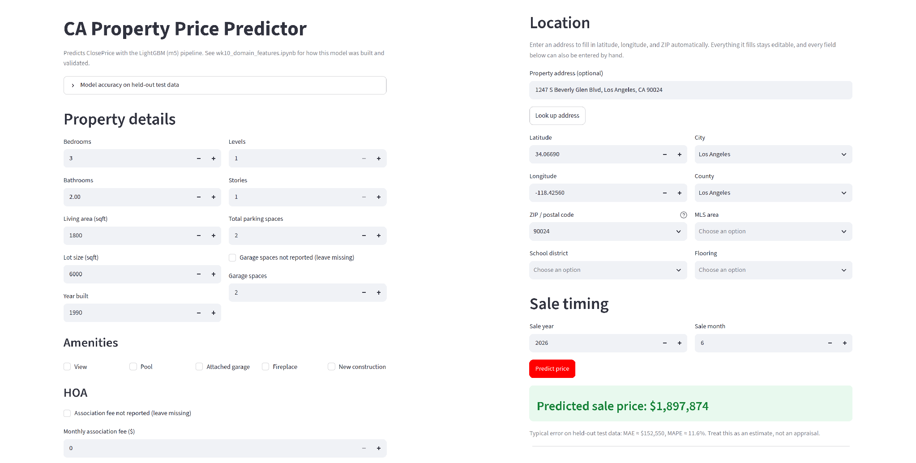
The app, end to end

Slide 26
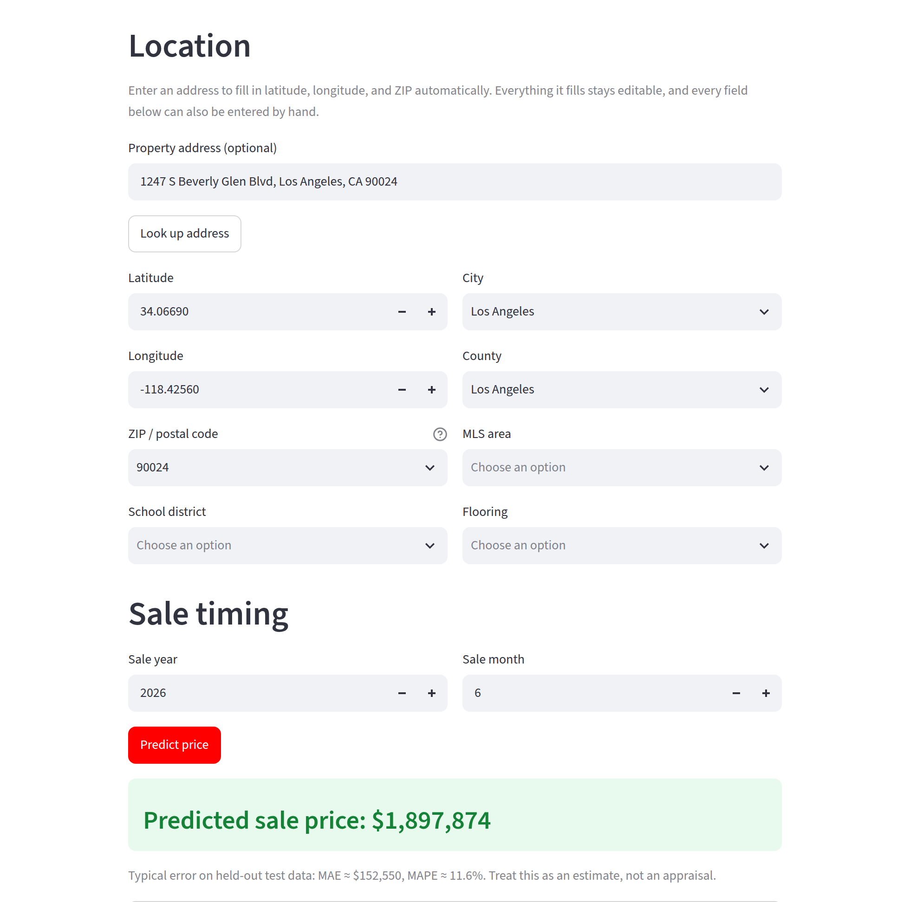
Address in, estimate out
Type an address and the app fills in latitude, longitude, and ZIP.
Add the property details, then click Predict.
The estimate appears with the model's real error range beside it.

Slide 27
What deployment took
Features
Comps
Versions
Git test
Geocoding
Some model inputs are computed, not typed: distance to job centers, month encoding, property age.
The ZIP price-per-sqft table lived only in notebook memory. Rebuilt, then saved as its own file.
requirements.txt pins the exact library versions the model was trained under.
Dropdowns depended on a file excluded from git. Caught by testing a fresh clone.
Address lookup uses Google Maps, with a free fallback if the key or quota fails.

Slide 28
Test R2 of 0.91 held up across 23 monthly retrains
The model scores 0.95 on rows it trained on and 0.91 on data it has never seen. That gap is normal for a model this flexible.
It was not a one-off. Retraining month by month across two years kept test R2 between 0.894 and 0.920, with no downward trend.
Winter months run 1 to 1.5 points worse on MAPE. That is seasonality, not decay.

Slide 29
Next steps
Retrain
Retrain monthly. The walk-forward test showed winter months run slightly worse, so refresh rather than deploy once.
Document
The README documents every result, including the parts that are not yet verified.
Share
The app is live on Streamlit Cloud and open to anyone on the team.

Slide 30
Thank you!

Slide 31
SLIDES PAST THIS ARE SLIDE TEMPLATES FOR ANYONE ELSE TO USE

Slide 32





Customer journey
Stages
Actions
Emotions
Pain points
Touch points
Opportunities
Stage 1
Stage 2
Stage 3
What specific actions do customers execute during this stage?
What specific actions do customers execute during this stage?
What specific actions do customers execute during this stage?
What specific actions do customers execute during this stage?
What specific actions do customers execute during this stage?
What specific actions do customers execute during this stage?
What challenges or frustrations do they encounter?
What challenges or frustrations do they encounter?
What challenges or frustrations do they encounter?
What challenges or frustrations do they encounter?
What challenges or frustrations do they encounter?
What challenges or frustrations do they encounter?
What challenges or frustrations do they encounter?
What challenges or frustrations do they encounter?
What challenges or frustrations do they encounter?
Where do customers interact with your product or service?
Where do customers interact with your product or service?
Where do customers interact with your product or service?
Where do customers interact with your product or service?
Where do customers interact with your product or service?
Where do customers interact with your product or service?
Where do customers interact with your product or service?
Where do customers interact with your product or service?
Where do customers interact with your product or service?
In what ways can you improve the customer experience?
In what ways can you improve the customer experience?
In what ways can you improve the customer experience?
In what ways can you improve the customer experience?
In what ways can you improve the customer experience?
In what ways can you improve the customer experience?
In what ways can you improve the customer experience?
In what ways can you improve the customer experience?
In what ways can you improve the customer experience?
Confidential

Slide 33
A claim about the role of marketing channels in your campaign
Channel name
Channel name
Channel name
Channel name
Describe the channel and what role it will play in your campaign.
Audience
Identify the segment you hope to reach.
Actions Explain what you will do to reach your target. For example, it could be a video ad, a viral post, thought leadership content, etc.
Goal
Share your marketing objectives or calls to action.
Describe the channel and what role it will play in your campaign.
Audience
Identify the segment you hope to reach.
Actions Explain what you will do to reach your target. For example, it could be a video ad, a viral post, thought leadership content, etc.
Goal
Share your marketing objectives or calls to action.
Describe the channel and what role it will play in your campaign.
Audience
Identify the segment you hope to reach.
Actions Explain what you will do to reach your target. For example, it could be a video ad, a viral post, thought leadership content, etc.
Goal
Share your marketing objectives or calls to action.
Describe the channel and what role it will play in your campaign.
Audience
Identify the segment you hope to reach.
Actions Explain what you will do to reach your target. For example, it could be a video ad, a viral post, thought leadership content, etc.
Goal
Share your marketing objectives or calls to action.
Confidential

Slide 34
A claim about the role of marketing channels in your campaign
Content marketing
Channel
name
Channel
name
Channel
name
Channel
name
Campaign
Channel
name
Social
media
Channel
name
Channel
name
Offline
channels
Channel
name
Channel
name
Channel
name
Channel
name
Channel
name
Other
Confidential

Slide 35
A claim about the role of marketing channels in your campaign
Content marketing
Offline channels
Channel name
Description, asset types, etc.
Channel name
Description, asset types, etc.
Channel name
Description, asset types, etc.
Channel name
Description, asset types, etc.
Channel name
Description, asset types, etc.
Channel name
Description, asset types, etc.
Channel name
Description, asset types, etc.
Channel name
Description, asset types, etc.
Channel name
Description, asset types, etc.
Channel name
Description, asset types, etc.
Channel name
Description, asset types, etc.
Channel name
Description, asset types, etc.
Social media
Other
Confidential

Slide 36
How we’ll measure the success of the campaign
Channel name
Channel name
Channel name
Channel name
Now introduce the key performance indicators (KPIs) for each channel. You might have a single KPI or several. List them out like this:
Now introduce the key performance indicators (KPIs) for each channel. You might have a single KPI or several. List them out like this:
Now introduce the key performance indicators (KPIs) for each channel. You might have a single KPI or several. List them out like this:
Now introduce the key performance indicators (KPIs) for each channel. You might have a single KPI or several. List them out like this:
KPI 1
KPI 1
KPI 1
KPI 1
KPI 2
KPI 2
KPI 2
KPI 2
KPI 3
KPI 3
KPI 3
KPI 3
Confidential

Slide 37
How we’ll measure the success of the campaign
Platform
KPIs
Platform name
XXB
KPI 1
KPI 2
KPI 3
KPI 4
Platform name
XXB
KPI 1
KPI 2
KPI 3
KPI 4
Platform name
XXB
KPI 1
KPI 2
KPI 3
KPI 4
Platform name
XXB
KPI 1
KPI 2
KPI 3
KPI 4
Platform name
XXB
KPI 1
KPI 2
KPI 3
KPI 4
Platform name
XXB
KPI 1
KPI 2
KPI 3
KPI 4
Confidential

Slide 38
Launch timeline
Month
Month
Month
Month
Month
Month
Month
CAMPAIGN STAGE
Summarize what will happen during this stage of the campaign. Think about production steps or marketing actions.
CAMPAIGN STAGE
Summarize what will happen during this stage of the campaign. Think about production steps or marketing actions.
CAMPAIGN STAGE
Summarize what will happen during this stage of the campaign. Think about production steps or marketing actions.
WE’RE HERE
Start date/End date
Start date/End date
Start date/End date
Start date/End date
CAMPAIGN STAGE
Summarize what will happen during this stage of the campaign. Think about production steps or marketing actions.
Confidential

Slide 39

Campaign stage: Planning and development
In a few lines, explain what needs to happen during the opening stages of the campaign.
For example, you might have to set goals, agree on a budget, develop your media strategy, build a team, etc.
You can talk about each step in paragraphs or bullet points. Whatever is clearest for your audience.
Confidential

Slide 40

Campaign stage: Execution and launch
With the planning out of the way, it’s time to make the campaign a reality.
Depending on the nature of your campaign, this might involve:
Creating your marketing content
Hiring external contractors
Partnering with influencers
Securing online or offline advertising space
Confidential

Slide 41

Campaign stage: Monitoring and analysis
Now that the campaign has reached its final stages, what needs to happen before it wraps up?
You might need to analyze your key performance indicators, hold a retrospective with the team, or review your budget.
Alternatively, your campaign might not have a definite end point. It might include post-launch updates or a long-term content pipeline. Mention that here, too.
Confidential

Slide 42
Budget
Low budget
Mid budget
High budget
Phase 1
$00
$00
$00
Phase 2
$00
$00
$00
Phase 3
$00
$00
$00
Total
$00
$00
$00
Confidential

