Slide 1
Bellabeat data analysis case
Presented by :
Ottah Daniel Chukwuemeka

Slide 2
Beallabeat
The Business Task
Bellabeat is a high-tech company that manufactures health-focused smart products for women.
We seek to :
understand how people utilize the bellabeat devices differently by analyzing smart device usage from a sample of customers.
Using the information from the study , we wish to suggest some new opportunities form the company’s growth.

Slide 3
Bellabeats Product Lineup
Bellabeat app:
It connects to users line of smart wellness products.
It provides Users with health data related to their activity, sleep, stress, menstrualcycle, and mindfulness habits which help users to better understand their current habits and make healthy decisions.
Time:
This wellness watch combines the timeless look of a classic time piece with smart technology to track user activity, sleep, and stress.
Leaf:
Bellabeat’s classic wellness tracker can be worn as a bracelet , necklace ,or clip.
Spring:
This is a water bottle that tracks daily water intake using smart technology to ensure that you are appropriately hydrated throughout the day. The Spring bottle connects to the Bellabeat app to track your hydration levels.
Bellabeatmembership:
Bellabeat also oﬀers a subscription based membership program for users.
Membership gives users24/7 access to fully personalized guidance on nutrition, activity, sleep, health and beauty, and mindfulness based on their lifestyle and goals.

Slide 4
Focus of our Analysis
1. The impact of Everyday Activity
Daily activity is vital for our analysis since it allows us to
find patterns in our user’s behaviour throughout the day.
2. The importance of Weight
Weight is an important consideration sice we feel fitness
is one of the primary reasons our consumers will utilitize
the product . In our investigation, we hope to confirm this
hypothesis and build a service around it.
3. Prioritizing sleep
We feel sleep is an essential component because we can
determine whether we need to expand our services useful
information form such service.

Slide 5

THE IMPACT
OF
EVERYDAY-ACTIVITY

Slide 6
Daily Activity Breakdown
2013 the average number of calories burned Daily Activity Breakdown.
7671 is the average number of steps taken by our users.
6 miles is the average total distance our users record in a given day.

Slide 7
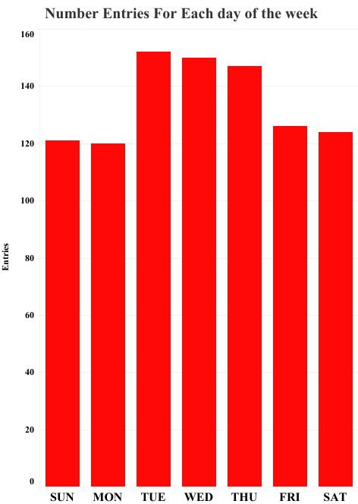
Device usage throughout the week
There does not appear to be a consistent pattern for device usage among our users; nonetheless, we can observe that during the week, Tuesdays and Wednesdays are the days when our users use their devices the most, while Sundays and Mondays are the days when they use them the least.

Slide 8
Our users throughout the day
Bellabeat members spend 82% percent of their day in a Sedentary stage of activity, which means they are somewhat sedentary.
16% percent are lightly active.
1% percent are somewhat active
2% percent are extremely active.
The WHO advocates a more balanced lifestyle along with moderate exercise.

Slide 9
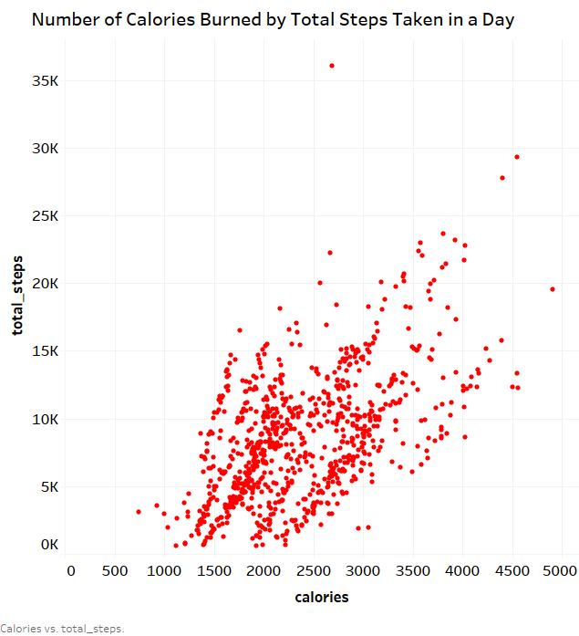
We observed a definite association between the amount of calories burnt and the overall number of steps completed based on our data. The greater the number of steps taken, the more calories burned.
Informing the customer could be a top priority regarding weight loss. Higher weight is correlated with overall worst health.
The link between calories and steps per day

Slide 10
THE IMPORTANCE
OF
WEIGHT

Slide 11
Our users
159 Average Weight
25.2 Average BMI (Body Mass Index)

Slide 12
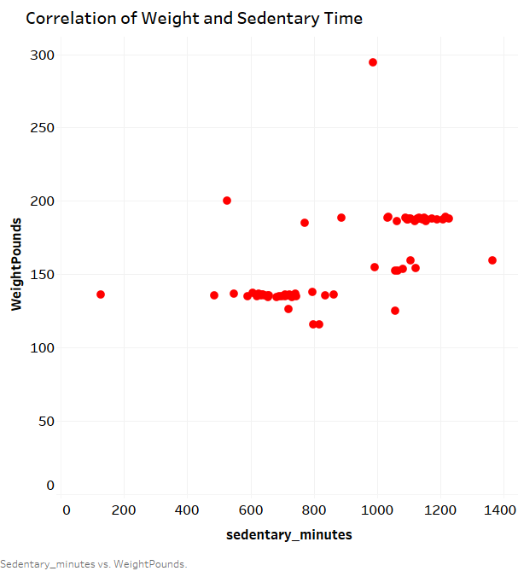
Correlation of Weight and Different Sedentary Activity Levels
We discovered that being more sedentary correlates with having a larger weight. Users that are average sedentary tend to weigh less.

Slide 13
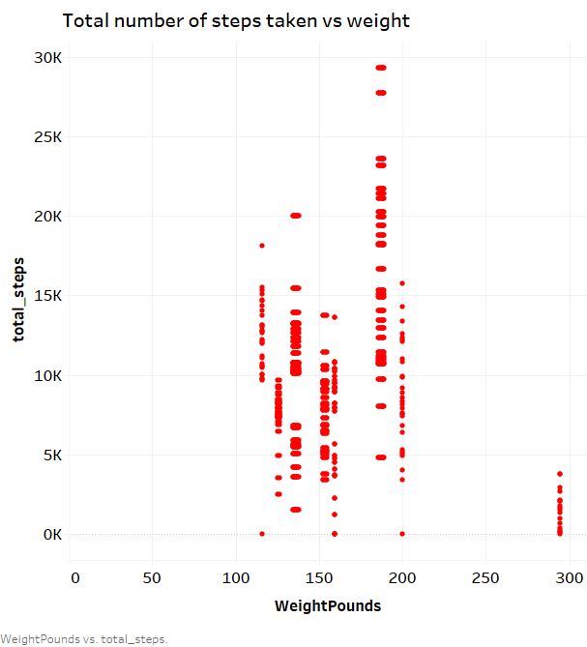
How weight interacts with daily steps
We discovered that the more a user weighs, the less number of steps thy will take in a given day. On average most of our users take a relatively small number of steps. The WHO recommends at least 10,000 steps in ones daily routine.
Giving our consumer frequent reminders might be good if they are seeking to take control of their health.

Slide 14
PRIORITIZING SLEEP

Slide 15
Our users
7 Average Number of Hours spent sleeping
7.64 Amount of hours spent in bed
38 Minutes spent in bed after waking up

Slide 16
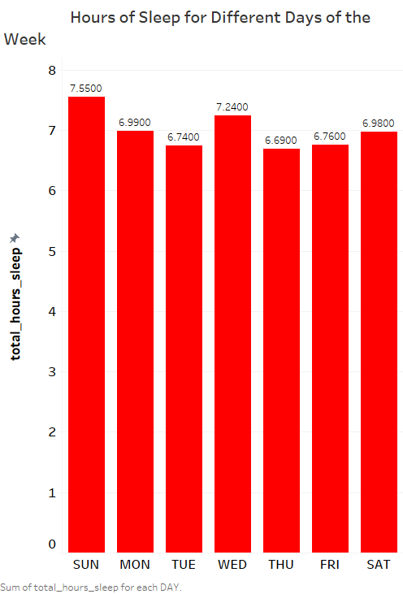
Sleep Patterns Through the Week
Our users spend 7 hours of time sleeping on average, we can see that those time are spread throughout the week at different days.
Generally our users sleep the most on Sundays and Wednesdays, while getting the least amount of sleep on Tuesdays and Thursdays.
We could conclude our users consider Sunday to be a relaxing day, while Thursday is a busy day from start to finish.

Slide 17
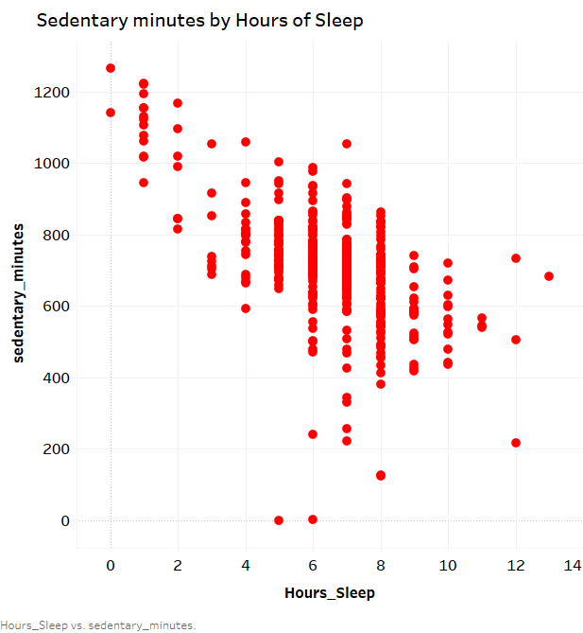
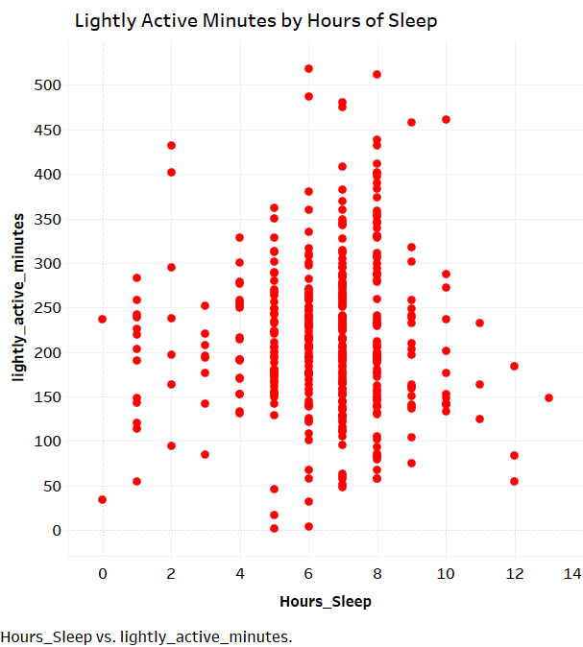
Activity Patterns from Sleep
The WHO recommends sleeping for a minimum of 7-8 hours every night. We can observe that when people spend more time sleeping, they feel more refreshed, which corresponds to greater energy levels and, eventually, less sedentary behavior.
Users tend to be “Fairly” more active as the number of hours of sleep increases, decreasing as our users sleep less.

Slide 18
Key Findings:
Weight
Users who weight more, tend to spend less time being active.
The heavier one weighs, the less steps they will take in a day.
Everyday Activity
Our users tend to use Bellabeat devices at separate times of the week.
Sleep
Users tend to be in a sedimentary state of activity 82% of the day
The more steps our users record, the more calories they burn. A great point of emphasis for many.

Slide 19
Recommendations
1. Developing a wellness program for member, in our analysis we observed that users wear the devices in order to gain insight into their health. We may include a reminder for simple actions, such as taking a specific amount of steps or running the last mile. Users who need motivation to take charge of their health may benefit from a weight loss option.
2. Focus on sleep. Our observations show that when a person sleeps for 7-8 hours, he or she is considerably more engaged in everyday tasks. We might give a colorful daily statistic that could be readily shared on social media to remind people of the necessity of getting enough sleep.
3. Focus on expanding the industry . I recommend that Beallabeat should take advantage of schools where they can influence girls/women on the benefits of using their product especially on Saturdays where people do have work out and also, enlightening the young minds on their product will be a great boost to their market both now and in the future.
4. Bellabeat could host events limited to those that are enrolled in their Bellabeat memberships which would reward users who engage in a healthy lifestyle(e.g 8k steps a day, less than 7 hours sedentary, etc.) .With enough points, users could then use points to purchase products that help supplement a healthy lifestyle.
5. Bellabeat could partner with brands (e.g wellness, sports, health) to reward users who consistently engage in a healthy lifestyle with coupons/store discounts.
With the 2 previous points combined, Bellabeat could select previously unhealthy individuals (who are now healthy), interview them and publish motivational videos as to how Bellabeat encouraged them to have a change in lifestyle.

Slide 20
Resources:
● FitBit Fitness Tracker Data (CC0: Public Domain, dataset made available through Mobius)

Slide 21
Thank
You all
for your
time

