Slide 1

Portfolio Analysis of SMI Stocks
Risk analysis and optimization of portfolio weights
Time Series Analysis in Finance – HSLU 2023 Daniele Buson Goran Nikolov

Slide 2
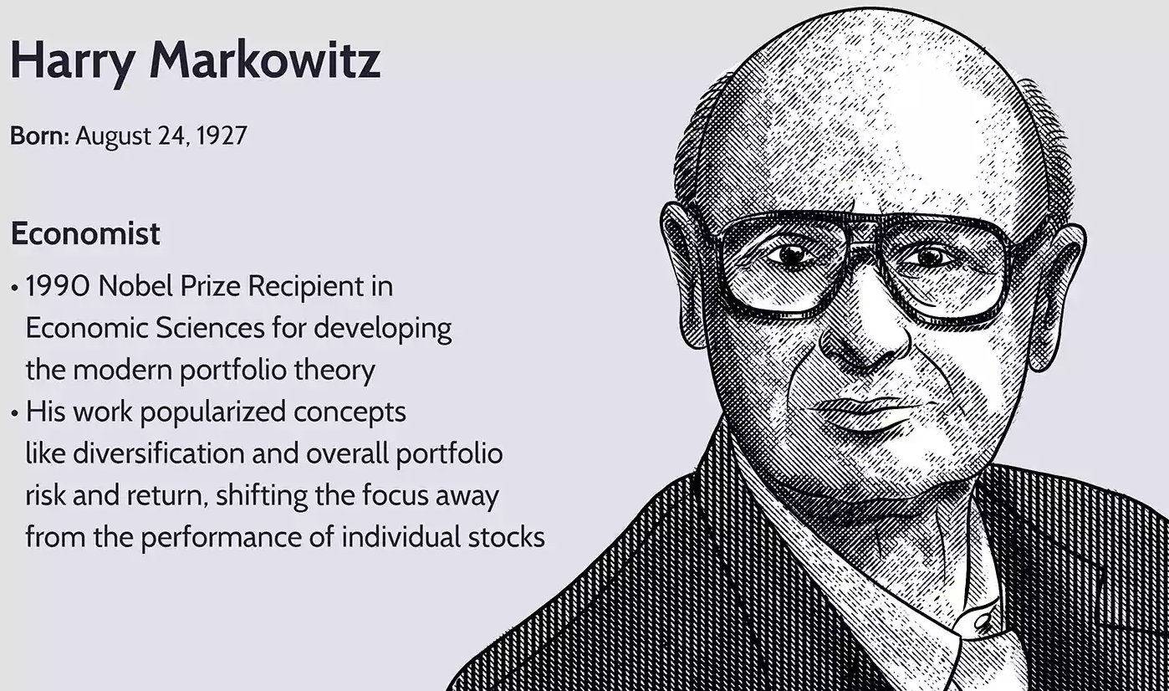
Markowitz Portfolio Theory
Definition
Risk and Return
Critiques
Example

Slide 3

Michaud's Resampled Efficiency Portfolio Theory
Definition
Risk and Return
Benefits
Example

Slide 4

Optimization of Modern Portfolio Theory
What is modern portfolio theory?
How to optimize?
Compare with Shiny Dashboard

Slide 5

Conclusion
Recap
Findings
Recommendations

