Slide 1
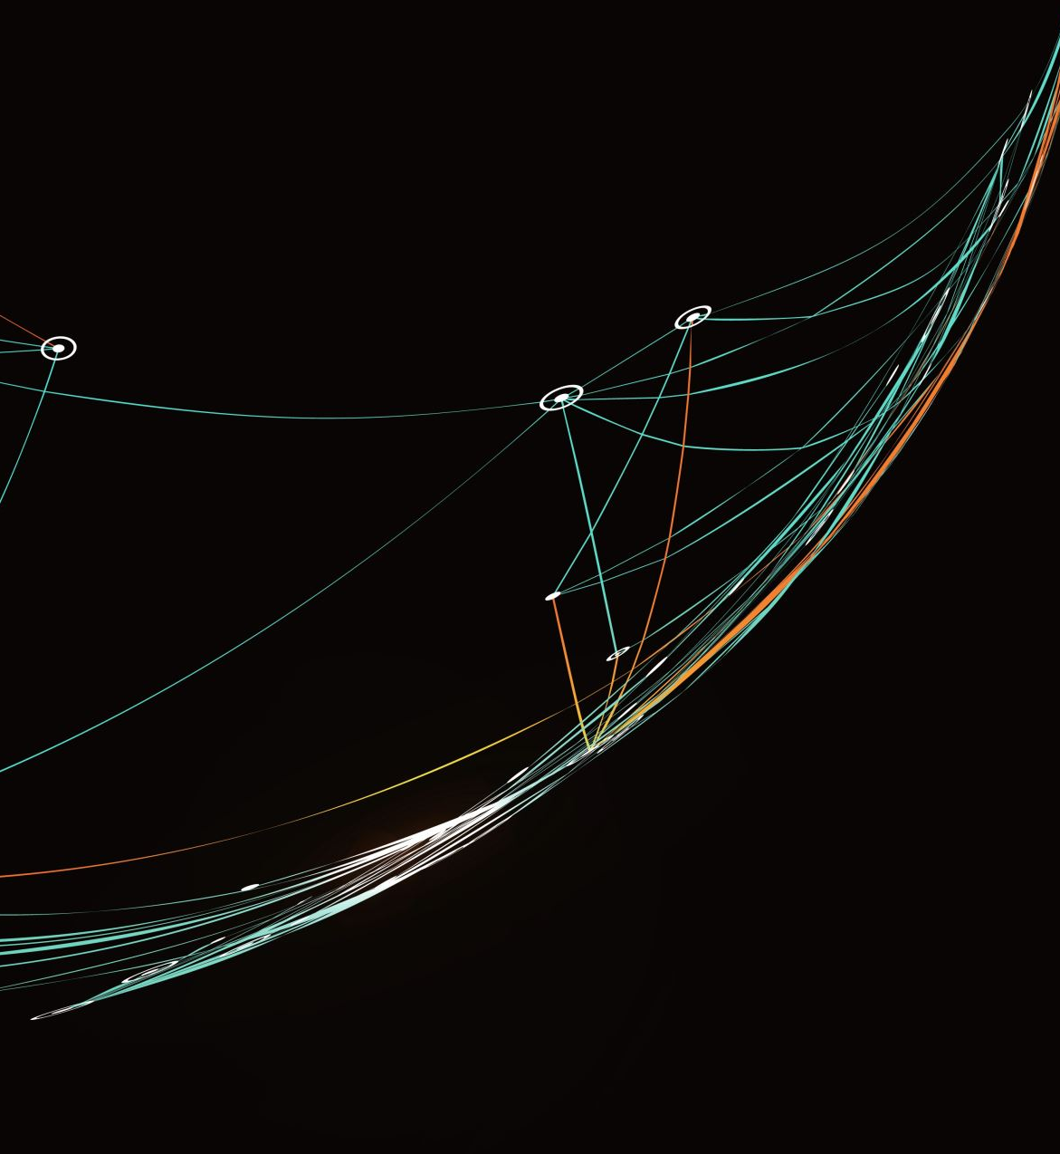
MONTECARLO INTEGRATION
STATISTIC NUMERIC METHOD FOR INTEGRATION

Slide 2
PRESENTATION INDEX
Mathematical aspects of MonteCarlo
Code design and implementation
Scalability results

Slide 3
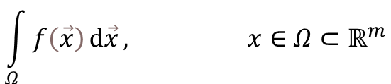
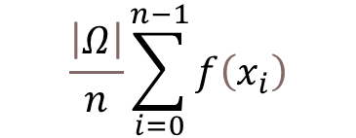
MATHEMATICAL INTRODUCTION
MonteCarlo is an algorithm that is used to approximate integrals.
We have an integral of the form:
The idea is to randomly generate a certain number of points in our domain Ω and then approximate the integral using the following formula:
(n is the number of random samples)

Slide 4

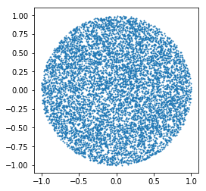
MONTECARLO RELATIVE ERROR
The error estimation can be provided by the variance.
In particular, can be shown that when n grows, the relative error is reduced of a quantity proportional to
In this 2D example, we have the unitary circle as domain: we generate our points and then we evaluate the function in each one

Slide 5
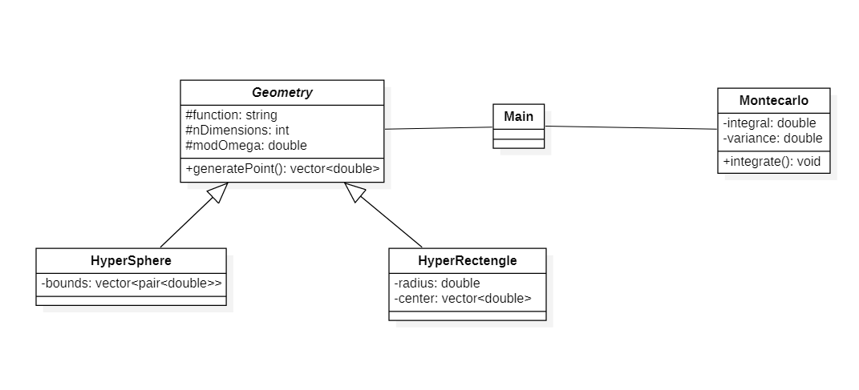
CODE DESIGN
OSS: to provide a function as an input we included the muparser library into the code.

Slide 6
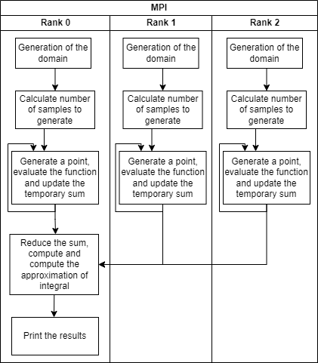
PARALLELISM: MPI
We use MPI in order to improve the performances.
In the figure we suppose to have 3 MPI threads.
Each one calculates the number of samples to generate with the following formula:
mySamples = N/size – (rank < (N % size)).
We try to balance the load as much as possible. It might happen that the threads with a lower rank are going to perform more iterations.

Slide 7
PARALLELISM: OPENMP
The loop for the generation of the points is also parallelized using OpenMp.
The scheduling strategy is the default one because after trying all the possible solutions we noticed that there is no improvement on using a different schedule.
We tried to combine MPI and OpenMp in order to get the best possible
performances from a parallel code

Slide 8
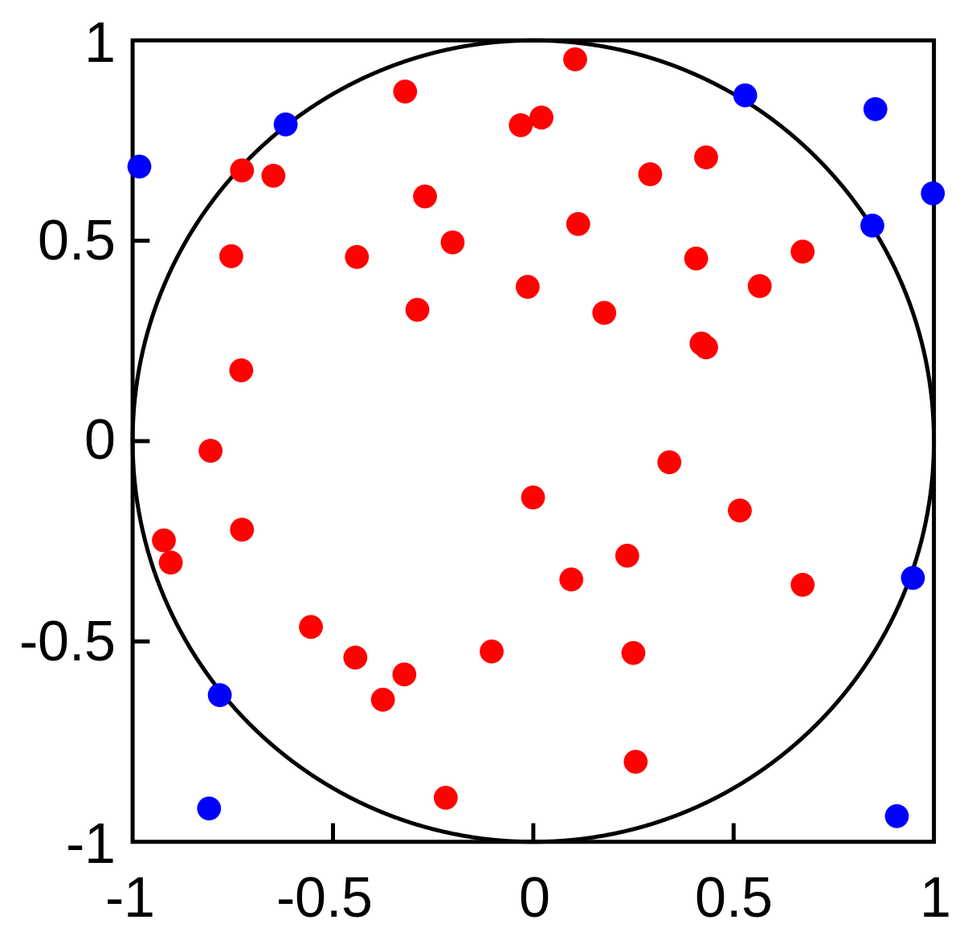
RANDOM POINTS GENERATION
If the domain is an hyper-rectangle, points are generated coordinate-after-coordinate, and each coordinate is generated between the 2 bounds in that direction.
If the domain is an hyper-sphere, we are going to use the rejection sample algorithm.
Points are randomly generated in the hyper-cube circumscribing the hyper-sphere. If the generated point is not inside our initial domain, the point is rejected, otherwise it is considered valid.
An example of generation in 2D: the domain is the circle.
All points are generated, but blue points are rejected.

Slide 9
RANDOM POINTS GENERATION
Each MPI thread is going to generate an object of type std::mt19937 using as a seed its actual rank.
When the function generatePoint() is called, will be defined an object “distribution” of type std::uniform_real_distribution that is going to have the extreme point of a range as a parameters.
We are going to use the random number generated in this range as part of the coordinates.
We are going to perform the same operation for n times, where n is the space dimension.

Slide 10
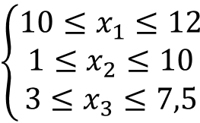

INTEGRATION TESTS
$$f\left(\vec{x}\right)=x_{1}+x_{2}+2x_{3}$$
We consider the function
The domain considered is the following 3-dimensional hyper-rectangle:
$$\left\{\left.\begin{matrix}10≤x_{1}≤12 \\ 1≤x_{2}≤10 \\ 3≤x_{3}≤7,5\end{matrix}\right.\right.$$

Slide 11
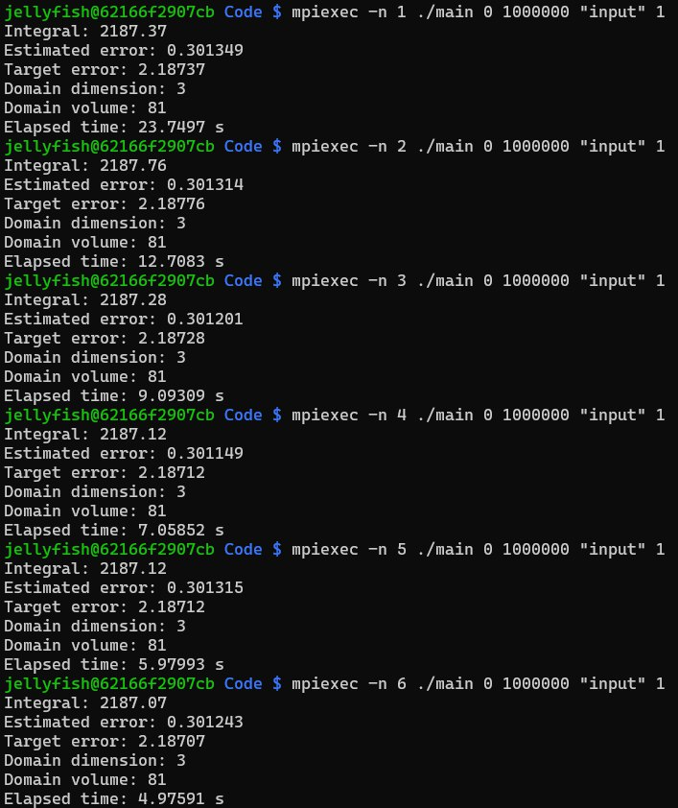
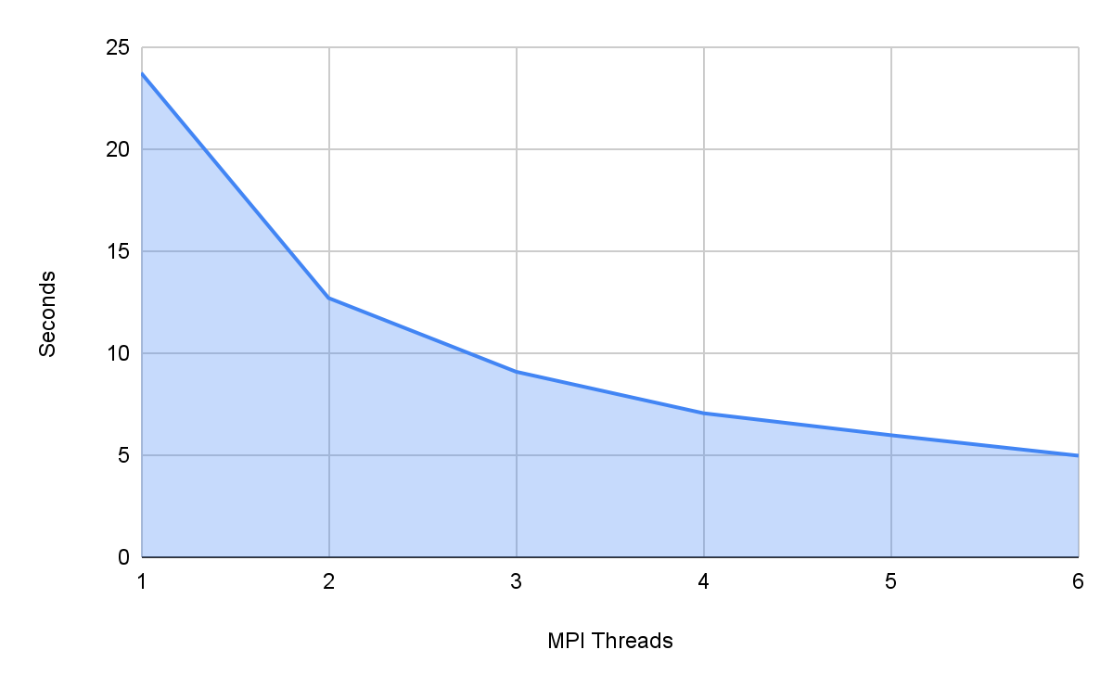
COMPUTATIONAL TIME ANALYSIS

Slide 12
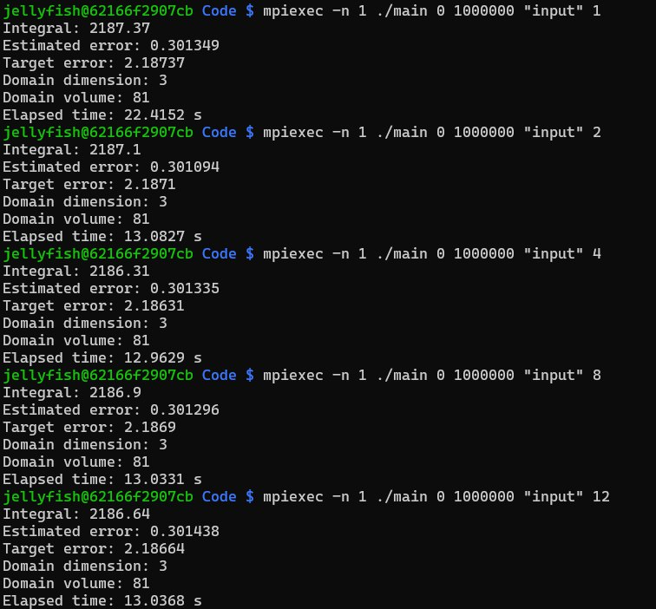
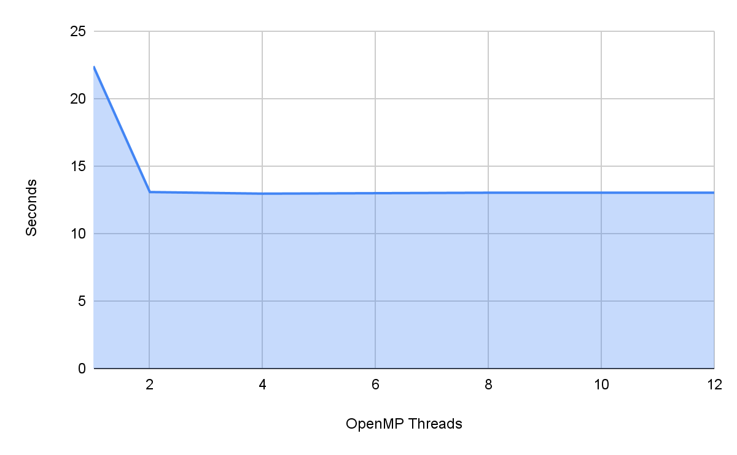
COMPUTATIONAL TIME ANALYSIS

Slide 13
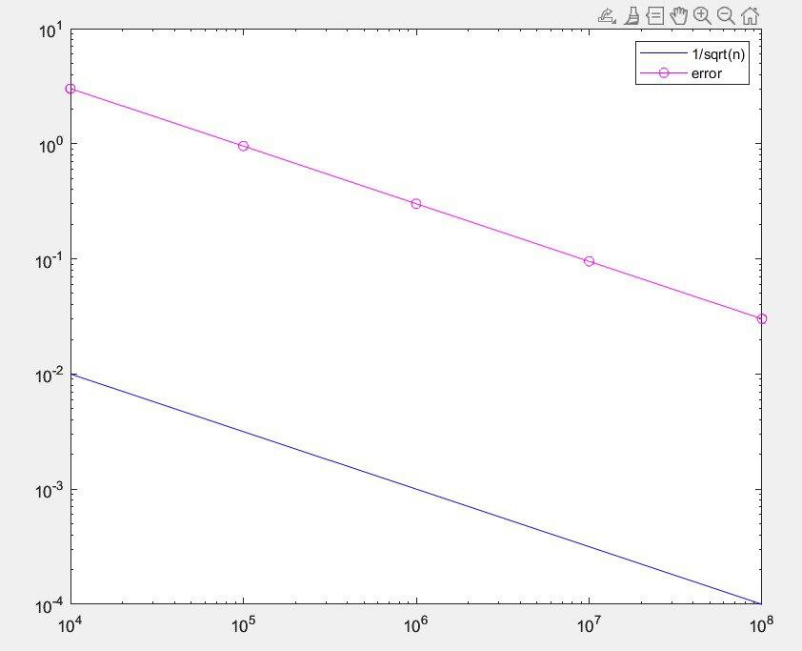
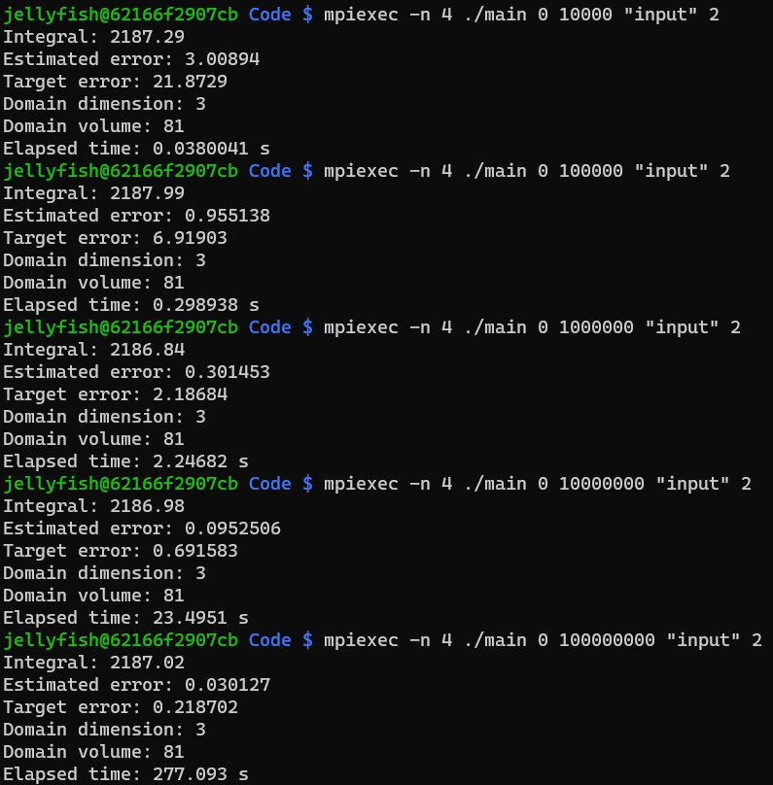
ERROR TREND

