Slide 1

Statistical Learning: Prediction of food delivery times
Computer science engineering
Students
Gotti Daniele - 1079011
Mazzoleni Gabriele - 1079514
A.Y. 2024/2025

Slide 2

Problem setting – food delivery
Food delivery is a market that has become a key component of the global economic and social system.
It grew massively in importance in 2020 – 2021 due to the spread of COVID-19, reaching over 1 billion € of market value in Italy in 2021.

Slide 3



Problem setting – food delivery
In the current market for food delivery, full of already established services, it is paramount to find new ways to differentiate, to ensure a wider range of consumers.

Slide 4

Objective of this analysis
New comforts for customers = more customers;
today, quickness and timeliness in delivery is considered highly important;
IDEA : develop statistical model to accurately predict delivery times and implement it into an application.

Slide 5
Selected dataset: Food Delivery Time Prediction
Dataset designed for predicting food delivery times based on various influencing factors.
It contains simulated data based on various real-world factors.
Reference link: https://www.kaggle.com/datasets/denkuznetz/food-delivery-time-prediction

Slide 6
Dataset Variables
Order ID: Unique identifier for each order (unused, irrelevant)
Distance (km): The order delivery distance
Weather: Weather conditions during the delivery
Traffic Level: Traffic conditions
Time of Day: The time when the delivery took place
Vehicle Type: Type of vehicle used for delivery
Preparation Time (min): The time required to prepare the order
Courier Experience (years): Experience of the courier
Delivery Time (min): The total delivery time (target variable)

Slide 7
Preliminary analysis
The dataset contained 1000 rows, reduced to 883 after removal of rows with null values.
We then removed outliers using the Interquartile Range (IQR) method.
Remaining rows: 879

Slide 8
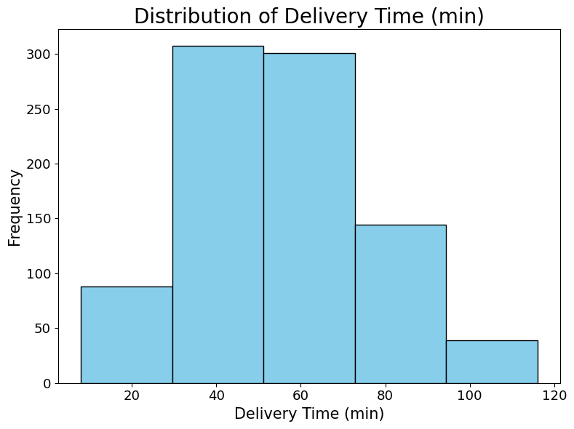
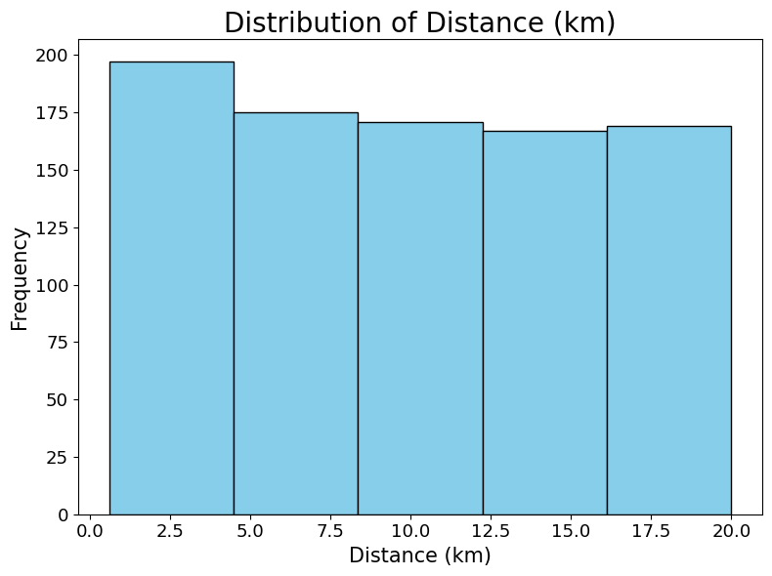
Data Distribution - numerical variables

Slide 9
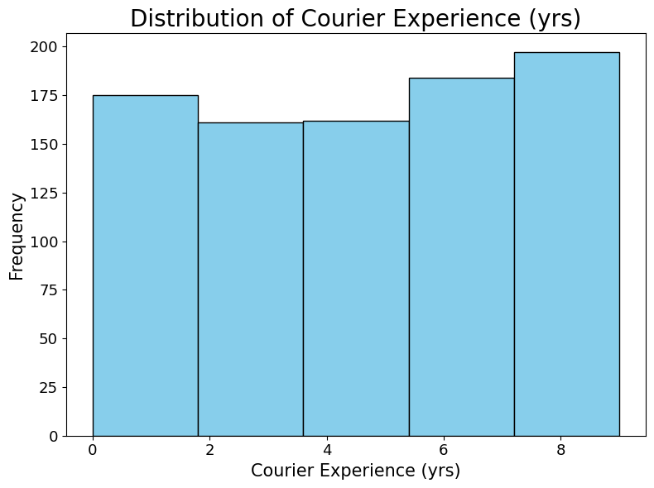
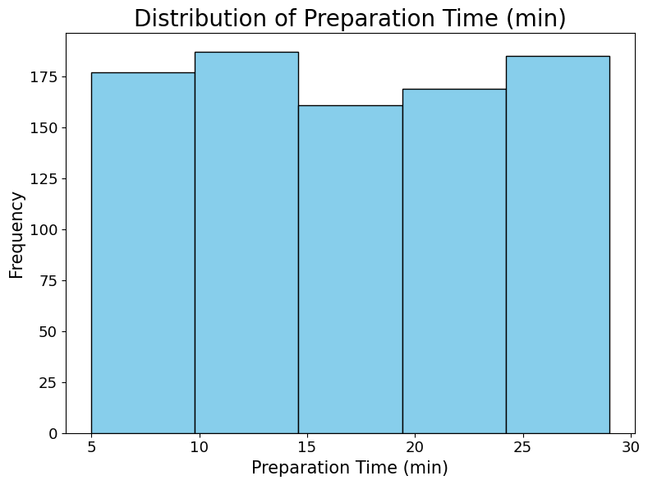
Data Distribution - numerical variables

Slide 10
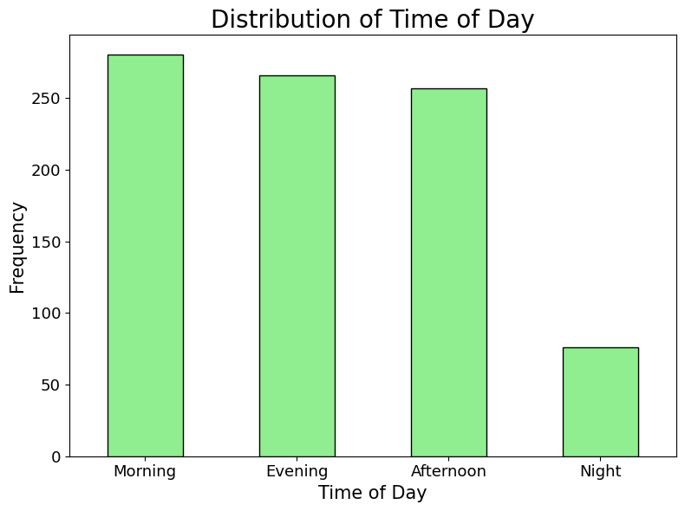
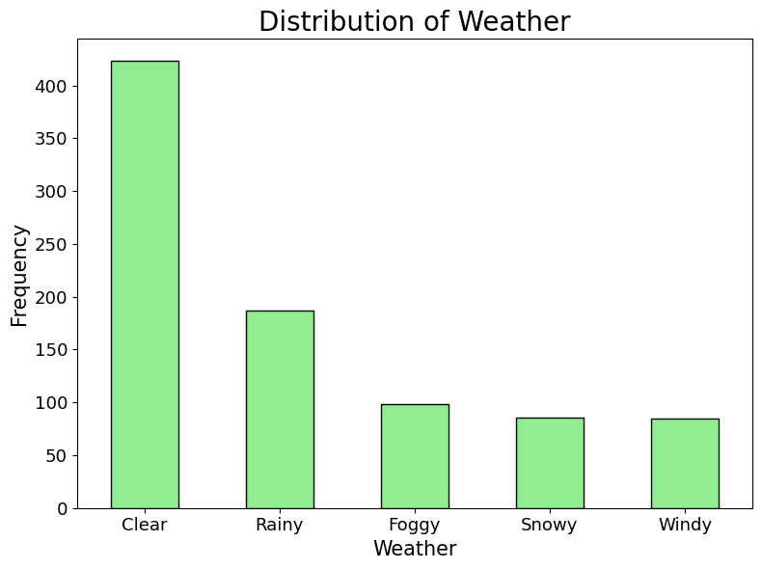
Data Distribution – categorical variables

Slide 11
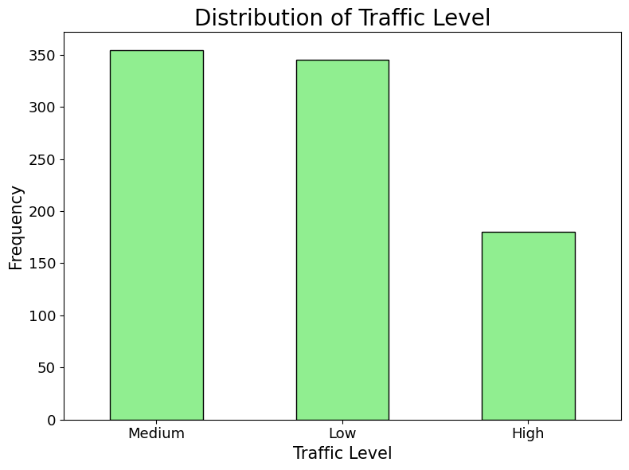
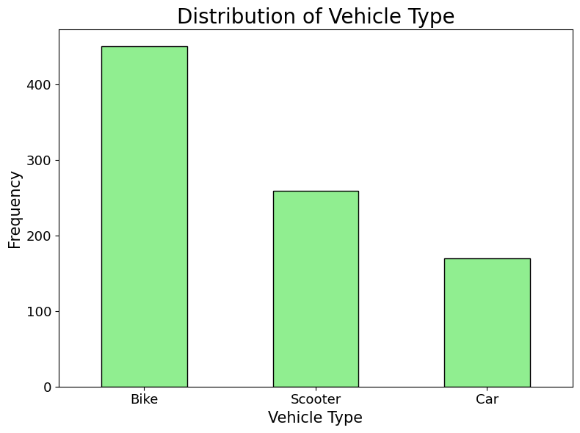
Data Distribution - categorical variables

Slide 12
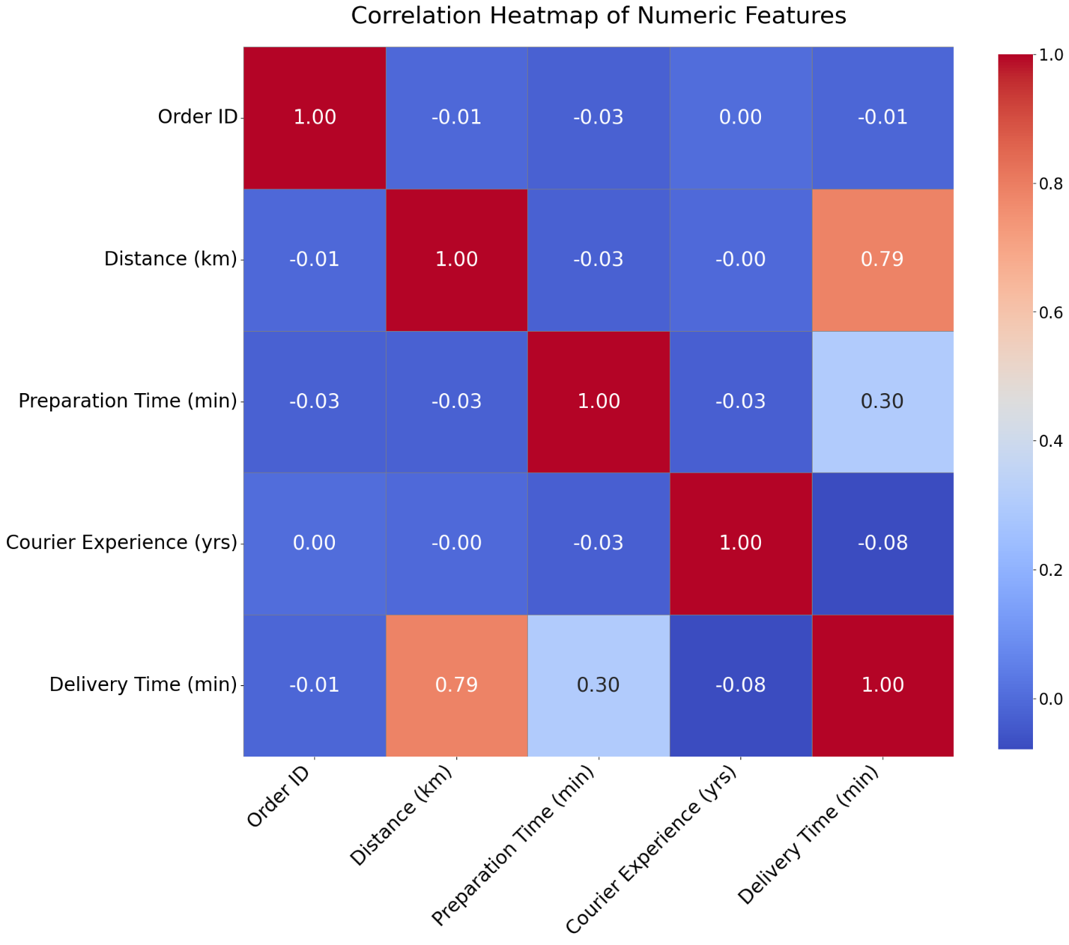
Evaluating correlation
Some numerical variables show a clear linear relationship with delivery time.
Even though Courier Experience is numerical we will consider it as categorical because the values represent discrete levels of experience.

Slide 13
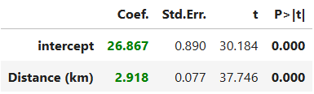
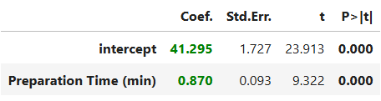
Simple linear regression - Objective
The two numerical variables, Distance and Preparation Time, are selected, and the relationship between each of them and the response variable Delivery Time is analysed individually.
Delivery Time (min) = b0 + b1 * Variable + e
Distance
Preparation time

Slide 14
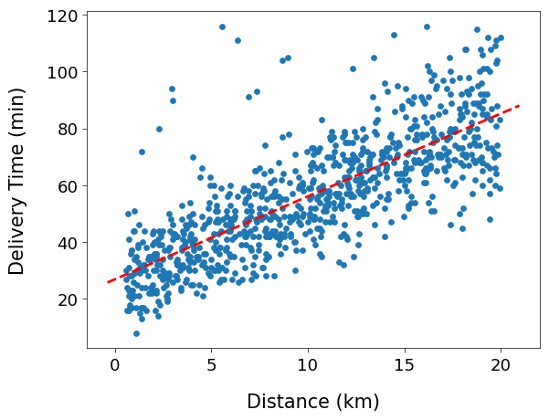
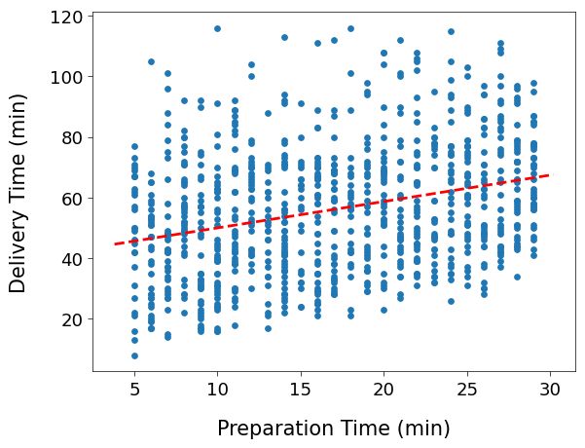
Simple linear regression - Scatterplots

Slide 15
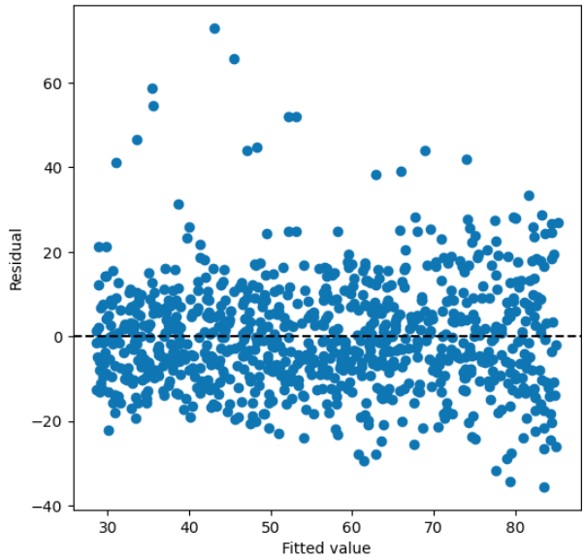
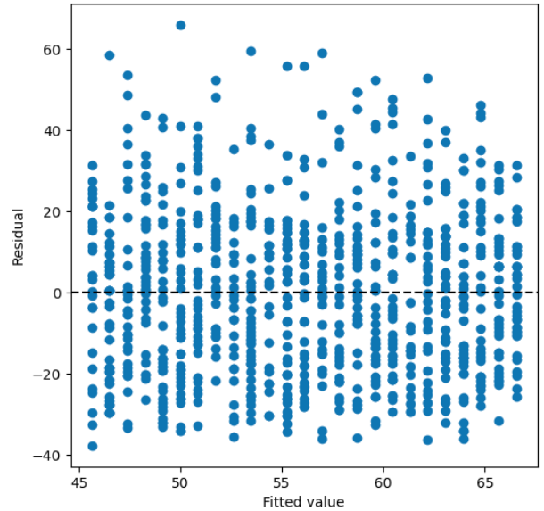
Simple linear regression - Residuals
Distance
Preparation time

Slide 16
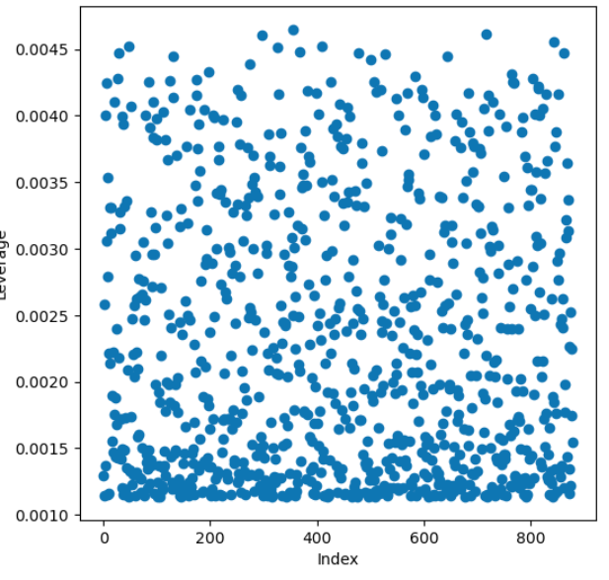
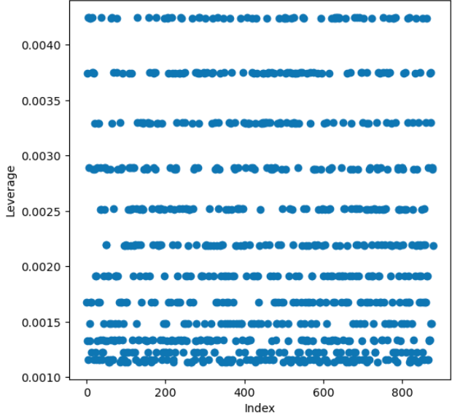
Simple linear regression - Leverage
Distance
Preparation time

Slide 17
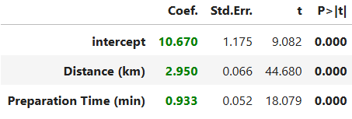

Multiple linear regression - using numerical predictors only
Both variables are useful to determine delivery times.
Overall, the model performs well.

Slide 18
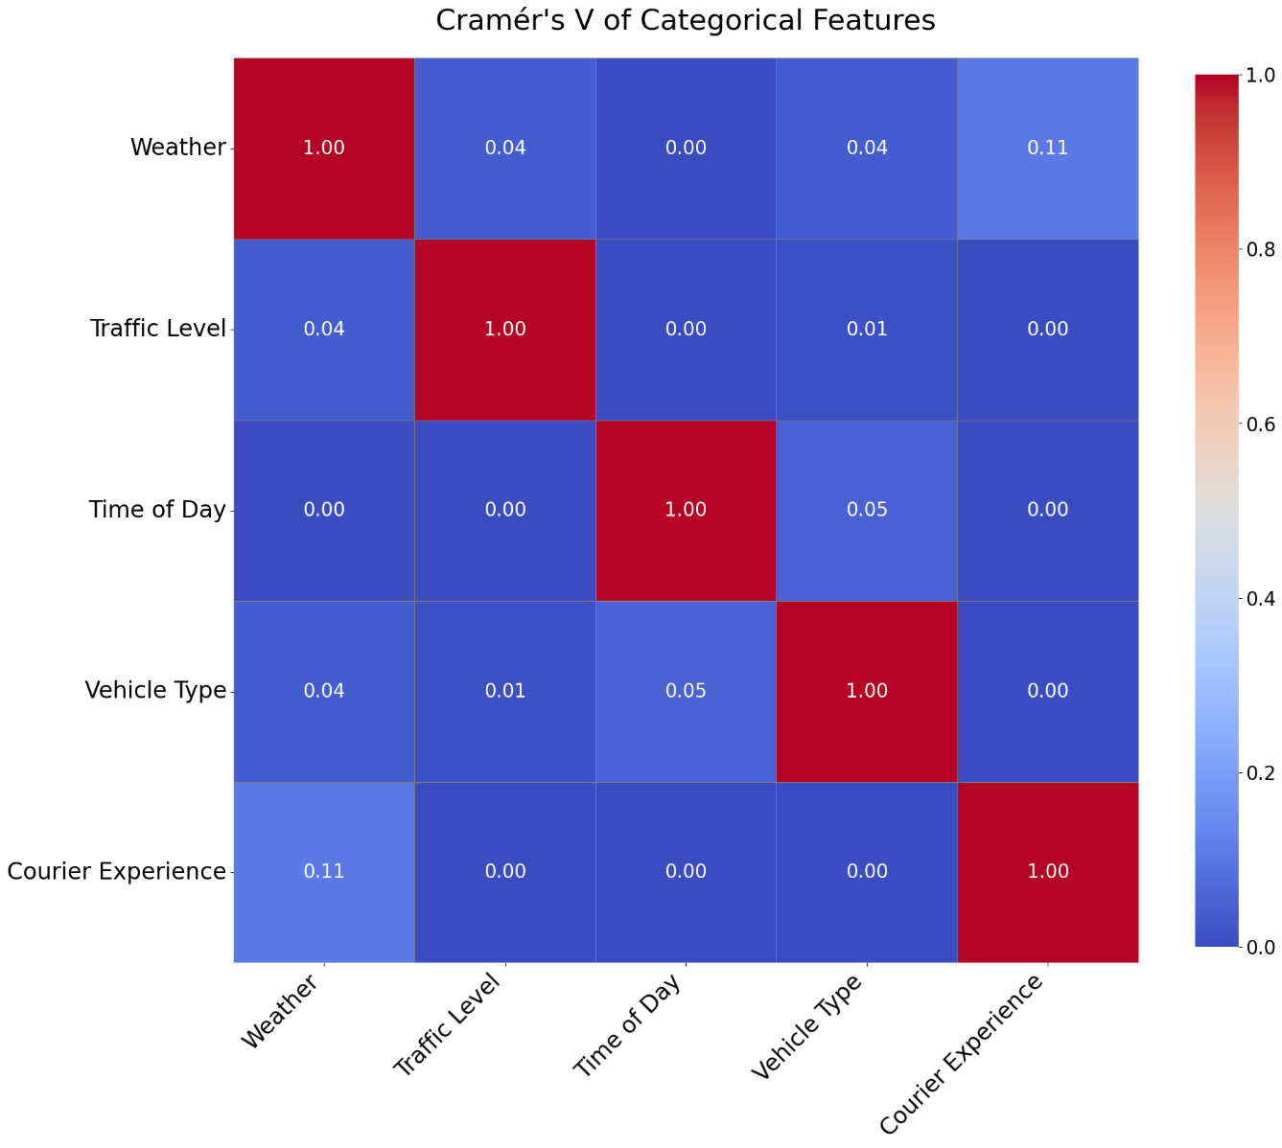
Multiple linear regression - categorical regressors
We verify that the categorical variables are not strongly correlated with each other.
To do so, we use Cramér's V, a statistical measure of association between two categorical variables.

Slide 19
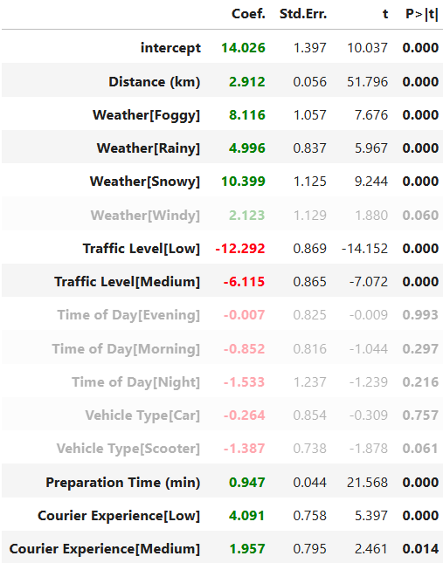

Multiple linear regression - full model evaluation
Overall, the model has improved in both explanatory power and prediction accuracy.
We notice that the p-values for Vehicle Type and Time of Day are high, so we choose to remove them.

Slide 20
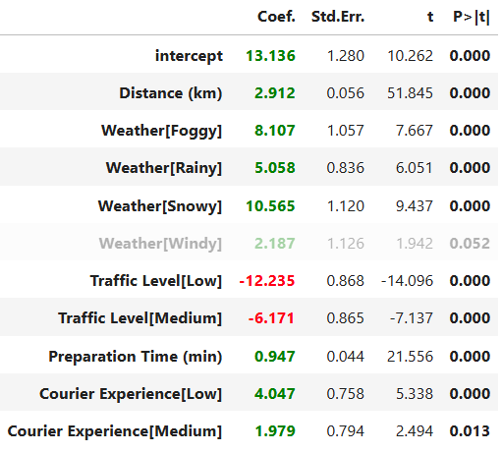

Multiple linear regression - refined model
By removing those two variables, we obtained a simpler and more interpretable model.
This was achieved without losing the good performance of the previous full model.

Slide 21
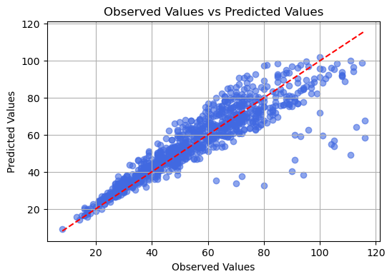
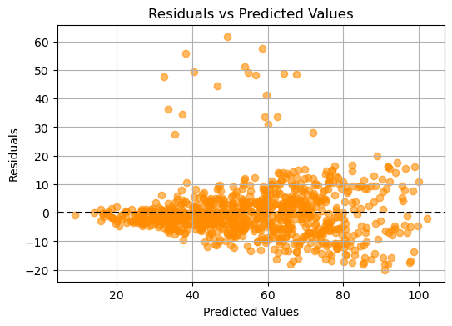
Multiple linear regression - refined model
In the residuals, we can observe a clear cone-shaped pattern, which indicates heteroscedasticity.

Slide 22
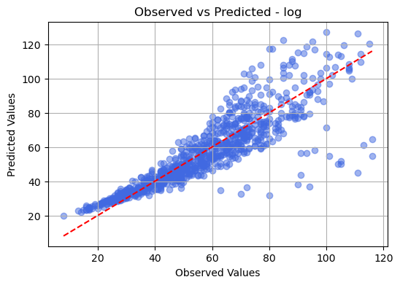
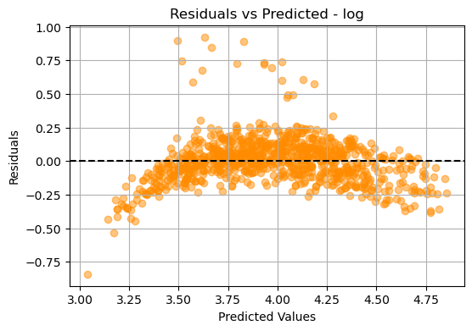
Multiple linear regression - log transformation
$R^{2}$: 0.823

Slide 23
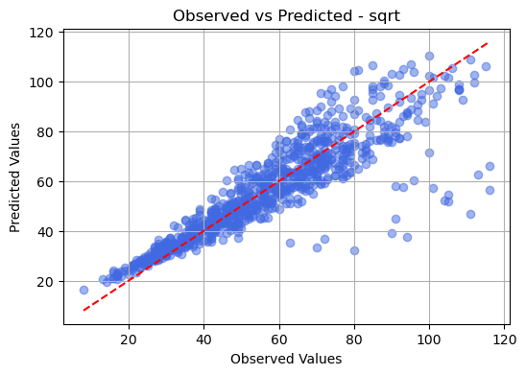
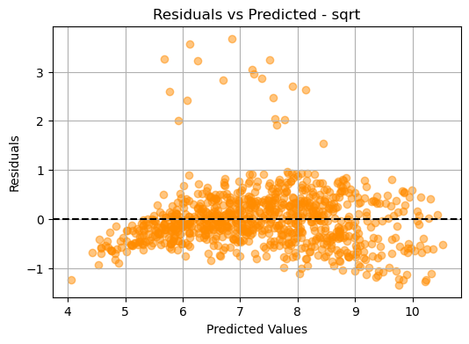
Multiple linear regression - square root transformation
$R^{2}$: 0.827

Slide 24
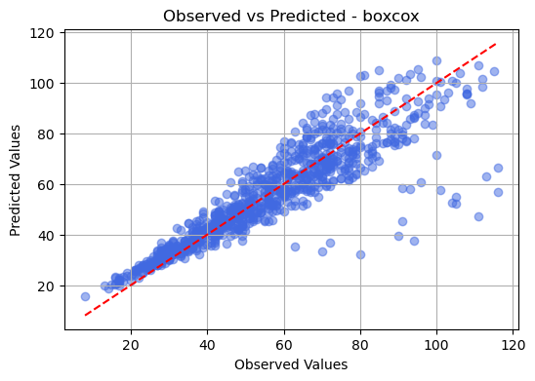
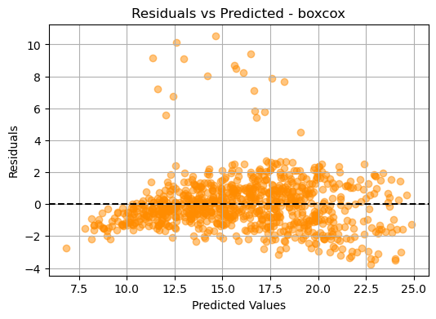
Multiple linear regression - box cox transformation
$R^{2}$: 0.825

Slide 25
Cross validation
We split the dataset to compute three Cross Validation methods on the linear regression model.
Basic Cross Validation: fastest method, obtains mediocre results;
MSE: 96.075 RMSE: 9.802
Leave-One-Out Cross Validation: much more precise but also expensive;
MSE: 89.766 RMSE: 9.474
K-Fold Cross Validation: yields the best results out of the three methods.
MSE: 89.613 RMSE: 9.466

Slide 26
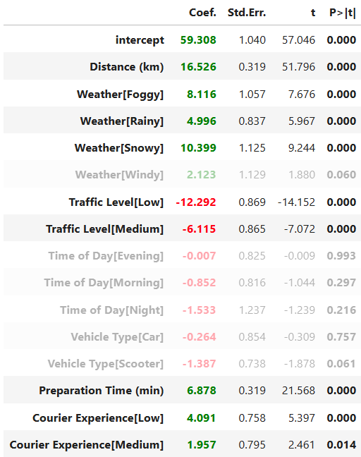
Shrinkage methods
We utilize two methods: Ridge and Lasso regression.
For this evaluation, we need to return to a model with all variables.
It is also important to standardize the model, as this ensures all variables are on the same scale.

Slide 27
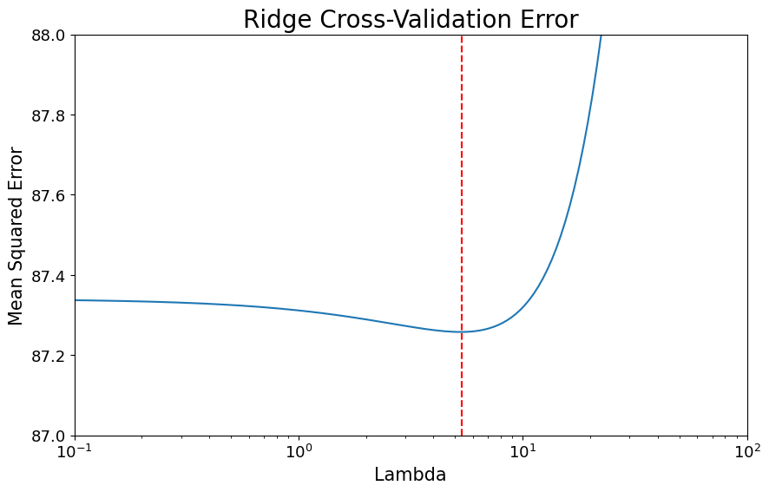
Ridge regression
We begin by splitting the database into train and test sets, and we search for the optimal lambda for ridge regression, using 10-fold cross-validation.
Best Ridge Lambda: 5.359

Slide 28
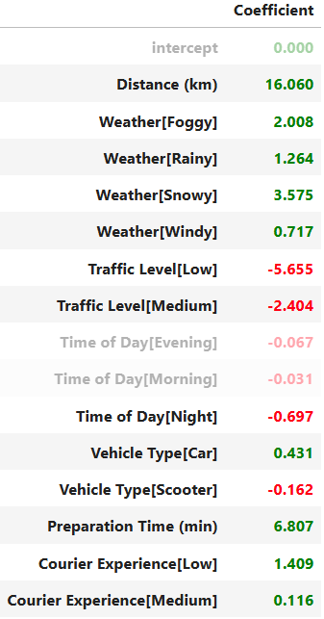

Ridge regression
We see that the less significant variables have coefficients very close to zero for ridge regression.

Slide 29
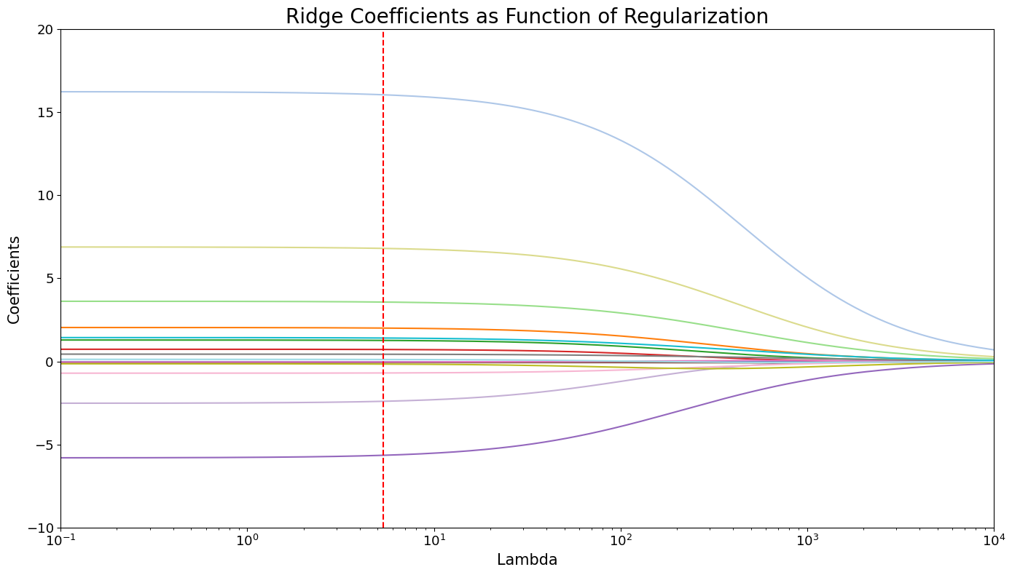
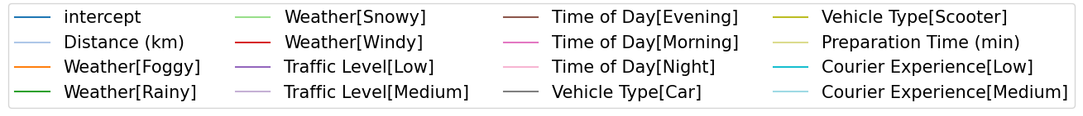
Ridge regression

Slide 30
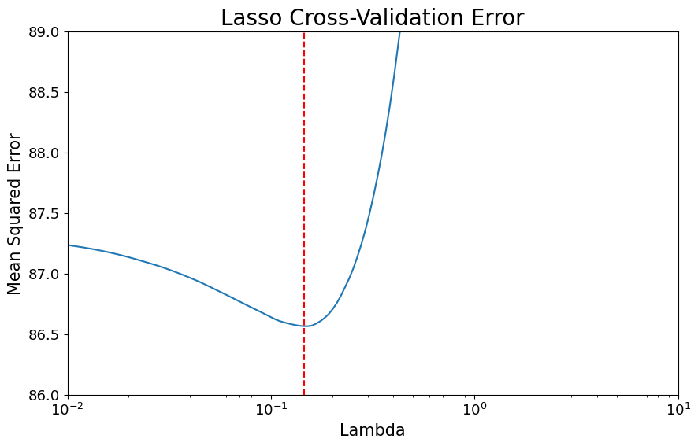
Lasso regression
We proceed in the same manner with lasso regression.
Best Lasso lambda: 0.146

Slide 31
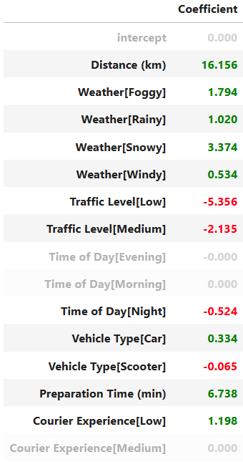

Lasso regression
With lasso regression, the less significant variables are driven exactly to zero, allowing for model simplification.

Slide 32
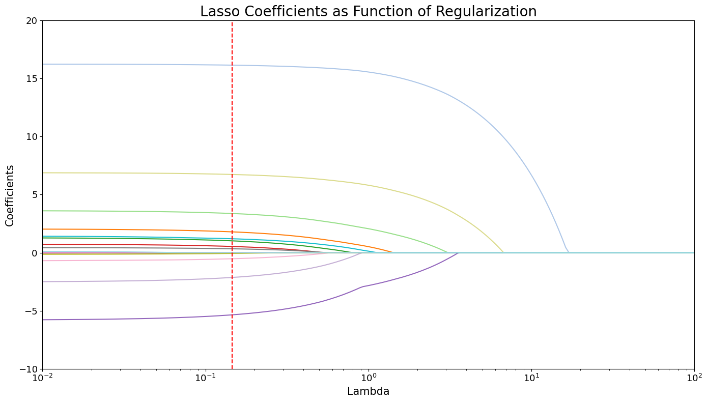
Lasso regression

Slide 33
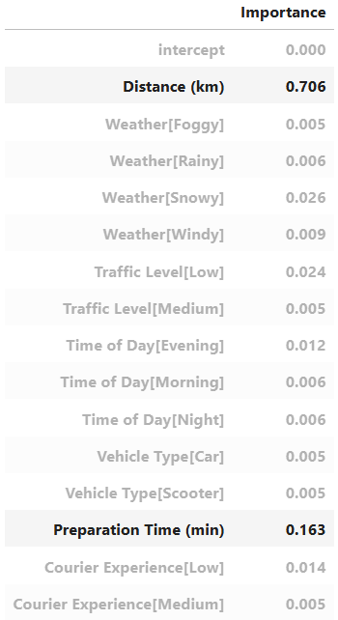
Decision trees
We return to a non-normalized model, as normalization is not needed.
Decision trees use binary splits on the regressors to classify expected value ranges.
Here are the importance rate of all the variables according to our first decision tree attempt.

Slide 34
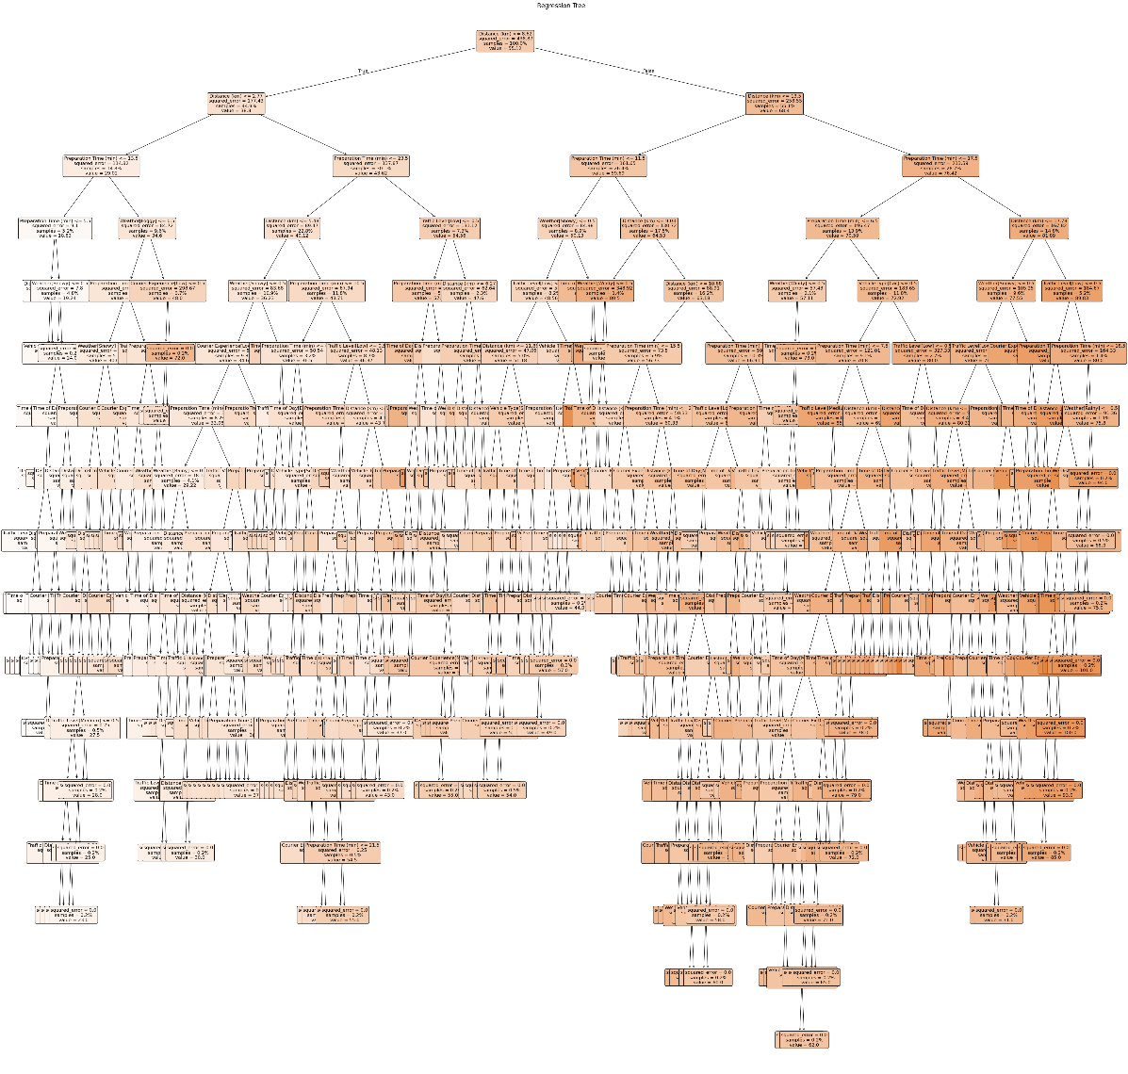
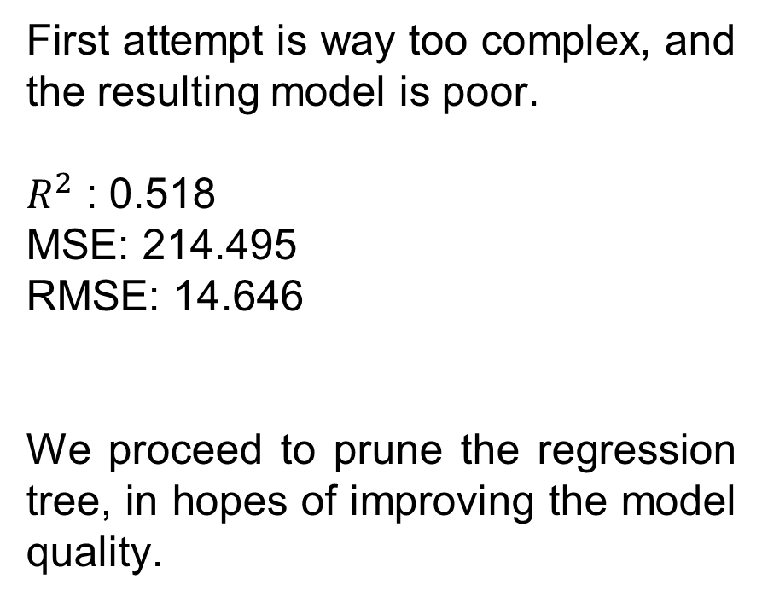
Regression tree – first attempt
First attempt is way too complex, and the resulting model is poor.
$R^{2}$ : 0.518
MSE: 214.495
RMSE: 14.646
We proceed to prune the regression tree, in hopes of improving the model quality.

Slide 35
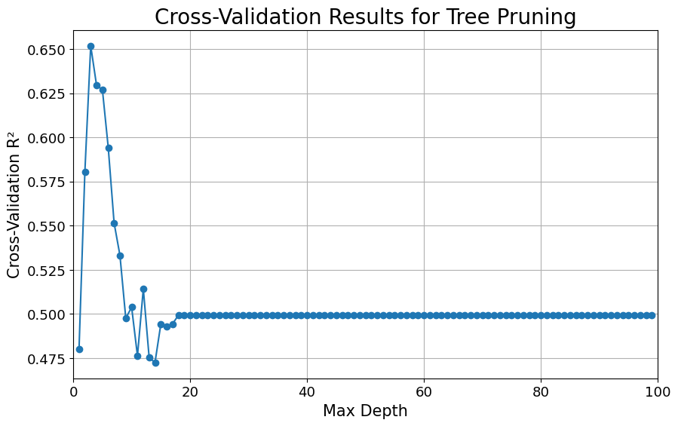
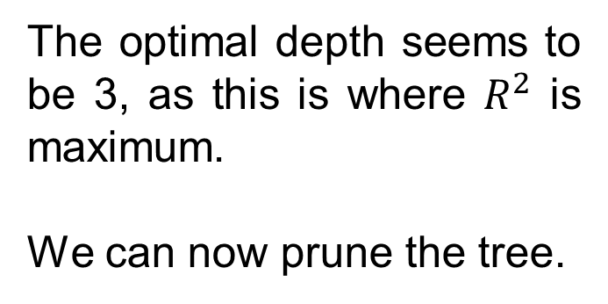
Regression tree – best depth
The optimal depth seems to be 3, as this is where $R^{2}$ is maximum.
We can now prune the tree.

Slide 36
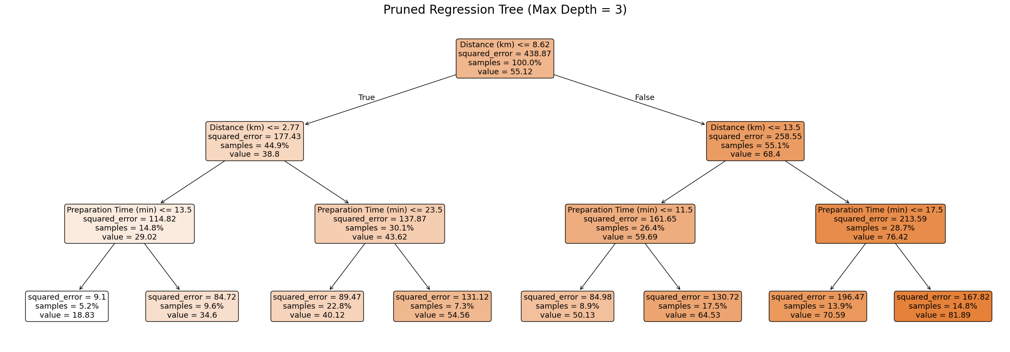
Regression tree – pruned tree
$R^{2}$ : 0.608 MSE: 174.627 RMSE: 13.215

Slide 37
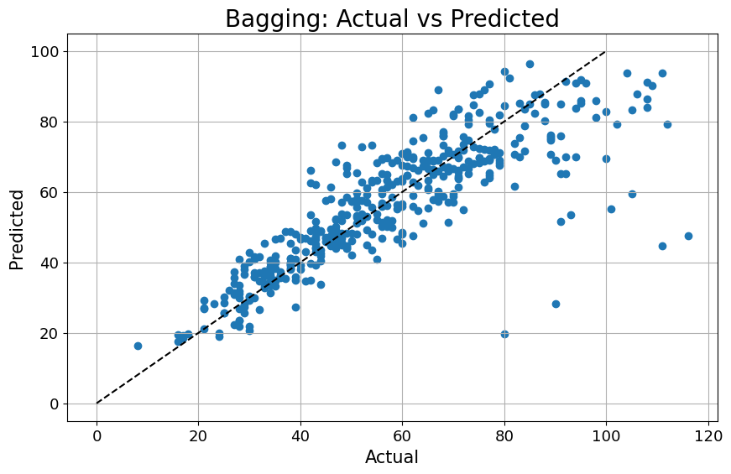
Ensemble methods - Bagging
The residual analysis shows better results compared to previous tree-based models.
Bagging MSE: 132.252
Bagging RMSE: 11.500

Slide 38
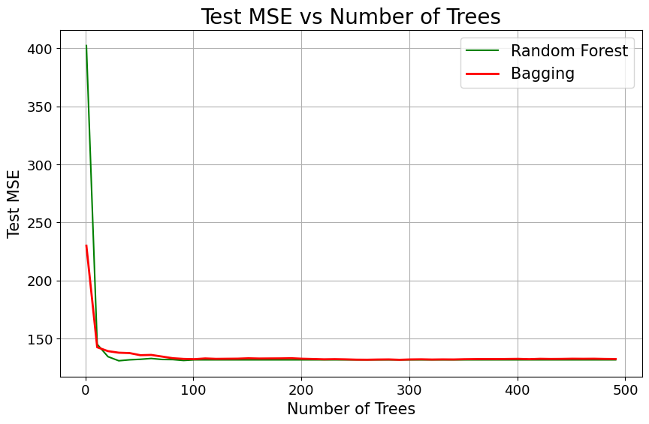
Ensemble methods - Random forest
Using Random Forest, we select a random subset of features at each split, rather than considering all features.
Random Forest MSE: 131.571
Random Forest RMSE: 11.470

Slide 39
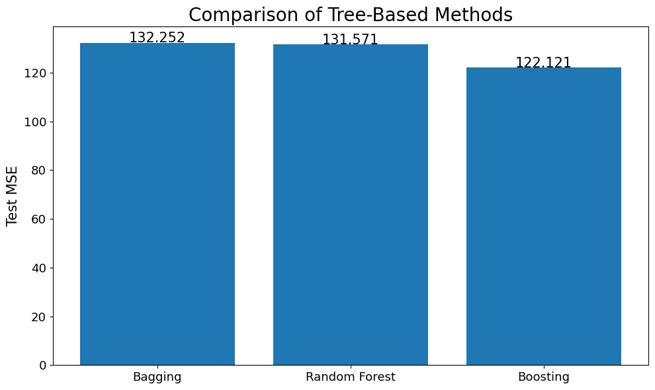
Ensemble methods - Boosting
Based on the results, it appears that Boosting is the most effective tree-based method.
Boosting MSE: 122.121
Boosting RMSE: 11.051

Slide 40
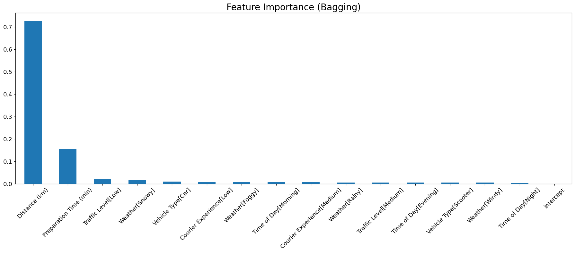
Ensemble methods – feature importance
The order and magnitude of feature importance was almost the same for all three methods used.

Slide 41
Conclusions – linear regression vs trees
Overall, regression trees models have worse performances compared to any regression model in this analysis, at least in terms of prediction.
This might be due to the characteristics of the dataset: it is composed of generated data, perhaps using a linear regression model like the one utilized in this analysis.

Slide 42
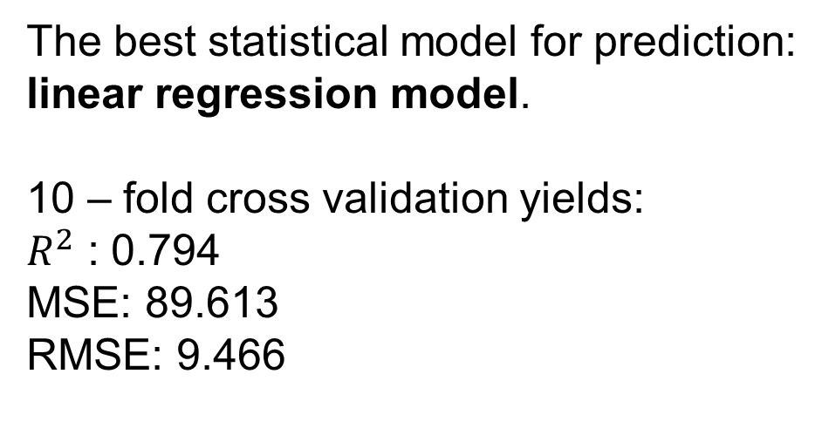
Conclusions - overall best model
The best statistical model for prediction:
linear regression model.
10 – fold cross validation yields:
$R^{2}$ : 0.794
MSE: 89.613
RMSE: 9.466

Slide 43
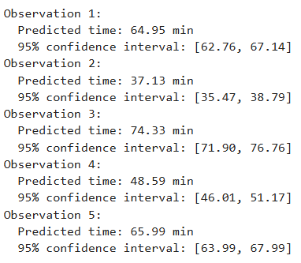
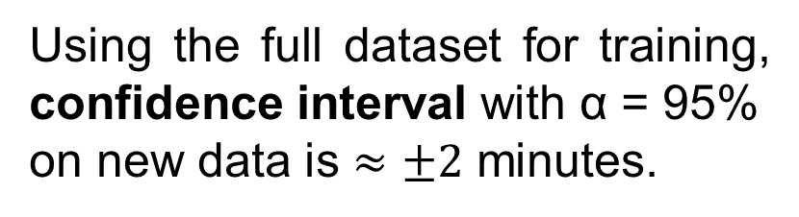
Conclusions - overall best model
Using the full dataset for training, confidence interval with α = 95%
on new data is $≈±2$ minutes.

