Slide 1
Statistical Learning: Dataset analysis project
Presentation by
Gotti Daniele – 1079011
Mazzoleni Gabriele - 1079514

Slide 2
Selected dataset - Food Delivery Time Prediction
Reference link: https://www.kaggle.com/datasets/denkuznetz/food-delivery-time-prediction
This dataset is designed for predicting food delivery times based on various influencing factors such as distance, weather, traffic conditions, and time of day.
This dataset contains simulated data to predict food delivery times based on various real-world factors.

Slide 3
Dataset variables
Order_ID: Unique identifier for each order (unused in this analysis, as it is irrelevant for regression models).
Distance_km: The delivery distance in kilometers.
Weather: Weather conditions during the delivery, including Clear, Rainy, Snowy, Foggy, and Windy.
Traffic_Level: Traffic conditions categorized as Low, Medium, or High.
Time_of_Day: The time when the delivery took place, categorized as Morning, Afternoon, Evening, or Night.
Vehicle_Type: Type of vehicle used for delivery, including Bike, Scooter, and Car.
Preparation_Time_min: The time required to prepare the order, measured in minutes.
Courier_Experience_yrs: Experience of the courier in years.
Delivery_Time_min: The total delivery time in minutes (target variable).

Slide 4
Objective of the analysis
The objective of this analysis is the creation of a model that can predict the necessary time for food delivery given a set of circumstance data.
Such model may then be implemented in software applications for delivery services, to inform clients of expected wait times even before the order has been completed.

Slide 5
Preliminary analysis
We begin our analysis by “cleaning” the dataset, specifically removing rows containing null values that would cause errors during further computations; this operation reduced the number of total rows from the initial 1000 to 883.
We then remove any outliers that may distort the model, luckily, only four rows are classified as outliers at this point.
[vogliamo aggiungere boxplot o simili qui?]

Slide 6
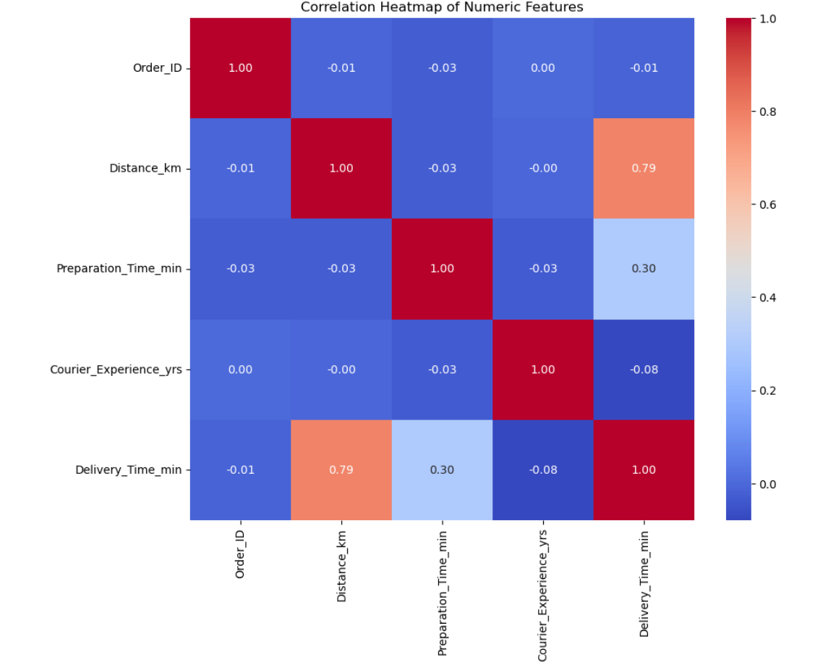
Evaluating correlation
Before building regression models, we assess the quality of the dataset by analyzing the correlation between variables through the construction of a correlation matrix.
In our case, some variables show a clear linear relationship with delivery time, indicating their potential importance in the regression model. Additionally, the predictors are not highly correlated with each other, suggesting that the dataset is suitable for linear regression and that multicollinearity is not a concern.

Slide 7
Simple linear regression
The three numerical variables (Distance_km, Preparation_Time_min, Courier_Experience_yrs) are selected, and the relationship between each of them and the response variable Delivery_Time_min is analyzed individually.
The resulting models are mostly similar, all three variables individually have a high importance (as discernible by their low P-value); the travel distance generates the best model out of the three, while the preparation time and courier experience, while having an impact on the delivery time, seem to not be enough by themselves to predict delivery time.

Slide 8
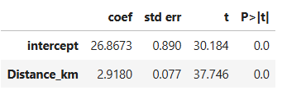
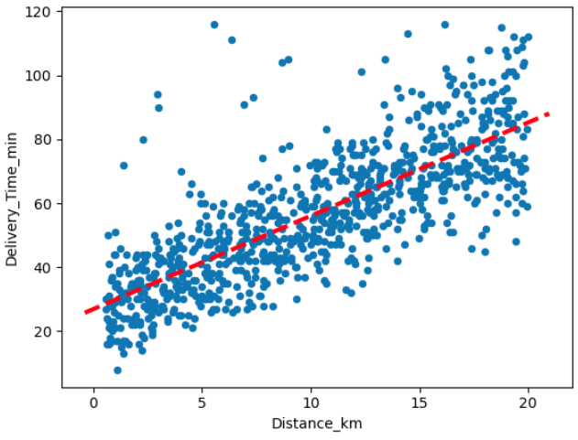
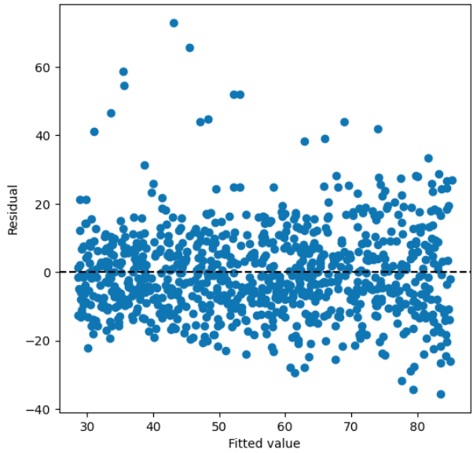
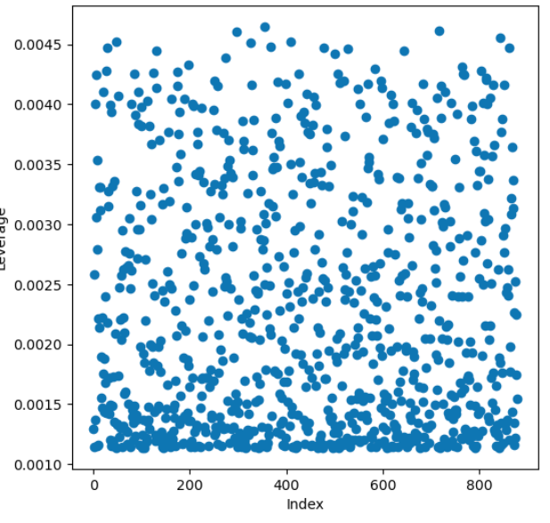
First case: modelling Distance_km

Slide 9
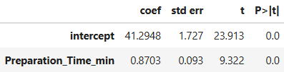
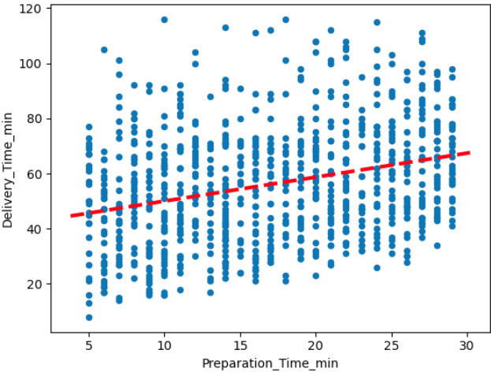
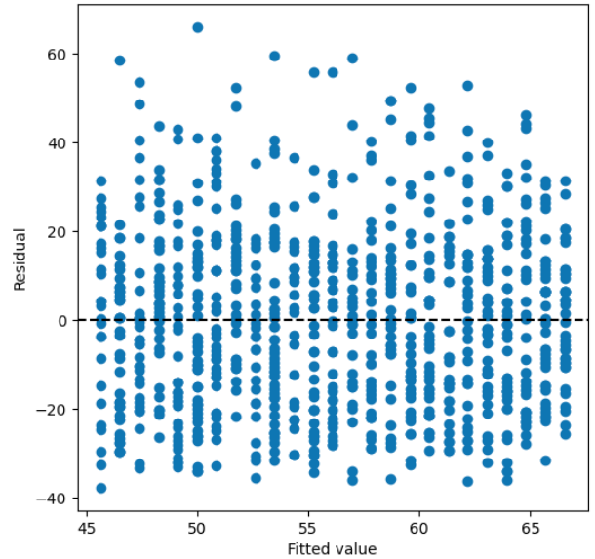
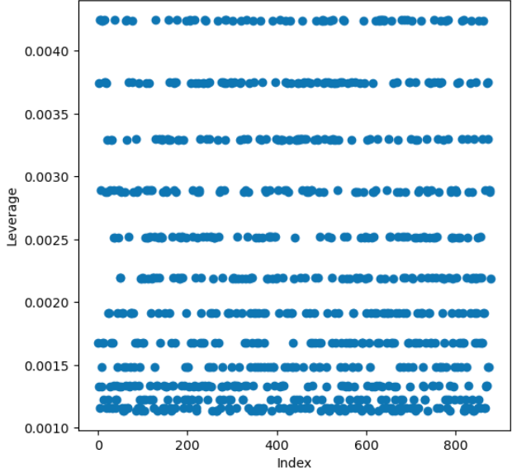
Second case: modelling Preparation_Time_min

Slide 10
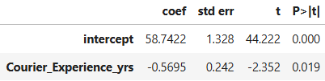
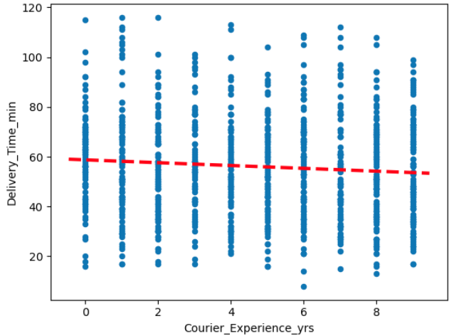
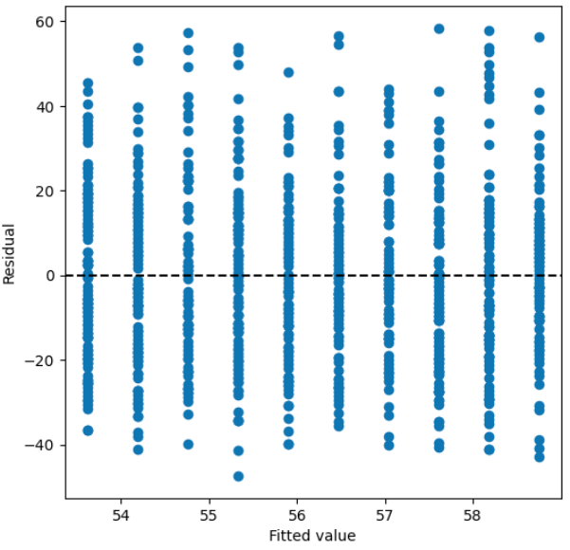
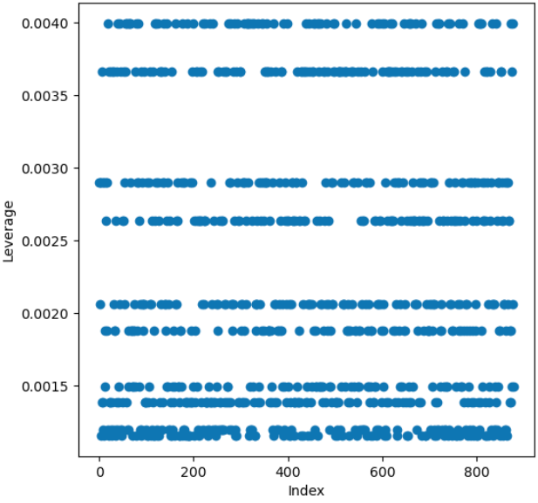
Third case: modelling Courier_Experience_yrs

Slide 11
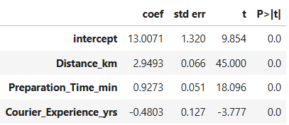

Multiple linear regression - using numerical predictors only
The results of the linear regression model indicate that distance, preparation time, and courier experience significantly influence food delivery time (p-values = 0).
The linear regression model explains approximately 73% of the variance in food delivery time, indicating a strong fit. The residual standard error (RSE) is 11 minutes, suggesting a moderate prediction error given the likely range of delivery times. Overall, the model performs well.

Slide 12
Multiple linear regression - evaluation of categorical regressors
Before creating the new model, we verify that the categorical variables are not strongly correlated with each other, ensuring that each one contributes useful information to the model. Since the variables are not numerical, we cannot use a standard correlation matrix. Instead, we use Cramér's V, a statistical measure of association between two categorical variables, which ranges from 0 (no association) to 1 (perfect association).

Slide 13
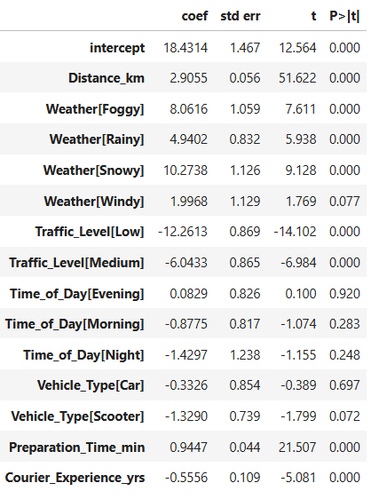

Multiple linear regression - full model evaluation
Distance_km has a strong and significant positive effect on delivery time.
Adverse weather conditions like Foggy, Rainy, and Snowy significantly increase delivery time, compared to Clear weather.
Traffic_Level[Low] and Medium significantly reduce delivery time compared to High traffic, which is the baseline.
Different times of the day (Morning, Evening, Night) do not show statistically significant differences (p-values > 0.05) from the baseline (Afternoon).
Similarly, neither Car nor Scooter types show significant differences (p-values > 0.05) from the baseline vehicle (Bike), suggesting that vehicle type may not strongly influence delivery time in this model.
Preparation_Time_min significantly increases delivery time, as expected.
Courier_Experience_yrs is negatively associated with delivery time, indicating that more experienced couriers tend to deliver faster.

Slide 14
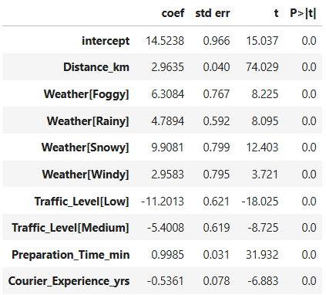
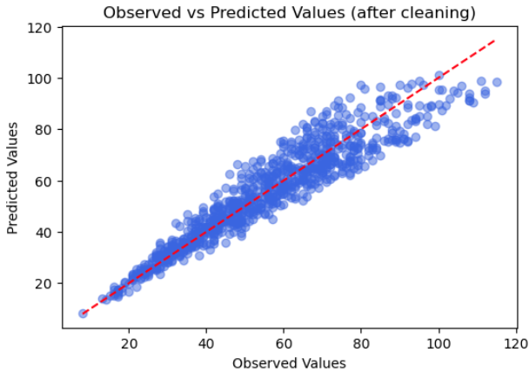
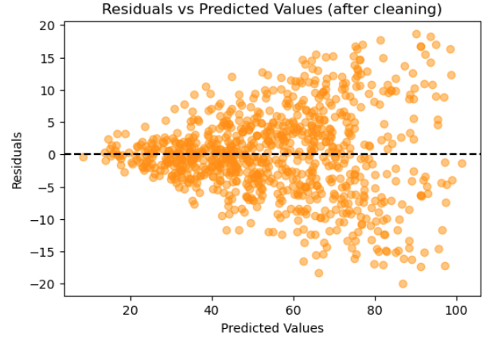

Multiple linear regression - refined model with cleaned data
We decided to remove Vehicle_Type and Time_of_day, as they were the least statistically significant, with high p-values.
We also removed some remaining outliers, resulting in the following model:

Slide 15
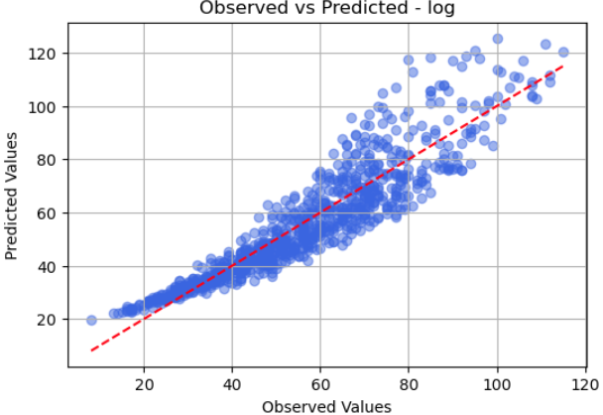
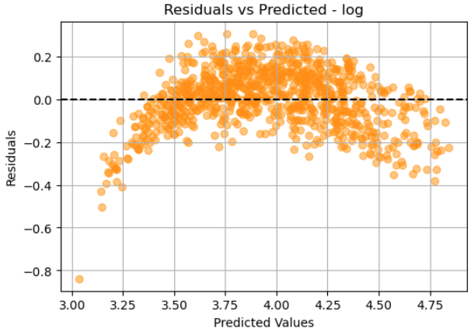
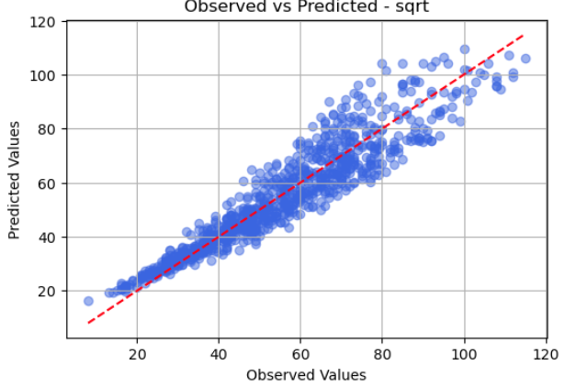
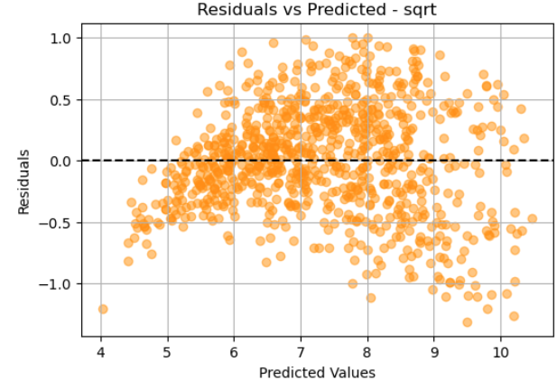
Multiple linear regression - model transformations
After noticing heteroscedasticity in the previous model’s residuals graph, we attempted transformations on the model to try to improve its performance.
th

Slide 16
Cross validation

Slide 17
Preliminary results

