Slide 1
Statistical Learning: Dataset analysis project
Presentation by
Gotti Daniele – 1079011
Mazzoleni Gabriele - 1079514

Slide 2
Selected dataset - Food Delivery Time Prediction
Reference link: https://www.kaggle.com/datasets/denkuznetz/food-delivery-time-prediction
This dataset is designed for predicting food delivery times based on various influencing factors such as distance, weather, traffic conditions, and time of day.
This dataset contains simulated data to predict food delivery times based on various real-world factors.

Slide 3
Dataset variables
Order_ID: Unique identifier for each order (unused in this analysis, as it is irrelevant for regression models).
Distance_km: The delivery distance in kilometers.
Weather: Weather conditions during the delivery, including Clear, Rainy, Snowy, Foggy, and Windy.
Traffic_Level: Traffic conditions categorized as Low, Medium, or High.
Time_of_Day: The time when the delivery took place, categorized as Morning, Afternoon, Evening, or Night.
Vehicle_Type: Type of vehicle used for delivery, including Bike, Scooter, and Car.
Preparation_Time_min: The time required to prepare the order, measured in minutes.
Courier_Experience_yrs: Experience of the courier in years.
Delivery_Time_min: The total delivery time in minutes (target variable).

Slide 4
Objective of the analysis
The objective of this analysis is the creation of a model that can predict the necessary time for food delivery given a set of circumstance data.
Such model may then be implemented in software applications for delivery services, to inform clients of expected wait times even before the order has been completed.

Slide 5
Preliminary analysis
We begin our analysis by “cleaning” the dataset, specifically removing rows containing null values that would cause errors during further computations; this operation reduced the number of total rows from the initial 1000 to 883.
We then remove any outliers that may distort the model, luckily, only four rows are classified as outliers at this point.
[vogliamo aggiungere boxplot o simili qui?]

Slide 6
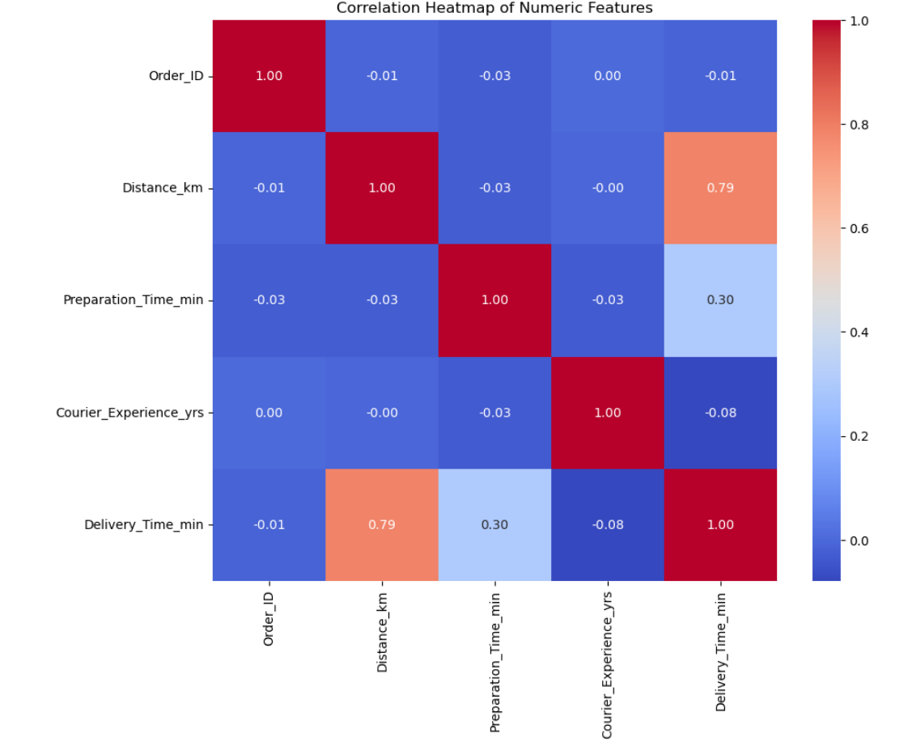
Evaluating correlation
Before building regression models, we assess the quality of the dataset by analyzing the correlation between variables through the construction of a correlation matrix.
In our case, some variables show a clear linear relationship with delivery time, indicating their potential importance in the regression model. Additionally, the predictors are not highly correlated with each other, suggesting that the dataset is suitable for linear regression and that multicollinearity is not a concern.

Slide 7
Simple linear regression
The three numerical variables (Distance_km, Preparation_Time_min, Courier_Experience_yrs) are selected, and the relationship between each of them and the response variable Delivery_Time_min is analyzed individually.
The resulting models are mostly similar, all three variables individually have a high importance (as discernible by their low P-value); the travel distance generates the best model out of the three, while the preparation time and courier experience, while having an impact on the delivery time, seem to not be enough by themselves to predict delivery time.

Slide 8
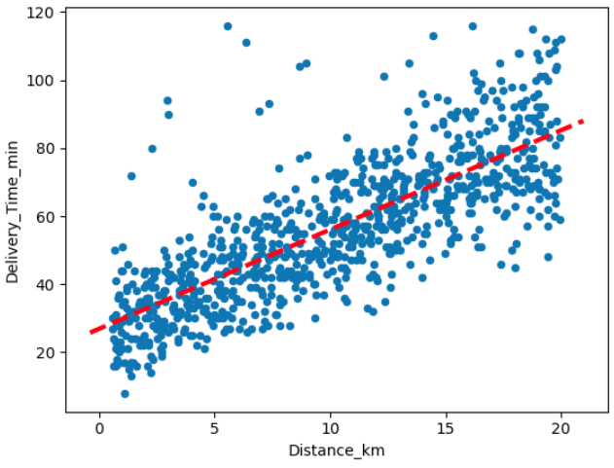
First case: modelling Distance_km
The scatter plot shows a positive correlation between distance in kilometers and delivery time in minutes.
The data points align well with the linear trend line, indicating that the model is accurate and useful for predicting delivery times based on distance.

Slide 9
Second case: modelling Preparation_Time_min

Slide 10
Second case: modelling Courier_Experience_yrs

Slide 11
Multiple linear regression

Slide 12
Cross validation

Slide 13
Preliminary results

