Slide 1

Statistical Learning: Dataset analysis project
Computer science engineering
Students
Gotti Daniele (matr 1078011)
Mazzoleni Gabriele (matr 1079514)
A.Y. 2024/2025

Slide 2



Problem setting – food delivery
In the current market for food delivery, full of already established services, it is paramount to find new ways to differentiate, to ensure a wider range of consumers.

Slide 3

Objective of this analysis
New comforts for customers = more customers;
today, quickness and timeliness in delivery is considered highly important;
IDEA : develop statistical model to accurately predict delivery times and implement it into an application.

Slide 4
Selected dataset: Food Delivery Time Prediction
Dataset designed for predicting food delivery times based on various influencing factors.
It contains simulated data based on various real-world factors.
Reference link: https://www.kaggle.com/datasets/denkuznetz/food-delivery-time-prediction

Slide 5
Dataset Variables
Order ID: Unique identifier for each order (unused, irrelevant)
Distance (km): The order delivery distance
Weather: Weather conditions during the delivery
Traffic Level: Traffic conditions
Time of Day: The time when the delivery took place
Vehicle Type: Type of vehicle used for delivery
Preparation Time (min): The time required to prepare the order
Courier Experience (years): Experience of the courier
Delivery Time (min): The total delivery time (target variable)

Slide 6
Preliminary analysis
The dataset contained 1000 rows, reduced to 883 after removal of rows with null values.
We then removed outliers using the Interquartile Range (IQR) method.
Remaining rows: 879

Slide 7
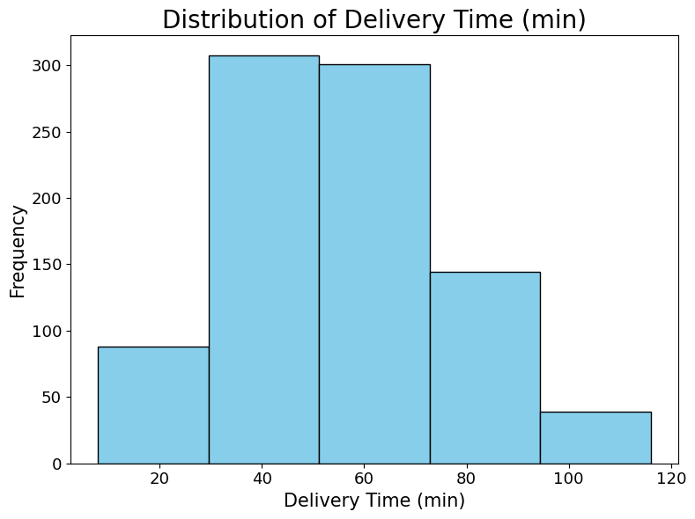
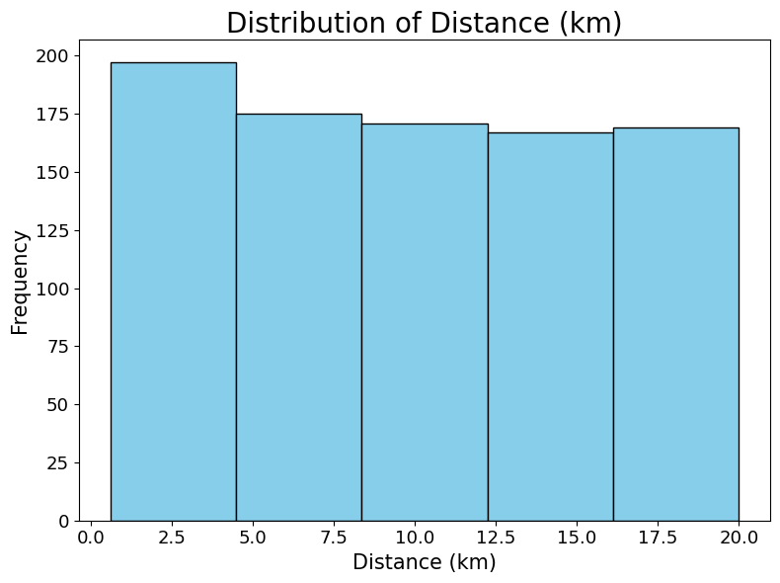
Data Distribuition - numerical variables

Slide 8
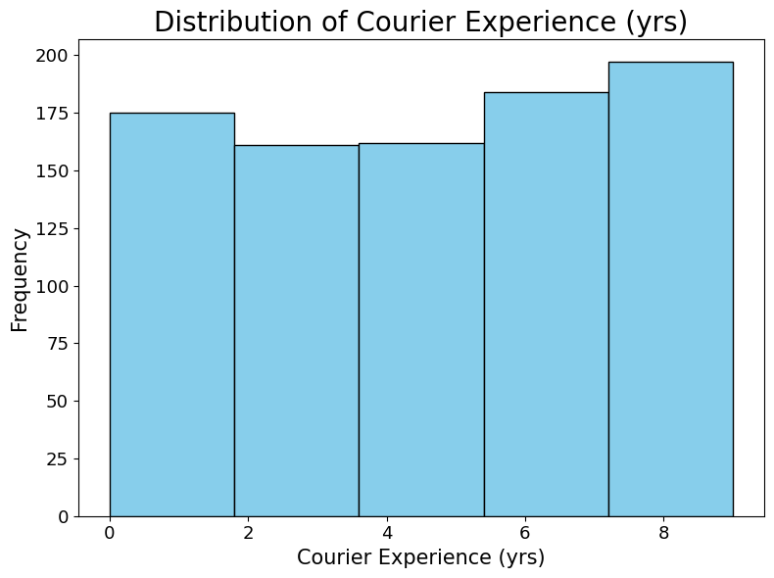
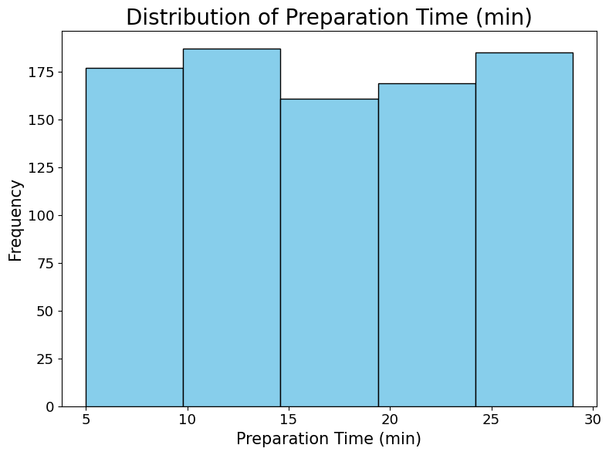
Data Distribuition - numerical variables

Slide 9
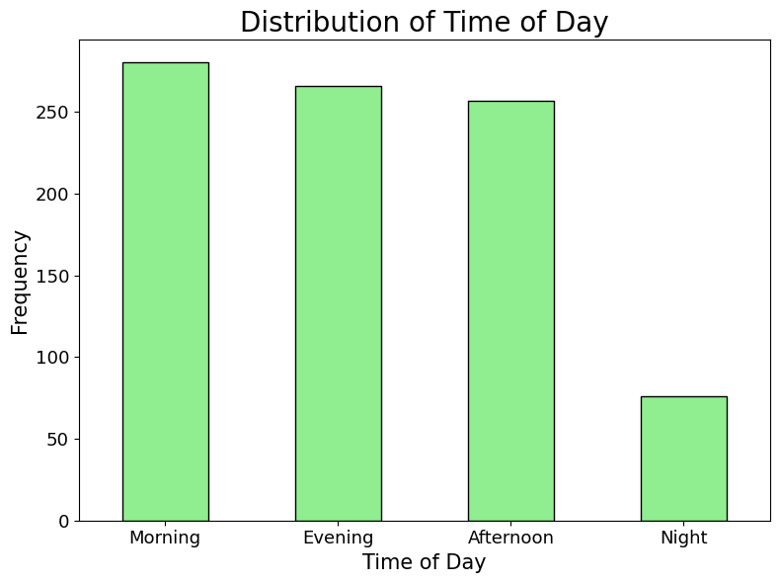
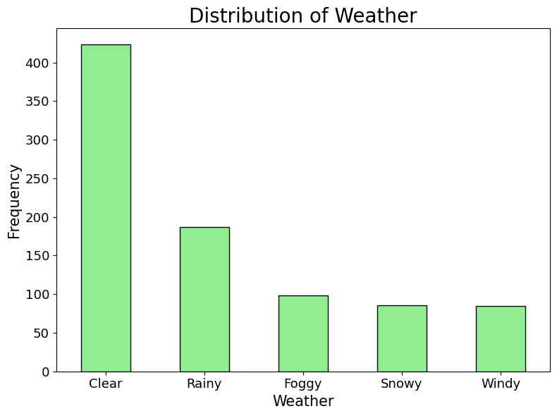
Data Distribuition – categorical variables

Slide 10
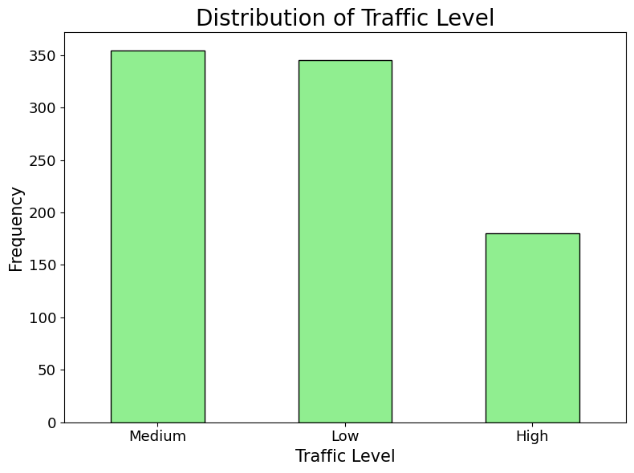
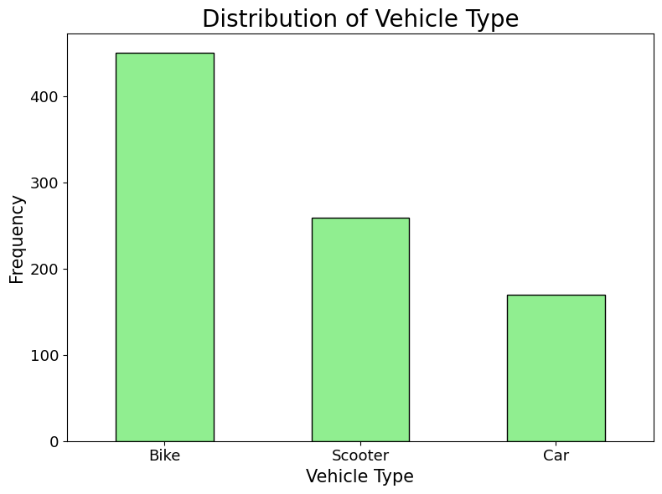
Data Distribuition - categorical variables

Slide 11
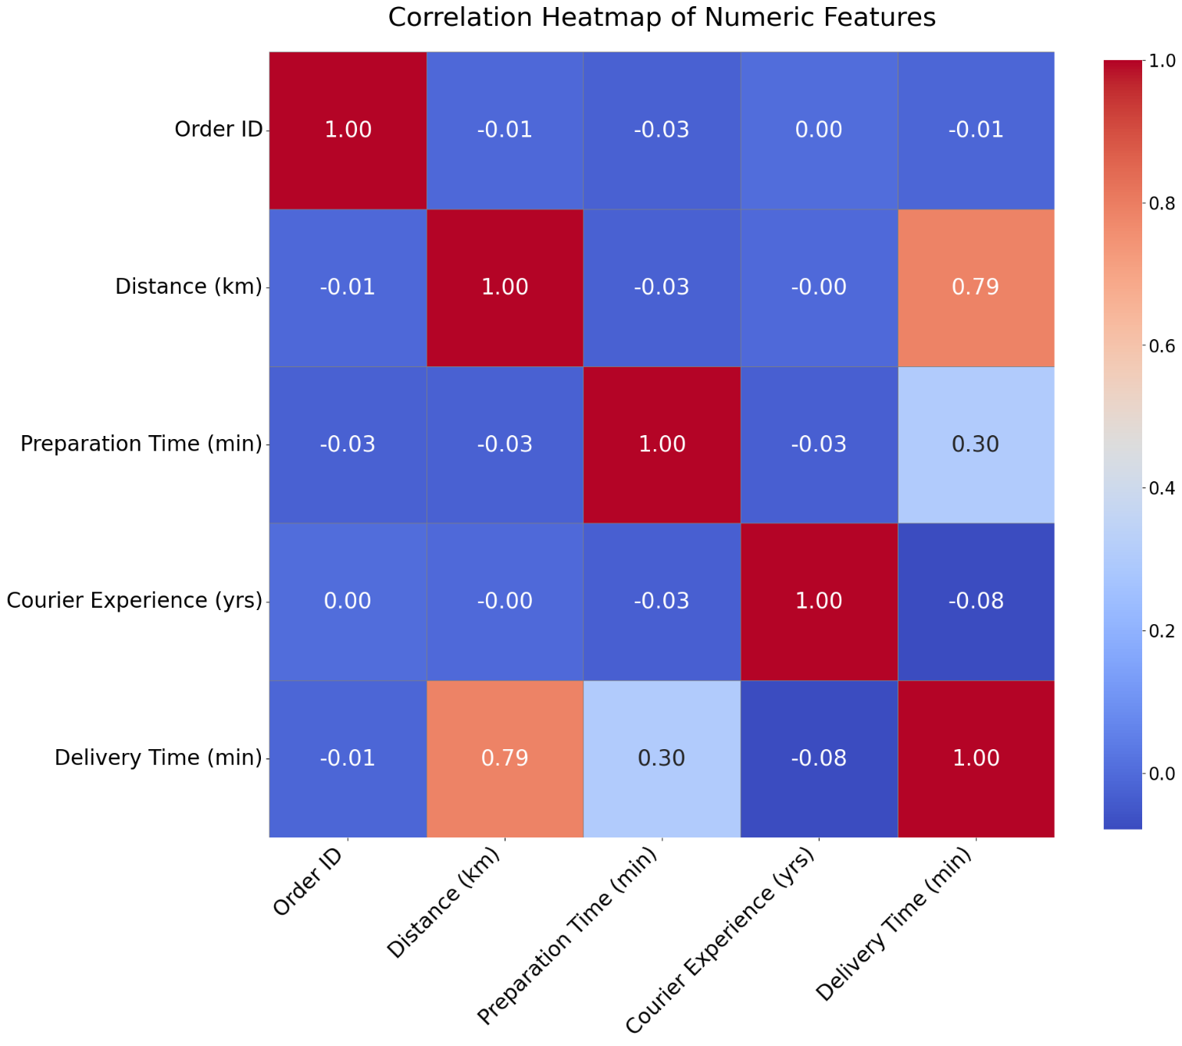
Evaluating correlation
Some numerical variables show a clear linear relationship with delivery time.
Even though Courier Experience is numerical we will consider it as categorical because the values represent discrete levels of experience.

Slide 12
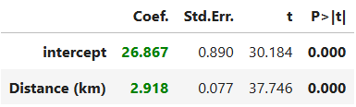
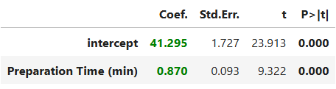
Simple linear regression - Objective
The two numerical variables, Distance and Preparation Time, are selected, and the relationship between each of them and the response variable Delivery Time is analyzed individually.
Delivery Time (min) = b0 + b1 * Variable + e
Distance
Preparation time

Slide 13
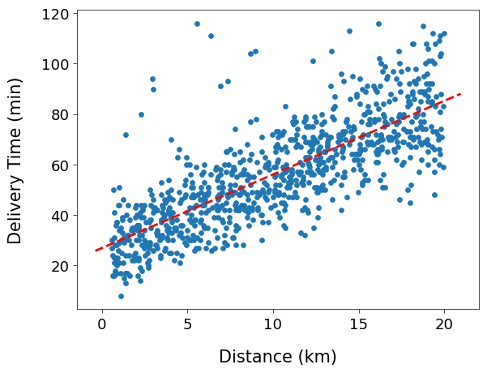
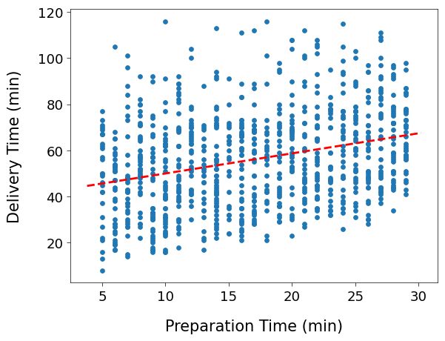
Simple linear regression - Scatterplots

Slide 14
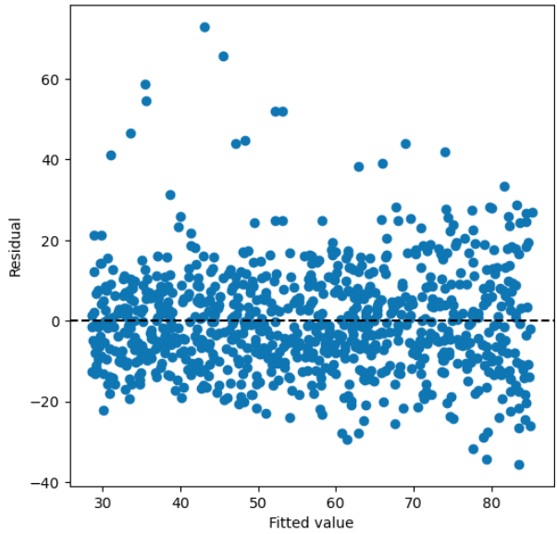
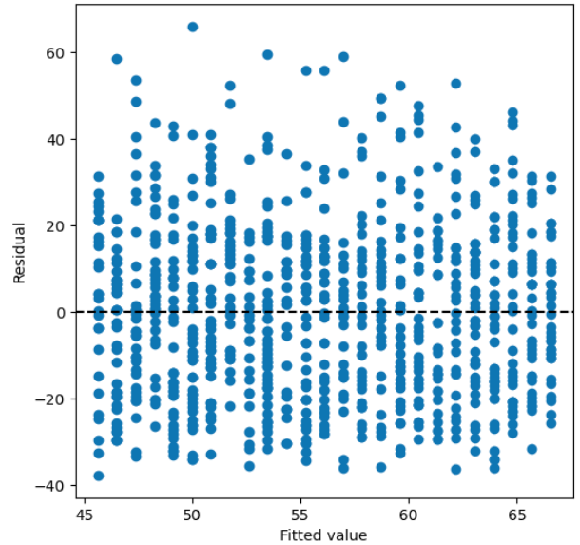
Simple linear regression - Residuals
Distance
Preparation time

Slide 15
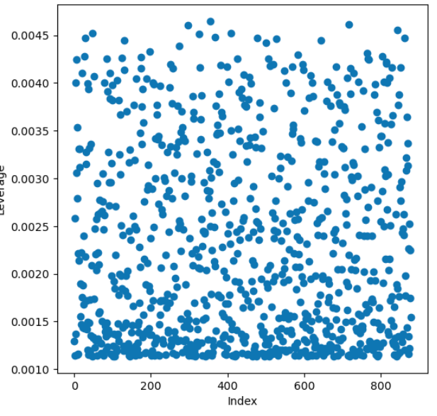
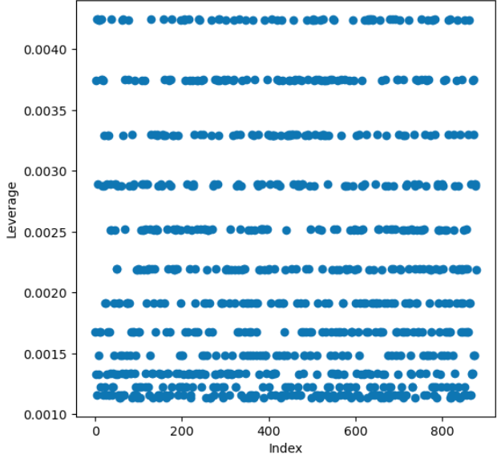
Simple linear regression - Leverage
Distance
Preparation time

Slide 16
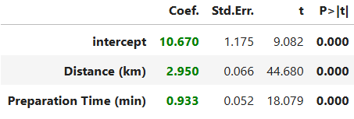

Multiple linear regression - using numerical predictors only
Both variables are useful to determine delivery times.
Overall, the model performs well.

Slide 17
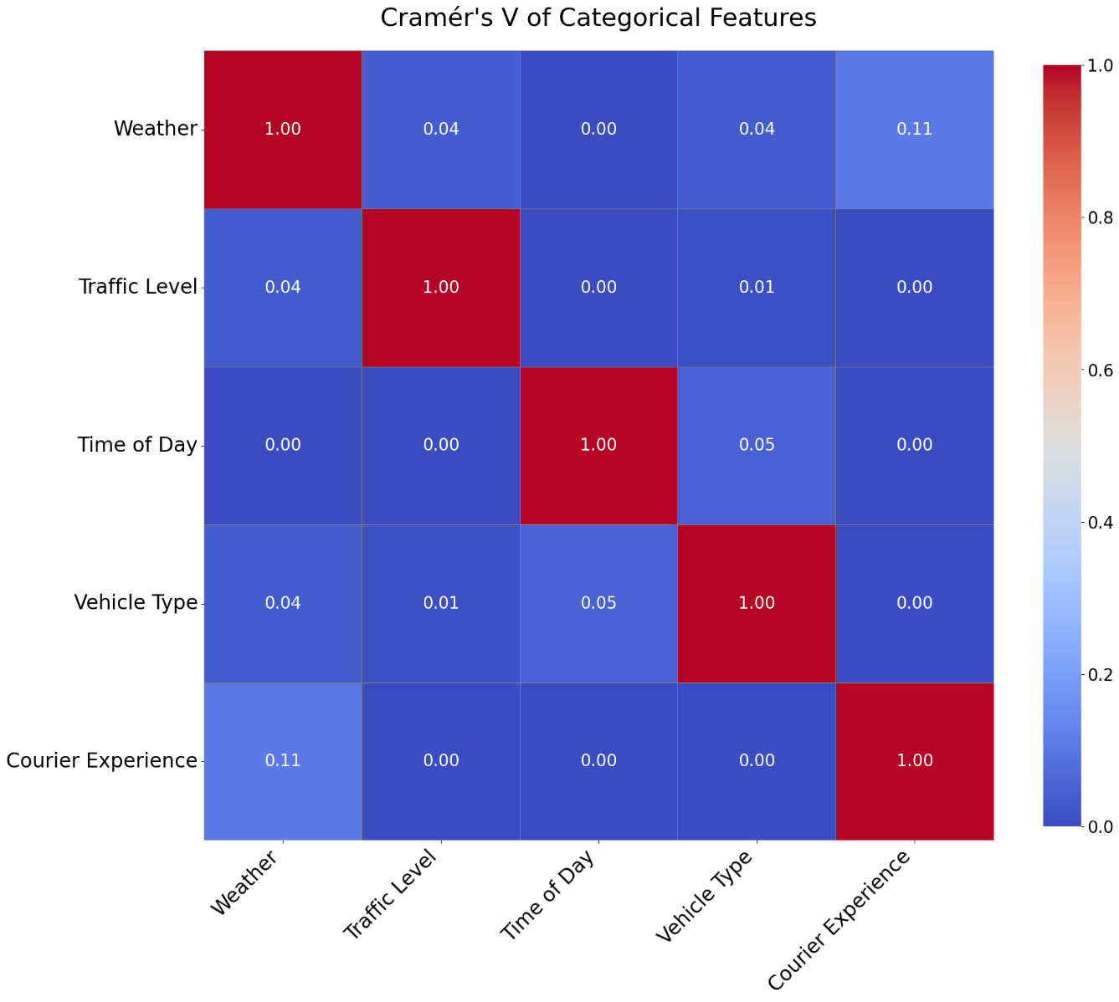
Multiple linear regression - categorical regressors
We verify that the categorical variables are not strongly correlated with each other.
To do so, we use Cramér's V, a statistical measure of association between two categorical variables.

Slide 18
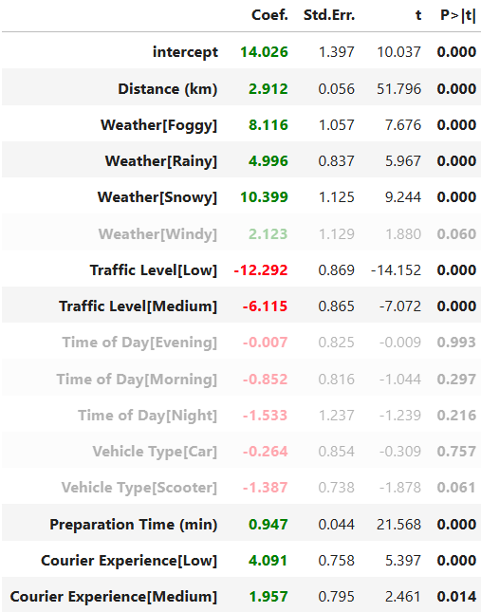

Multiple linear regression - full model evaluation
Overall, the model has improved in both explanatory power and prediction accuracy.
We notice that the p-values for Vehicle Type and Time of Day are high, so we choose to remove them.

Slide 19
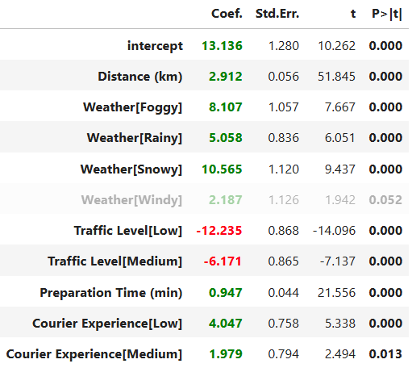

Multiple linear regression - refined model
By removing those two variables, we obtained a simpler and more interpretable model.
This was achieved without losing the good performance of the previous full model.

Slide 20
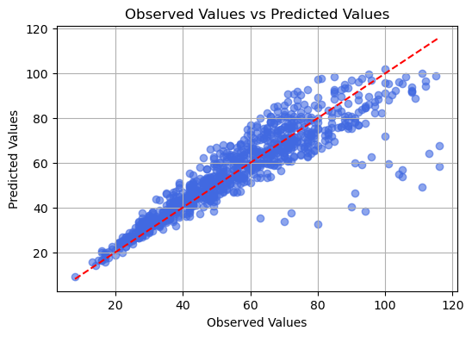
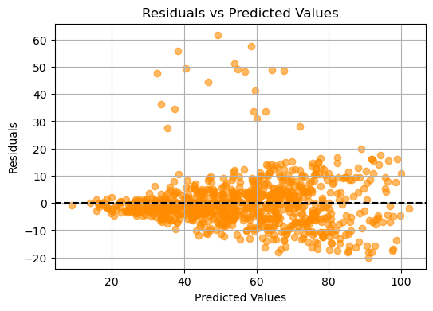
Multiple linear regression - refined model
In the residuals, we can observe a clear cone-shaped pattern, which indicates heteroscedasticity.

Slide 21
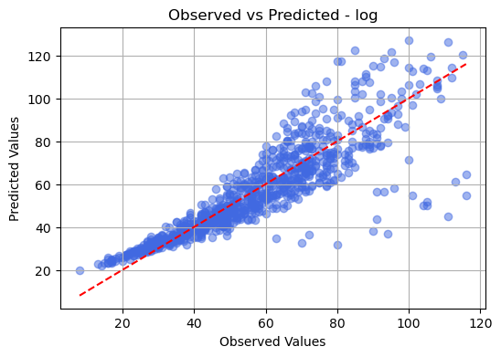
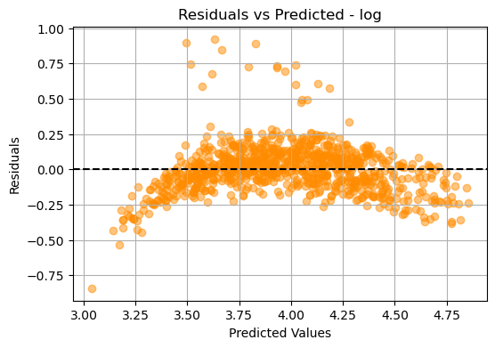
Multiple linear regression - log transformation
$R^{2}$: 0.823

Slide 22
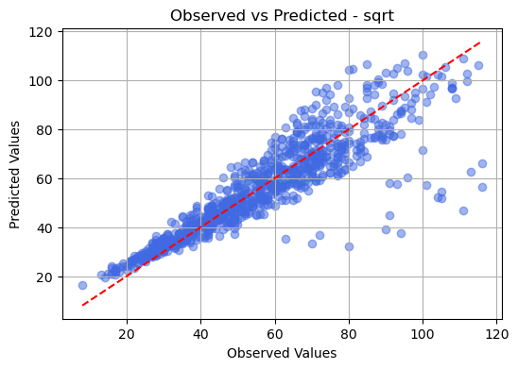
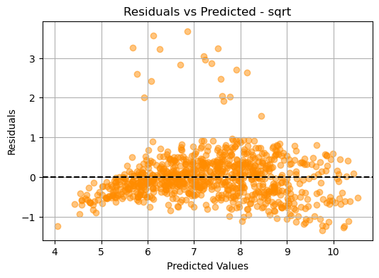
Multiple linear regression - square root transformation
$R^{2}$: 0.827

Slide 23
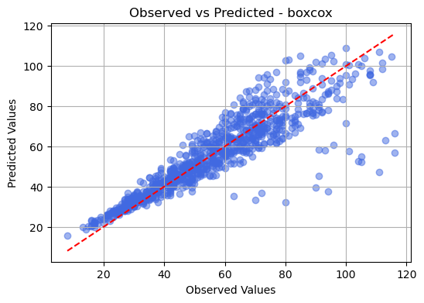
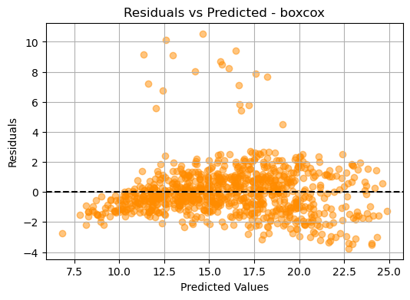
Multiple linear regression - box cox transformation
$R^{2}$: 0.825

Slide 24
Cross validation
We split the dataset to compute three Cross Validation methods on the regression model.
Basic Cross Validation: fastest method, obtains mediocre results;
MSE: 96.075 RMSE: 9.802
Leave-One-Out Cross Validation: much more precise but also expensive;
MSE: 89.766 RMSE: 9.474
K-Fold Cross Validation: yields the best results out of the three methods.
MSE: 89.613 RMSE: 9.466

