Slide 1

Statistical Learning: Dataset analysis project
Computer science engineering
Students
Gotti Daniele (matr 1078011)
Mazzoleni Gabriele (matr 1079514)
A.Y. 2024/2025

Slide 2



Problem setting – food delivery
In the current market for food delivery, full of already established services, it is paramount to find new ways to differentiate, to ensure a wider range of consumers.

Slide 3

Objective of this analysis
New comforts for customers = more customers;
today, quickness and timeliness in delivery is considered highly important;
IDEA : develop statistical model to accurately predict delivery times and implement it into an application.

Slide 4
Selected dataset: Food Delivery Time Prediction
Dataset designed for predicting food delivery times based on various influencing factors.
It contains simulated data based on various real-world factors.
Reference link: https://www.kaggle.com/datasets/denkuznetz/food-delivery-time-prediction

Slide 5
Dataset Variables
Order ID: Unique identifier for each order (unused, irrelevant)
Distance (km): The order delivery distance
Weather: Weather conditions during the delivery
Traffic Level: Traffic conditions
Time of Day: The time when the delivery took place
Vehicle Type: Type of vehicle used for delivery
Preparation Time (min): The time required to prepare the order
Courier Experience (years): Experience of the courier
Delivery Time (min): The total delivery time (target variable)

Slide 6
Preliminary analysis
The dataset contained 1000 rows, reduced to 883 after removal of rows with null values.
We then removed outliers using the Interquartile Range (IQR) method.
Remaining rows: 879

Slide 7
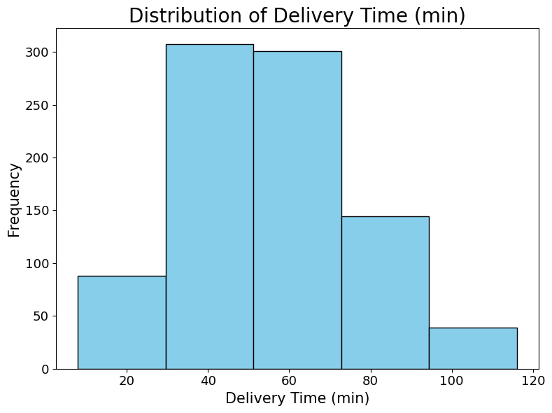
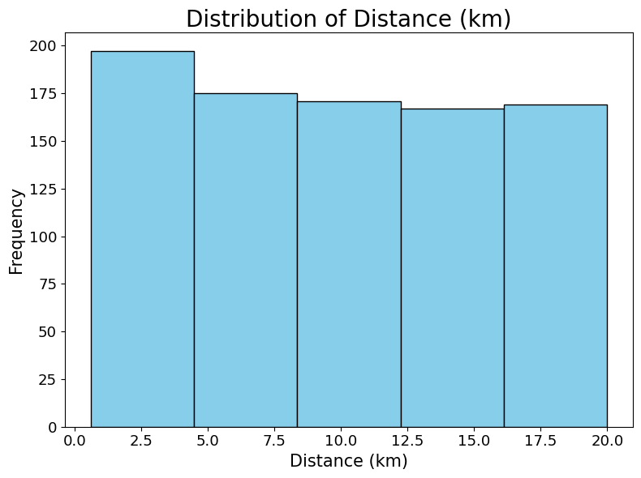
Data Distribuition - numerical variables

Slide 8
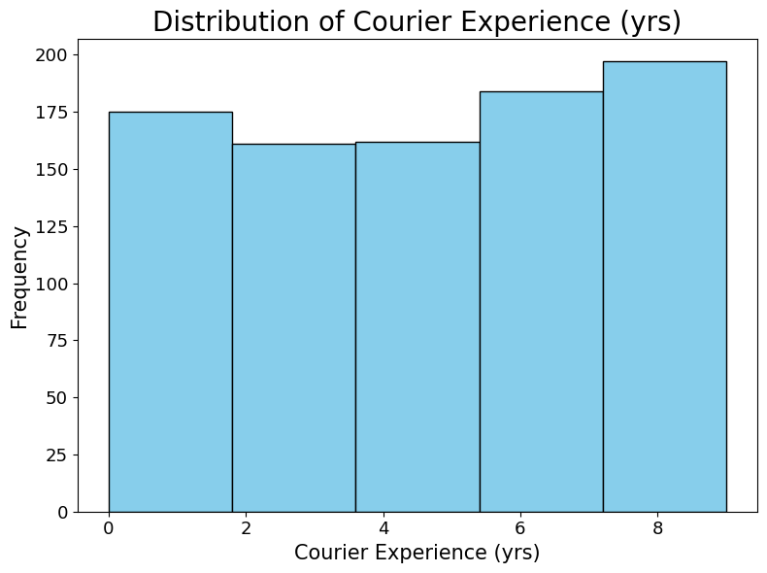
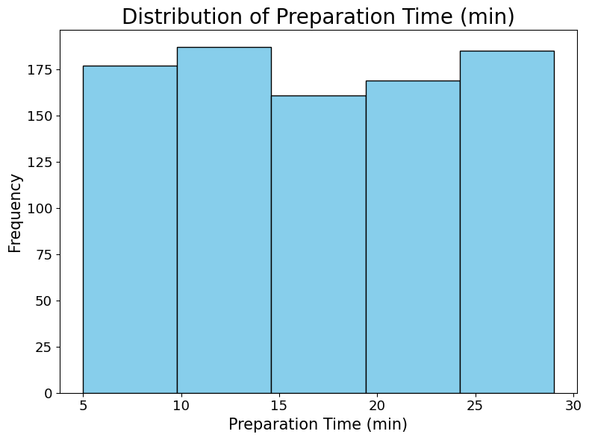
Data Distribuition - numerical variables

Slide 9
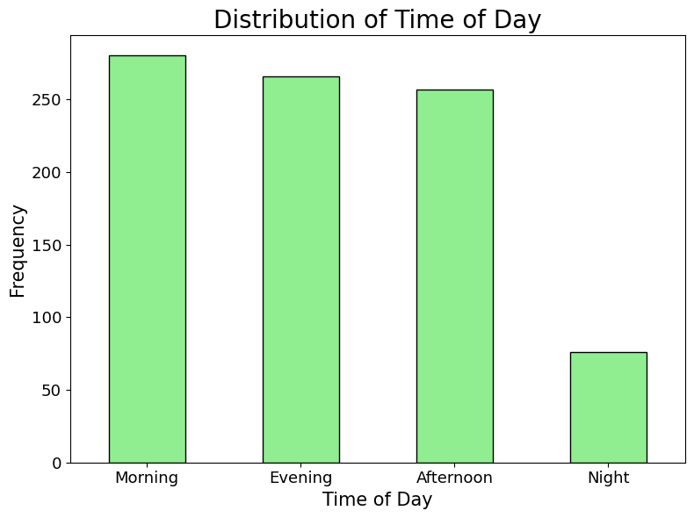
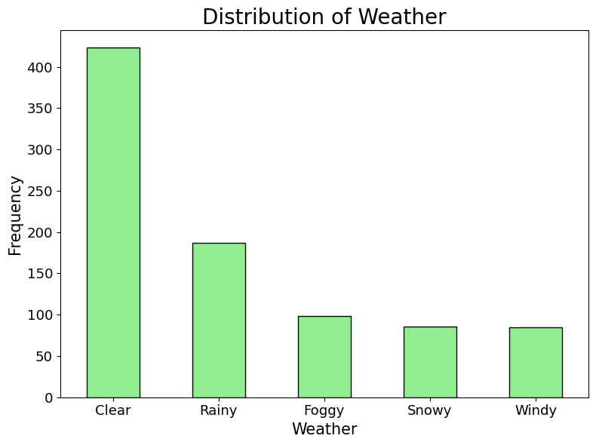
Data Distribuition – categorical variables

Slide 10
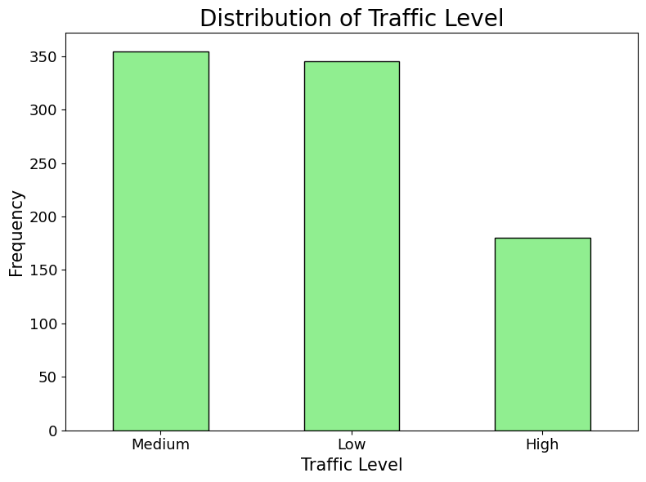
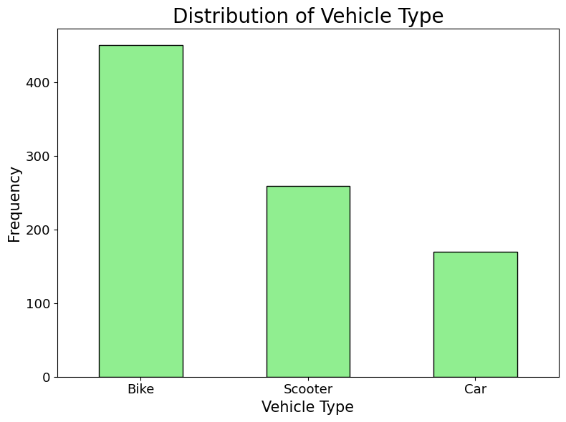
Data Distribuition - categorical variables

Slide 11
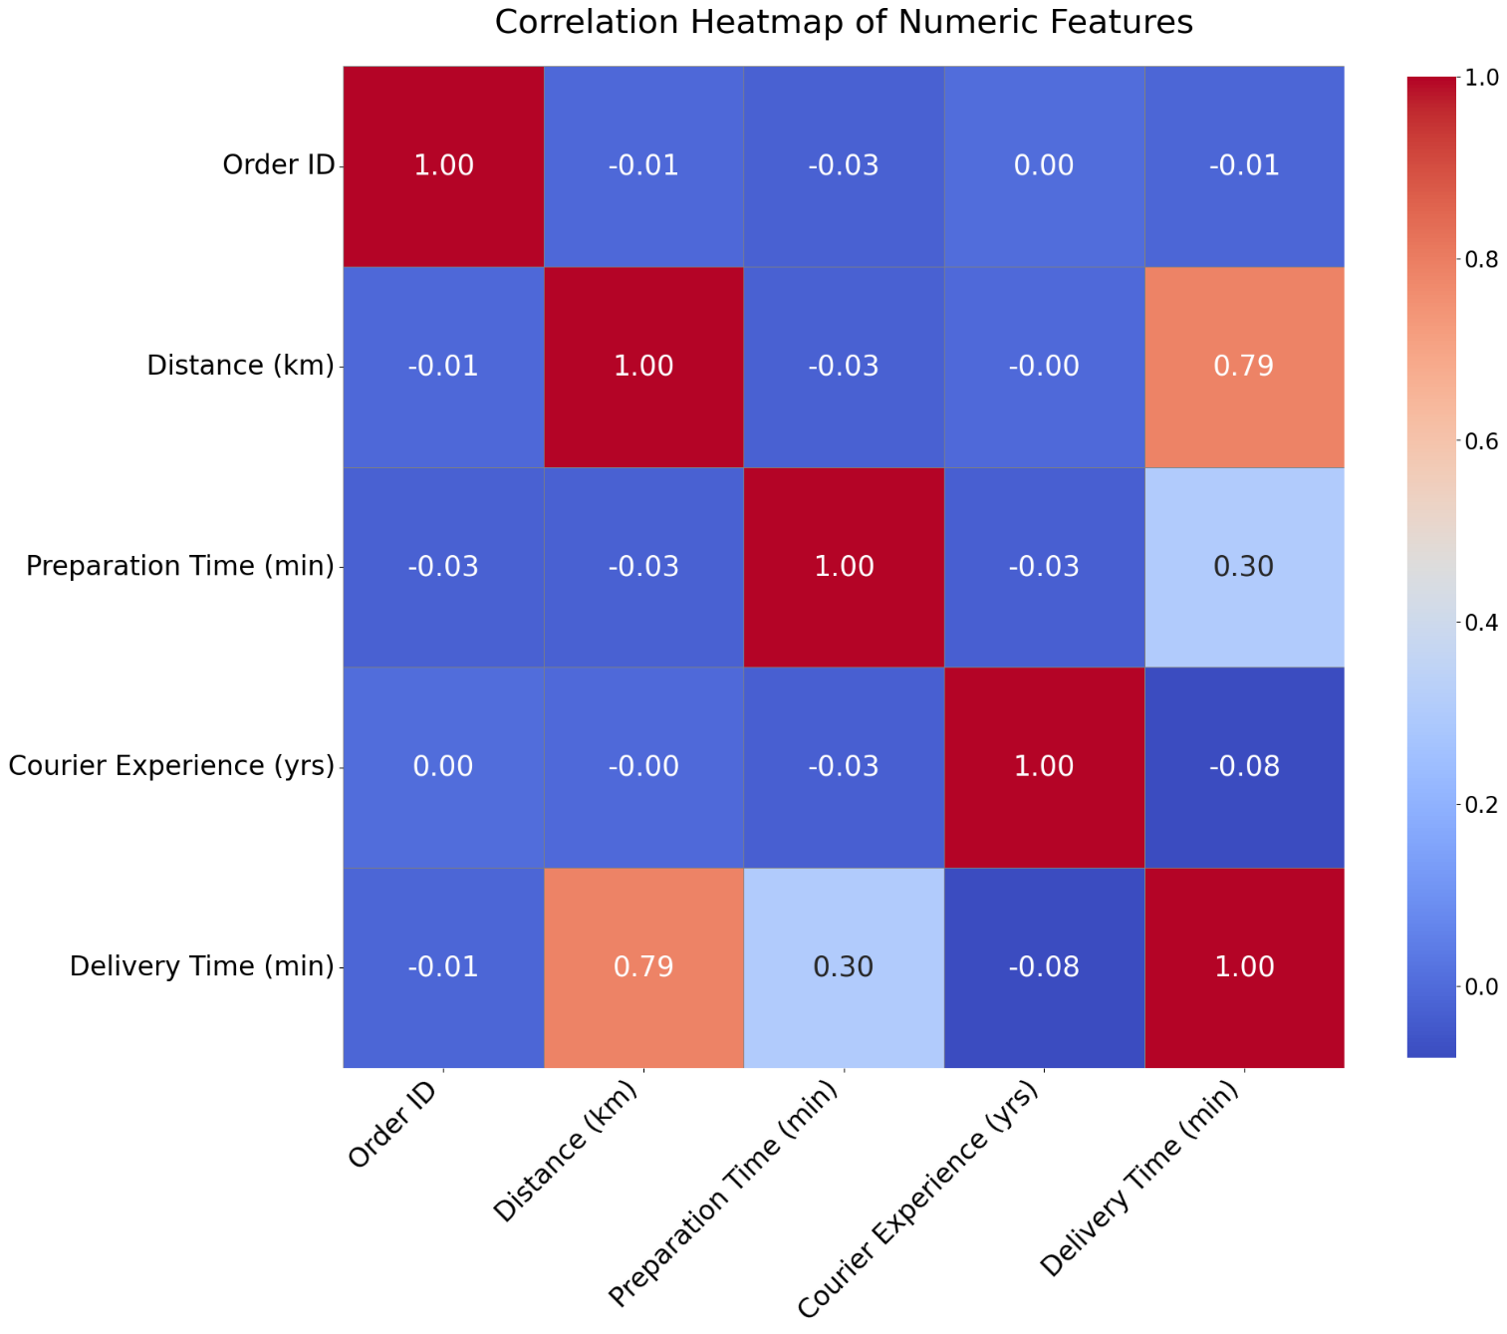
Evaluating correlation
Some numerical variables show a clear linear relationship with delivery time.
Even though Courier Experience is numerical we will consider it as categorical because the values represent discrete levels of experience.

Slide 12
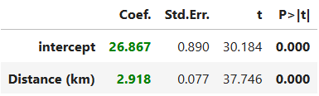
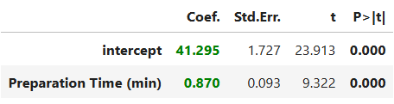
Simple linear regression - Objective
The two numerical variables, Distance and Preparation Time, are selected, and the relationship between each of them and the response variable Delivery Time is analyzed individually.
Distance
Preparation time

Slide 13
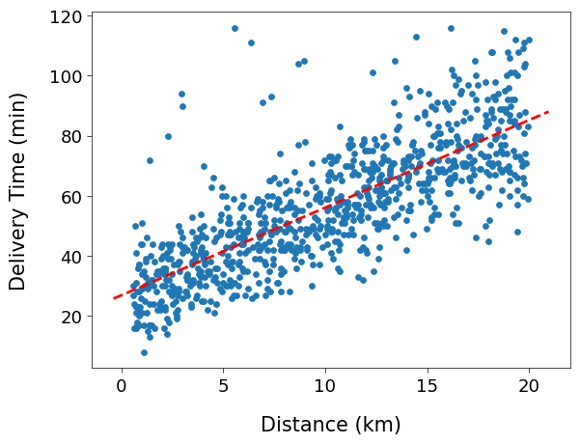
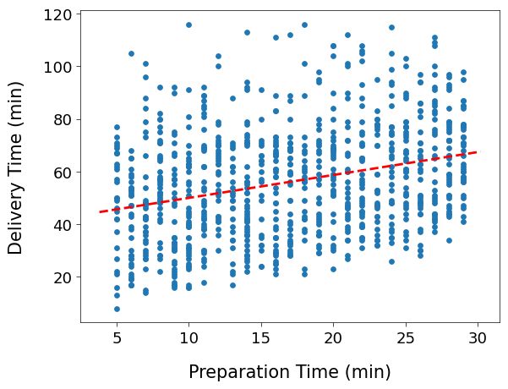
Simple linear regression - Scatterplots

Slide 14
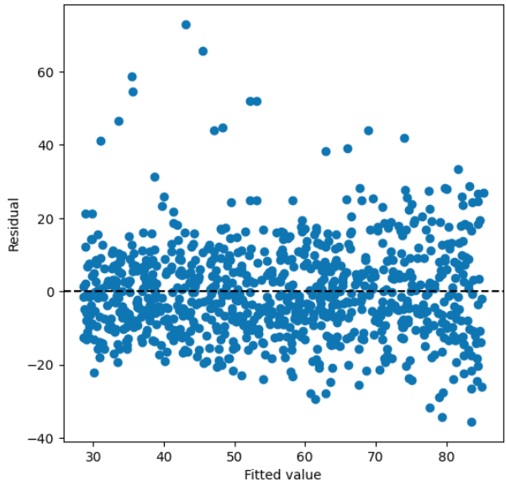
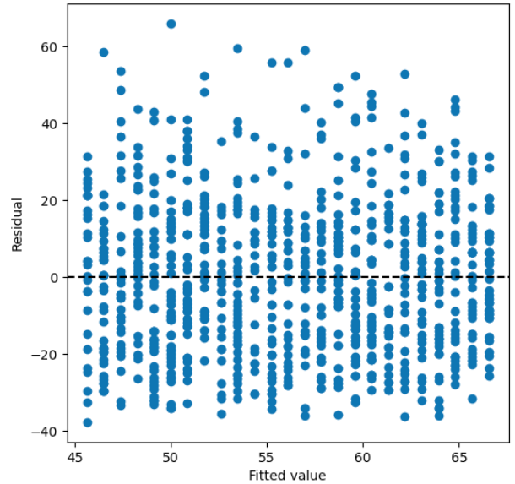
Simple linear regression - Residuals
Distance
Preparation time

Slide 15
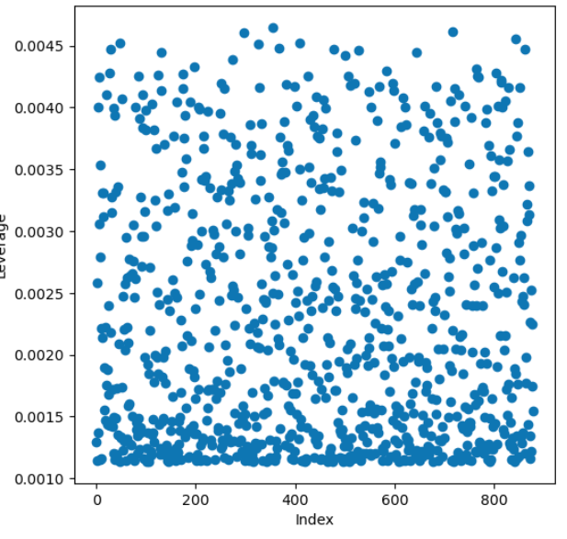
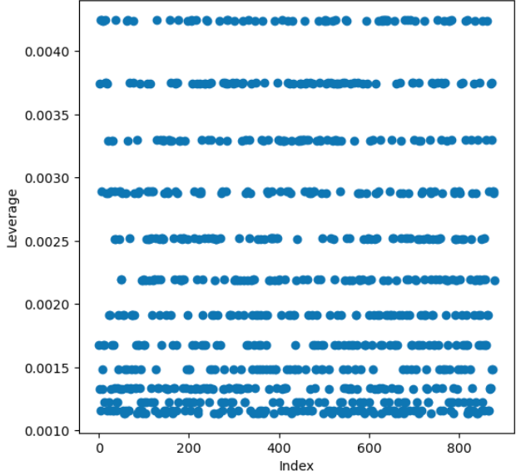
Simple linear regression - Leverage
Distance
Preparation time

