Slide 1



QPFL HACKATON 2026
QUANTUM ICING
Federico Quartieri, Alessandro Ruzza,
Gabriele Santandrea, Daniele Salvi
Lausanne, Switzerland 2026

Slide 2
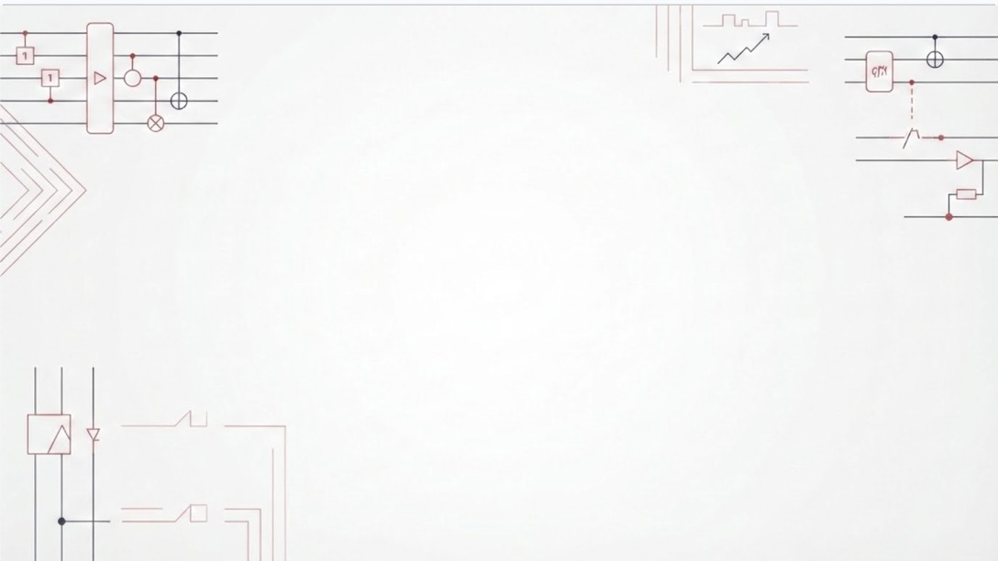
CAT QUBITS
Cat Qubits are superconducting qubits that trade off an exponential decrease in bit flip errors for a linear increase in phase-flip ones.
This inherent advantage makes it possible to reduce the QEC problem from 2 dimensions (bit-flip && phase-flip) to a 1 dimensional problem (bit-flip || phase-flip)

Slide 3

HOW DID WE USE AI?

Slide 4
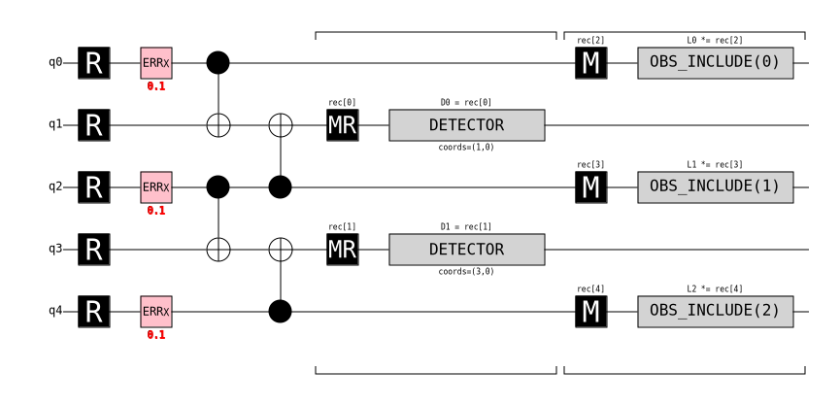
Task 3:
Repetition Code and Decoder
The three ingredients:
- an encoding tuple (n, k, d)
- stabilizers
- decoder

Slide 5




Repetition Code
Experiment:
Memory Mode Threshold
GOAL
DECODING
Estimate logical error probability of repetition code in memory mode & identify threshold
Decoding before detectors
NOISE MODEL
NUMERICAL ESTIMATE
Phenomenological bit-flip modeled as an X gate with probability p
Parametrization over error probability p and distances d

Slide 6
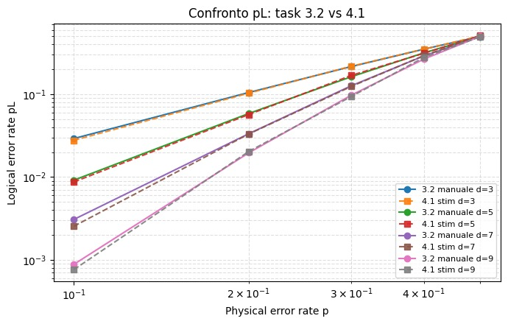
Our manual simulation matched stim’s circuit

Slide 7
Quantum Error Correction
inspired by classical methods

Slide 8
Low-Density Parity Codes
A brave experiment

Slide 9
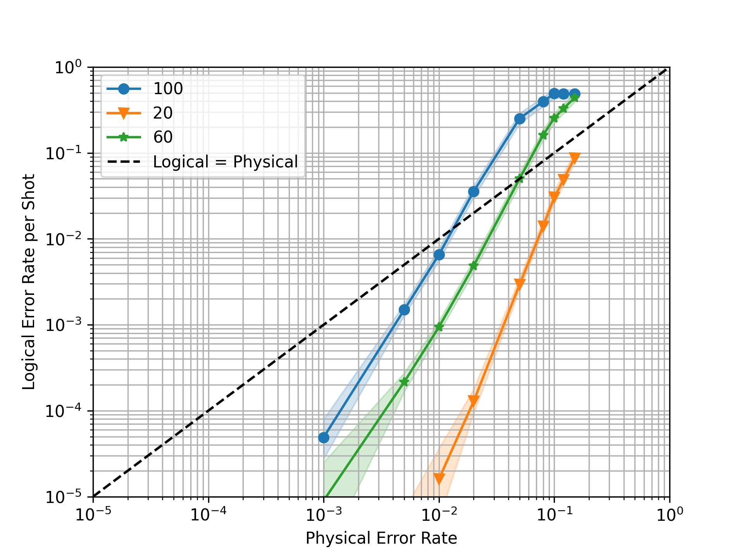
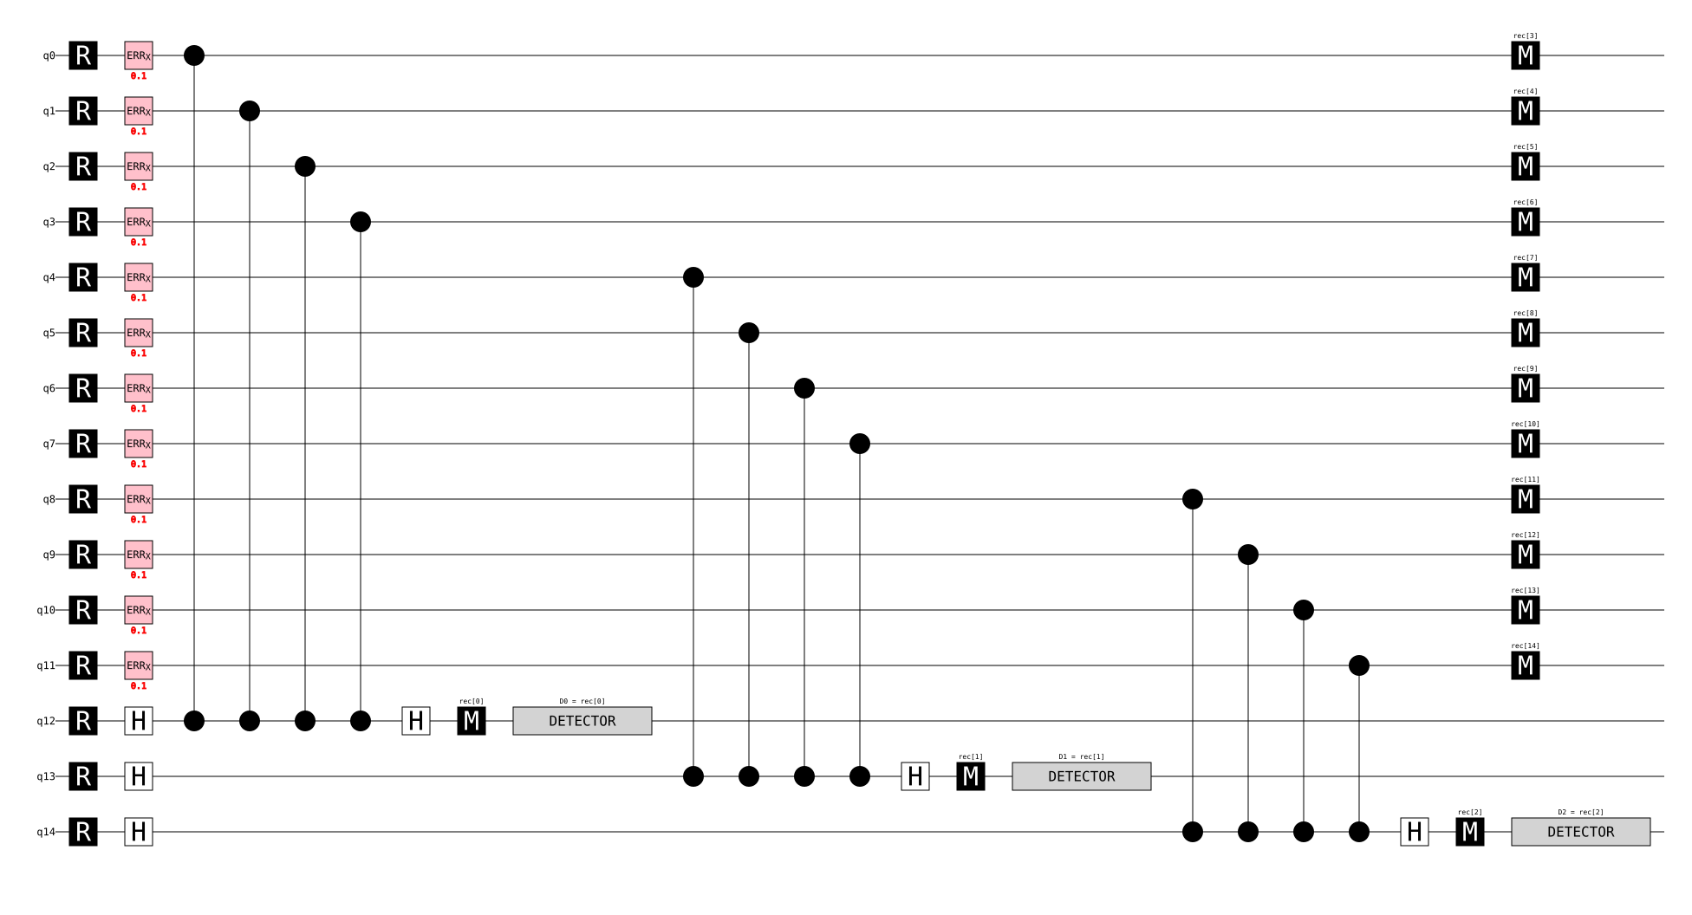
AN INTUITIVE IMPLEMENTATION OF LDPC
DECODER (BP-OSD):
Belief Propagation + Ordered Statistics Decoding

Slide 10
Custom H
(made by us, 2 forms)
Format A (1 ancilla per 4 data + 2 global)
Ancilla #1
Ancilla #2
Global #1
Global #2
Easily scales by adding 1 row, 4 column.
Added row (before globals) contains 0s – 1111
Global rows repeat the “1100” / “1010” pattern in the new columns.
Rate grows towards 4/5 ~ 0.8
Format B (3 ancillas per 4 data)
Block #1
Easily scales by adding 3 rows, 4 columns
Added rows contain the pattern along diagonal.
Rate fixed at 4/7 ~ 0.57
Block #2

Slide 11
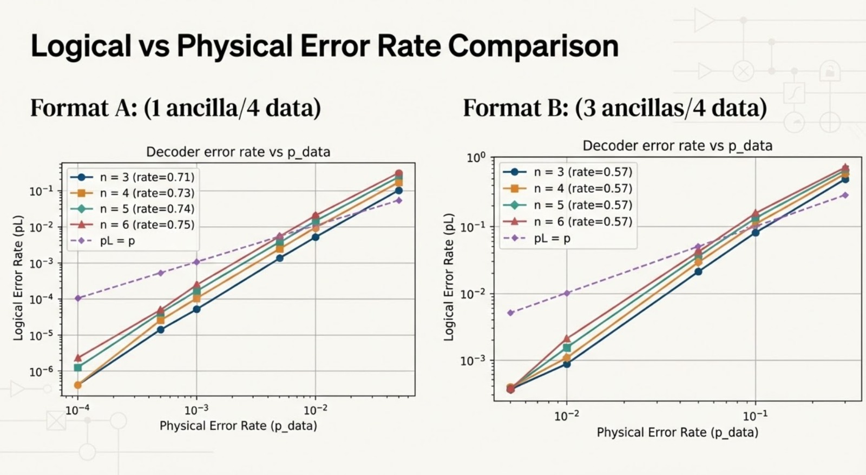

Slide 12
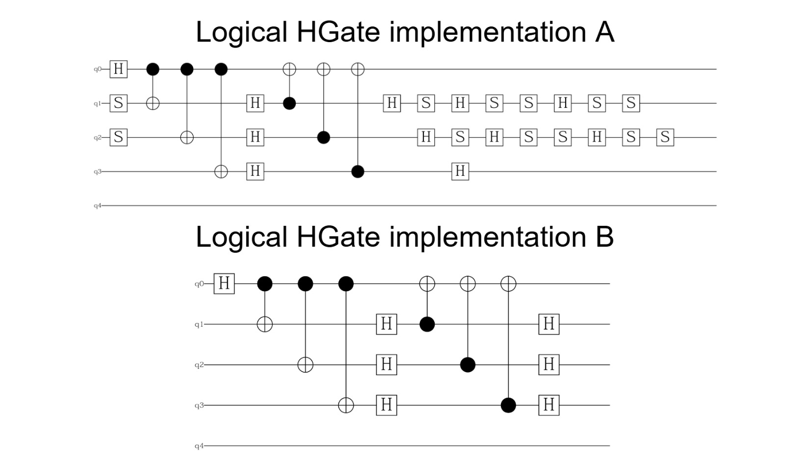

Slide 13
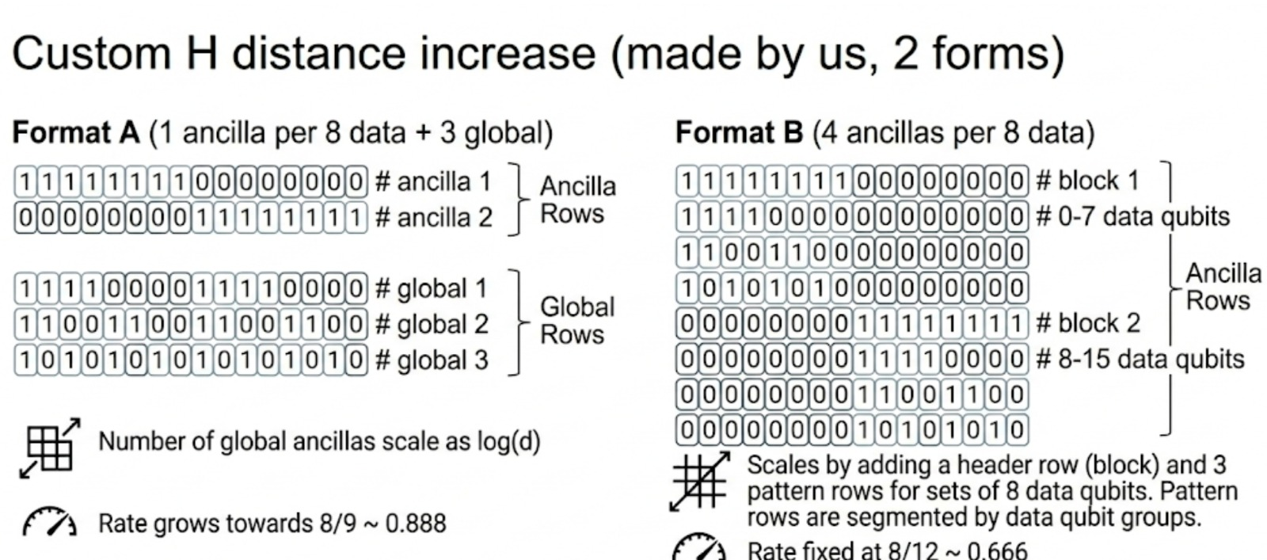

Slide 14
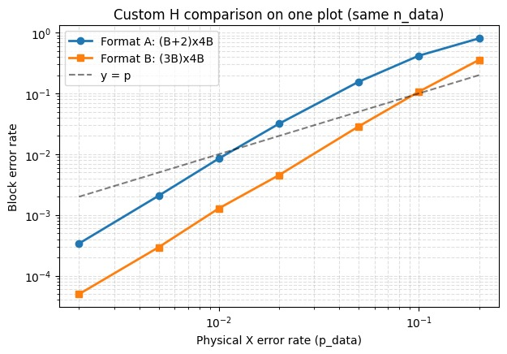
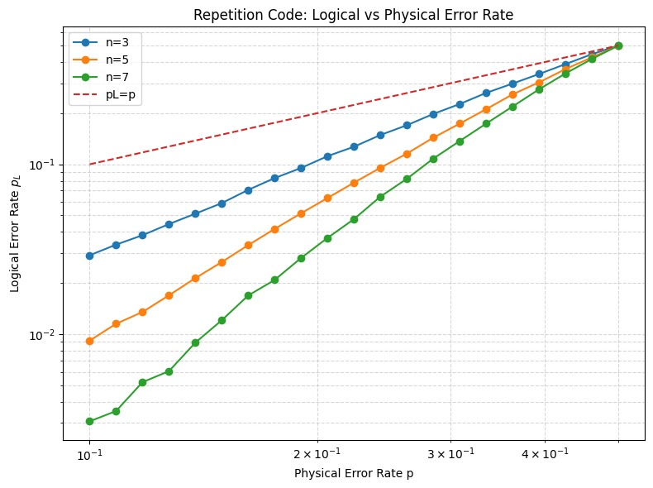

Slide 15
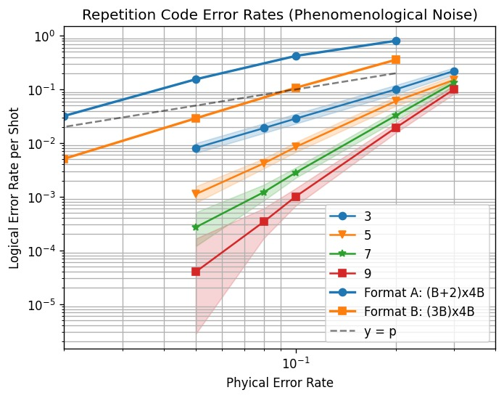

Slide 16
Binary Golay
The perfect linear code

Slide 17
Punctured Binary
Golay
[n=23, k=12, d=7]-code
(correct up to 3 bit-flips).
Perfect code: every syndrome maps to a unique error with wt≤3 (full syndrome table). Block failure for independent bit-flips p:
Reference: Raymond Hill, *A First Course in Coding Theory*, Oxford University Press, 1986.

Slide 18
DECODER
Setup: we use the binary Golay code, which can correct up to t = 3 bit-flips error.
A bit flip error is modeled as a vector e∈ {0,1}²³, where ei indicates an X error on data qubit i
Syndrome extraction: with the parity-check matrix 𝐻, the circuit measures 11 parity checks and outputs a syndrome s∈ {0,1}¹¹.
Lookup table: since the equation He = s generally has multiple solutions, decoding selects the most likely error, which for an independent bit-flip channel corresponds to the minimum-weight solution.
We therefore precompute a table T mapping each syndrome to its coset leader
ê = T(s) restricting to errors with wt(e) <= 3
Correction:

Slide 19
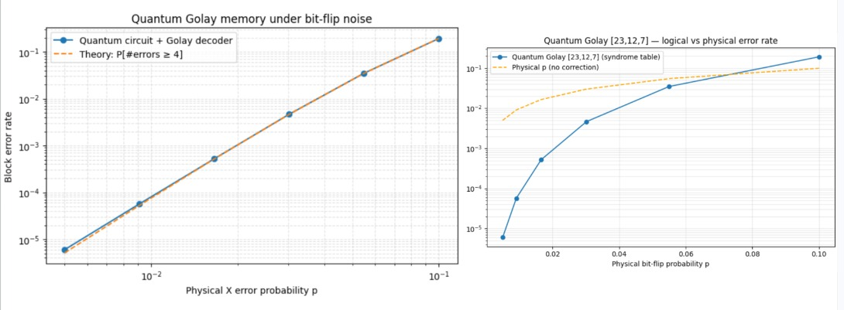
Results

Slide 20
Extended Binary Golay
[n=24, k=12, d=8]-code
(same bounded-distance correction radius).
Advantage: larger distance (better separation / robustness), cost: +1 qubit per block.Block failure (independent bit-flips p):

Slide 21
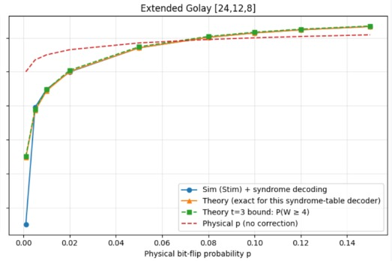
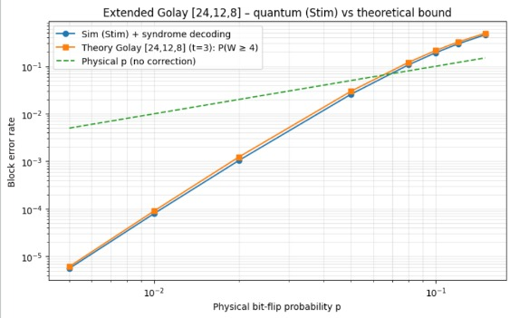
Results

Slide 22
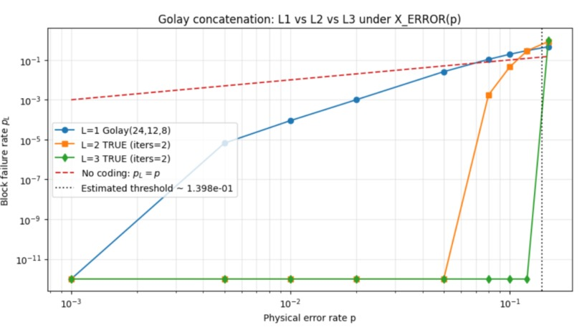
Golay 3 Level concatenation

Slide 23
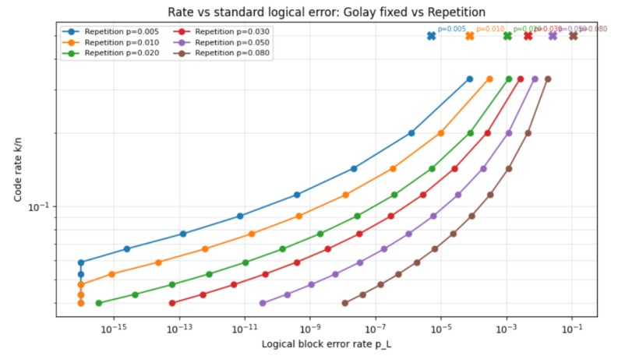
Golay vs Repetition

Slide 24
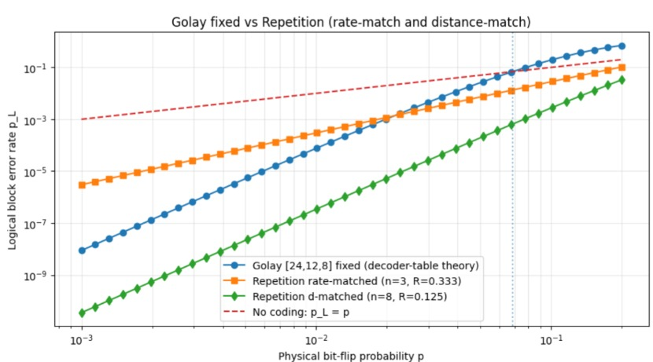
Golay vs Repetition

Slide 25
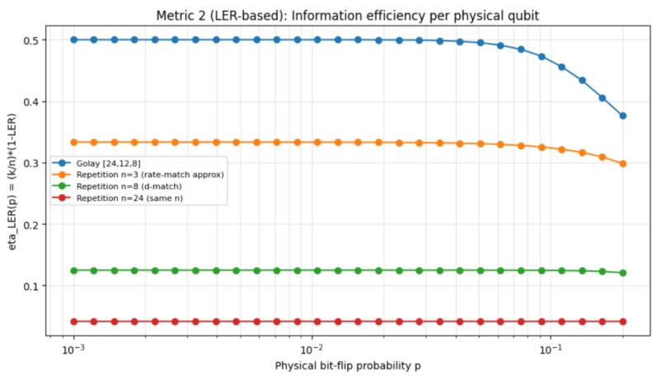
Golay vs Repetition

Slide 26
Steane Overview
Parameters: n= 7, k=1, d=3
CSS Architecture: Separates X and Z tracking to analyze hardware noise bias.
Deterministic Prep: Encodes perfect 0 states without dropping shots.
Safe Extraction: Non-destructive parity checks using dedicated ancilla qubits.
Precise Decoding: Deterministic Hamming-mapped decoder to track physical errors instantly.

Slide 27
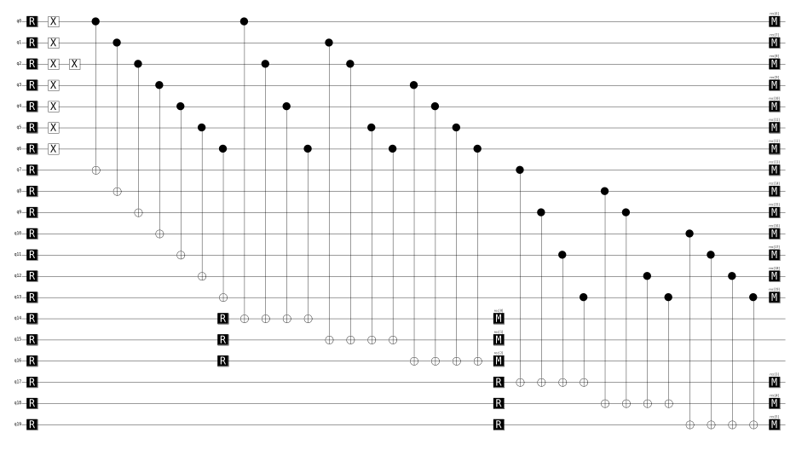
Steane
CNOT - scenario A

Slide 28
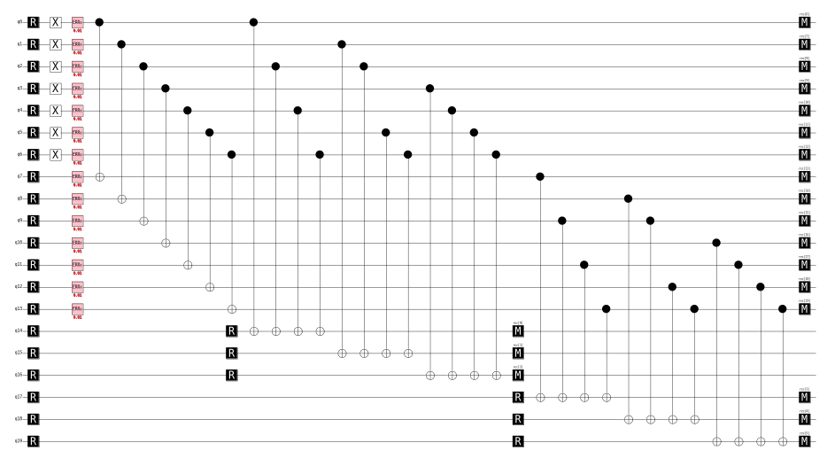
Steane
CNOT - scenario B

Slide 29
Steane
CNOT overview
The Math: Propagates X to X from control to target.
The Advantage: Never rotates X errors into the lethal Z basis.
Simulation Error Rate:
Scenario A: 0 error
Scenario B: 0.0075 (p = 0.01, shots = 20000)
Verdict: CNOT is natively safe. We must use it via Gate Teleportation to safely execute H and S gates.

Slide 30
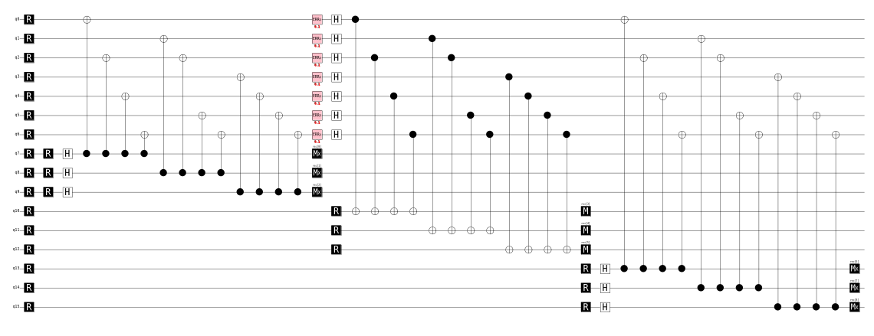
Steane
H - scenario A

Slide 31
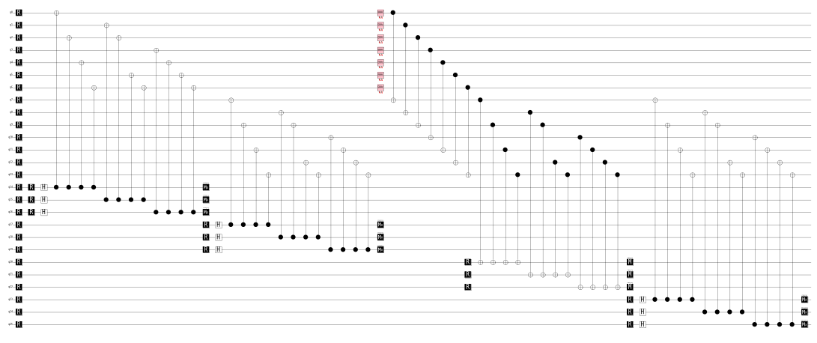
Steane
H - scenario B

Slide 32
Steane
H overview
Scenario A: Direct Transversal H Gate
~51.87% → Z-Error Triggers
The H gate mathematically swaps axes (X → Z).
Harmless bit flips are converted into lethal phase-flips, completely destroying Cat Qubit bias.
Scenario B: CNOT-Based Gate Teleportation
~50.15% → X-Error Triggers
Errors safely propagate strictly as bit-flips (X → X).

Slide 33
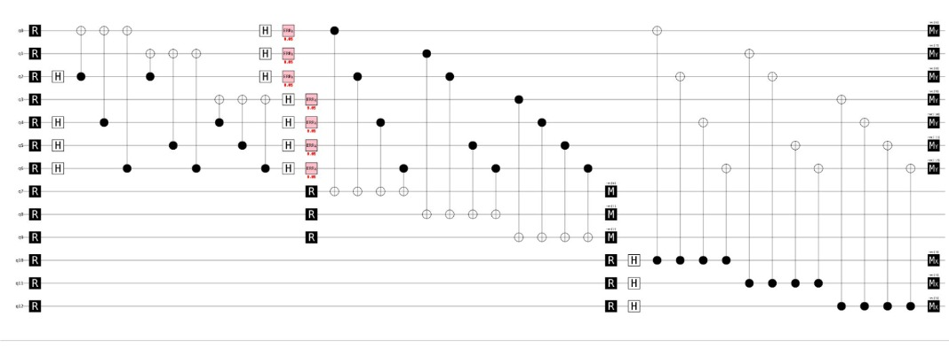
Steane
S - scenario A

Slide 34
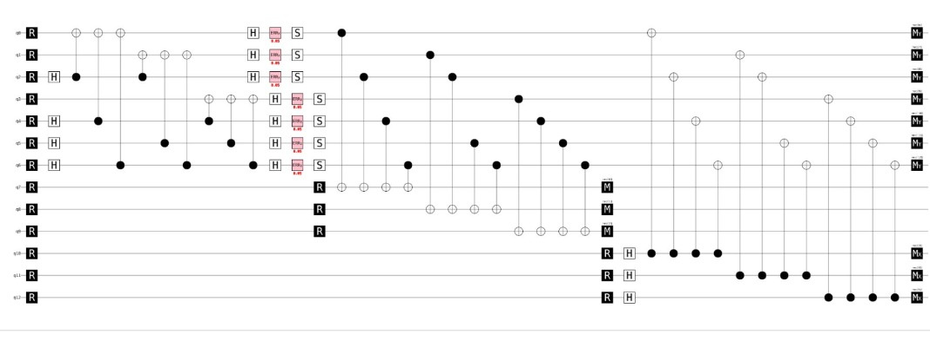
Steane
S - Scenario B

Slide 35
Steane
S overview
Scenario A: without S Gate
~30.00% → X-Error Triggers
0.00% → Z-Error Triggers
Scenario B: with S Gate
~30.00% → X-Error Triggers
~30.00% → Z-Error Triggers

Slide 36
Golay Gates
Logical meaning: with the common “extended Golay as 12×24 CSS checks” setup you often end up with k = 0, so you’re showing stabilizer/syndrome behavior, not a gate on a logical qubit.
Syndrome extraction cost: Golay checks are heavier/denser, so measuring stabilizers needs many more CNOTs + ancillas, making error propagation and scheduling much more important than in small codes.
Syndrome differencing: Golay demos often require reference rounds / syndrome differencing (especially for X-checks), otherwise “syndrome triggers” can be dominated by a nontrivial baseline rather than noise or the gate effect.
Decoding burden: Golay decoding is not a tiny lookup; you typically need a more structured decoder to interpret syndromes reliably.

Slide 37
THANK YOU

Slide 38

Q&A

