Slide 1
Data bases 2
Gamified marketing application

Slide 2
Specifications
An application deals with gamified consumer data collection. A user registers with a username, a password and an email. A registered user logs in and accesses a HOME PAGE where a “Questionnaire of the day” is published. The HOME PAGE displays the name and the image of the “product of the day” and the product reviews by other users. The HOME PAGE comprises a link to access a QUESTIONNAIRE PAGE with a questionnaire divided in two sections: a section with a variable number of marketing questions about the product of the day (e.g., Q1: “Do you know the product?” Q2: Have you purchased the product before?” and Q3 “Would you recommend the product to a friend?”) and a section with fixed inputs for collecting statistical data about the user: age, sex, expertise level (low, medium high). The user fills in the marketing section, then accesses (with a next button) the statistical section where she can complete the questionnaire and submit it (with a submit button), cancel it (with a cancel button), or go back to the previous section and change the answers (with a previous button). All inputs of the marketing section are mandatory. All inputs of the statistical section are optional. After successfully submitting the questionnaire, the user is routed to a page with a thanks and greetings message. The database contains a table of offensive words. If any response of the user contains a word listed in the table, the transaction is rolled back, no data are recorded in the database, and the user’s account is blocked so that no questionnaires can be filled in by such account in the future.
When the user submits the questionnaire one or more trigger compute the gamification points to assign to the user for the specific questionnaire, according to the following rule:
One point is assigned for every answered question of section 1 (remember that the number of questions can vary in different questionnaires).
Two points are assigned for every answered optional question of section

Slide 3
Specifications
When the user cancels the questionnaire, no responses are stored in the database. However, the database retains the information that the user X has logged in at a given date and time. The user can access a LEADERBOARD page, which shows a list of the usernames and points of all the users who filled in the questionnaire of the day, ordered by the number of points (descending). The administrator can access a dedicated application on the same database, which features the following pages
A CREATION page for inserting the product of the day for the current date or for a posterior date and for creating a variable number of marketing questions about such product.
An INSPECTION page for accessing the data of a past questionnaire. The visualized data for a given questionnaire include:
List of users who submitted the questionnaire.
List of users who cancelled the questionnaire.
Questionnaire answers of each user.
A DELETION page for ERASING the questionnaire data and the related responses and points of all users who filled in the questionnaire. Deletion should be possible only for a date preceding the current date.

Slide 4
Entity Relationship
Admin
id
username
password
1:1
Log
id
datetime
OffensiveWord
term
logging
0:N
id
username
password
email
banned
User
0:N
Product
0:N
referring
id
name
image
date
0:N
having
1:1
1:1
sending
Submission
id
points
cancelled
Question
id
text
1:1
id
age
sex
expertise
associating
1:1
0:N
0:N
1:1
Answer
1:1
Statistics
including
1:1
id
text
replying

Slide 5
Relational model
log(id, user, datetime)
user(id, username, password, email, banned)
submission(id, user, product, points)
answer(id, submission, question, text) product(id, name, image, date)
statistics(id, submission, age, sex, expertise) question(id, product, text, mandatory)
admin(id, username, password)
offensive_word(term)

Slide 6
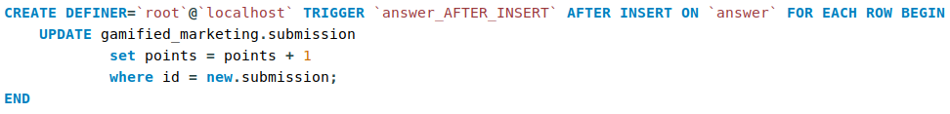
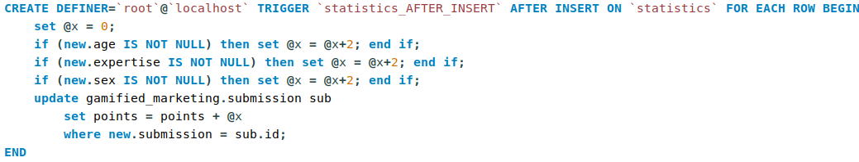
Triggers
Add 1 point after the insertion of a new answer
Add 2 points for each statistic question answered after the insertion of a new statistic answer

Slide 7
Triggers
Delete questions and submission after the delete of the relative product
Delete answers after the delete of the relative marketing questions
Delete statistic answers after the delete of the relative submissions

Slide 8
Relationship “logging”
logging
User
Log
User → Log @OneToMany
For each user, the database stores multiple log containing date and time of the access
Not implemented
Log → User @ManyToOne
Many logs refer to a single user
Owner of the relationship
Unidirectional 1:N
Do not map the @ToMany side of the relationship as a collection data member and use (named) JPQL queries to retrieve the correlated objects when needed
0:N
1:1
User
*
Log
1
User
Log

Slide 9
Relationship “sending”
sending
User
Submission
User → Submission @OneToMany
Each user can send many submission
Not implemented
Submission → User @ManyToOne
Many submissions can be sent by the same user
Owner of the relationship
Unidirectional 1:N
Do not map the @ToMany side of the relationship as a collection data member and use (named) JPQL queries to retrieve the correlated objects when needed
0:N
1:1
User
*
Submission
1
User
Submission

Slide 10
Relationship “referring”
referring
Product
Submission
Product → Submission @OneToMany
Each product can be referred to many submissions
Submission → Product @ManyToOne
Many submissions can refer to the same product
Owner of the relationship
Unidirectional 1:N
Do not map the @ToMany side of the relationship as a collection data member and use (named) JPQL queries to retrieve the correlated objects when needed
0:N
1:1
Product
*
Submission
1
Product
Submission

Slide 11
Relationship “including”
including
Submission
Answer
Submission → Answer @OneToMany
Each submission includes many answer
fetch = FetchType.LAZY, cascade = {CascadeType.REMOVE,CascadeType.PERSIST}, orphanRemoval = true
Answer → Submission @ManyToOne
Many answers can be included in the same submission
Owner of the relationship
Bidirectional
0:N
1:1
Submission
*
Answer
1
Submission
Answer

Slide 12
Relationship “associating”
associating
Submission
Statistics
Submission → Statistics @OneToOne
Each submission has its statistics answer
cascade = {CascadeType.REMOVE,CascadeType.PERSIST}
Statistics → Submission @OneToOne
Each statistics answer is associated with a submission
Owner of the relationship
Bidirectional
1:1
1:1
Submission
1
Statistics
1
Submission
Statistics

Slide 13
Relationship “replying”
replying
Question
Answer
Question → Answer @OneToMany
Each question can be replied by many questions
Answer → Question @ManyToOne
Many answers can reply the same question
Owner of the relationship
Unidirectional 1:N
Do not map the @ToMany side of the relationship as a collection data member and use (named) JPQL queries to retrieve the correlated objects when needed
0:N
1:1
Question
*
Answer
1
Question
Answer

Slide 14
Relationship “having”
having
Product
Question
Product → Question @OneToMany
Each product has many questions
Question → Product @ManyToOne
Many questions can be related to the same product
Owner of the relationship
Unidirectional 1:N
Do not map the @ToMany side of the relationship as a collection data member and use (named) JPQL queries to retrieve the correlated objects when needed
0:N
1:1
Product
*
Question
1
Product
Question

Slide 15
Entity Log
@Entity
@Table(name = "log", schema = "gamified_marketing")
@NamedQuery(name = "Log.findByUsername", query = "SELECT l FROM Log l WHERE l.user.username = :username")
public class Log implements Serializable {
private static final long serialVersionUID = 1L;
@Id
@GeneratedValue(strategy = GenerationType.IDENTITY)
private Integer id;
@ManyToOne
@JoinColumn(name = "user")
private User user;
private Timestamp datetime;
public Log() {
// EJB constructor
}
public Log(User user, Timestamp datetime) {
super();
this.user = user;
this.datetime = datetime;
}
public Integer getId() {
return id;
}
public void setId(Integer id) {
this.id = id;
}
public User getUser() {
return user;
}
public void setUser(User user) {
this.user = user;
}
public Date getDatetime() {
return datetime;
}
public void setDatetime(Timestamp datetime) {
this.datetime = datetime;
}
}

Slide 16
Entity User
@Entity
@Table(name = "user", schema = "gamified_marketing")
@NamedQuery(name = "User.checkCredentials", query = "SELECT u FROM User u WHERE u.username = ?1 and u.password = ?2")
@NamedQuery(name = "User.findByUsername", query = "SELECT u FROM User u WHERE u.username = ?1")
public class User implements Serializable {
private static final long serialVersionUID = 1L;
@Id
@GeneratedValue(strategy = GenerationType.IDENTITY)
private Integer id;
private String username;
private String password;
private String email;
private Boolean banned;
public User () {
// EJB constructor
}
public User(String username, String password, String email) {
this.username = username;
this.password = password;
this.email = email;
this.banned = false;
}
public Integer getId() {
return id;
}
public void setId(Integer id) {
this.id = id;
}
public String getUsername() {
return username;
}
public void setUsername(String username) {
this.username = username;
}
public String getPassword() {
return password;
}
public void setPassword(String password) {
this.password = password;
}
public String getEmail() {
return email;
}
public void setEmail(String email) {
this.email = email;
}
public Boolean getBanned() {
return banned;
}
public void setBanned(Boolean banned) {
this.banned = banned;
}
}

Slide 17
Entity Admin
@Entity
@Table(name = "admin", schema = "gamified_marketing")
@NamedQuery(name = "Admin.checkCredentials", query = "SELECT r FROM Admin r WHERE r.username = ?1 and r.password = ?2")
public class Admin implements Serializable {
private static final long serialVersionUID = 1L;
@Id
@GeneratedValue(strategy = GenerationType.IDENTITY)
private Integer id;
private String username;
private String password;
public Admin() {
// EJB constructor
}
public Integer getId() {
return id;
}
public void setId(Integer id) {
this.id = id;
}
public String getUsername() {
return username;
}
public void setUsername(String username) {
this.username = username;
}
public String getPassword() {
return password;
}
public void setPassword(String password) {
this.password = password;
}
}

Slide 18
Entity Submission
@Entity
@Table(name = "submission", schema = "gamified_marketing")
@NamedQuery(name = "Submission.findByUsername", query = "SELECT s FROM Submission s WHERE s.user.username = :username")
@NamedQuery(name = "Submission.findByProduct", query = "SELECT s FROM Submission s WHERE s.product.id = :productId AND s.cancelled = FALSE")
@NamedQuery(name = "Submission.findCancelledByProduct", query = "SELECT s FROM Submission s WHERE s.product.id = :productId AND s.cancelled = TRUE")
@NamedQuery(name = "Submission.findByDate", query = "SELECT s FROM Submission s WHERE s.product.date = :dateNow ORDER BY s.points DESC")
@NamedQuery(name = "Submission.hasAlreadySubmitted", query = "SELECT s FROM Submission s WHERE s.product.date = :dateNow AND s.user.id = :userId and s.cancelled = FALSE")
public class Submission implements Serializable {
private static final long serialVersionUID = 1L;
@Id
@GeneratedValue(strategy = GenerationType.IDENTITY)
private Integer id;
private Integer points;
private Boolean cancelled;
@ManyToOne
@JoinColumn(name = "user")
private User user;
@ManyToOne
@JoinColumn(name = "product")
private Product product;
//bi-directional many-to-one association to Answer
@OneToMany(mappedBy="submission", fetch = FetchType.LAZY, cascade = {CascadeType.REMOVE,CascadeType.PERSIST}, orphanRemoval = true )
private List<Answer> answers;
@OneToOne(mappedBy="submission", cascade = {CascadeType.REMOVE,CascadeType.PERSIST})
private Statistics statistics;
public Submission() {
// EJB constructor
}
public Submission(User user, Product product) {
this.user = user;
this.product = product;
this.cancelled = false;
this.points = 0;
}
public Integer getId() {
return id;
}
public void setId(Integer id) {
this.id = id;
}

Slide 19
Entity Submission(continue)
public User getUser(){
return user;
}
public void setUser(User user) {
this.user = user;
}
public Product getProduct() {
return product;
}
public void setProduct(Product product) {
this.product = product;
}
public Integer getPoints() {
return points;
}
public void setPoints(Integer points) {
this.points = points;
}
public Boolean getCancelled() {
return cancelled;
}
public void setCancelled(Boolean cancelled) {
this.cancelled = cancelled;
}
public List<Answer> getAnswers() {
return answers;
}
public void setAnswers(List<Answer> answers) {
this.answers = answers;
}
public Statistics getStatistics() {
return statistics;
}
public void setStatistics(Statistics statistics) {
this.statistics = statistics;
}
public void addAnswer(Answer answer) {
answer.setSubmission(this);
if (answers != null) {
answers.add(answer);
} else {
answers = new ArrayList<Answer>();
answers.add(answer);
}
}
public void addStatistics(Statistics stats) {
stats.setSubmission(this);
this.statistics = stats;
}

Slide 20
Entity Product
@Entity
@Table(name = "product", schema = "gamified_marketing")
@NamedQuery(name = "Product.getProductById", query = "SELECT p FROM Product p WHERE p.id = :productId")
@NamedQuery(name = "Product.getAllProducts", query = "SELECT p FROM Product p ORDER BY p.date DESC")
@NamedQuery(name = "Product.findDailyProduct", query = "SELECT p FROM Product p WHERE p.date = ?1")
@NamedQuery(name = "Product.findPreviousProduct", query = "SELECT p FROM Product p WHERE p.date < ?1")
public class Product implements Serializable {
private static final long serialVersionUID = 1L;
@Id
@GeneratedValue(strategy = GenerationType.IDENTITY)
private Integer id;
private String name;
@Basic(fetch = FetchType.LAZY)
@Lob
private byte[] image;
private Date date;
public Product() {
// EJB constructor
}
public Product(String name, byte[] image, Date date) {
this.name = name;
this.image = image;
this.date = date;
}
public Integer getId() {
return id;
}
public void setId(Integer id) {
this.id = id;
}
public String getName() {
return name;
}
public void setName(String name) {
this.name = name;
}
public byte[] getImage() {
return image;
}
public void setImage(byte[] image) {
this.image = image;
}
public Date getDate() {
return date;
}
public void setDate(Date date) {
this.date = date;
}
public String getBase64Image() {
return Base64.getMimeEncoder().encodeToString(image);
}
}

Slide 21
Entity Question
@Entity
@Table(name = "question", schema = "gamified_marketing")
@NamedQuery(name = "Question.findByProduct", query = "SELECT q FROM Question q WHERE q.product.id = :productId")
public class Question implements Serializable {
private static final long serialVersionUID = 1L;
@Id
@GeneratedValue(strategy = GenerationType.IDENTITY)
private Integer id;
@ManyToOne
@JoinColumn(name = "product")
private Product product;
private String text;
public Question() {
// EJB constructor
}
public Question(Product product, String text) {
this.product = product;
this.text = text;
}
public Integer getId() {
return id;
}
public void setId(Integer id) {
this.id = id;
}
public Product getProduct() {
return product;
}
public void setProduct(Product product) {
this.product = product;
}
public String getText() {
return text;
}
public void setText(String text) {
this.text = text;
}
}

Slide 22
Entity Answer
@Entity
@Table(name = "answer", schema = "gamified_marketing")
@NamedQuery(name = "Answer.findBySubmission", query = "SELECT a FROM Answer a WHERE a.submission.id = :submissionId")
@NamedQuery(name = "Answer.findByQuestion", query = "SELECT a FROM Answer a WHERE a.question.id = :questionId")
public class Answer implements Serializable {
private static final long serialVersionUID = 1L;
@Id
@GeneratedValue(strategy = GenerationType.IDENTITY)
private Integer id;
@ManyToOne
@JoinColumn(name = "submission")
private Submission submission;
@ManyToOne
@JoinColumn(name = "question")
private Question question;
private String text;
public Answer() {
super();
// TODO Auto-generated constructor stub
}
public Answer(Submission sub, Question question, String text) {
super();
this.question = question;
this.text = text;
this.submission = sub;
}
public Integer getId() {
return id;
}
public void setId(Integer id) {
this.id = id;
}
public Submission getSubmission() {
return submission;
}
public void setSubmission(Submission submission) {
this.submission = submission;
}
public Question getQuestion() {
return question;
}
public void setQuestion(Question question) {
this.question = question;
}
public String getText() {
return text;
}
public void setText(String text) {
this.text = text;
}
}

Slide 23
Entity Statistics
@Entity
@Table(name = "statistics", schema = "gamified_marketing")
@NamedQuery(name = "Statistics.findBySubmission", query = "SELECT s FROM Statistics s WHERE s.submission.id = :submissionId")
public class Statistics implements Serializable{
private static final long serialVersionUID = 1L;
@Id
@GeneratedValue(strategy = GenerationType.IDENTITY)
private Integer id;
@OneToOne
@JoinColumn(name = "submission")
private Submission submission;
private int age;
private String sex;
private String expertise;
public Statistics() {
super();
// TODO Auto-generated constructor stub
}
public Statistics(Submission submission, int age, String sex, String expertise) {
super();
this.submission = submission;
this.age = age;
this.sex = sex;
this.expertise = expertise;
}
public Statistics(int age, String sex2, String expertise2) {
// TODO Auto-generated constructor stub
}
public int getAge() {
return age;
}
public void setAge(int age) {
this.age = age;
}
public String getSex() {
return sex;
}
public void setSex(String sex) {
this.sex = sex;
}
public String getExpertise() {
return expertise;
}
public void setExpertise(String expertise) {
this.expertise = expertise;
}
public Submission getSubmission() {
return submission;
}
public void setSubmission(Submission submission) {
this.submission = submission;
}
}

Slide 24
Entity OffensiveWord
@Entity
@Table(name = "offensive_word", schema = "gamified_marketing")
@NamedQuery(name = "OffensiveWord.findAll", query = "SELECT o FROM OffensiveWord o")
public class OffensiveWord implements Serializable {
private static final long serialVersionUID = 1L;
@Id
private String term;
public OffensiveWord() {
// EJB constructor
}
public String getTerm() {
return term;
}
public void setTerm(String term) {
this.term = term;
}
}

Slide 25
Components
Client Tier
AdminPage.html
BannedPage.html
CreationPage.html
DeletionPage.html
GreetingPage.html
Home.html
InspectionPage.html
Leaderboard.html
QuestionnairePage.html
Index.html

Slide 26
Components
Web Tier
AddQuestion
CancelQuestionnaire
CheckLogin
CreateProduct
DeleteQuestionnaire
GetInfo
GoToAdminPage
GoToBannedPage
GoToCreationPage
GoToDeletionPage
GoToGreetingPage
GoToHomePage
GoToInspectionPage
GoToLogin
GoToQuestionnairePage
GoToRegisterPage
Leaderboard
Logout
SubmitQuestionnaire

Slide 27
Components
Business Tier
OffensiveWordService
findAllBadwords()
LogService
addLog(User user)
UserService
checkCredentials(String usrn, String pwd)
setBanned(String username)
addUser(String username, String password, String email)
checkExistence(String username)
AdminService
checkCredentials(String usrn, String pwd)

Slide 28
Components
Business Tier
QuestionService
getQuestions(Integer productId)
addQuestion(int productId, String text)
ProductService
findDailyProduct()
getAllProducts()
findPreviousProduct()
getProductById(int productId)
addProduct(String name, byte[] image, Date date)
deleteProduct(int productId)

Slide 29
Components
Business Tier
SubmissionService
findLeaderboard()
findSubmission(Date date)
hasAlreadySubmitted(Integer userId)
findByProduct(Integer product)
findCancelledByProduct(Integer product)
submitDailyQuestionnaire(User user, int age, String sex, String expertise, List<String> strAnswers)
cancelSubmission(User user)

Slide 30
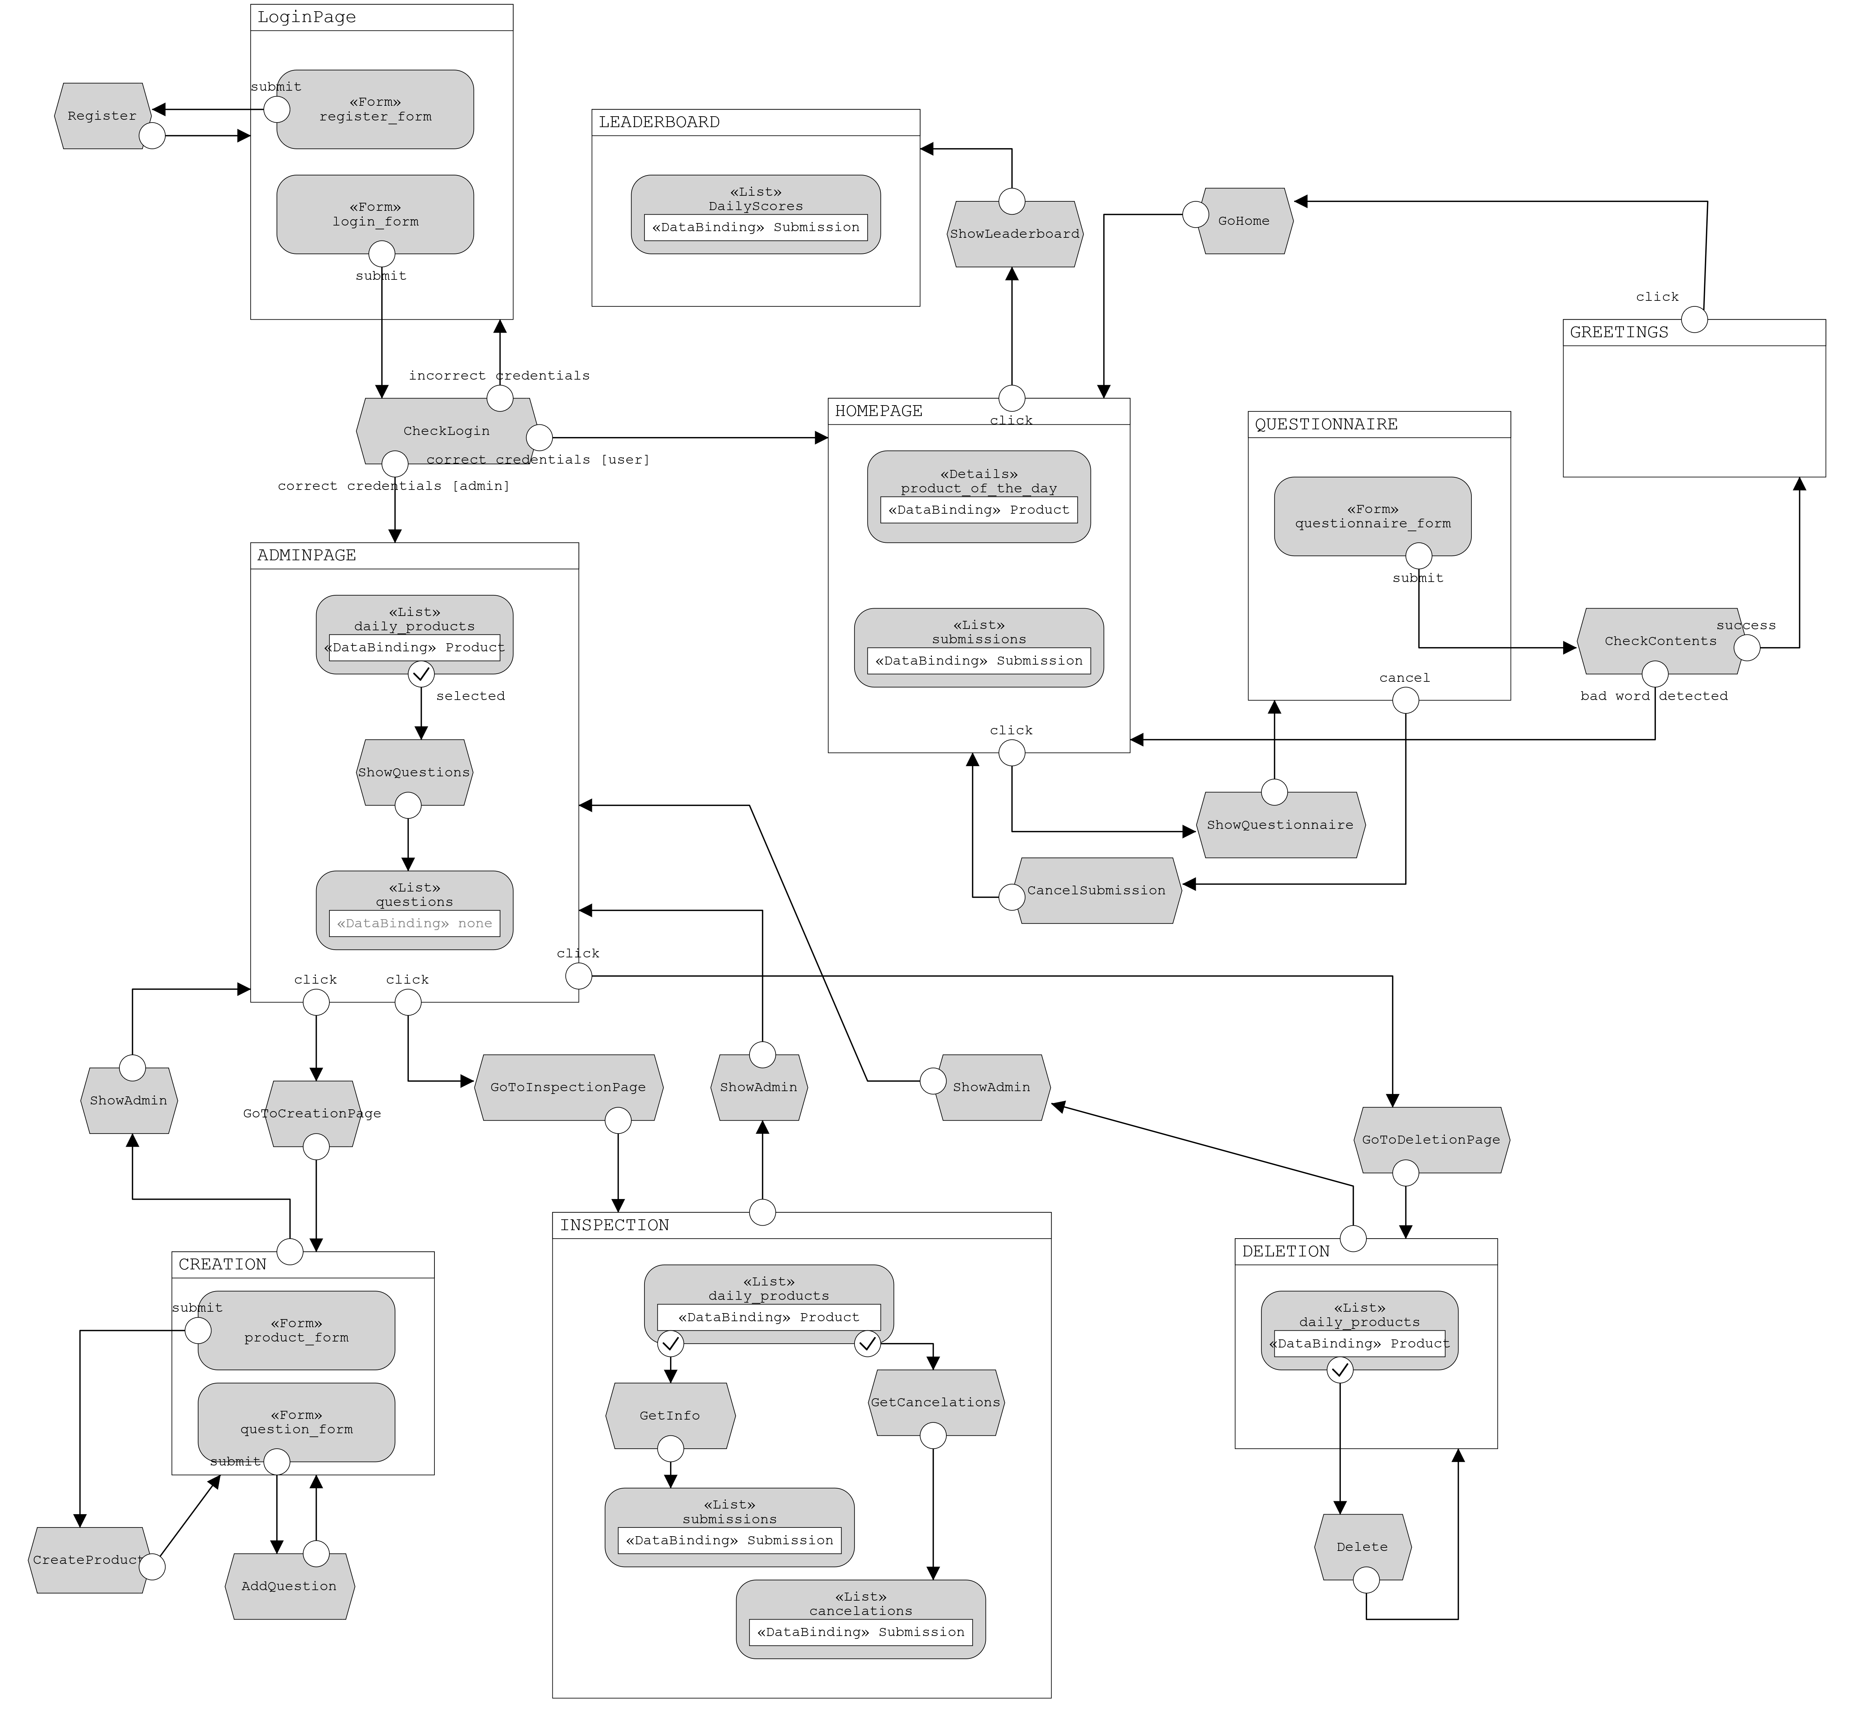
IFML

