Slide 1
Data bases 2
Gamified marketing application

Slide 2
Specifications
An application deals with gamified consumer data collection. A user registers with a username, a password and an email. A registered user logs in and accesses a HOME PAGE where a “Questionnaire of the day” is published. The HOME PAGE displays the name and the image of the “product of the day” and the product reviews by other users. The HOME PAGE comprises a link to access a QUESTIONNAIRE PAGE with a questionnaire divided in two sections: a section with a variable number of marketing questions about the product of the day (e.g., Q1: “Do you know the product?” Q2: Have you purchased the product before?” and Q3 “Would you recommend the product to a friend?”) and a section with fixed inputs for collecting statistical data about the user: age, sex, expertise level (low, medium high). The user fills in the marketing section, then accesses (with a next button) the statistical section where she can complete the questionnaire and submit it (with a submit button), cancel it (with a cancel button), or go back to the previous section and change the answers (with a previous button). All inputs of the marketing section are mandatory. All inputs of the statistical section are optional. After successfully submitting the questionnaire, the user is routed to a page with a thanks and greetings message. The database contains a table of offensive words. If any response of the user contains a word listed in the table, the transaction is rolled back, no data are recorded in the database, and the user’s account is blocked so that no questionnaires can be filled in by such account in the future.
When the user submits the questionnaire one or more trigger compute the gamification points to assign to the user for the specific questionnaire, according to the following rule:
One point is assigned for every answered question of section 1 (remember that the number of questions can vary in different questionnaires).
Two points are assigned for every answered optional question of section

Slide 3
Specifications
When the user cancels the questionnaire, no responses are stored in the database. However, the database retains the information that the user X has logged in at a given date and time. The user can access a LEADERBOARD page, which shows a list of the usernames and points of all the users who filled in the questionnaire of the day, ordered by the number of points (descending). The administrator can access a dedicated application on the same database, which features the following pages
A CREATION page for inserting the product of the day for the current date or for a posterior date and for creating a variable number of marketing questions about such product.
An INSPECTION page for accessing the data of a past questionnaire. The visualized data for a given questionnaire include:
List of users who submitted the questionnaire.
List of users who cancelled the questionnaire.
Questionnaire answers of each user.
A DELETION page for ERASING the questionnaire data and the related responses and points of all users who filled in the questionnaire. Deletion should be possible only for a date preceding the current date.

Slide 4
Entity Relationship
Admin
id
username
password
1:1
Log
id
date
OffensiveWord
word
logging
0:N
id
username
password
email
banned
User
0:N
Product
3:N
referring
id
name
image
date
0:N
having
1:1
1:1
sending
Submission
id
canceled
points
age
Question
id
text
mandatory
1:1
id
age
sex
expertise
belonging
1:1
0:N
0:N
1:1
Answer
1:1
Statistics
including
1:1
id
text
replying

Slide 5
Relational model
log(id, user, datetime)
user(id, username, password, email, banned, points)
submission(id, user, product)
answer(id, submission, question, text) product(id, name, image, date)
statistics(id, submission, age, sex, expertise) question(id, product, text, mandatory)
admin(id, username, password)
offensive_word(name)

Slide 6
Motivation
If there are considerations about the ER and the logical model write them here

Slide 7
Relationship “logging”
logging
User
Log
User → Log @OneToMany
For each user the database stores multiple log containing date and time of the access
Log → User @ManyToOne
Many logs refer to a single user
Owner of the relationship
0:N
1:1
User
*
Log
1
User
Log

Slide 8
Relationship “sending”
sending
User
Submission
User → Submission @OneToMany
Each user can send many submission
Submission → User @ManyToOne
Many submissions can be sent by the same user
Owner of the relationship
0:N
1:1
User
*
Submission
1
User
Submission

Slide 9
Relationship “referring”
referring
Product
Submission
Product → Submission @OneToMany
Each product can be referred to many submissions
Submission → Product @ManyToOne
Many submissions can refer to the same product
Owner of the relationship
0:N
1:1
Product
*
Submission
1
Product
Submission

Slide 10
Relationship “including”
including
Submission
Answer
Submission → Answer @OneToMany
Each submission includes many answer
Answer → Submission @ManyToOne
Many answers can be included in the same submission
Owner of the relationship
0:N
1:1
Submission
*
Answer
1
Submission
Answer

Slide 11
Relationship “replying”
replying
Question
Answer
Question → Answer @OneToMany
Each question can be replied by many questions
Answer → Question @ManyToOne
Many answers can reply the same question
Owner of the relationship
0:N
1:1
Question
*
Answer
1
Question
Answer

Slide 12
Relationship “having”
having
Product
Question
Product → Question @OneToMany
Each product has many questions
Question → Product @ManyToOne
Many questions can be related to the same product
Owner of the relationship
3:N
1:1
Product
*
Question
1
Product
Question

Slide 13
Entity Log
@Entity
@Table(name = “log”, schema = “gamified_marketing”)
public class A implements Serializable {
private static final long serialVersionUID = 1L;
// attributes & their annotations
@Id
@GeneratedValue(strategy = GenerationType.IDENTITY)
private int id;
@Temporal(TemporalType.TIMESTAMP)
private Date datetime;
// relationships & their annotations
@ManyToOne
@JoinColumn(name = "user)
private User user;
/*
clone this slide as may times as there are entities
*/

Slide 14
Entity User
@Entity
@Table(name = “user”, schema = “gamified_marketing”)
public class User implements Serializable {
private static final long serialVersionUID = 1L;
// attributes & their annotations
@Id
@GeneratedValue(strategy = GenerationType.IDENTITY)
private int id;
private Integer id;
private String username;
private String password;
private String email;
private Boolean banned;
private Integer points;
@Temporal(TemporalType.TIMESTAMP)
private Date datetime;
// relationships & their annotations
@ManyToOne
@JoinColumn(name = "user)
private User user;
/*
clone this slide as may times as there are entities
*/

Slide 15
Entity Admin
@Entity
@Table(name = "admin", schema = "gamified_marketing")
public class Admin implements Serializable {
private static final long serialVersionUID = 1L;
@Id
@GeneratedValue(strategy = GenerationType.IDENTITY)
private Integer id;
private String username;
private String password;
public Admin() {
// EJB constructor
}
public Integer getId() {
return id;
}
public void setId(Integer id) {
this.id = id;
}
public String getUsername() {
return username;
}
public void setUsername(String username) {
this.username = username;
}
public String getPassword() {
return password;
}
public void setPassword(String password) {
this.password = password;
}
}

Slide 16
Entity Answer
@Entity
@Table(name = "answer", schema = "gamified_marketing")
public class Answer implements Serializable {
private static final long serialVersionUID = 1L;
@Id
@GeneratedValue(strategy = GenerationType.IDENTITY)
private Integer id;
private Integer submission;
private Integer question;
private String text;
public Integer getId() {
return id;
}
public void setId(Integer id) {
this.id = id;
}
public Integer getSubmission() {
return submission;
}
public void setSubmission(Integer submission) {
this.submission = submission;
}
public Integer getQuestion() {
return question;
}
public void setQuestion(Integer question) {
this.question = question;
}
public String getText() {
return text;
}
public void setText(String text) {
this.text = text;
}
}

Slide 17
Entity User
@Entity
@Table(name = “user”, schema = “db_gamified_marketing_app”)
public class User implements Serializable {
private static final long serialVersionUID = 1L;
// attributes & their annotations
@Id
@GeneratedValue(strategy = GenerationType.IDENTITY)
private int id;
private Integer id;
private String username;
private String password;
private String email;
private Boolean banned;
private Integer points;
@Temporal(TemporalType.TIMESTAMP)
private Date datetime;
// relationships & their annotations
@ManyToOne
@JoinColumn(name = "user)
private User user;
/*
clone this slide as may times as there are entities
*/

Slide 18
Entity User
@Entity
@Table(name = “user”, schema = “db_gamified_marketing_app”)
public class User implements Serializable {
private static final long serialVersionUID = 1L;
// attributes & their annotations
@Id
@GeneratedValue(strategy = GenerationType.IDENTITY)
private int id;
private Integer id;
private String username;
private String password;
private String email;
private Boolean banned;
private Integer points;
@Temporal(TemporalType.TIMESTAMP)
private Date datetime;
// relationships & their annotations
@ManyToOne
@JoinColumn(name = "user)
private User user;
/*
clone this slide as may times as there are entities
*/

Slide 19
Entity method for doing something
// in entity A
public void method(Class arg, . . .) {
// code
}
// use if requested

Slide 20
Components
Client components
Login/Logout (if requested)
Servlets
Views
Business Components
BC1
(stateless or stateful)
Method BC11( params)
Method BC11( params)
BC2
(stateless or stateful)
Method BC21( params)
Method BC22( params)

Slide 21
Business method for doing something
public void method(Class arg, . . .) {
// code
}
// use if requested
/*
clone this slide as many tie as there are requested business methods
*/

Slide 22
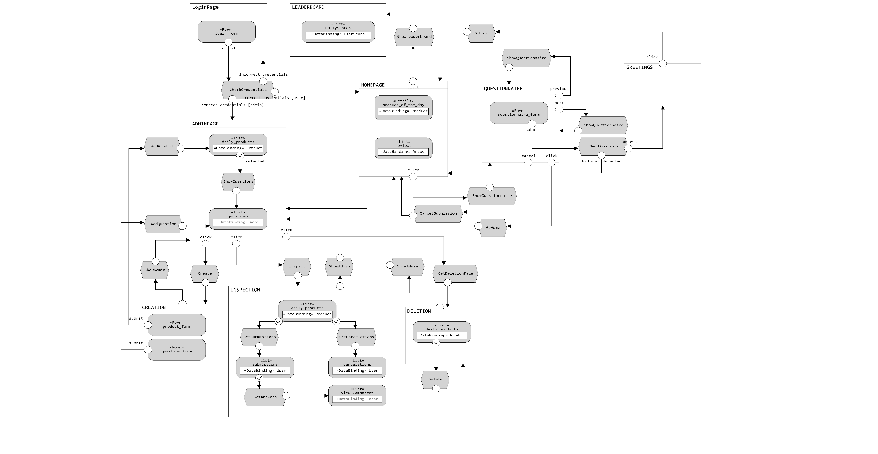
IFML

