Slide 1
RNA SEQUENCES GENERATION
Aim: Try generative models, to generate new valid and coherent RNA sequences,
learned from RNA sequences of COVID-19 vaccine.
Pipeline:
-Dataset
-Encoding
-Autoencoder (reduce dimensionality)
-Train RBM
-Train QGAN
-Test generated sequences and compare models

Slide 2
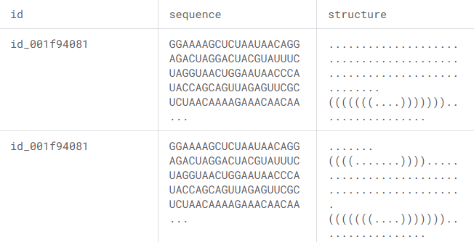
Dataset
-Nitrogenous bases
-Dot-Bracket notation for RNA
-Select only Sequences of 107 bases

Slide 3
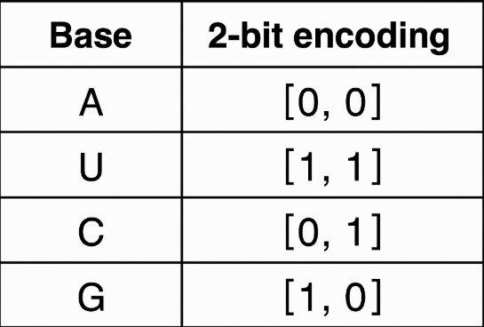
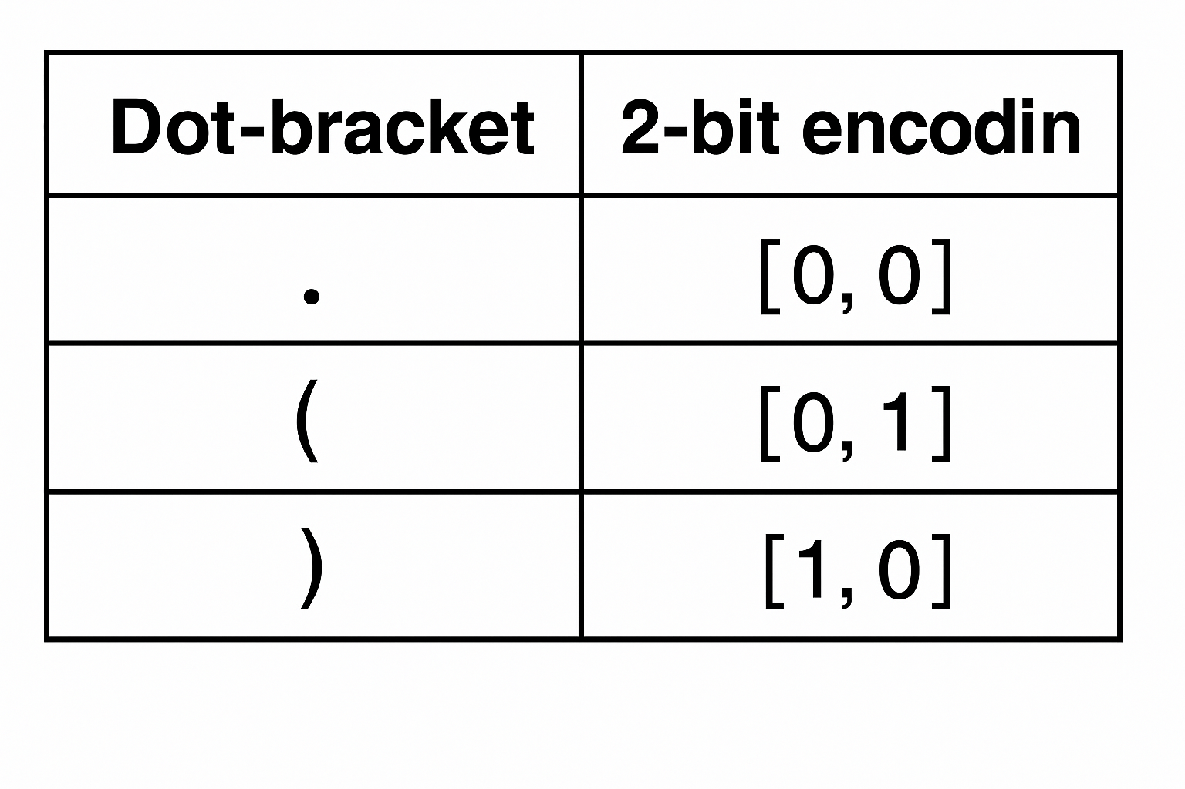
Encoding
Data augemention by shifting RNA sequences
(cyclic structure)
147 sequences
Dimension of encoding 107x(2-bit)x(2-bit)=428bit

Slide 4

Binary autoencoder
Train a binary autoencoder to reduce the dimensionality from 428 bits to 48 bits with a reconstruction error of 0.

Slide 5
Generative Adversarial Network
Generator: 12 Quantum Circuit with pennylane
Discriminator: Classical MLP (logistic)
Map bits from 0, 1 → -1, 1
300 epochs
Classical weights trained with Backpropagation
on logistic loss, also for discriminator.

Slide 6
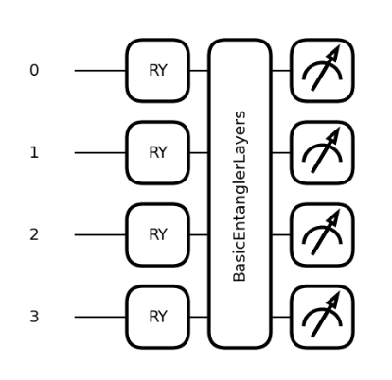
Quantum Circuit
Quantum circuit with 4 qubits
12 generators, 4x12=48 bits
Depth of 3 layers:
RY gates (random angle) not trainable
Measure on Z

Slide 7
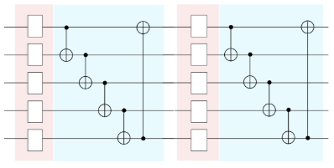

Basic Entangler Layer
each qubit entangled with next qubits
+ RY rotation, trained with Shift Rule
Depth=3

Slide 8
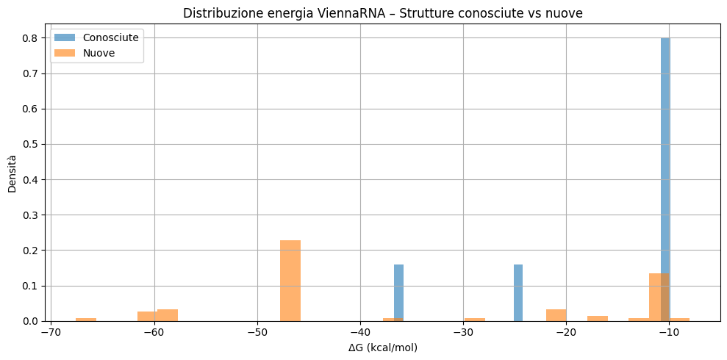
Results
Tested with ViennaRNA
Compute Gibbs Energy
RBM create 24 new valid structure on 1000 generation, some has lower Gibbs energy than all originals.

Slide 9
Results QGAN and motivation
QGAN generates only 4 valid structures over 100000 generation.
Never generate known RNA sequences.
There 12 generator of 4 qubits, but aren’t related each other
With a single generator of 48 bits, maybe this will be usefull.

