Slide 1

Spectral Analysis of Weight Matrix in Learning for RBM
Daniele Vanzan
RESTRICTED BOLTZMANN MACHINE
BASED ON ENERGY:
Weight matrix and bias vectors define the energy of the system
(v, h) configuration depends on Boltzmann distribution.
$E\left(v,h\right)=−v^{T}Wh−b^{T}v−c^{T}h$

Slide 2
Project Objective
Spectral analysis of the weight matrix during training, how spectral characteristics evolves throw epochs:
SVD
Marchenko-Pastur (MP) distribution of eigenvalues of the correlation matrix
Note: Eigenvalues of the correlation matrix are the square of the singular values of the SVD

Slide 3
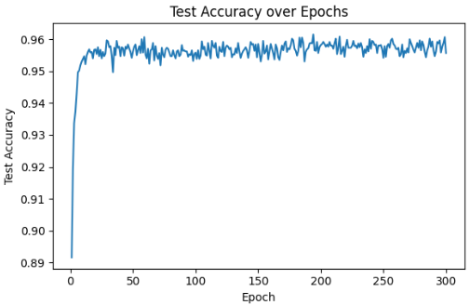
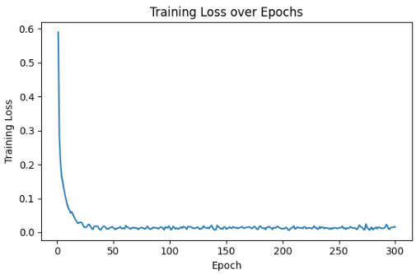
Dataset and Setup
Dataset: MNIST (handwritten digits labeled 0-9, binary images 28×28 → 784 input).
Supervised, Linear classifier layer
300 epochs, higher accuracy after 30.

Slide 4
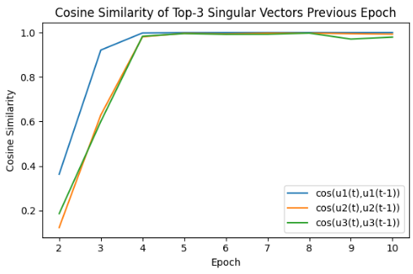
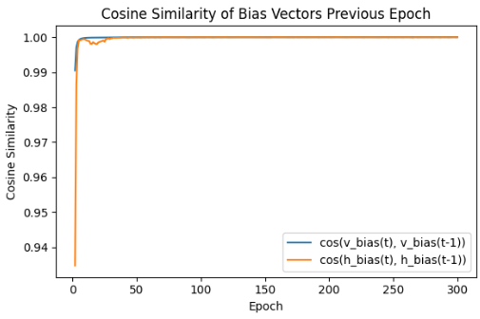
PCA and SVD
In first few epochs:
-first singular vectors are learned,
-bias vectors are learned
$W={UDV}^{T}$

Slide 5
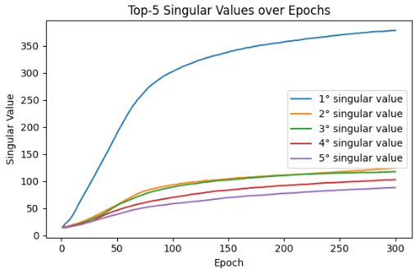
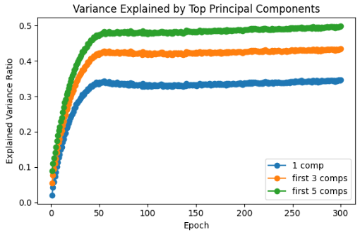
PCA – Singular Values
- After a few epochs (~4), the main direction stabilizes.
- Further learning amplifies the main singular value, and also the explained variance.

Slide 6
SVD Results
Weights evolution can be summarized in few dominant directions, that are learned in first 5-10 epochs, than further learning consists in increasing the first singular value.
“first, learn the direction of higher variance of weight matrix then, learn more and more in this direction”.

Slide 7
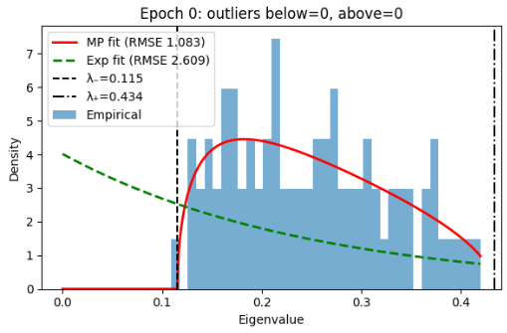
Marchenko-Pastur
Weights drawn from normal distribution → transition from random matrix to informative
Let W be a random matrix of size
with entries drawn from a normal distribution N(0, σ²).
The correlation matrix is defined as
$p×n,p,n→∞$
$\frac{1}{n}WW^{T}$

Slide 8
Marchenko-Pastur distribution
- The MP describes the distribution of eigenvalues λ in the interval [λ−, λ+], known as the bulk of the spectrum density.
- The bulk is defined by:
λ− = σ²(1 - √Q)²
λ+ = σ²(1 + √Q)²
where Q = p/n and σ² is the variance of W
-Outlier eigenvalues indicate learned signal, “what is not Gaussian noise”.

Slide 9
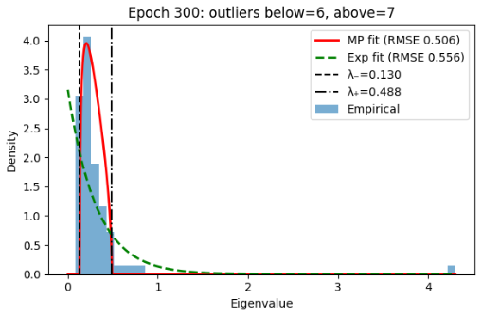
Signal vs Noise
- Below bulk: redundant dimensions → can be removed.
- Above bulk: informative directions → represent learned structure.

Slide 10
Conclusion
Learning of direction is done in first few epochs
After these, learning is only increasing singular value
Reduce hidden dimension, by removing numbers of outliers below the bulk.

